Slide 1

Deployment modeling for Base ontology
Source: Yuan Tao, Huawei Technologies
WG: MAS
Meeting: MAS17

Slide 2
Background
In previous session, a generic M2M design model called IOCD had been introduced, IOCD describes devices from four key properties: input (I), output (O), capability (C) and deployment (D).
Considerations on merging IOCD with other ontology.
  - Deployment is an useful concept in the M2M field, but it is missing in the oneM2M Base ontology.
  - Combining deployment and service of the device can make quick and effective reasoning to satisfy application demands.

Slide 3
Concept of Deployment modeling
Definition: Deployment describes where and when a device operates in the environment.
Deployment is not only to reflect and the device’s location itself, but also reflect all features of the deployed environment (e.g. the relations with the surrounding devices).
To enable the deployment description to support semantic analysis and reasoning.

Slide 4
Deployment Modeling (1/3)

Slide 5
Deployment Modeling (2/3)
Description: the platform, devices are deployed to, determines the life cycle and work cycle of devices through power management and policy
  - Life cycle: represents the device’s lifetime. Device gets out of service when the lifetime expires
  - Work cycle: describes the cycle service time of devices. Once activated, devices turn to normal mode from hibernation
Location: using absolute location and relative location to enhance semantic reasoning
- Absolute location: describes a device’s location in terms of:
* Geo-coordinates: contains the latitude, longitude and altitude of the device
    * Address: it is represented with two tuples: <positionSpace;Coordination >. With the positionSpace, it applies the position description method based address element on address element. The Coordination describes the coordinates of devices in details, the default value of the coordinate datum point is the center point of the area.
  - Example: the deployment of the air conditioner is: China/Beijing/Huawei/MainBuilding/10th Floor/Room1, (x,y,z)

Slide 6
Deployment Modeling (3/3)
- Relative location: directly represents the location of existing M2M devices. Consists of:
  * Reference point: represents the reference point of devices, which can be the URI of a certain device, or the triples representation like geographic coordinates
  * Reference offset: indicates the relative offset between devices and the reference point. Described by four attributes for the indoor scenario:
  the sameBuilding, the sameFloor, the sameRoom, and nearby (describing two devices very close, because of the relative function, or deployed around the reference point).

Slide 7
Use Case of Deployment Modeling
Case 1: smog sensor and extinguisher
One or more extinguishers are deployed in each floor corridor, the smog sensors are deployed in the rooms. Once a smog sensor exceeds a certain threshold, M2M platform will receive the message from the smog sensor and proceed to reasoning. The normal flow is searching all the devices for the extinguisher closed to that sensor and set off it. It is time consuming in this emergency case. However, with the deployment information, the appropriate extinguisher can be easily found out. For instance, the relativeLoction property of the smog sensor is “extinguisher (e.g. URL), the sameFloor”, and the service property is supposed to be “extinguish”.

Slide 8
Use Case of Deployment Modeling
Case 2: automatic control of light in a smart meeting room
In a meeting room, a lot of lights are deployed usually, when the projector is open, the nearby light is expected to be turned down or turned off automatically. However, it is difficult to find out the device closed to the projector with the current ontology. While this problem can be solved quickly by querying the deployment information of the projector. For instance, the relativeLoction property of projector is “light1, nearby”, and the service property is supposed to be “light control”.

Slide 9
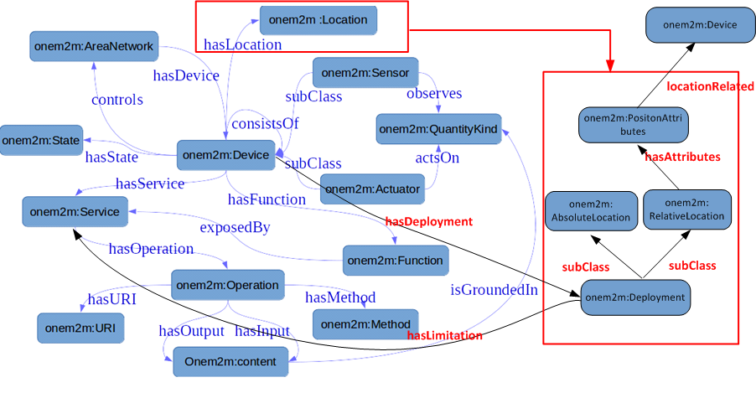
Consideration for merging with SAREF
Deployment is same as Location of SAREF.
The PostionAttributes of RelativeLocation can link to a location related device.
The service of a device has a valid service range determined by its location.

Slide 10
Thank you

