Slide 1

SDT - Proposed Changes for Version 4.0 (DRAFT)
Group Name: MAS
Source: Andreas Kraft, Deutsche Telekom, a.kraft@telekom.de
Meeting Date: 2017-02-16
Agenda Item:
Notes:
改一改Source和date

Slide 2
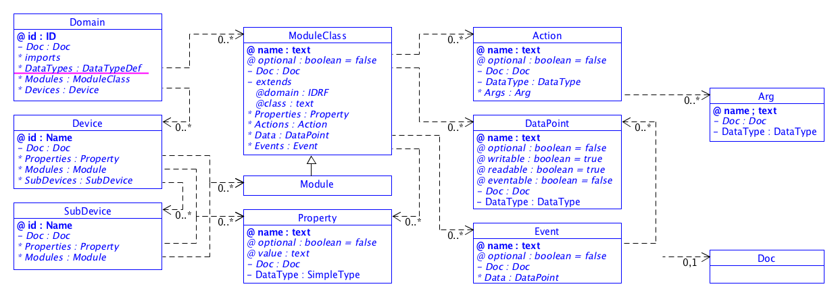
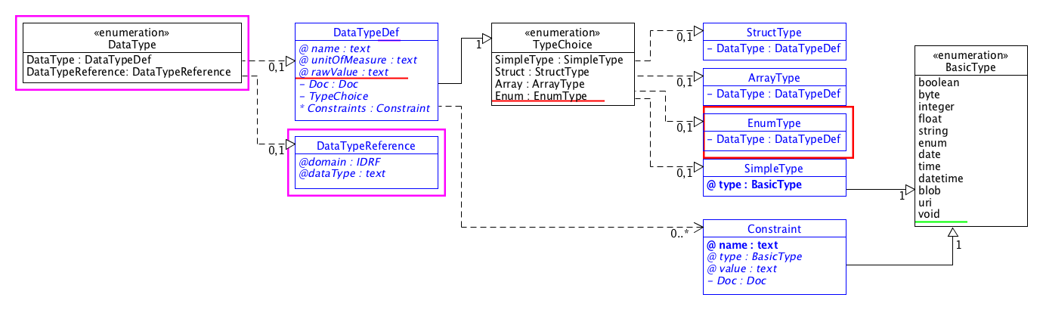
Draft SDT 4.0

Slide 3
New Datatype: Enums
Define enumeration types and values within SDT
Support for
  “normal” enumerations with raw value assignments
  simple type – enums
  structured enums (such as in Swift)
Enable generation of enum XSD files etc
<DataPoint name=”aDP" readable="true" writable="true">
<DataType>
<Enum>
<DataType name="doorClosed" rawValue="1”>
<SimpleType type="integer" />
</DataType>
<DataType name="doorOpened">
<SimpleType type="float" />
</DataType>
<DataType name="coordinates">
<Struct>
<DataType name=”x">
<SimpleType type="integer" />
</DataType>
<DataType name="y">
<SimpleType type="integer" />
</DataType>
</Struct>
</DataType>
</Enum>
</DataType>
</DataPoint>

Slide 4
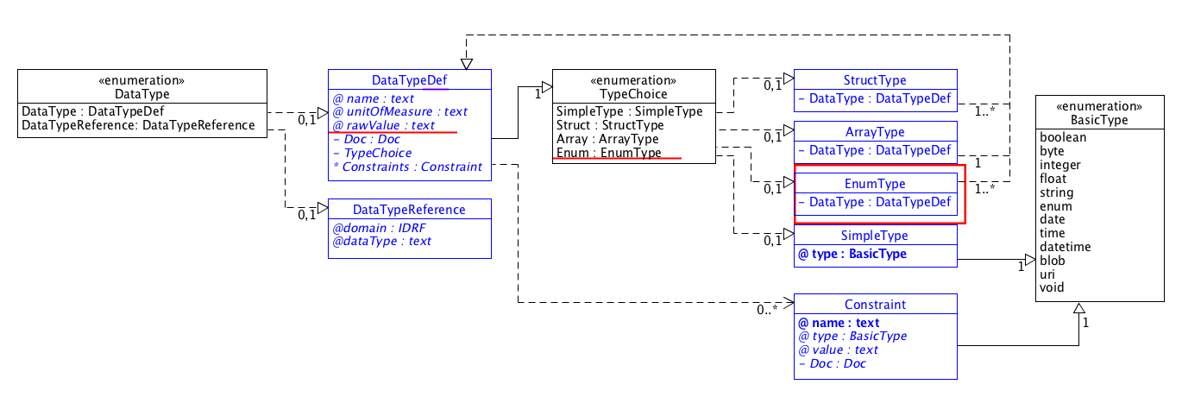
New Datatype: Enums (2)
Add an optional “rawValue” attribute
Add a new structured type choice
Add a new structured type definition, similar to <Struct>

Slide 5
Global Datatype Definitions
Prevent re-definition of data types again and again
Add a data type definition section under Domain
Data type definitions can be referenced, even from another domain
Final, not extensible
<Domain … id="datatypes.SDT">
<DataTypes>
<DataType name=”Point”>
<Struct>
<DataType name="x">
<SimpleType type="integer" />
</DataType>
<DataType name="x">
<SimpleType type="integer" />
</DataType>
</Struct>
</DataType>
</DataTypes>
<Modules>
<ModuleClass name="dataTypeRefTest">
<Data>
<DataPoint name="coordinate">
<DataTypeReference domain="datatypes.SDT”
dataType="Coordinates"/>
</DataPoint>
</Data>
</ModuleClass>
</Modules>
</Domain

Slide 6
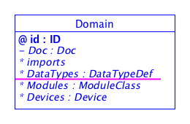
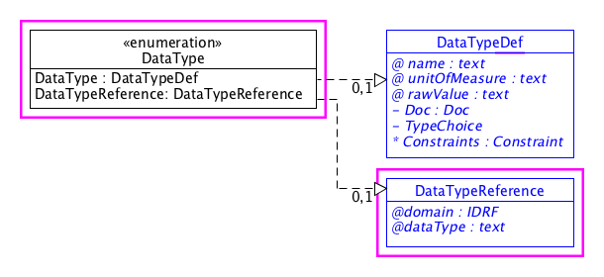
Global Datatype Definitions (2)
Add a new section to <Domain>
Rename the old <DataType> element
to <DataTypeDef>
Add a new DataType choice:
Either a normal <DataType> element
Or a <DataTypeReference> element
Add a new <DataTypeReference> element defintion

Slide 7
New Datatype: “void” SimpleType
Question: Do we need a “void” data type?
Very small change.
Actions, which have no type are implicitly “void”
Plus: less ambiguous when mapping between SDT and semantics
Minus: what are “void” data points?
<ModuleClass name="voidActionText”>
<Actions>
<Action name="explicitVoidAction”>
<DataType>
<SimpleType type="void" />
</DataType>
</Action>
<Action name="implicitVoidAction" />
</Actions>
</ModuleClass>

Slide 8
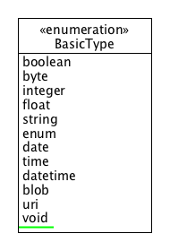
New Datatype: “void” SimpleType (2)
Add “void” keyword to BasicType enumeration definition

Slide 9
Make Device Inheritable
TBD
Under discussion

Slide 10
New License for SDT 4.0
SDT Versions 1 .. 3 are published under APL2
APL2 licensed artifacts can be used by oneM2M
Contributing to APL2 projects seems to be problematic
Best alternative: BSD3 license?
…

Slide 11
Thank you for your attention

