Slide 1

SDT 4.0 – Introducing Enumerations
Group Name: MAS
Source: Andreas Kraft, a.kraft@telekom.de
Meeting Date: 2018-07-16

Slide 2
Motivation
Enumerations are used in ModuleClasses, but the definition of Enumeration Types is not supported in SDT 3.x .

Slide 3
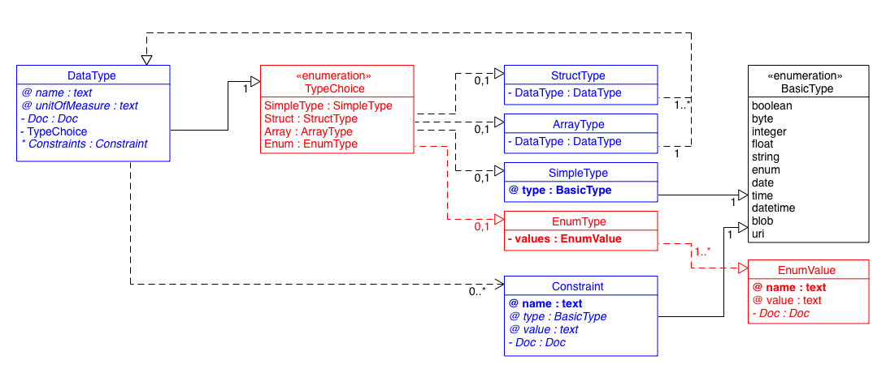
Proposed Solution (UML)
Add EnumType to DataType choices

Slide 4
Example
<DataPoint name="aDataPoint">
<DataType name="hd:anEnumType">
<EnumType>
<EnumValue name="enumValue_A" value="0" />
<EnumValue name="enumValue_B" value="1" />
<EnumValue name="enumValue_aString" value="aStringValue" />
</EnumType>
</DataType>
</DataPoint>

Slide 5
Thank you!

