Slide 1
Way forward for WI-0070 and TR-0046
TaeHyun KIM (SyncTechno Inc.) / Sept. 2018 MAS#37

Slide 2
WI-0070 Public Warning Service Enabler
WI-0070, Public Warning Service Enabler, started to develop mechanism of helping authorities provide warning for the public safety by making things understand warning notification from authorities.
Targeted receiver
Authority
Public Warning Message
Human
Human readable
Natural disaster warning
Man-made disaster warning
Other emergency warning
Things
Machine understandable

Slide 3
IoT-based Public Warning Service
IoT-based Public Warning Service is a warning notification for IoT devices by an additional dissemination channel of existing Integrated Public Warning System.
TV, Radio, …
Public Warning Channel 1
CAP 1.2
Authorities
IPWS
Authorities
CAP¹⁾ 1.2
CAP 1.2
Public Warning Channel 2
(3GPP PWS²⁾)
Authority
Mobile Phone
CAP 1.2
Public Warning Channel N
(M2M)
1) CAP : OASIS Common Alerting Protocol
2) PWS : Public Warning System
Things
M2M Service Boundary

Slide 4
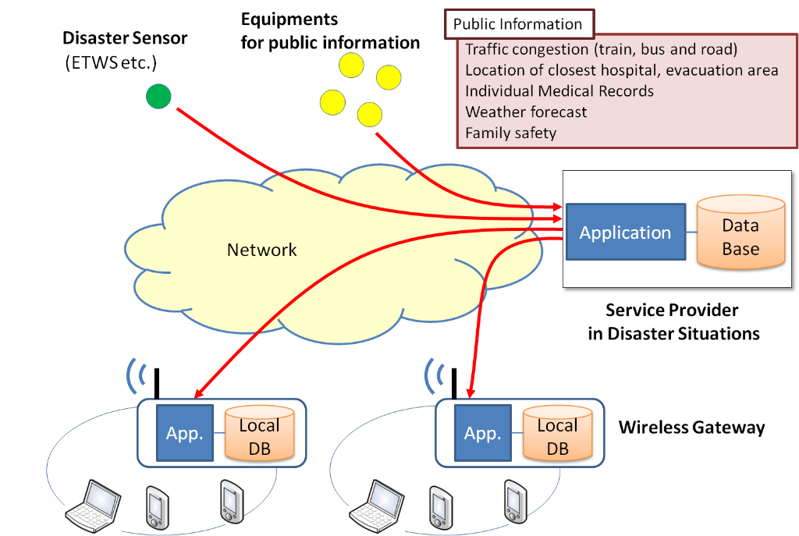
Focus area of WI-0070
Focus area of WI-0070 is the development of message semantics and message format for a machine-understandable public warning notification.
Public Warning Message Semantics
Public Warning Message Format
oneM2M Protocols
Figure 8-4 High Level System View
(TR-0001 Use Cases Collection)

Slide 5
Work scope of WI-0070
Work scope of WI-0070
Content of TR-0046
Case studies of existing public warning systems
Use cases and potential requirements
Architecture analysis for the new use cases and requirements with current oneM2M system
Security impacts analysis
Abstract data models for public warning services
Semantic interworking between the data models and extended oneM2M ontology
Case studies of existing public warning systems.
Use cases and potential requirements for automated or intelligent devices that re-act emergency situations.
Architecture analysis for the new use cases and requirements with current oneM2M system.
Security impacts analysis.
Abstract data models for public warning services.
Semantic interworking between the data models and extended oneM2M ontology.
TS-XXXX Public Warning Data Model and Mapping
❋ Change request(s) to existing Technical Report(s) and Technical Specification(s) if needed.

Slide 6
CR for TR-0046 Skeleton
AS-IS | TO-BE | Changes
5. Case studies of existing disaster alert and warning systems | 5. Case studies of existing public warning systems | Aligned with proposed changes
6. Use cases and potential requirements | 6. Use cases and potential requirements
7. Architecture analysis for the new use cases and requirements with current oneM2M system | 7. Architecture analysis for the new use cases and requirements with current oneM2M system
8. Security impacts analysis | 8. Security impacts analysis
9. Abstract data models for emergency alert services | 9. Abstract data models for public warning services | Aligned with proposed changes
10. Semantic interworking between the data models and extended oneM2M ontology |  | To be handled in the new TS

Slide 7
Schedule of WI-0070
17 Sep. 2018
3 Dec 2018
18 Feb 2019
5 May 2019
37
37.x
38
38.x
39
39.x
40
40.x
Korea
Japan
TR-0046 Study on Public Warning Service Enabler
TS-XXXX Public Warning Service Information Model and Mapping

