Slide 1
Smart City based on Semantics and Context
MAS-2018-0120-Smart_City_based_on_Semantics_and_Context
Group Name: MAS
Source: JaeSeung Song (KETI)
Meeting Date: 2018-09-17 to 2018-09-21

Slide 2
Smart City (Key Findings)
Various IoT platforms are co-existing and collaborating (even several oneM2M platforms)
Data level interoperability
Common Terminology and Ontology across various service domains
Interworking between smart cities
Semantics and Context should work together to provide more precise service

Slide 3











In Reality
Dashboards
City Apps
Analytics apps
3rd party apps
Cloud apps
Dashboards
City Apps
Analytics apps
3rd party apps
REST
APIs
SPARQL or
REST APIs
REST
APIs
NGSI-LD
Smart city backend
Semantics
Context
Data Hub
Common data model, terminology, ontology
Smart city frontend
Other data
sources
Existing
deployments
I/F to other
IoT platforms
oneM2M from SP A
oneM2M from SP B
oneM2M-V2X from SP B
Adapter
Data center
App
App
App
Field domain
Gateway
Gateway
Device
D
D
D
D
D
D
D
D
D
LWM2M

Slide 4
In Reality
Common Data Model, Terminology and Ontology for selected service
(e.g., V2X, Smart Building) ➔ MAS should standardize
Dashboards
City Apps
3rd party apps
Analytics apps
Cloud apps
Dashboards
City Apps
3rd party apps
Analytics apps
REST
APIs
REST
APIs
SPARQL or
REST APIs
Data Hub
Semantic & context-aware support (e.g., NGSI-LD)
➔ MAS should standardize
Smart city backend
Semantics
Other data
sources
Smart city frontend
Existing
deployments
I/F to other
IoT platforms
oneM2M from SP A
oneM2M from SP B
oneM2M-V2X from SP B
Adapter
Data center
App
App
App
Field domain
Gateway
Gateway
Device
D
D
D
D
D
D
D
D
D
LWM2M

Slide 5
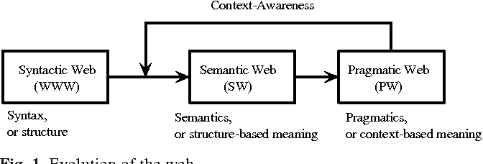
Semantics and Context
Semantics
Definition: The study of meaning in Things
Languages: SPARQL, etc.
Context (Pragmatic)
Definition: The study of how context contributes to meaning in Things
Languages: NGSI-LD, etc.
Example in Web

Slide 6
Items for MAS
Define terminology, data model and ontology for selected smart city services
  Vehicle Domain Service and Transportation
  Smart Building
  Smart Energy
A new work item for Context-Awareness
  Collaboration with ETSI CIM-ISG
Study how to use both Semantics and Context
  Interworking mechanisms
  Mapping
  Gap analysis
  Generic APIs for both Semantics and Context
Collaboration with other standards bodies e.g.,
  W3G Web-of-Things (for semantics and ontology)
  ITU-T SG-20 (for terminology and requirements for smart city reference architecture)
  ISO (for terminology)

Slide 7
Thank you!

