Slide 1
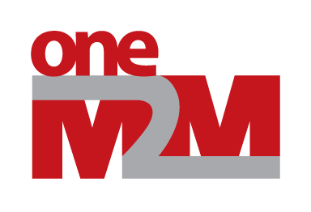
Discussions on Inheritance in SDT 4.0
Group Name: MAS
Source: Andreas Kraft, a.kraft@telekom.de
Meeting Date: 2018-12-02

Slide 2
Motivation
This presentation discusses open issues regarding inheritance in SDT 4.0.
Blacklisting of Actions and DataPoints and ModuleClasses when inheriting.
DeviceClass inheritance should be supported, similar do the inheritance mechanism of ModuleClass.
Inheritance should be supported for SubDevices as well.

Slide 3
Improve Inheritance Mechanism

Slide 4
Inheritance Re-Cap
SDT does support “extending” inheritance, i.e. including previous defined functionalities.
No mix-in or abstract classes.
Everything is a concrete class.

Slide 5
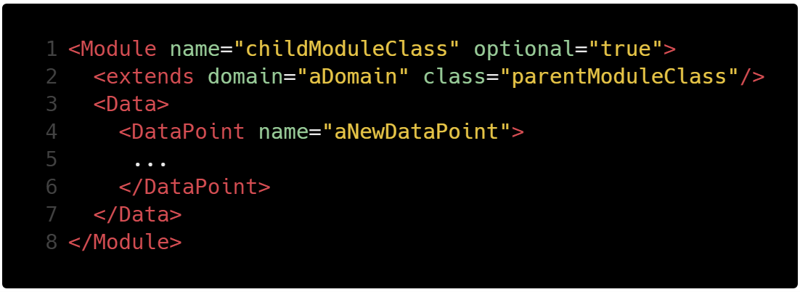
Inheritance Re-Cap
Inheritance in ModuleClasses works by extending an existing ModuleClass.
The child ModuleClass inherits everything from the parent.
Notes:
https://carbon.now.sh/?bg=rgba(255%2C255%2C255%2C0)&t=tomorrow-night-bright&wt=bw&l=xml&ds=false&dsyoff=18px&dsblur=100px&wc=false&wa=true&pv=0px&ph=0px&ln=true&fm=Hack&fs=14.5px&lh=132%25&si=false&code=%253CModule%2520name%253D%2522childModuleClass%2522%2520optional%253D%2522true%2522%253E%250A%2520%2520%253Cextends%2520domain%253D%2522aDomain%2522%2520class%253D%2522parentModuleClass%2522%252F%253E%250A%2520%2520%253CData%253E%250A%2520%2520%2520%2520%253CDataPoint%2520name%253D%2522aNewDataPoint%2522%253E%250A%2520%2520%2520%2520%2520...%250A%2520%2520%2520%2520%253C%252FDataPoint%253E%250A%2520%2520%253C%252FData%253E%250A%253C%252FModule%253E&es=2x&wm=false&ts=false

Slide 6
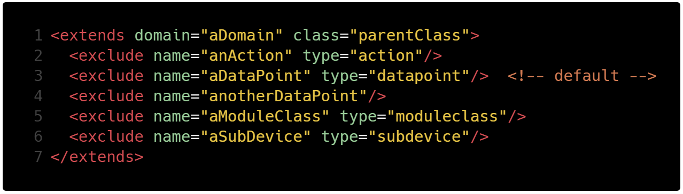
Suggestion: Blacklisting
Extend the SDT’s <extends> element to exclude unwanted data points, actions, devices, or sub-devices.
All other elements will be included.
Notes:
https://carbon.now.sh/?bg=rgba(255%2C255%2C255%2C0)&t=tomorrow-night-bright&wt=bw&l=xml&ds=false&dsyoff=18px&dsblur=100px&wc=false&wa=true&pv=0px&ph=0px&ln=true&fm=Hack&fs=14.5px&lh=132%25&si=false&code=%253Cextends%2520domain%253D%2522aDomain%2522%2520class%253D%2522parentClass%2522%253E%250A%2520%2520%253Cexclude%2520name%253D%2522anAction%2522%2520type%253D%2522action%2522%252F%253E%250A%2520%2520%253Cexclude%2520name%253D%2522aDataPoint%2522%2520type%253D%2522datapoint%2522%252F%253E%2520%2520%253C!--%2520default%2520--%253E%250A%2520%2520%253Cexclude%2520name%253D%2522anotherDataPoint%2522%252F%253E%2520%250A%2520%2520%253Cexclude%2520name%253D%2522aModuleClass%2522%2520type%253D%2522moduleclass%2522%252F%253E%250A%2520%2520%253Cexclude%2520name%253D%2522aSubDevice%2522%2520type%253D%2522subdevice%2522%252F%253E%250A%253C%252Fextends%253E&es=2x&wm=false&ts=false

Slide 7
Further Inheritance Support

Slide 8
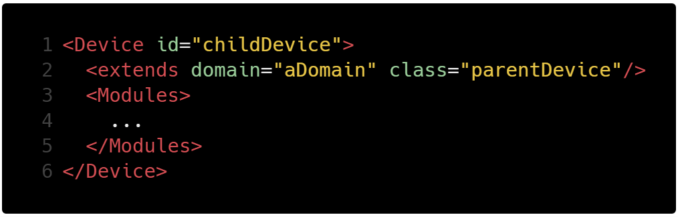
DeviceClass Inheritance
Add support for DeviceClass inheritance, similar to ModuleClasses.
With support of new inheritance mechanisms, of course.
Notes:
https://carbon.now.sh/?bg=rgba(255%2C255%2C255%2C0)&t=tomorrow-night-bright&wt=bw&l=xml&ds=false&dsyoff=18px&dsblur=100px&wc=false&wa=true&pv=0px&ph=0px&ln=true&fm=Hack&fs=14.5px&lh=132%25&si=false&code=%253CDevice%2520id%253D%2522childDevice%2522%253E%250A%2520%2520%253Cextends%2520domain%253D%2522aDomain%2522%2520class%253D%2522parentDevice%2522%252F%253E%250A%2520%2520%253CModules%253E%250A%2520%2520%2520%2520...%250A%2520%2520%253C%252FModules%253E%250A%253C%252FDevice%253E&es=2x&wm=false&ts=false

Slide 9
SubDevice Inheritance
Add support for SubDeviceClass inheritance. This is a bit more complicated, since SubDevices are part of a Device, and not directly addressable under a domain.
Possible solutions:
Move SubDevices from Device to Domain.
→ Reference mechanism needed.
Introduce a path notation in the <extends> element.
→ Ugly?
Transform SubDevices to Devices. See discussion on GitLab: https://git.onem2m.org/MAS/SDT/issues/17
→ Bigger impact
Don’t support inheritance for SubDevices.
→ Is it really necessary?

Slide 10
Thank you!
10

