Slide 1
Vulnerable Road Users Discovery Use Case for Resource Offloading
REQ-2018-0046
Group Name: REQ
Source: Youngjin Na, Min-Byeong Lee, Joon-Young Kim / HYUNDAI Motor (TTA)
JaeSeung Song (KETI)
Meeting Date: 2018-07-16 to 2018-07-20

Slide 2
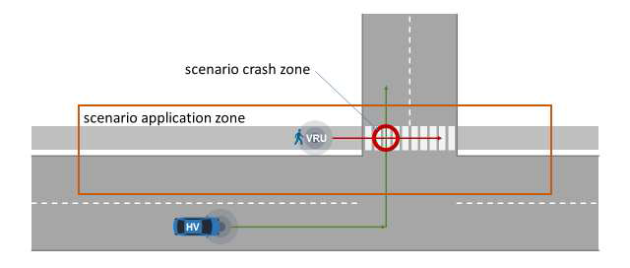
Vulnerable Road Users Discovery
Vulnerable Road User Discovery (VRU Discovery)
  Detects pedestrians and cyclists
  The VRUs make their presence/location known through their mobile devices (e.g., smartphone, tablets), along with vehicle’s use of that information
  These information should be shared with the central server but also an entity close to vehicles to improve traffic safety and to avoid accidents.
  Example:
    The driver of a Host Vehicle (HV) intends to
    make a left turn
    The driver is alerted to the presence of a VRU

Slide 3
VRU Use Case in oneM2M
Vulnerable Road User Discovery (VRU Discovery)
  There is an application monitoring VRU and detecting potential collision
  When new moving objects are entering to an area where MN is covering, offloading resource procedures can be performed to have resources at the MN
  (for Edge/Fog computing purposes)
  Offloading triggering is sent to MN
  MN performs offloading resources
  (resource selection, resource retrieval, etc)
  Now the Edge/Fog node have its own resources
  and offloaded resources, which are enough to
  perform VRU discovery and collision analysis
  With offloaded resources, the Application running
  on Edge can perform analysis analysis to detect
  potential collision among moving objects
IoT Cloud
(IN-CSE)
Resource
Offloading
Edge/Fog
(MN-CSE)

Slide 4
High-level concept of Resource Offloading
IoT server
(IN-CSE)
R
R
R
C
C
C
Offload workload
(resources & tasks)
IoT Edge/Fog
(MN-CSE)
R
C
Direct support
IoT End Devices
(ADN or ASN)

Slide 5
Resource Offloading Procedures
AE-1
IN-CSE
MN-CSE
AE-2
001: Request offloading
002: Local processing
003: Send offloading resources
004: Internal processing
005: Retrieve Offloaded resources
006: Update Offloaded resources
007: Update resources
008: Synchronize resources

Slide 6
Resource Offloading Procedures
Step 001: AE-1 requests offloading to IN-CSE with the following information:
  Offloading indication, Target offloading resources (a list of target resources), Contact of address of the Destination CSE (IN-CSE or MN-CSE), Status of offloading resources (block, readable, writable)
      Block – The source resources are invisible while the resources are being offloaded
      Readable – The source resources are readable at the source IN-CSE even they are offloaded to other CSEs
      Writable – The source resources are writable at the source IN-CSE even they are offloaded to other CSEs
  For example, AE sends an offloading request to several resources or group resources to be offloaded
Step 002: IN-CSE configures offloading resources
  Each offload resources is configured (marked as offloading resources with additional information)
Step 003: IN-CSE registers its offloading resources to the destination MN-CSE (PUSH resources to MN-CSE)
Step 004: MN-CSE creates offloading resources based on the request from IN-CSE
Step 005: AE-2 is now able to retrieve the offloaded resources from MN-CSE to perform VRU discovery and warning
Step 006: AE-2 updates one of offloaded resources (or a set of offloaded resources)
Step 007: MN-CSE updates values of the given offload resources from AE-2
Step 008: MN-CSE updates the updated values to IN-CSE for synchronization. If the resources are blocked to other users, UPDATE (i.e., synchronization) is being paused until the offloaded resources are all released from the MN-CSE.

Slide 7
System Requirements
REQ1: oneM2M System shall be able to send the information about resource offloading
REQ2: oneM2M System shall be able to synchronize the data between the source resources and offloaded resources
REQ3: oneM2M System shall be able to manage offloaded resources based on given properties from the users, e.g., blocking the offloaded resources to be accessed while the resources are offloaded to other oneM2M System

Slide 8
Thank you!

