Slide 1
Distributed Blockchain Database
Use Case
REQ-2018-0076
Group Name: REQ
Source: ChanHyung Lee, Lewis Nkenyereye, JaeSeung Song (KETI)
Meeting Date: 2018-09-17 to 2018-09-21

Slide 2
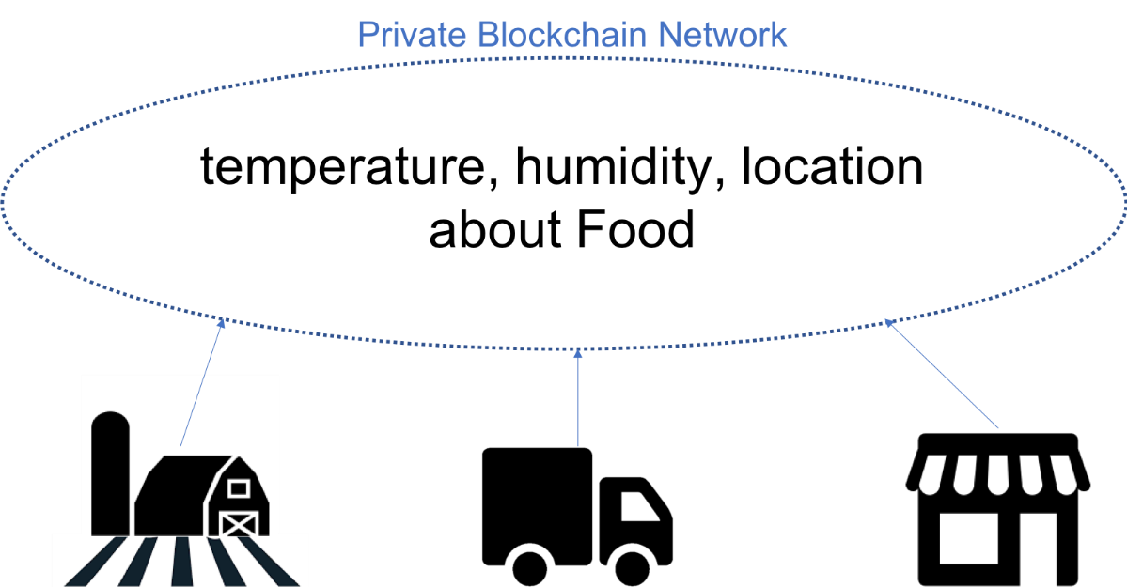
Distributed Blockchain Database
Distributed Blockchain Database
  Data would be stored in multiple blockchain peers
  Between peers, they will be a consensus on the data before sharing it
  The shared data shared and added to block is hard to compromise by malicious user or attacker.
    Because, for a data to be modified, many blocks on all peers should also be modified at the same time.
  To provide integrity of data, blockchain based distributed database
  can be a good option on IoT service.
  Example:
    Let’s think about this on food supply chain.
    Farmer, transporter, seller need to share the data
    about food like temperature, humidity.
    Data will be stored on each peer, and before it is added to block,
    all peers will check and have a consensus on the data.
    After that, the integrity of data is achieved due
    to the advantages of blockchain.

Slide 3
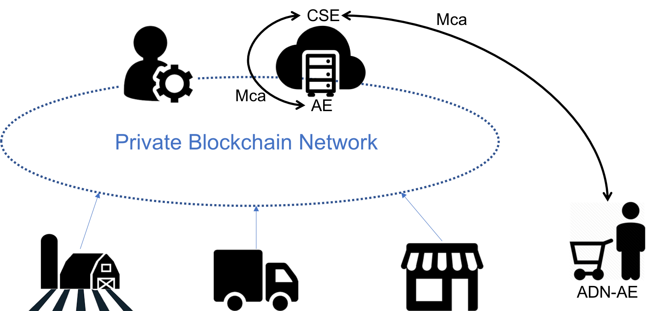
Distributed Blockchain Database
Use Case in oneM2M
Distributed Blockchain Database
  There are AEs and CSE on private blockchain network.
  AEs parse blockchain transaction created by each marking peer,
  and forward to CSE using Mca reference point with the peer’s information like AE-ID.
  CSE provides CRUD operations using distributed blockchain database for specific resources like containing ‘bc’ optional attribute.
  CSE also can provide the data with its integrity to consumer.

Slide 4
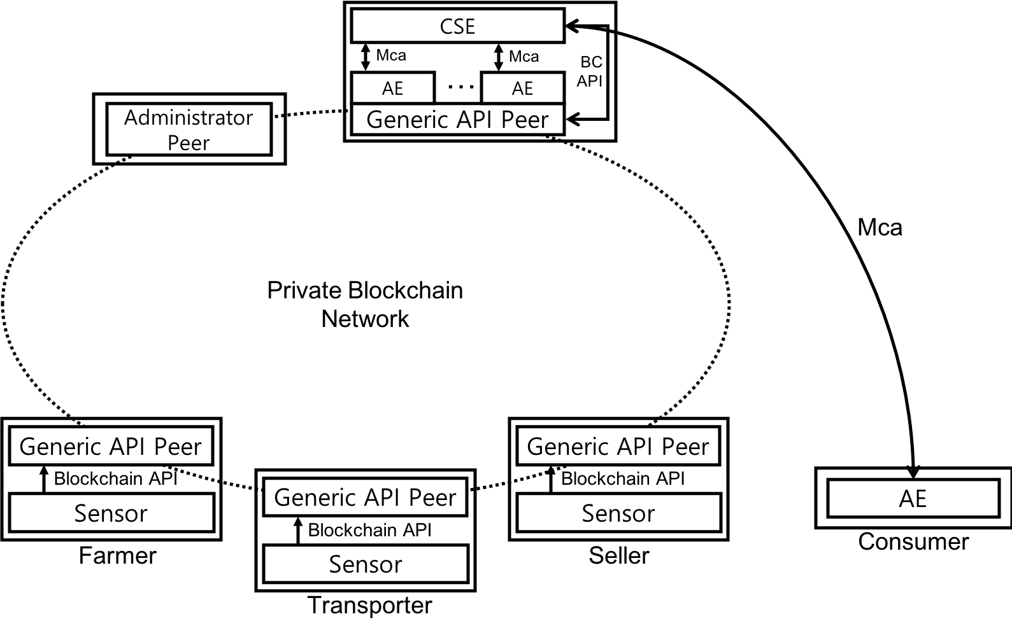
High-level concept of Distributed Blockchain Database Use case

Slide 5
Blockchain database usage Procedures
Blockchain Peers
(Sensors)
AE-1
CSE
AE-2
001: Data generate
002: Internal processing
003: Create resource
004: Store resource to blockchain
005: Retrieve resource
006: Retrieve resource from blockchain
007: Response
008: Internal processing
009: Response

Slide 6
Blockchain database usage Procedures
Step 001: Data is generated by sensor and forwarded to AE-1 by blockchain peer
Step 002: AE-1 parse blockchain transaction and make to oneM2M a resource creation request
including sensor information like AE-ID
Step 003: AE-1 requests resource creation to CSE with ‘bc’ optional attribute
  ‘bc’ optional attribute : It means the resource would be stored in distributed blockchain database.
Step 004: CSE creates blockchain transaction containing oneM2M resource information
and the resource would be stored in blockchain
Step 005: AE-2 requests resource retrieving to CSE
Step 006: CSE check ‘bc’ optional attribute, after that, retrieve data from blockchain peer
Step 007: Blockchain peer returns data with guaranteed integrity
Step 008: CSE makes comparison between internal data and blockchain data
  If there is any difference difference, CSE sends a warning to service manager.
  This step will consume computational power and time. If there is no sufficient computational capabilities,
  this step can be ommited. Then CSE will return the data from blockchain.
Step 009: Data integrity is guaranteed for AE-2

Slide 7
System Requirements
REQ1: oneM2M System shall be able to use multiple databases (e.g., relational database, distributed databases and distributed ledger) to be selected by oneM2M Applications
REQ2: oneM2M System shall be able to use blockchain APIs to create and retrieve data from blockchain

Slide 8
Thank you!

