Slide 1
Missing flow for Location Request in TS-0001
Preeti Rani (preetir@cdot.in)
C-DOT
22 May 2018

Slide 2
Types of Location Request
Protocols
OMA RESTful NetAPI for Terminal Location
OMA Mobile Location Protocol
Location Request
CASE1 :
Positioning Procedure by CSE
CASE 2:
Positioning Procedure by NSE
CSE creates one time periodic subscription at NSE. NSE sends location notifications to CSE periodically.
CSE makes location request to location Server periodically and gets Location
<number>

Slide 3
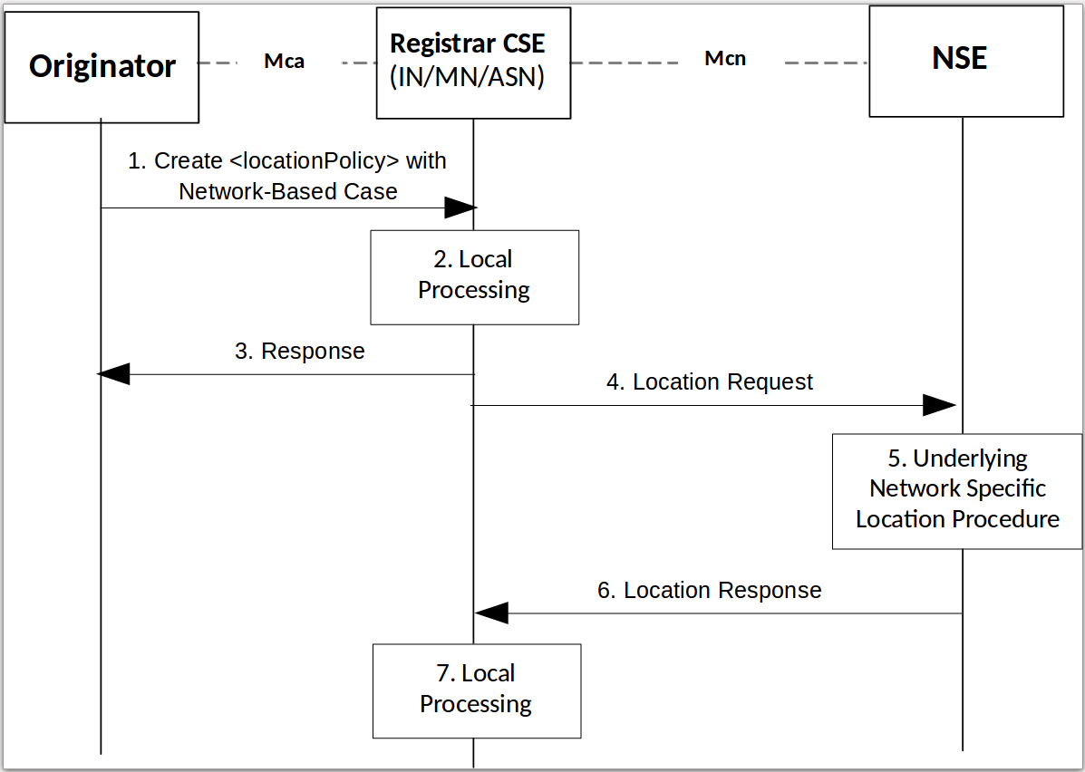
Case 1 : as per TS-0001 – Section 8.3.4
<number>

Slide 4
Case 2: (Missing in TS-0001) Positioning Procedure by NSE
Originator
Mca
Registrar CSE
(IN/MN/ASN)
Mcn
NSE
1. Create <locationPolicy> with Network-Based Case
Valid locationUpdatePeriod >0
2. Local Processing
3. Create Subscription on Location Server
4. Success Response with subscriptionID
Timer set = LUP
5. Subscription on Container on behalf of originator
6. <locationPolicy> Response Primitive
Timer expiration reset timer = LUP
7. Periodical location info
8. Create new <CI> (containing location info) under <container>
9. Subscribed container notification
<number>

Slide 5
Impacts on TS-0001 and TS-0002
TS-0001 Section 8.3.4 - Location Request
TS-0001 Section 10.2.9.2 Location Management - Create <locationPolicy>
TS-0004 Section 7.4.10 Resource Type <locationPolicy>
<number>

Slide 6
Thanks for your listening!
Q & A

