Slide 1
oneM2M Sustainability
Sub-Committee Kick-off
Dale Seed, Convida Wireless
4/20/2021

Slide 2
Agenda
Introductions (10 mins)
SSC objectives (15 mins)
SSC activities and deliverables (10 mins)
Recruitment and networking (10 mins)
Logistics (10 mins)
Other suggestions (5 mins)

Slide 3
Introductions
Name and company
What you’d like to see SSC accomplish
Initial thoughts on how you might like to contribute. For example,
  Partners may have a member news report or blog site that we can use to circulate information about SSC that will help extend our reach beyond members that have already expressed an interest here in oneM2M
  We are looking for ways to contact colleagues in other organizations that are focusing on sustainability since they may be interested in working together with this initiative.
    E.g., There may be opportunities to share knowledge about the quantitative impact of IoT on sustainability, etc.
  Are there example applications of IoT that you are aware (e.g., from your company, from your member organization), that demonstrate an impact on sustainability that the SSC might be able to publicize?
  Are there IoT technologies having relevance to sustainability that folks are developing or deploying that define new requirements that might be of interest to oneM2M?

Slide 4
SSC Objectives
Demonstrate the importance of sustainability, the valuable role of IoT and oneM2M’s commitment to the issue
Increase awareness of the oneM2M standard and how it can positively impact sustainability
Generate oneM2M content emphasizing sustainability (that MARCOM can then disseminate)
Recruit new participants to oneM2M activities (going beyond standardization experts)
Others?

Slide 5
SSC Activities and Deliverables
Webinars
Case studies
Thought leadership articles
Short papers
Others?

Slide 6
SSC Recruitment and Networking
Recruit, partner and network with like-minded organizations and individuals focusing on sustainability
  Sustainability experts in industry, academia and research
  Other standards and industry bodies (e.g., AIOTI, GSMA, NGMN, etc.)
  Colleagues in member organizations
  Others?

Slide 7
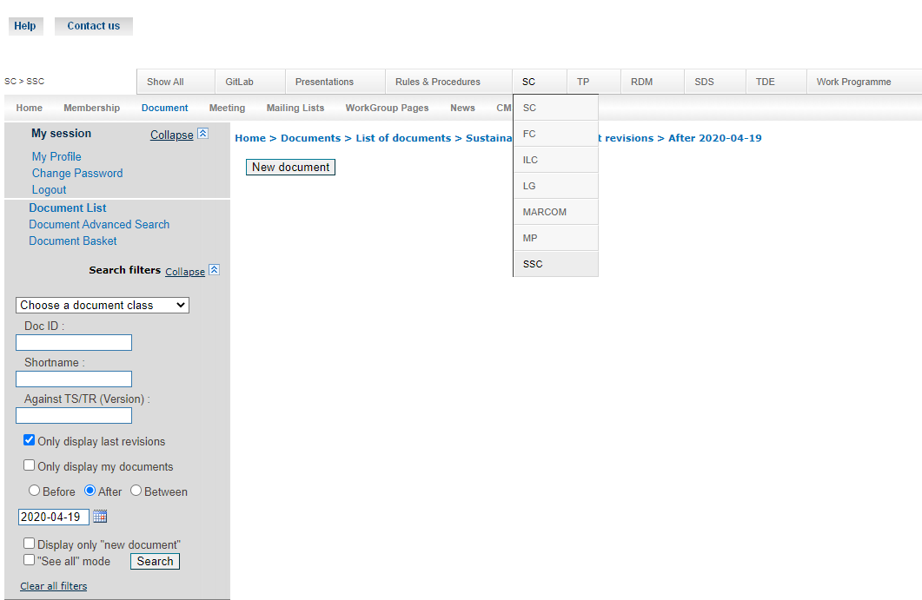
SSC Logistics
Next meeting?
  Proposal - Tuesday April 19 – 11am UTC?
  (7am New York, 4:30pm India, 1pm Paris, 8pm Seoul)
Meeting cadence?
  Proposal – Initially bi-weekly then maybe monthly?
Email List - ONEM2M_SSC@LIST.ONEM2M.ORG
  List owner: ONEM2M_SSC-request@LIST.ONEM2M.ORG
Contributions
  Members – oneM2M Portal
  Non-members – oneM2M FTP site (stay tuned)

Slide 8
Next Steps
Issue initial SSC press release
Continue to get the word out about SSC and recruit folks
Firm-up near-term plans/roadmap and deliverables
Firm up partnerships with other like-minded organizations
Others?

Slide 9
Other Suggestions?
???

