Slide 1
oneM2M Sustainability Initiative
Dale Seed, oneM2M TP Vice Chair
May 27th, 2021

Slide 2
Agenda
Brief overview of oneM2M [5 min]
Overview of oneM2M Sustainability Initiative [5 min]
Discuss collaborating / Q&A [5 min]

Slide 3












oneM2M Partnership Project
More than 200 member organizations in oneM2M
founded¹ July, 24th 2012
TP#1: Sep 24th-29th 2012
[1] Partnership Agreement V 2.0 (Approved March 2013)
Join forces
=> reduce fragmentation
=> Reuse e.g.
HGI
e.g. Release 2 transposition
ITU-T SG20 Y.4500.x
www.oneM2M.org All documents and specifications are publically available
Notes:
oneM2M is the global Partnership Project that specifies a horizontal IoT Service Layer standard.
oneM2M has reached the market and it is a mature and deployed standard. By design its inter-working with other standards and even with proprietary solutions already on the market.
Most recently India has adopted oneM2M standards at the national level towards the end of 2020. Especially for use in its Smart City deployments

Slide 4
Developers use platform tools to build and support IoT systems
Traditional Market Structure
oneM2M’s Standards-based Structure
Application
Application
Extensible ‘toolkit’ of standardized common services
Application Enablement Platform
Many hundreds of proprietary IoT platforms
Common Services Layer
Connected Devices Platform
Communications Network #A
Communications Network #A
D
D
D
D

Slide 5

oneM2M Common Services “Toolkit”
Common Services
IoT Application Layer
Registration
Discovery &
Announcement
Security
Group Management
Communication
Management &
Delivery Handling
oneM2M Common Services Layer
Data
Management &
Repository
Subscription &
Notification
Device Management
Application &
Service Layer
Management
Network Service
Exposure
IoT Devices and Connectivity Layer
Location
Service
Charging &
Accounting
Semantics
Transaction Management
Time
Management
Notes:
Re-use instead of re-invention. Abstraction and
Common Services: a set of services that are commonly needed for applications across different IoT verticals and deployment domains.

Slide 6











oneM2M links distributed components and technologies in end-to-end IoT systems
Legacy Controller
Dashboard
Control
Non-oneM2M
Cloud
IoT Platform
Connected Street Lights
Common Services Layer
Non-oneM2M
Non-oneM2M
Analytics as a Service
Legacy Street Lights
Municipality Data
Notes:
Today IoT stakeholders are exposed to many different technology choices. This leads to complexity and hampers interoperability.
Many IoT deployments can have diverse types of IoT sub-systems and platforms that require interworking devices, apps and data all to one another
oneM2M interworking and abstraction capabilities, are able to hide the complexity of interworking from IoT app developers
oneM2M is able to help future proof IoT deployments by enabling different types of brownfield and greenfield technologies to more seamlessly be deployed together in a more sustainable fashion
oneM2M is a standard and mitigates vendor lock-in
Using oneM2M, the developer only uses the globally specified oneM2M APIs. This greatly simplifies life for IoT stakeholders

Slide 7
oneM2M's Sustainability Initiative
oneM2M launched a dedicated Sustainability Sub-Committee in April 2021
The aim of this initiative is to promote the message that IoT enables sustainability
  There are many examples - smart cities, intelligent transport, energy management, and data sharing to optimize distributed supply chains
Standardization is important to maximize the potential of sustainability
  Standards enable increased interoperability, scalability, modularity, and re-use which are central tenets of the oneM2M standard
This committee will serve an important role in external communications and as a means of feeding new requirements into the oneM2M standard

Slide 8
Overview of oneM2M Sustainability Sub-Committee
Objectives
Advocate the role that IoT and the oneM2M standard have with respect to sustainability
Recruit new participants to oneM2M activities, going beyond standardization experts
Identify requirements that may feed into oneM2M working group activities
Create a market-responsive forum to promote the oneM2M standard externally
Approach
Focus on the role of IoT in enabling sustainability
Demonstrate a strategic commitment to sustainability
Generate various content (webinars, articles, blogs, tweets, videos, etc.)
Develop liaisons with other IoT sustainability initiatives (e.g. AIOTI Digital for Green)
Increase awareness of oneM2M capabilities that enable sustainability
Organization
Open to both members and non-members of oneM2M
Report to oneM2M SC and provide regular updates to TP and MARCOM
Coordinate closely with oneM2M MARCOM to promote generated content

Slide 9
High-level 'Next Steps'
1. Planning & Recruiting
Invite your organization's colleagues who are involved in sustainability
Sustainability experts interested in leveraging IoT
Others (Industry, Academia, Research, Government, etc.)
2. Raise Profile & Organize Communities of Interest
Publish short articles/example applications
Arrange webinar(s)
Case Studies & Longer-format 'thought-leadership' Papers
E.g., AIOTI Digital for Green
3. Longer Term Initiatives
Sector Liaisons
New standardization requirements
Pilot/Test-bed projects

Slide 10
oneM2M Sustainability Sub-committee Work Plan
 | Apr | May | Jun | Jul | Aug | Sep | Oct | Nov | Dec
oneM2M SSC Meetings | 4/20 SSC Kick-off Meeting | 5/20 - SSC Monthly Meeting | 6/24 - SSC Monthly Meeting | 7/22 - SSC Monthly Meeting | 8/19 - SSC Monthly Meeting | 9/23 - SSC Monthly Meeting | 10/21 - SSC Monthly Meeting | 11/30 - SSC Monthly Meeting | 12/15 - SSC Monthly Meeting
Recruiting Phase
Quarterly Report (to SC, MARCOM, TP) |  |  | SSC Quarterly Report |  |  | SSC Quarterly Report |  |  | SSC Quarterly Report
Speaking Events | 6GWorld web event | Peggy Smedley Show (podcast) |  |  |  | AIOTI event – IoT/Edge and UN SDGs
Liaison Activities (AIOTI, others) |  | Liaison initiated with AIOTI Digital for Green
Executive Insight Articles | Article #1 | Article #2
Webinars (e.g., industry experts)
Position Papers |  |  |  | IoT and Sustainability |  | How IoT helps corporates to meet supply-chain reporting obligations (TBD)
Short Articles on IoT Sustainability​ | ​ | ​ | Architecture & Governance magazine​ ​ | ETSI Enjoy! article​ | ​ | ​ | ​ | ​ | ​
Guest Speaker Series
Ad hoc initially, leading to sub-groups/deliverables as contributors and areas of common interest emerge

Slide 11
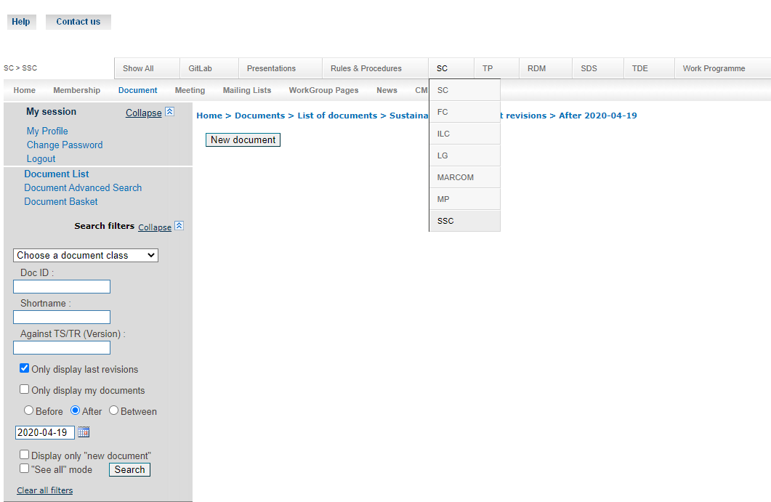
How to get involved
Monthly Meetings – May 20th, June 24th, July 22nd , …
Email list - ONEM2M_SSC@LIST.ONEM2M.ORG
Contribute via speaking events, liaisons, articles, webinars, position papers, guest speakers, case studies
Documents available via:
  oneM2M portal (members-only access)
  oneM2M FTP site (non-members access)
    https://ftp.onem2m.org/Meetings/SSC/

Slide 12
Q&A
Vision:
“A world of interoperable and secure IoT services where market adoption is easy and delivers benefits to society.”
Mission:
“We are the global community that develops IoT standards to enable interoperable, secure, and simple-to-deploy services for the IoT ecosystem. oneM2M standards are open, accessible and internationally recognized.”
Dale.Seed@InterDigital.com

Slide 13
Backup

Slide 14

oneM2M Key-events Timeline
Interop 1
Interop 2
Interop 3
Interop 4
Interop 5
Interop 6
Interop 7
oneM2M
established
Release 4
planned
Release 5
initial plan
Release 1
Release 2
Release 2A
Release 3
2012
2015
2016
2017
2018
2019
2020
2021
2022
2023
Industry
Day 1
Industry
Day 2
Industry
Day 4
Industry
Day 5
Industry
Day 3
oneM2M WS & Developers Training / China*
oneM2M
Certification
launch
15+ products
certified
GCF
oneM2M
Certification
launch
oneM2M Hack-a-Thon Event
Notes:
*InDiCo and SCSC: IoT and oneM2M Standards Workshop & Advanced Developers Training
Jinan, Shandong Province, CHINA, 11-13 November 2020
Recent hack-a-thons in Malaga and in Korea

Slide 15
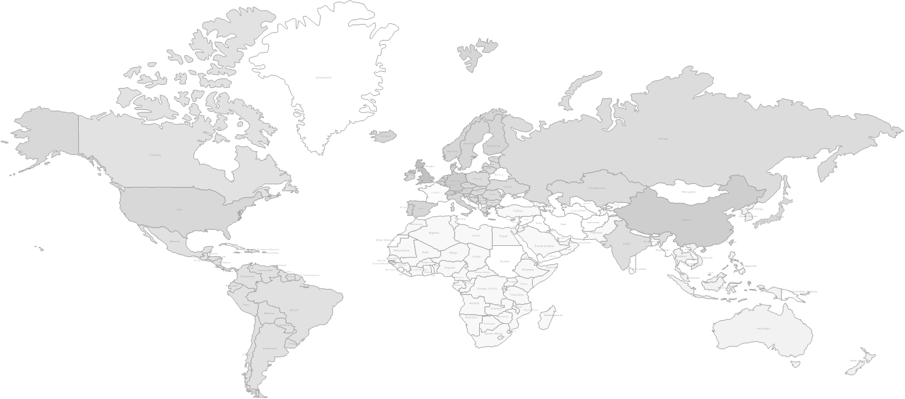
oneM2M Adoption is Global
oneM2M Open Source Project
oneM2M Product Offerings
oneM2M Trial Deployment
oneM2M Commercial Deployment
Use of oneM2M recommended (Smart Cities)
Click here for List of oneM2M deployments

Slide 16
Organization
http://onem2m.org/about-onem2m/organisation-and-structure
Finance
Steering
Committee
Industry Liaison
Partners
Legal
Marketing
Methods/Procedures
NEW
Sustainability
Technical
Plenary
Work Programme
Coordination Group
Methods of Work
Members / Partners
RDM
SDS
TDE
Requirements and Domain Models
System Design and Security
Testing and Developers Ecosystem
Notes:
It was approved to establish a sub-committee to the Steering Committee on the topic of sustainability. The aim of this initiative is to promote the message that IoT enables sustainability. There are many examples of applications such as smart cities, intelligent transport, energy management, and data sharing to optimize distributed supply chains. Standardization is important to maximize the potential of sustainability, especially in matters related like interoperability, scalability, modularity, and re-use which are central to the oneM2M design philosophy. This committee will play an important role in external communications and as a means of feeding new requirements into the technical specifications process.

Slide 17




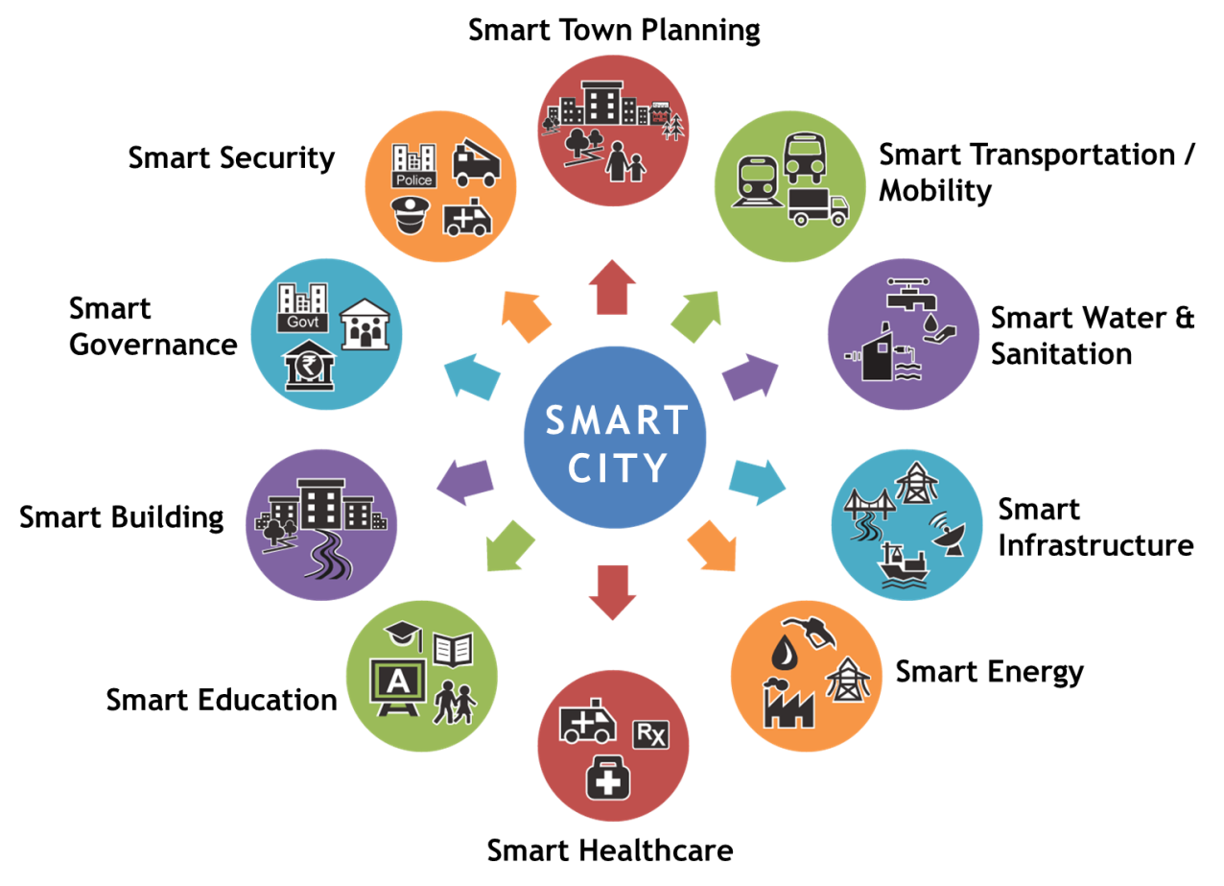



oneM2M Breaks Down the Silos
Horizontal
Information Flow
Smart
Emergency
Services
Smart
Transportation
Smart
Infrastructure
Smart
Emergency
Services
Smart
Transportation
Smart
Infrastructure
Vertical
Information Flow
Vertical
Information Flow
Vertical
Information Flow
…
Service Layer
…
…
Notes:
Without oneM2M:
Highly fragmented market with limited vendor specific applications
Re-inventing the wheel: same services developed again and again
Each silo contains its own technologies without interoperability
With oneM2M:
End-to-end platform: common service capability layer
Interoperability at the level of data and control exchanges via unifom APIs
Seamless interaction between heterogeneous applications and devices

Slide 18
oneM2M Feature Summary by Release
Release 4
(planned)
  SDT 4.0 and the Information Models for Multiple Domains
  oneM2M Conformance Tests
  Geo Query
  Process Management
  Message Primitive Profiles
  Semantic Reasoning
  Time Management
  Enhanced 3GPP Interworking
    Session QoS
    Congestion Monitoring
  Fog/Edge Computing
    Software Campaigning
    Resource Synchronization
  Service Subscriber Management
  Security Enhancements
  Group Anycast/Somecast
  Modbus Interworking
  Discovery Based Operations
  Semantic OntologyMapping
Release 3
Semantic Querying/Mashup
3GPP SCEF Interworking
    Non-IP Data Delivery
    UE reachability Monitoring
    Device triggering
    Etc.
  Transaction Management
  Service Layer routing
  Common oneM2M Interworking Framework
    OCF
    OPC-UA
    OSGi
  oneM2M Conformance Tests and Profiles
  Security Enhancements
    Distributed Authorization
    etc.
  Ontology Based Interworking
Release 2
Time Series Data
Flexible Resources that can be customized by app developers (flex container)
Semantics Description & Discovery
Security Enhancements
    Dynamic Authorization
    Content Security
    E2E Security
WebSocket Binding
Ontology for Home Area Information Model
oneM2M App-ID Registry
oneM2M Interworking
    LWM2M
    Alljoyn
    3GPP Triggering
Release 1
Registration
Discovery
Security
Group Management
Data Mgmt. & Repository
Subscription & Notification
Device Management
Communication Mgmt
Service Charging
Network Service Exposure
App & Service Mgmt
HTTP/CoAP/MQTT Bindings
2015
2016
2018
2021

Slide 19
For more information …
visit www.oneM2M.org
Executive Viewpoints - https://onem2m.org/insights/executive-viewpoints
oneM2M in the News - https://onem2m.org/news-events/newsmenu/onem2m-in-the-news
Technical Specifications - https://onem2m.org/technical/published-drafts

