Slide 1
Sustainability and IoT
Overview of oneM2M Sustainability Initiative
INSERT PRESENTER NAME
DATE AND LOCATION

Slide 2

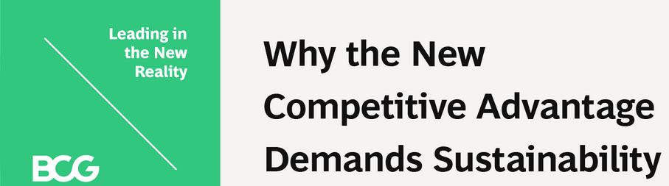

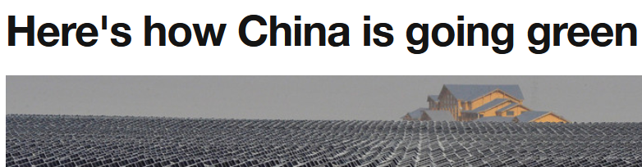


Sustainability has a strong influence on government policy and business strategy across the world
UN Sustainable Development Goals
Boston Consulting Group on Sustainability Strategy
National Sustainability Initiatives

Slide 3
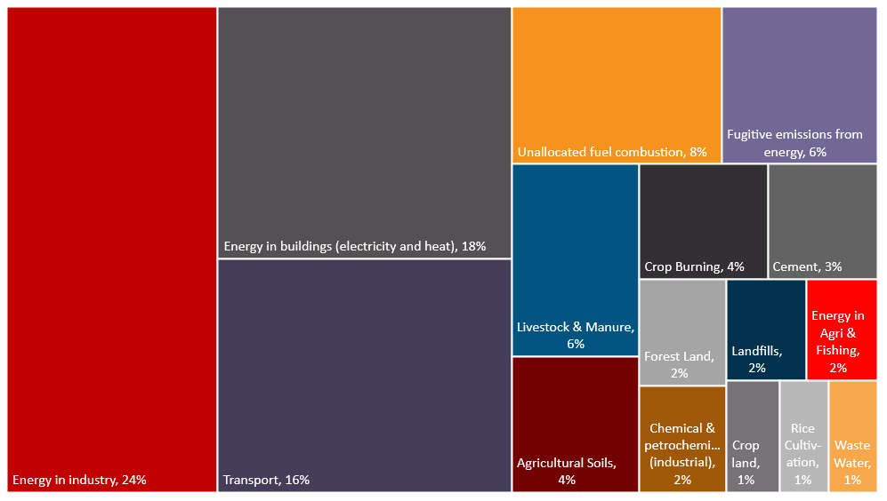
GHG emissions highlight key sectors to improve sustainability
Global Greenhouse Gas (GHG) Emissions
by Sector
"Industry, buildings & transport represent over 70% of GHG emissions"
Source: Our World in Data
Where do global greenhouse gases come from?
Note: Grassland category (not shown) accounts for <1%

Slide 4
The recent action plan for the EU's Green Deal identifies six priorities to address sustainability challenges
Investing in environmentally friendly technologies
Supporting industry to innovate
Rolling out cleaner, cheaper and healthier forms of private and public transport
Decarbonising the energy sector
Ensuring buildings are more energy efficient
Working with international partners to improve global environmental standards
SOURCE: A European Green Deal

Slide 5








Improvements depend on remote sensing, resource management and environmentally sound technologies
Elements Evaluated in Global Scorecard on the Environmental Dimensions of the UN SDGs
Energy efficiency
Reduce CO2 emissions via circular economy & new production paradigms
Water quality & resource management
Public transport & disaster management
Air & water-pollution mortality
Materials footprint & domestic consumption
Common Themes for
Improving Sustainability
Sustainable agricultural practices
Environmentally sound technologies
Significant Role for
IoT Technologies
Remote connectivity to machines & sensors
Cross-silo IoT Applications (interoperability)
IoT data
(time-series)
Constrained devices
(low-power,
low-cost)
Source: UN Environment Program report on Measuring Progress: Towards Achieving the Environmental Dimension of the SDGS (2019)
Notes:
Link to Report - https://wedocs.unep.org/bitstream/handle/20.500.11822/27627/MeaProg2019.pdf?sequence=1&isAllowed=y
See Figure 1 in report for composition of measures used to evaluate progress against each SDG

Slide 6




Common services, as defined in oneM2M standards, help developers build repeatable and scalable IoT systems
Traditional Market Structure
oneM2M’s Standards-based Structure
Application
Application
Many hundreds of proprietary, IoT platforms
Extensible ‘toolkit’ of standardized common services
Application Enablement Platform
Common Services Layer
Connected Devices Platform
Communications Network #A
Communications Network #A
Device(s)
Sensor(s)
Device(s)
Sensor(s)

Slide 7
How oneM2M enables sustainability
Shareable, horizontal architecture – ‘build once, apply many times’
Toolkit of common services for developers to build IoT systems, repeatably
Open standard for vendor, technology and data interoperability
Ability to re-use legacy systems in ‘brownfield + greenfield’ scenarios via a cross-domain, interworking capability
Avoid re-invention by reusing established industry standards and enhancing them with new capabilities

Slide 8
oneM2M plays an important role as a standard and for its enabling technology
oneM2M is integral in several sustainability usage scenarios
  Early deployments in street lighting, intelligent transport, smart city and waste management applications
oneM2M standards align with the core principles of sustainability
  Interoperability, scalability, modularity and re-use
Existing functionality in oneM2M enables sustainable IoT deployments
  Energy Efficiency: enable devices to power down and conserve energy without impacting users / applications.
  Reuse of legacy systems: oneM2M’s information model enables interworking with non-oneM2M components, enabling a transition from installed assets as more sustainable systems are deployed

Slide 9
oneM2M’s Sustainability Initiative
Objectives
Advocate the role that IoT and the oneM2M standard have with respect to sustainability
Create a market-responsive forum to promote the oneM2M standard externally
Recruit new participants to oneM2M activities, going beyond standardization experts
Identify requirements that may feed into oneM2M working group activities
Approach
Demonstrate a strategic commitment to sustainability via a dedicated oneM2M sub-committee
Sub-committee will generate various content (webinars, articles, blogs, tweets, videos, etc.):
  the role of IoT in enabling sustainability, leveraging oneM2M deployment examples
  oneM2M capabilities that enable sustainability (network resource management, messaging scheduling for efficient communications etc.)

Slide 10
How to get involved
Get in touch
Follow our work
ONEM2M_SSC@LIST.ONEM2M.ORG
oneM2M press release on sustainability initiative
Viewpoint article on sustainability, Dale Seed of Convida Wireless
IoT standardization and sustainability, Girish Ramachandran of TCS
Using IoT to Promote Sustainability, Ken Figueredo representing oneM2M

