Slide 1
Open Interconnect Consortium
Introduction for oneM2M
Jooyeol Lee
OIC Standard WG Chair
January, 19th 2015

Slide 2
Agenda
Vision & Objective
Organization Structure
Use Case
Conceptual Framework
License Term
Membership status
Timeline
Collaboration Proposal

Slide 3
Vision
IoT vertical service enablement, secure and reliable device discovery and connection among IoT devices across multiple OSs and connectivity technologies are foundational capabilities to enable the Internet of Things.
Industry consolidation around a common interoperable approach, across all vertical markets, is essential to enable scale
Notes:
While it is a foundational capability, enabling easy-to-use discovery, connectivity and interoperability over multiple transports is not a business in and of itself. It’s a necessary building block that will enable other businesses.

Slide 4
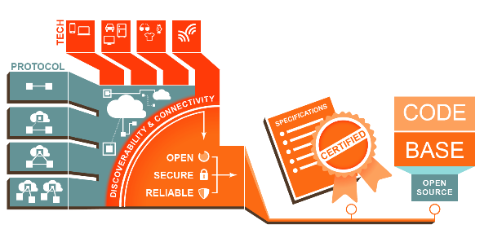
OIC Objectives
A broad industry effort on enabling IoT vertical services
Open standard to provide interoperability from the network to service
Open source to provide a fast path to market for developers and manufacturers
No barriers to use specifications and open source code
Ensuring time-to-market for commercialization with certification

Slide 5

Organization
OIC
Board of Directors
Standard
Specification & Certification
IoTivity
Open Source Project
Open Source
Coordination
Steering Group
Membership
Sponsored (funded) by OIC
Develops reference implementation of OIC standard
Technology Planning
Ecosystem
Marketing Communications
Notes:
Unique combination of Standard & Open Source implementation
Specification, certification & branding to deliver reliable interoperability
Connectivity framework that abstracts complexity
Open specification that anyone can implement (not tied into using mandatory open source code)
IP protection & branding for certified devices (via compliance testing)
Service-level interoperability
Open Source implementation to enable application developers and device manufacturers

Slide 6
Standardization
Standard WG
Remote
Access
Core Framework
Security
Smart Home
Industrial
Internet
Certification
Core Functions
Vertical Service additions
Notes:
Unique combination of Standard & Open Source implementation
Specification, certification & branding to deliver reliable interoperability
Connectivity framework that abstracts complexity
Open specification that anyone can implement (not tied into using mandatory open source code)
IP protection & branding for certified devices (via compliance testing)
Service-level interoperability
Open Source implementation to enable application developers and device manufacturers

Slide 7













Vertical Use Case Example (Smart Home)
Cloud
2
Appliance
3
Environment
6
Out Door
Control
1
Lighting
In-door
Control
Hub
5
Smartwatch
Noti&Control
4
Fire Safety
and Monitor

Slide 8




Conceptual Framework
Vertical
Resources
Home
Enterprise
Industrial
Automotive
Education
Health
Framework
Resource Model
Discovery &
Provisioning
Messaging
Device
Management
Notification
Security, Identity & Permissions
Transports
Remote
Access
Cloud
LE
Notes:
Focus is on a common resource model for developers to interact with.

Slide 9
OIC Intellectual Property Rights Policy
OIC is a royalty free organisation
Open Source – Apache 2.0
  Copyright & patent coverage for submitted code
Standard – RANDZ
  IP cross licensing covering “Compliant Portions” of a member company’s products

Slide 10















































Members
Diamond
Platinum
Gold

Slide 11
2015 Roadmap – High Level
2015.1
Spec v1.0
Spec v1.5
Certification Program
Open Source
Iotivity
Includes initial Smart Home and Framework Specification
co-timed specification and open source release
Certification Program launch
Live
Updated
features, other verticals
Initial release supports smart home use cases but architected to support multiple vertical markets
Future releases will support industrial, smart city, etc…

Slide 12
Motivations of Collaboration
Avoid fragmentation for consumers, manufacturers and service providers
Avoid duplication/conflict of any effort on both side
Envision a mutual synergy regarding standard technology, certification and open source
Envision a bigger momentum with cross member participation

Slide 13
Potential Way Forwards
Establishment of Liaison
Joint Workshops to identify technology gap and collaboration plan
Make work items on both OneM2M and OIC
Possible certification and open source alignment

Slide 14



&

Slide 15
Thank You!
Q&A…

