Slide 1

Introduction of HERIT
September, 2015

Slide 2




Presentation Agenda
Company Introduction
HERIT Overview
Our IoT Business
HUBISS IoT solution
Our References
LGU+, Samsung, KT
oneM2M & Open IoT Platform

Slide 3
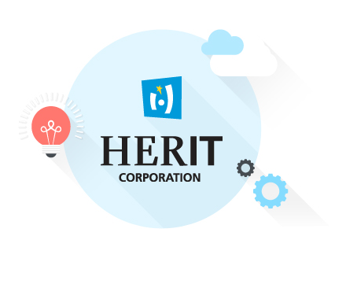
Company Overview
Company Introduction
Kangnam-gu, Seoul, Korea
18, January , 2000
40 personnel
80% of them are developers
www.herit.net

Slide 4

Our Business
Company Introduction
IoT Platform
IoT Solution
Open Solution
IN Solution
HUBISS (IoT Middleware)
Smart home
Open API service solution
SCP/AS IN solution
HUBISS DM
(IoT Device Management)
Remote maintenances
Open common DB
Number Portability DB
HUBISS SE
(IoT Service Enabler)
Smart farm
Parlay AS/GW
Value added services
Smart transportation
IN : Intelligent Network
SCP/AS : Service Control Point/Application Server

Slide 5



Our Customers
Company Introduction

Slide 6

Our IoT Business
HUBISS

Slide 7
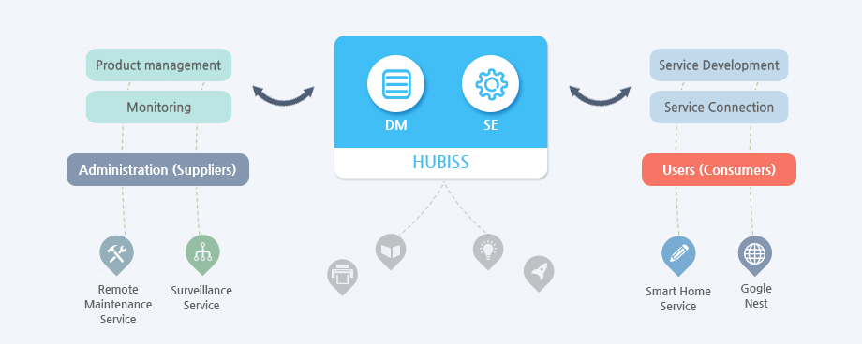
HUBISS Overview
A total solution for colorful IoT services and remote maintenance service
Other platform

Slide 8
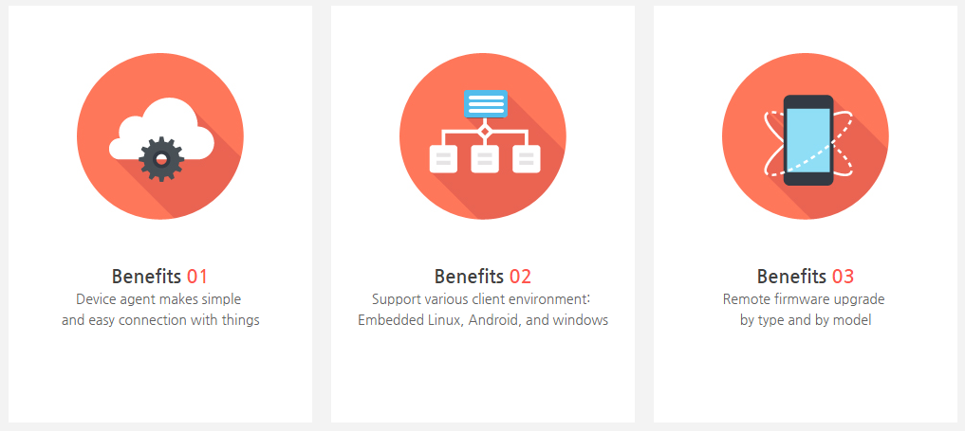
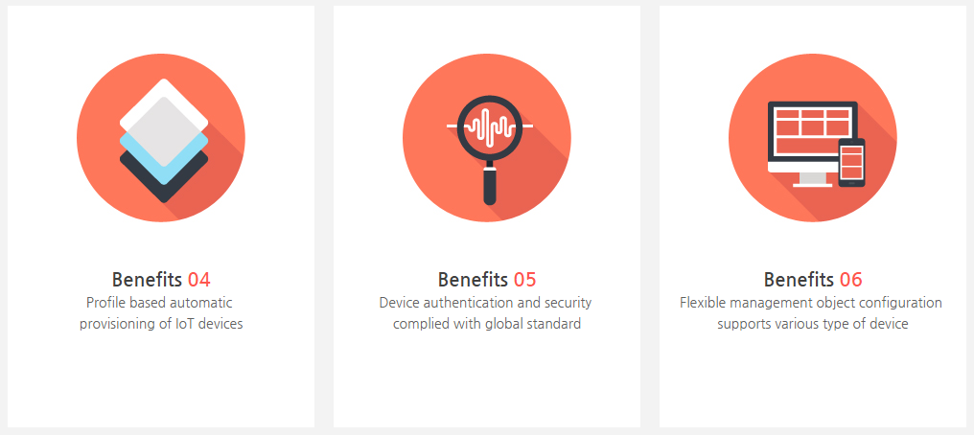
HUBISS Features
Key features
Device Agent
Firmware upgrade
Auto-provisioning
Authentication
Flexible MO
Diagnostics

Slide 9
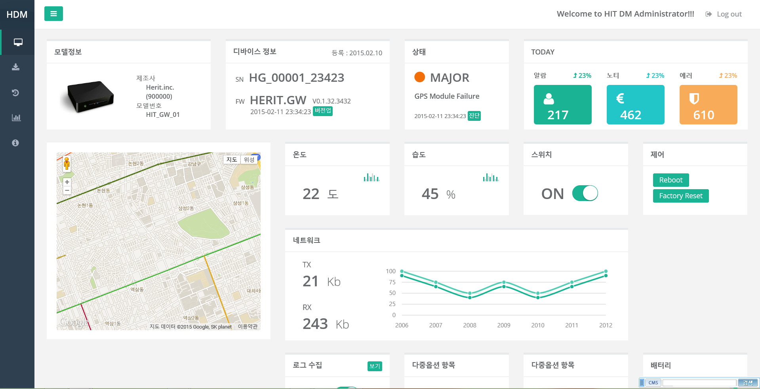
HUBISS DM UI
DM dashboard sample screen shot

Slide 10

Our References
LGU+
Samsung
KT

Slide 11
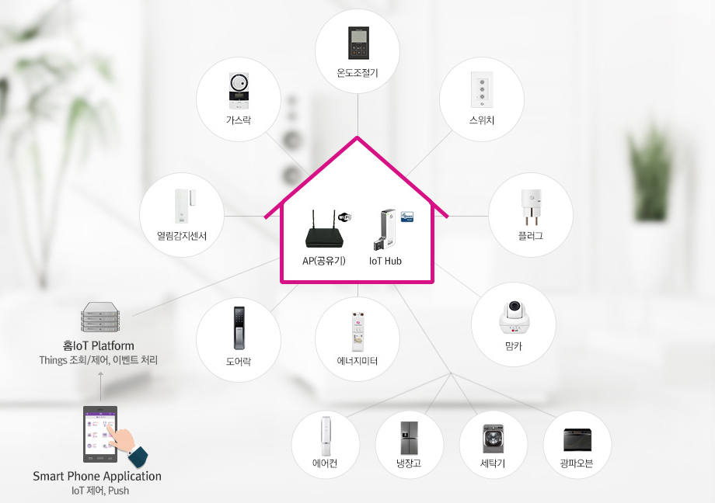



HUBISS- Smart Home
IoT plafrom for LGU+ IoT@home services
Gas Lock
Thermostat
Switch
Plug
Door lock
Energy meter
Open/Closed Sensor

Slide 12
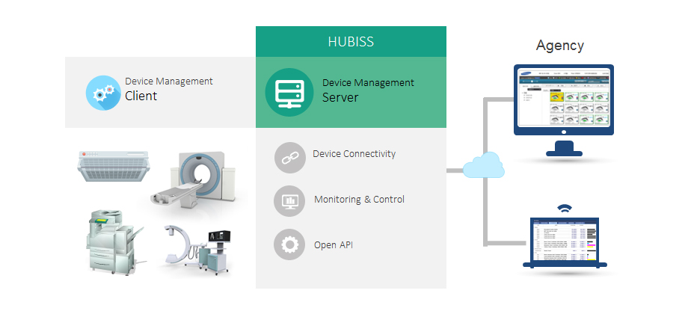
HUBISS- Smart Office(DM) IoT
Remote maintenance system for Samsung products (system air conditioner, printers, medical equipment)

Slide 13
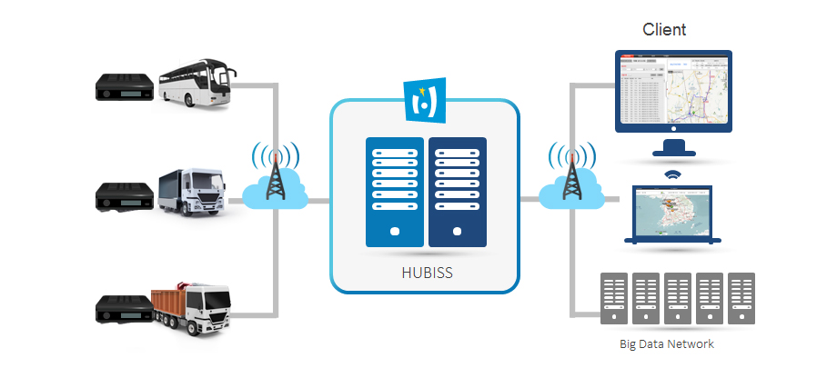
HUBISS-Smart Transportation IoT
Real-time vehicle operation and management service for KT

Slide 14

oneM2M &
Open IoT Platform

Slide 15

Open Web Service for IoB
(Internet of Business)
EASY ENABLE & MANAGE
Open
Open Source
& Social Coding
EASY ENGAGE
Co-work
Standard
Global Standard
EASY CONNECT
Internet of Things Eco System

Slide 16
HERIT IoT Platform based on oneM2M
oneM2M Interoperability event,
14-16 September 2015, in Sophia Antipolis, France

Slide 17
THANK YOU
Discussion & Questions
sales@herit.net

