Slide 1
oneM2M Ecosystem Accelerator (OEA)
Presentation to oneM2M TP meeting
Beijing, November 2015
Paul Russell on behalf of Ken Figueredo

Slide 2
Agenda
IoT platforms and oneM2M market visibility
The need for the ‘oneM2M Ecosystem Accelerator’ – (OEA)
Invitation to participate in the OEA

Slide 3
There are many IoT platforms in the market but few references to oneM2M
Data adapted from ‘A gap analysis of IoT platforms’, J. Mineraud et. al, Feb 2015
Notes:
oneM2M platforms are competing with numerous proprietary alternatives, many of which have significantly higher brand recognition (e.g. GE Predix, ThingWorx etc.)
Outside of some specialists in the technical community, there is little awareness of oneM2M

Slide 4

Companies will not
invest in oneM2M
if they do not
know about it
Notes:
We need to shine more light on oneM2M and let the benefits of the standard become much more visible and influential in how buyers of IoT solutions define their requirements

Slide 5

oneM2M needs more visibility beyond technical audiences; the OEA complements oneM2M to meet this objective
TECHNICAL AUDIENCES
COMMERCIAL AUDIENCES
oneM2M Ecosystem Accelerator (OEA)
Objective - Develop and maintain oneM2M standard
Approach - Promote oneM2M to technical audiences
Partner model (ARIB, ATIS, CCSA, ETSI, TIA, TSDSI, TTA, TTC)
Objective – promote oneM2M and raise awareness in the commercial arena
Approach - collaborate with oneM2M organization to promote oneM2M to commercial audiences
Company model – demonstrates growing eco-system of commercial oneM2M platforms and solutions
Notes:
oneM2M focuses on the standard and technical audiences. The OEA is a complementary activity, that works in close collaboration with MARCOMs, to promote oneM2M to commercial audiences (buyers, corporate decision makers etc.)

Slide 6
oneM2M Ecosystem Accelerator – key stages of the initiative
Discussions at Mobile World Congress
Test the OEA approach
Agree Long-term Plan
March 2015
May 2015
December 2015
Evaluate interest in collaborative marketing of oneM2M
Five companies agree to try out a working model
Agree work plan and resources for 2016+
Gemalto
HP
iconectiv/Ericsson
InterDigital
Sierra Wireless
Notes:
The OEA came about from supportive discussions with oneM2M companies and oneM2M (Steering Cttee. And MARCOMs). Companies agreed on the need for additional resources to support MARCOMs and are currently in a pilot testing phase ahead of a fund-raising process to put in place a long-term plan and budget for 2016

Slide 7
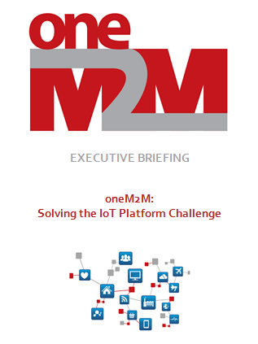
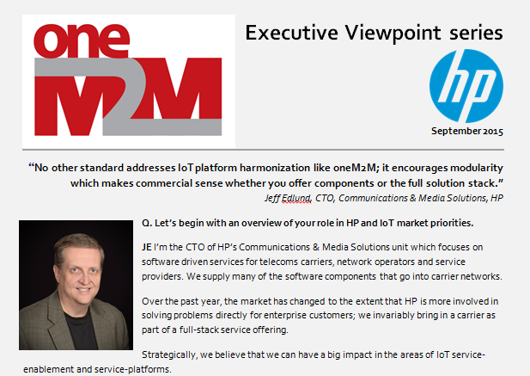
oneM2M Ecosystem Accelerator Results – Executive Briefings
Executive Briefing article:
“oneM2M: Solving the IoT Platform Challenge”
Publication of Executive Interviews
  Jeff Edlund, CTO, Communications & Media at HP
  Jim Nolan, EVP at InterDigital Solutions
  Planned interviews with VP Marketing (Gemalto)
  and VP Market Development (Sierra Wireless)
Notes:
In its brief existence, the OEA is already generating oneM2M promotional outputs in the form of an Executive Briefing (article to be published on oneM2M website) and the first of a set of Executive Interviews with senior executives in oneM2M companies.

Slide 8
oneM2M Ecosystem Accelerator – planned activities
Executive Briefing Series (articles, white papers etc.)
  Security Solutions for the IoT (under preparation jointly by Gemalto and InterDigital)
  The role of registries for IoT Applications (iconectiv/Ericsson)
  Smart city choices and oneM2M (HP)
Intelligent-transport application webinar
  Application of a oneM2M platform for an intelligent transport application in the UK
  Presenters will discuss the customer perspective (i.e. view from outside the telecoms industry)
Ideas under discussion
  Support for a developer community
  Database to list oneM2M companies and contacts
Notes:
Several activities are being planned within the OEA for release over the coming months.
We are demonstrating thought leadership on important IoT topics and demonstrating how companies are collaborating to advance the market. An early topic is security for which Gemalto is collaborating with InterDigital.
It is important to take oneM2M beyond the telecoms arena and into promising verticals. In January, a webinar is planned to discuss the application of a oneM2M platform in the UK. The webinar will include a presentation from the customer’s perspective in terms of business and operational requirements and how these need to be supported by an IoT platform.
Some of the ideas under discussion with potential OEA company members are a developer community effort and a database of company (business) contacts.

Slide 9
Invitation to participate in the OEA – make oneM2M stand out in the market
We can promote oneM2M more effectively by joining our resources and working together
OEA participants benefit through:
  International visibility will drive demand for standards-based solutions in local markets
  Becoming part of a network to collaborate and exchange ideas with product management and business development executives from other oneM2M companies
Notes:
The purpose of this presentation is to invite a boarder set of companies to contribute to the OEA.
By working together, we can make oneM2M stand out from the crowd.
Participating companies will benefit from the publicity surrounding oneM2M. Their participation in the OEA allows business development and product management executives to interact with their counterparts in other companies.

Slide 10
OEA funding model to cover the cost of additional resources to support MARCOMs (under discussion)
oneM2M Partners Type 1 unable to commit additional funding for MARCOMs activities
  Company contributions are the only way to supplement current MARCOMs funds (about $80,000)
Target budget of $150,000 to $250,000 for 2016
2-tier contribution model to share target budget
  Founder members with influence over objectives (e.g. $25,000 each)
  Contributing members (e.g. $10,000 each)
“Not-for-profit” - all funds to be used to promote oneM2M
Notes:
The Type 1 Partners in oneM2M will not contribute significant additional funding to MARCOMs. The current budget (roughly $84k in funds) is inadequate for any significant marketing effort. The only way to supplement this funding is through company contributions.
The target budget for 2016 is in the region of $150,000 to $250,000 depending on the scope of work participating companies agree to address. These funds are for additional resources (primarily Ken Figueredo’s fees for his time in managing the OEA) and to support expenses (travel to present at key events, costs to translate materials, promotional costs on web-sites/journals etc.)
Based on recent discussions, companies favour a 2-tier model. One permutation is to have 4 Founder members (contributing a total of $100,000) and 10 Contributing members (providing another $100,000) for example (i.e. a total of 14 active participants). Alternative permutations are possible depending on the breadth of participation i.e. contributions can be lowered if 20 or 30 companies agree to share the costs.
We will accept contributions in kind as long as we have a base level of funding.
All funds raised will be used to promote oneM2M through the efforts of the OEA on a not-for-profit basis.

Slide 11
Next Steps
Participate in discussions to plan OEA activities for 2016
Please contact Ken Figueredo (ken@more-with-mobile.com) who is coordinating the multi-company initiative
Notes:
Discussions are underway with different companies and senior leaders in oneM2M Please contact Ken to join in the discussion noting that we need to agree on the long term plan and funding in time for Jan 2016.

