Slide 1

Welcome to oneM2M!
Group Name: oneM2M Welcome Session
Source: Mitch Tseng, ARC WG Vice Chair & oneM2M Secretariat
2016-05

Slide 2
Introduction
On July 24, 2012 a number of the world’s leading
ICT Standards Development Organizations (SDOs) launched a new global organization: the oneM2M Partnership Project: http://www.oneM2M.org to:
  cooperate in the production of globally applicable, access-independent M2M Service Layer specifications, including Technical Specifications and Technical Reports related to M2M Solutions and
  ensure the most efficient deployment of machine to machine (M2M) communications systems

Slide 3















Global Partners

Slide 4
Mission
The goal of oneM2M is to develop technical specifications which address the need for a common M2M Service Layer that can be readily embedded within various hardware and software, and be relied upon to connect the myriad of devices in the field with M2M application servers worldwide.
A critical objective of oneM2M is to attract and actively involve organizations from M2M-related business domains such as: telematics and intelligent transportation, healthcare, utilities, industrial automation, smart homes, etc.

Slide 5
Scope
Initially, oneM2M shall prepare, approve and maintain the necessary set of Technical Specifications and Technical Reports for:
  Use cases and requirements for a common set of Service Layer capabilities;
  Service Layer aspects with high level and detailed service architecture, in light of an access independent view of end-to-end services;
  Protocols/APIs/standard objects based on this architecture (open interfaces & protocols);
  Security and privacy aspects (authentication, encryption, integrity verification);
  Reachability and discovery of applications;
  Interoperability, including test and conformance specifications;
  Collection of data for charging records (to be used for billing and statistical purposes);
  Identification and naming of devices and applications;
  Information models and data management (including store and subscribe/notify functionality);
  Management aspects (including remote management of entities); and
  Common use cases, terminal/module aspects, including Service Layer interfaces/APIs between: Second Level
    Application and Service Layers;
    Service Layer and communication functions

Slide 6
Participation
Levels of participation:
  Partner Type 1
    Member companies participate directly
  Partner Type 2
    Contributes on behalf of member companies
  Member (companies)
  Associate Member
  Observer
Join: http://www.onem2m.org/membership/join-onem2m
Published docs: http://www.onem2m.org/technical/published-documents
News: http://www.onem2m.org/news-events/news

Slide 7
Membership Structure
oneM2M Member
  Members are admitted through affiliation with a Partner Type 1 & they may:
    attend & provide input to the Technical Plenary and its subgroups; &
    have one vote per admitting Partner Type 1 in meetings of the Technical Plenary and its subgroups, as appropriate.
oneM2M Associate
  Associates are any government or regulatory agency with interest in oneM2M work, and they may:
    Attend and provide input to meetings of the Technical Plenary and its subgroups. However, such input shall be limited to clarifications regarding regulatory matters and informational contributions.
oneM2M Observers
  Invited to attend for a limited duration and they may not provide any technical input to the Technical Plenary of its subgroups

Slide 8
Organization
Finance
Legal
Steering Committee
(Partners)
MARCOM
Methods &
Processes
Certification
Technical Plenary
(Members / Partners)
Method
of Work
Work
Programme
Requirements
(REQ)
Testing
(TST)
Architecture
(ARC)
Protocols
(PRO)
Security
(SEC)
Management,
Abstraction,
Semantics
(MAS)

Slide 9
Steering Committee
SC Participation:
  Representatives of each Partner as identified by that Partner
  Chair and Vice Chairs of the Technical Plenary
SC Attendance:
  One representative of each Member (exclusive of Partner representatives)
SC Leadership:
  SC Chair: Fran O’Brian - Cisco (TIA)
  SC Vice Chair: Thomas Li - Huawei (CCSA)
  SC Vice Chair: Puneet Jain - Intel (ATIS)
  SC Vice Chair: Enrico Scarrone, Telecom Italia (ETSI)

Slide 10
Steering Committee
Key Steering Committee responsibilities:
    Developing, approving, and maintaining the oneM2M purpose and scope and oneM2M Working Procedures;
    Approving applications from organizations wishing to join oneM2M as new Partners;
    Managing the oneM2M Secretariat;
    Handling appeals from Partners and Members on procedural matters; and
    Approving liaison relationships
    Overseeing subcommittees: Finance committee, Legal Group, Marcom, and Methods and Procedures

Slide 11
Scope & Objectives
To develop: Global M2M end-to-end specifications -
using common use cases and architecture principles across multiple M2M applications to connect M2M devices with application servers worldwide with an access independent view of end-to-end services
To define: Service Layer platform with high level / detailed service architecture including:
- Protocols/APIs/standard objects (open interfaces & protocols)
- Interoperability, test and conformance specifications
- Common use cases, terminal/module aspects
- Service Layer interfaces/APIs between:
  Application and Service Layers
  Service Layer and communication functions
  - Security and privacy aspects
  authentication, encryption, integrity verification

Slide 12
Technical Plenary
Key Technical Plenary responsibilities:
  Creating Working Groups (WGs);
  Resolving deadlocks within and between WGs and handling of appeals on technical matters;
  Managing and approving work items (WIs) and study items;
  Providing coordination of the technical Work Program and its management;
  Handling the document release and change management process; and
  Liaising with other organizations on technical matters.
Technical Plenary leadership:
  TP Chair : Omar Elloumi, Nokia
  TP Vice Chair : Roland Hechwartner, Deutsche Telekom
  TP Vice Chair : Ki Young Kim, LGE
  TP Vice Chair : Nick Yamasaki, KDDI

Slide 13
TP/WG Work Areas
REQ – Requirements
  Use Case development, accept and process service requirements
ARC – Architecture
  Service-layer architectural options
PRO – Protocols
  Protocols for service layer, and interoperability
SEC – Security
  Ensuring Security and Privacy aspects are considered
MAS – Management, Abstraction, & Semantics
  Providing device management; Working on semantic library
TST – Testing
  Test Requirements, Methods, and Specifications

Slide 14
REQ Working Group
Requirements (REQ)
  Key REQ Responsibilities:
    Identify and document use cases that are relevant for oneM2M;
    Identify and specify service and system requirements that are relevant for oneM2M scope, including interworking aspects to other systems;
    Gather M2M service requirements specific to the vertical ecosystem contexts obtained from vertical industry groups and fora; and
    Conduct studies leading to deliverables pertaining the aggregation and analysis of requirements necessary for development of the M2M system according to the scope of oneM2M.
  REQ Leadership:
    REQ WG Chair : Shelby Kiewel - iconectiv
    REQ WG Vice Chair : Joerg Swetina - NEC Europe
    REQ WG Vice Chair : Rajesh Bhalla - ZTE

Slide 15
ARC Working Group
Architecture (ARC)
  Key ARC Responsibilities:
    Specify architecture for M2M system according to oneM2M scope;
    Develop specifications that meet requirements and choose whether to reuse/reference existing standards and specifications or parts thereof;
    Coordinate M2M architecture activity with that of other oneM2M WGs as well as other specification groups and fora; and
    Conduct studies leading to deliverables pertaining to the evolution of the M2M system.
  ARC Leadership:
    ARC WG Chair : Nicolas Damour, Sierra Wireless
    ARC WG Vice Chair : Mitch Tseng, Huawei
    ARC WG Vice Chair : SeungMyeong Jeong, LGE

Slide 16
PRO Working Group
Protocols (PRO)
  Key PRO Responsibilities:
    Protocols, APIs and information representation that cross defined interfaces, considering interoperability;
    Message formats and procedures for normal and error cases;
    Inter-working for protocols including consideration of mapping and encapsulation; and
    Guidelines for testing.
  PRO Leadership:
    PRO WG Chair : Peter Niblett, IBM
    PRO WG Vice Chair : Shingo Fujimoto, Fujitsu

Slide 17
SEC Working Group
Security (SEC)
  Key SEC Responsibilities:
    Overall responsibility for all technical aspects related to security and privacy within oneM2M;
    Security analysis of the oneM2M system architecture and application of best practices to derive technical solutions, including but not limited to authentication, encryption and integrity verification;
    Determine the resulting requirements to integrate security into the oneM2M system architecture and specify the security protocols; and
    Specify the means for provisioning and protecting sensitive data (e.g. security credentials) and to enable their management.
  SEC Leadership:
    Security WG Chair : Francois Ennesser, Gemalto
    Security WG Vice Chair : Dragan Vujcic, Oberthur
    Security WG Vice Chair : Wei Zhou, Datang Telecom

Slide 18
MAS Working Group
Management, Abstraction and Semantics (MAS)
  Key MAS Responsibilities:
    Focus on the technical aspects related to management of M2M entities and/or functions; and
    Provide support to the M2M system for application specific abstraction and semantics with regard to execution of M2M services.
  MAS Leadership:
    MAS WG Chair : Yongjing Zhang, Huawei
    MAS WG Vice Chair : Timothy Carey, Nokia

Slide 19
TST Working Group
Testing (TST)
  Key TST Responsibilities:
    Prepare Test Requirements, Methods, and Specifications in support of oneM2M Protocols and implementations
  TST Leadership:
    TST WG Chair : JaeSeung Song, KETI
    TST WG Vice Chair : Madhi Ben Alaya, Sensinov
    TST WG Vice Chair : Jason Yin, Huawei

Slide 20
TP/WG Work Program
Work Items
  Proposed to TP (Technical Plenary)
  Scope / Rapporteur / 4 Supporting Companies
  Defines one or more deliverables
Deliverable
  Intended to be made available for distribution beyond the membership of the Technical Plenary, such as to the Partners Type 1.
  A deliverable may be one of:
  TR (Technical Report) or TS (Technical Specification)
Release
  A set of ratified Deliverables that are technically consistent at the time of the freeze of the Release and which are made available to each Partner for publication.

Slide 21
Contributions to oneM2M Meetings
Agendas will be formed by the leadership to help outline the primary goals and topics of a given meeting.
All contributions to be submitted seven calendar days in advance of the meeting to which they are to be addressed.
  Contributions will generally be discussed during the meeting in order of their relationship to the outlined agenda topics, not necessarily in the order which they are received.
Late contributions can be considered with the consensus of the group.
Meeting notes and the document portal will capture the disposition of each contribution discussed.
  Draft, Noted, Agreed, or Withdrawn

Slide 22
oneM2M Release 1.
Release 1 Ratification
30 January, 2015
Deliverables available to all oneM2M
Partner Type 1 for their Publication on a
Regional basis
Partners choose to publish according to their individual process and timing
See: http://www.onem2m.org/technical/published-documents

Slide 23
Release 1 Specifications
WG | ID | Name
REQ | TS-0002 | Requirements
REQ | TS-0011 | Common Terminology
ARC | TS-0001 | Functional Architecture
PRO | TS-0004 | Service Layer Core Protocol
PRO | TS-0008 | CoAP Protocol Binding
PRO | TS-0009 | HTTP Protocol Binding
PRO | TS-0010 | MQTT Protocol Binding
SEC | TS-0003 | Security solutions
MAS | TS-0005 | Management enablement (OMA)
MAS | TS-0006 | Management enablement (BBF)

Slide 24
FRAND-based IPR Policies
Fair, Reasonable, and Non-Discriminatory
All the Partners Type 1 of oneM2M have IPR policies that support a FRAND IPR regime. The IPR policies of each of the Partners Type 1 of oneM2M also recognize the importance of respecting the rights of owners of essential/potentially essential IPRs. Thus, the IPR policies seek to balance such rights with the ability of implementers to access essential IPRs under Fair, Reasonable and Non-Discriminatory (FRAND) terms and conditions.
Each oneM2M Member is required to comply with the disclosure obligations of that admitting Partner’s IPR policies, procedures and guidelines with respect to IPRs that are or may be essential to Technical Specifications and/or Technical Reports developed in oneM2M. If a Member engages in oneM2M activities through more than one Partner, then the Member shall be required to comply with the IPR policies, procedures and guidelines of all Partners which have admitted such a Member.

Slide 25
Consensus and Objections
Consensus (from the oneM2M Working Procedures):
  General agreement, characterized by the absence of sustained opposition to substantial issues by any important part of the concerned interest and by a process that involves seeking to take into account the views of all parties concerned and to reconcile any conflicting arguments.
  Note that “consensus” does not imply “unanimity”.
Objections:
  Attempts shall be made to understand and address objections made by members.

Slide 26
TP/WG Working Process
Meeting Notice / Invitation (Regular or ad-hoc)
Agenda
Contributions
Discussion - as/required
Revisions - as/required
Agreement (or noted, withdrawn, etc.)
Added to draft deliverable (by Rapporteur)
Approval of final Draft (by the TP)

Slide 27
Face-to-Face Meetings
Held six times a calendar year
  Coordination meeting for leaders and Rapporteurs
  Technical Plenary and Working Group meetings run from Monday morning until Friday evening.
  oneM2M Meeting Calendar:
    http://www.onem2m.org/news-events/member-meetings
  Meeting invitations issued a minimum of 60 days prior to the meeting and may be found on the meeting calendar page or in the document portal.
  Depending on the need, interim face-to-face meetings or TP or WGs can be called with proper notices.

Slide 28
Virtual Meetings
Each WG sets their own virtual meeting schedule which is then agreed in TP.
  A virtual meeting is a formal meeting, in which decisions can be made and can be counted into voting eligibility.
  Virtual meetings will be announced 14 days in advance.
  Virtual meetings are typically two hours in duration, and detailed agendas will be posted prior to each meeting.
  Individual meeting invites can be found via the WG meeting calendars in the document portal.
  Virtual meetings are held using GoToMeeting or GoToWebinar tools.
    These tools require a software download, which you will be prompted to begin the first time you log-on to a meeting.

Slide 29
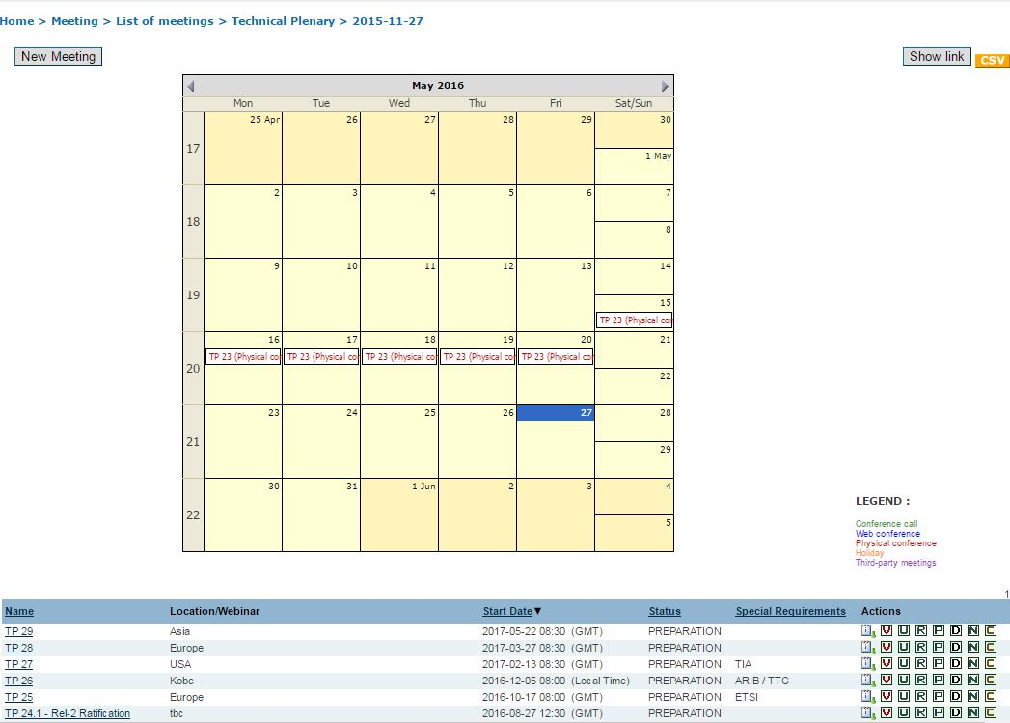
Meetings

Slide 30
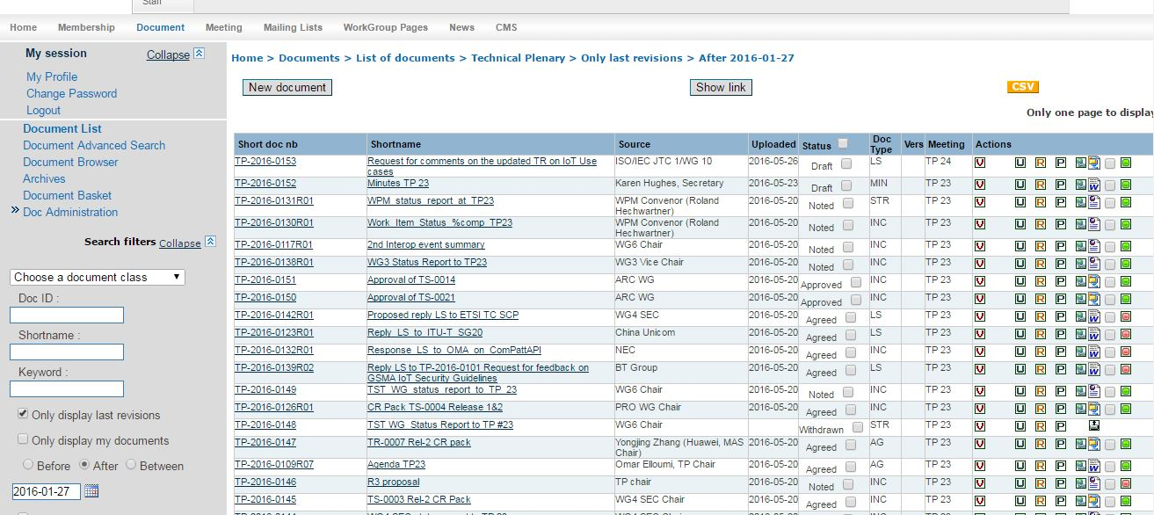
Documents

Slide 31
Document Disposition
Draft
  All contributions posted 7 days or more in advance of a meeting.
Noted
  A contribution not agreed to by the group, out of scope of the work, expected to be revised, or presented for information.
Agreed
  A contribution that is agreed to by the group.
Withdrawn
  Assigned at any time by the request of a contributor.
NOTE: Document dispositions are only updated by the Secretariat

Slide 32
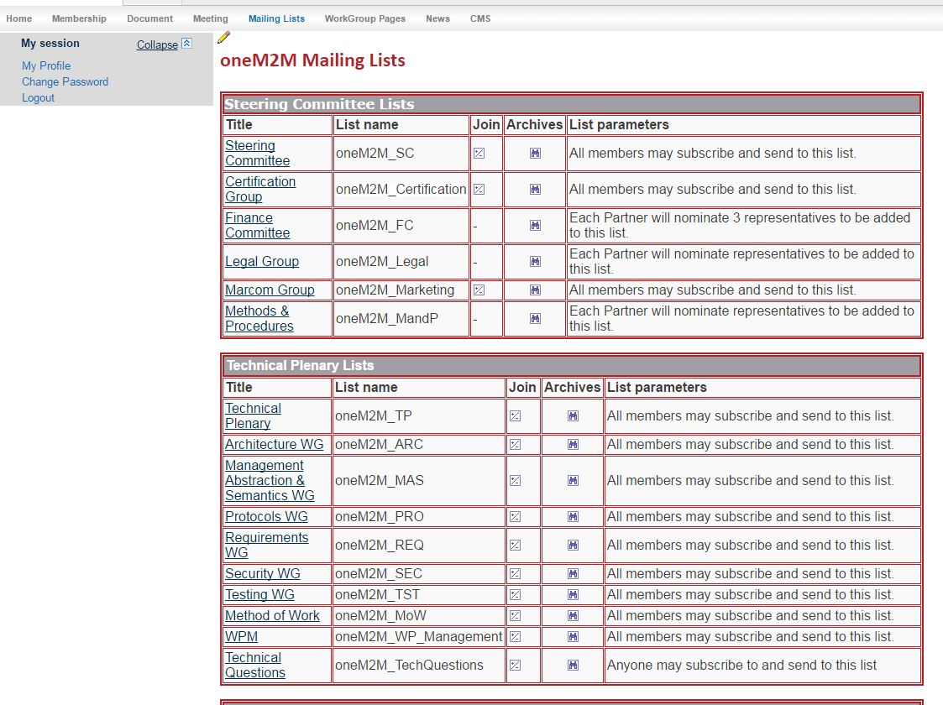
Mailing lists
http://member.onem2m.org/WebSite/private/mailing_lists.aspx.

Slide 33
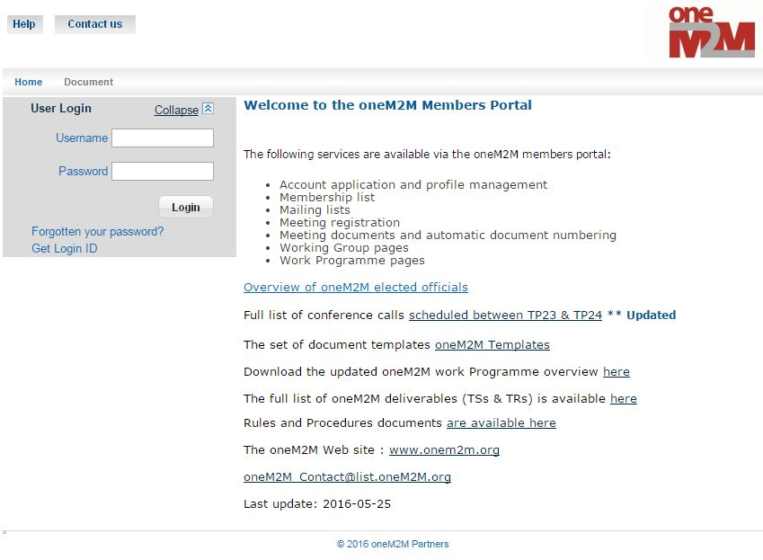
Portal

Slide 34
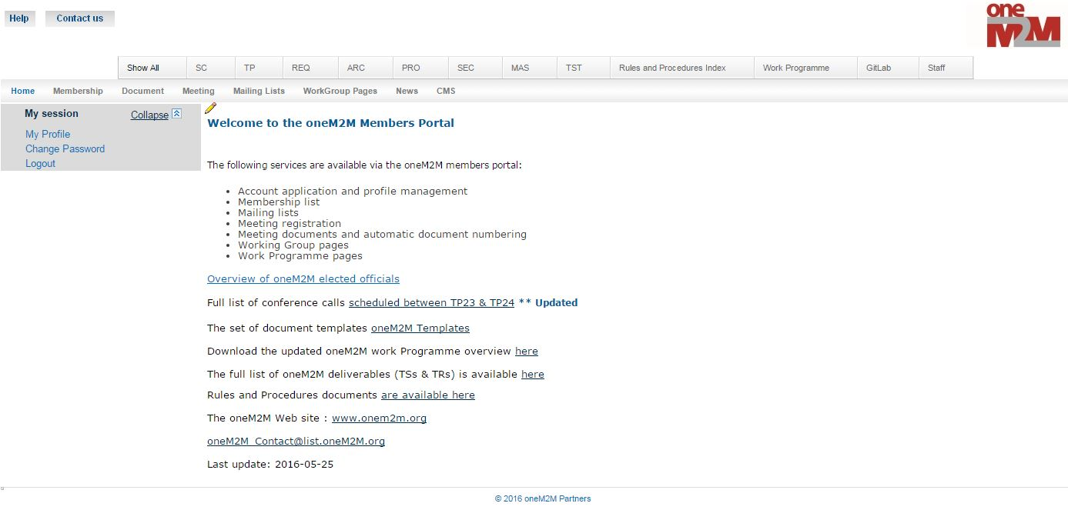
Portal
http://member.onem2m.org/website/homepage.aspx

Slide 35
Q&A
Welcome to oneM2M!

