Slide 1
oneM2M TP 28
27-31 March 2017

Slide 2



Who we are
The European Committee for Standardization
The European Committee for Electrotechnical Standardization
The European Telecommunications Standards Institute
= the 3 European Standards Organisations (“ESOs”) officially recognized by the European Commission
Effective co-regulation tool
    provide support to European legislation
CEN and CENELEC national delegation principle
    full consensus processes + identical national implementation
Voluntary standards and market driven

Slide 3
What we do
We
provide a platform for stakeholders in a specific area to come together
facilitate consensus at European level
help ensure principles of transparency, openness, coherence, consensus
develop European harmonised documents
help build support for the European Single Market
  Links to legislation
  Links to public policy

Slide 4




Where do we fit in
Vienna, 1991
(>30%)
Frankfurt, 2016
(>75%)
Industry, SMEs, federations, researchers, academia…
National standards bodies
National committees

Slide 5

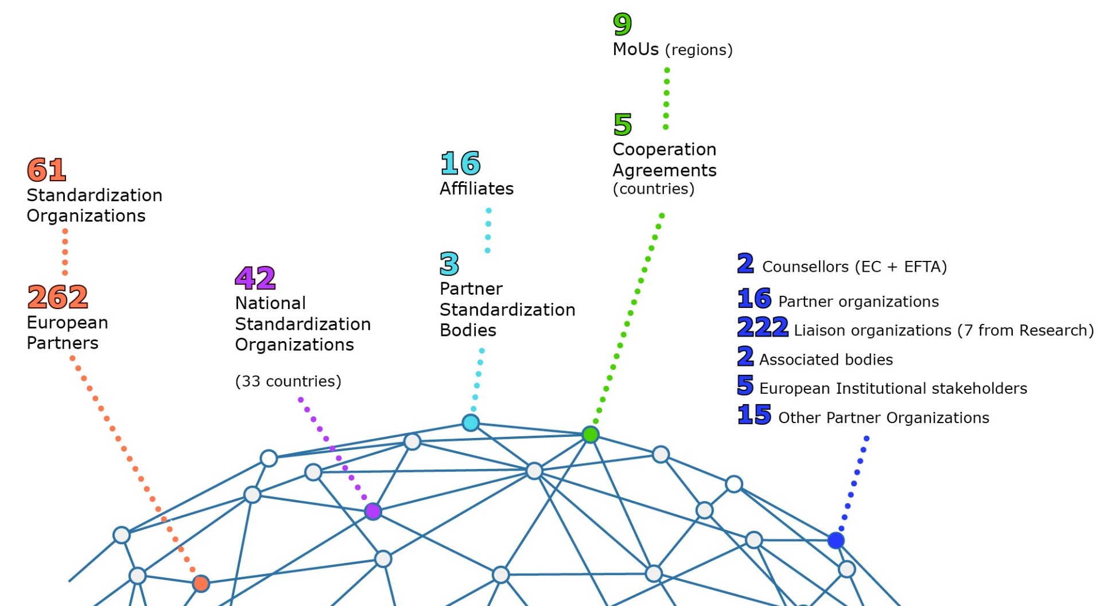

CEN and CENELEC Network
43
(34 countries)

Slide 6



























CEN and CENELEC Network
43 National Standards Bodies (34 countries)
Austria
Estonia
Hungary
Malta
Slovakia
Belgium
Finland
Netherlands
Slovenia
Iceland
Bulgaria
Norway
Spain
France
Ireland
Sweden
Croatia
Italy
Poland
FYROM
Cyprus
Switzerland
Latvia
Portugal
Germany
Czech Republic
Turkey
Lithuania
Romania
Denmark
Greece
Luxembourg
Serbia
United Kingdom

Slide 7


CEN and CENELEC – a network of excellence
19 859
Standards
(nearly 5 000 HS)
568
Technical Specifications
430
CWAs
511
Technical Reports

Slide 8
A unique system
CEN, CENELEC and ETSI Officially recognised as
European Standardization Organizations
(Regulation EU 1025/2012)
1 European Standard
34 identical national standards
All conflicting standards removed
Access to a market of 600 Million consumers!

Slide 9
CEN & CENELEC Standardization :
Sectors and Topics
CEN
Bio-based products
Chemicals
Construction
Food
Heating, Ventilation and Air Conditioning (HVAC)
Materials
Nanotechnologies
Pressure equipment
Services
CEN & CENELEC
Air and Space
Consumer products
Electric Vehicles
Energy and utilities
Health and safety
Healthcare
ICT
Machinery safety
Measurement
Medical equipment
Railways
Defence, Security and privacy
Smart Grids / Smart Meters
Transport and Packaging
CENELEC
Electrical engineering
Electromagnetic Compatibility (EMC)
Fibre-optic communications
Fuel Cells
Household Electrical Appliances
Solar (photovoltaic) electricity systems
Cross-sectoral issues
Accessibility | Environmental Protection | Energy-efficiency (Eco-Design)

Slide 10
What we standardize
CEN-CENELEC Portfolio per business domain

Slide 11




Thank you!
www.cen.eu
www.cenelec.eu
www.cencenelec.eu
Follow us on:

