Slide 1
ATIS Open Source IoT (OS-IoT)
Iain Sharp
isharp@atis.org
Senior Technical Consultant, ATIS
March 31st, 2017

Slide 2
About ATIS
Alliance for Telecommunications Industry Solutions
Forum for technical standard development and coordination of industry positions for North America and globally
Based in Washington DC
The founder North American Organizational Partner in 3GPP
Founder partner type 1 for oneM2M
http://www.atis.org/

Slide 3
oneM2M and Lightweight Clients
Analysis by ATIS’ oneM2M Open Source Community Landscape Team and an industry survey highlighted a support need for lightweight clients:
  Lightweight clients are required for many IoT applications (e.g., smart metering, smart city/transport, wearables)
A portable, lightweight, open source oneM2M client framework would drive industry adoption of oneM2M and help improve the quality and security of IoT devices.
  oneM2M is working to overcome perception that oneM2M is complex for clients
  Immaturity of the ecosystem for developers wishing to work on clients is currently an important barrier to the wider adoption of oneM2M
ATIS Open Source IoT (OS-IoT) group has initiated work on oneM2M client library

Slide 4
OS-IoT participation
Open to both ATIS members and non-members
Leaders:
AT&T
Qualcomm
Other participating companies:
ARM, CenturyLink, Cisco, Huawei, InterDigital, KETI, Linaro, Nokia, and Sierra Wireless
  Many contributors known to oneM2M!

Slide 5
Development Scope
OS-IoT library providing application-independent access to essential oneM2M functions.
Demo application to show operation of library.
Definition of API between applications and library.
Development language: C/C++
Initial target platform: Linux on ARM
  Aim for portability to allow scaling-down to lighter platforms
Demo Application or
Third Party Application
OS-IoT Library API
OS-IoT Library
Enabling application developers to quickly build oneM2M support into lightweight clients
Operating System

Slide 6
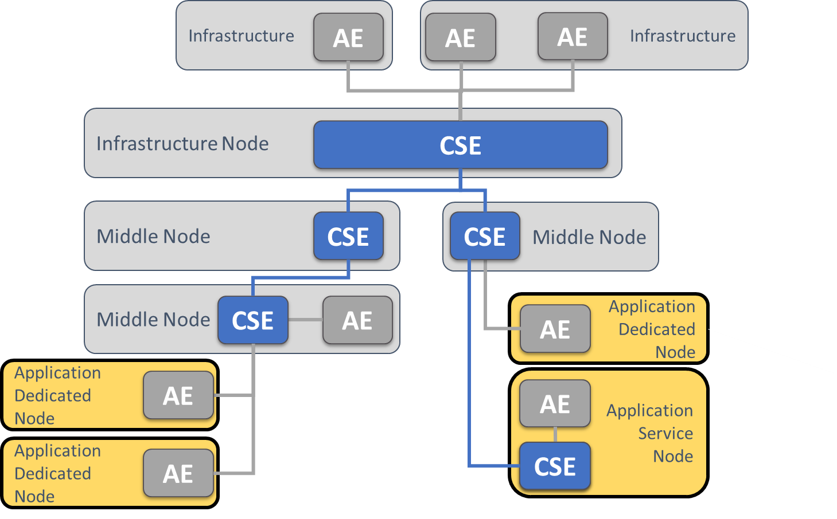
oneM2M System Aspects
Support oneM2M client Application Service Node (ASN) or Application Dedicated Node (ADN)
  Target basic sensor (thermometer) and actuator (door lock) applications
oneM2M security support intended as part of early deliverables
Initial release will assume IP network connectivity

Slide 7
IPR and Tooling
Legal framework established for code licensing and contribution process:
  Project conforms to 3 clause BSD open source license
  Clarification statement that ATIS RAND patent policy applies
  Developers Certificate of Origin confirmation for contributed code
Development environment supporting Git source code repository established

Slide 8
Status
High level requirements agreed and being refined in a living document
Starting development of a software architecture document
Collecting reference material to help structure the implementation:
  oneM2M client libraries in other languages
  oneM2M client APIs to applications
  Experience in applying industry-standard libraries to oneM2M (e.g. Open SSL)
Target to have code capable of being tested at oneM2M interop events expected late summer 2017
We welcome more participation, particularly with practical experience to define architecture and access to resources to help with the coding phase
  Contact isharp@atis.org for more information

