Slide 1
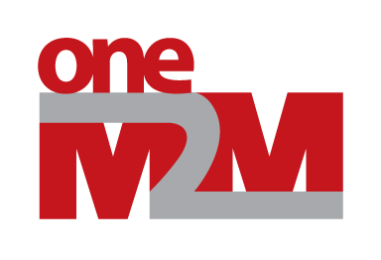
Enabling Blockchain to oneM2M
TST-2017-0266-Blockchain-IoT
Group Name: TP
Source: JaeSeung Song, KETI, jssong@sejong.ac.kr
Meeting Date: TST #31

Slide 2
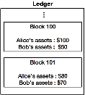
Introduction of Blockchain
What is Blockchain?
DATABASE – Blockchain can store various data.(e.g. Assets, temperature, etc)
Ledger
…
Block 100
Alice’s assets : $100
Bob’s assets : $50
peer
Block 101
Alice’s assets : $80
Bob’s assets : $70

Slide 3
Introduction of Blockchain
What is Blockchain?
DISTRIBUTED – Blockchain system does not requires centralized server.
server
client
peer
Traditional Service Network
(Server and Client)
Blockchain Network
(Peer to Peer)

Slide 4
Introduction of Blockchain
What is Blockchain?
Okay!
I checked hand over time and the medicine container’s GPS value.
Okay!
I checked hand over time and the medicine container’s GPS value.
CONSENSUS – Each block is stored in Blockchain, when peers agree.
Medicine tracking system
with Blockchain
Medicine tracking system
with Blockchain
Medicine tracking system
with Blockchain
…
…
…
Block 73
Manufacturer handed the medicine container over transporter at 10 a.m.
Block 73
Manufacturer handed the medicine container over transporter at 10 a.m.
Block 73
Manufacturer handed the medicine container over transporter at 10 a.m.
Block 74
Transporter handed the medicine container over pharmacy at 12 p.m.
Block 74
Transporter handed the medicine container over pharmacy at 12 p.m.
Block 74
Transporter handed the medicine container over pharmacy at 12 p.m.
Manufacturer
Transporter
Seller
Notes:
CONSENSUS – Each block is stored in Blockchain, when peers agree.

Slide 5
Introduction of Blockchain
What is Blockchain?
ENCRYPTED – Blocks of Blockchain are chained via hash value.
Block 0
Index: 0
Timestamp: 17:15 1/1/2017
Data: “block0data”
Hash: 0xea34ad…55
previousHash: 0
Block 1
Index: 1
Timestamp: 17:18 1/1/2017
Data: “block1data”
Hash: 0xf6e1da…eb
previousHash: 0xea34ad…55
Block 2
Index: 2
Timestamp: 17:21 1/1/2017
Data: “block2data”
Hash: 0x9326eb…3c
previousHash: 0xf6e1da…eb

Slide 6
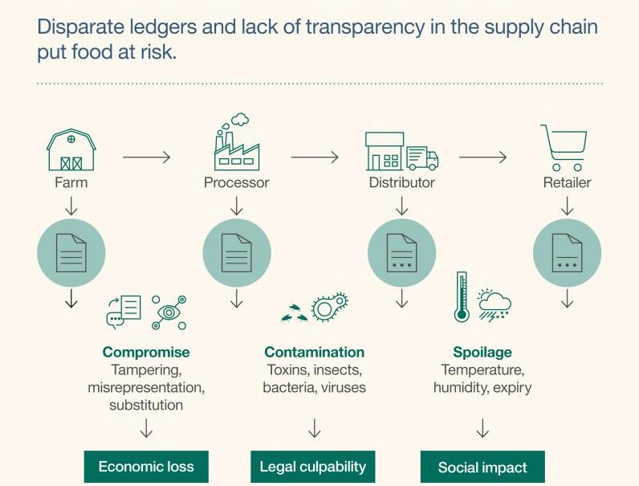
Introduction of Blockchain
IBM Blockchain to improve food safety
IBM and Walmart introduced Blockchain system to improve food safety.
All stakeholder (from farmer to seller) upload food information (e.g. temperature, humidity, storage duration) to Blockchain
Consumer can know about food safety from data in blockchain.
https://www.ibm.com/blogs/ibm-anz/australian-food-safety-blockchain-unexpected-solution/

Slide 7
- oneM2M with Blockchain Use Case 1 -
Allow users to select data to be managed by Blockchain
User can pick data to store in blockchain
  When someone’s private data is uploaded to IoT Service Platform,
  The data owner can set to store the data in Blockchain.

Slide 8
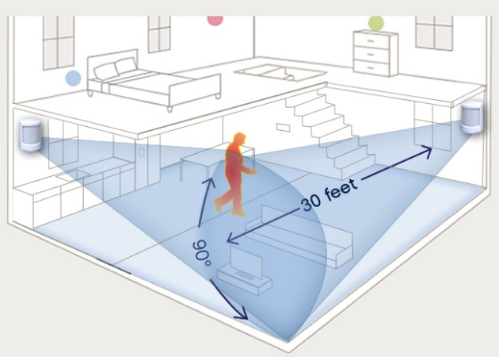
- oneM2M with Blockchain Use Case 1 -
Allow users to select data to be managed by Blockchain
Private Blockchain
Network
BC
Relational Database
CCTV data
Blockchain
R
BC
BC
oneM2M Service Platform
CCTV data
CCTV data
BC
CCTV data
Blockchain
Peer
CCTV
Sensors upload private data
to an IoT server constantly.
Select data to be stored at BC

Slide 9
- oneM2M with Blockchain Use Case 1 -
Allow users to select data to be managed by Blockchain
Private Blockchain
Network
BC
Relational Database
CCTV data
Blockchain
R
BC
BC
IN-CSE
oneM2M Service Platform
CCTV data
CCTV data
BC
CCTV data
Blockchain
Peer
mca
mca
ADN-AE
IN-AE
Sensors upload private data
to an IoT server constantly.
Select data to be stored at BC

Slide 10
oneM2M with Blockchain Use Case 2
Blockchain for global IoT services
Global IoT services using Blockchain
  Multiple IoT service providers can establish a global blockchain network to support global IoT service
  Selected data are shared among service providers involved in the blockchain network

Slide 11
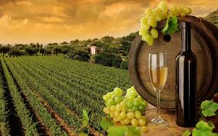
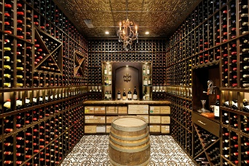

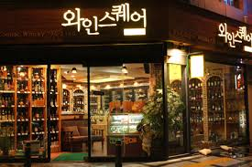
oneM2M with Blockchain Use Case 2
Blockchain for global service continuity – Scenario 1
Public Blockchain
Network
Secure
data
Private Blockchain
Network
Private Blockchain
Network
Secure
data
A user’s
Secure
data
A user’s
Secure
data
Secure
data
Secure
data
Winery data
Wine flight
Wine shop in Korea
Wine cellar
Blockchain

Slide 12
oneM2M with Blockchain Use Case 2
Blockchain for global service continuity
Public Blockchain
Network
Secure
data
Private Blockchain
Network
Private Blockchain
Network
Secure
data
IN-CSE
(EU side)
IN-CSE
(KR side)
A user’s
Secure
data
A user’s
Secure
data
Secure
data
Secure
data
ADN-AE
ADN-AE
ADN-AE
ADN-AE
Winery data
Wine flight
Wine shop in Korea
Wine cellar
Blockchain

Slide 13
Potential Impacts to oneM2M
Potential Impacts:
  New attributes to store data in blockchain?
  New primitives?
  New features on Mcc’ utilize a global open blockchain network?
How to proceed:
  A new WID?
  New enhancements?

