Slide 1

oneM2M WG4 –SEC (Security)
Introduction for ITU-T joint meeting
François Ennesser
oneM2M Security Working Group chair
francois.ennesser@gemalto.com

Slide 2
oneM2M security assumptions
IoT application development requires field experience!
  Not just Information & Communication Technology (ICT) expertise
IoT Platform development integrates ICT expertise
  Should expose underlying services to application
IoT security countermeasures shall be derived by each stakeholder
  From application specific risk assessment
  Considering Privacy and Safety expectations in particular
Multiple stakeholders may not trust each others
  Each stakeholder needs to control its own isolated « secure environment »
    Protect local sensitive information during storage and exchanges
    And in use (during program execution and data manipulation)
    Desired protection level determines security implementation (Hardware + Software)
Leveraging on shared infrastructures and implementations
  Solutions need to accommodate reliance on Trusted Third Parties

Slide 3
Security in oneM2M Release 2A
  Expose security services to IoT applications
Device Configuration
TS-0022
Security
Solutions
TS-0003
MEF & MAF interfaces
TS-0032
Enrolment services (RSPF / MEF)
Credentials Provisioning/Security Configuration of the M2M System
Secure communications services (SAEF / MAF)
Methods for Securing Information (PSK/PKI/Trusted Party)
Point-to-point and end-to-end solutions (TLS / DTLS)
Access Control & Authorization services
Requester Authentication
Information access Authorization
Static (ACL based) and Dynamic (token based) solutions
Privacy Policy Management

Slide 4
oneM2M Secure Environment and security levels
« Secure Environment » concept abstracts the security implementation
  Expose common services to applications, depending on implementation
  Provide common interface for remote security administration, if needed
oneM2M supported implementations distinguish 4 security levels
  No security (!)
    E.g. for devices otherwise protected from attackers, i.e. on trusted networks
  Software only security (obfuscation, White box crypto etc.)
    Always vulnerable to sufficiently motivated attacker
    Acceptable when compromise is not critical
  « Trusted Execution Environment » (TEE) relying on main CPU hardware features
    Good barrier against software based attacks
    Sufficient for remotely accessible, but not physically exposed devices
  Tamper resistant hardware Secure Element ((e)SE, (e)UICC)
    Required to protect secrets within devices physically exposed to attackers (SPA / DPA etc.)
    E.g. to protect unattended devices against cloning

Slide 5
Enrolment for M2M Services:
Remote Security Provisioning Frameworks (RSPF)
M2M Enrolment Function (MEF) allows 3 types of Remote Security Provisioning Frameworks (RSPF)
  Symmetric key authenticated RSPF
  Certificate authenticated RSPF
  GBA-authenticated RSPF (cf. Bootstrapping Server Function of 3GPP GBA)
MEF can trigger provisioning and configuration of Field Devices security parameters
MEF
RSPF
MAF-based SAEF
SAEF
MAF
SA
Node 1
Node 2

Slide 6



Onboarding oneM2M field devices
Onboarding brings M2M Field Devices into operation for IoT services
Handles a large variety of field devices types and Service Provider‘s business models
„M2M Enrolment Function“ (MEF) enables stakeholders to setup their preferred onboarding and enrolment mechanisms in an interoperable way
Field Device, provisioned with initial credentials, contacts MEF.
MEF configures Field Device with parameters and credentials of a Service Provider (IN-CSE)
Field device sends registration request to IN-CSE
IN-CSE authenticates the Field Device
MEF
1)
2)
4)
Field
Device
3)
IN-CSE
optional,
not in scope of
oneM2M specifications
Onboarding Device
(e.g. smartphone)
Web Portal

Slide 7
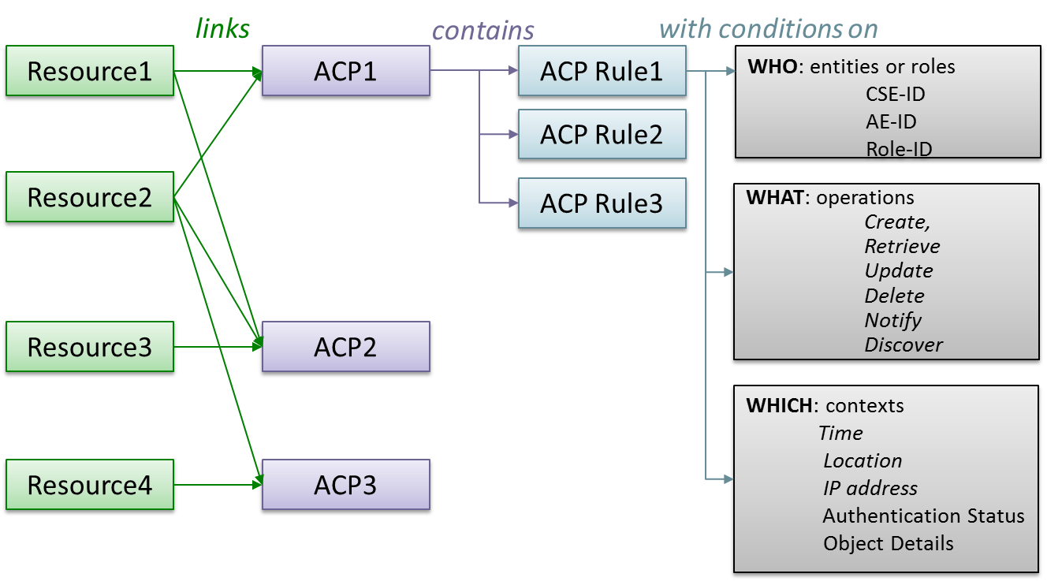
Authorization using Access Control Lists
Access control rules define who can do what under which circumstances

Slide 8
SEC Working Group ongoing Work Items
Work in progress for Release 3 and 4 – Contributions welcome!
TS-0016 « Secure environment abstraction » specification (Rel-3)
  Provide unified security services API to device applications
  Relying on implementation bindings provided by other bodies
TR-0041 Distributed Authentication
  Proposes to add IBC-based framework to TS-0003 (Rel-4)
TR-0048 App-ID registry enhancements
  Facilitates application management by the stakeholders
TR-0050 Attributes-based access control policy
TR-0038 Security Developers guide
TR-0040 Trust Management in oneM2M
GlobalPlatform Interworking specification
  Integrate Secure Environment administration within IoT device management

Slide 9
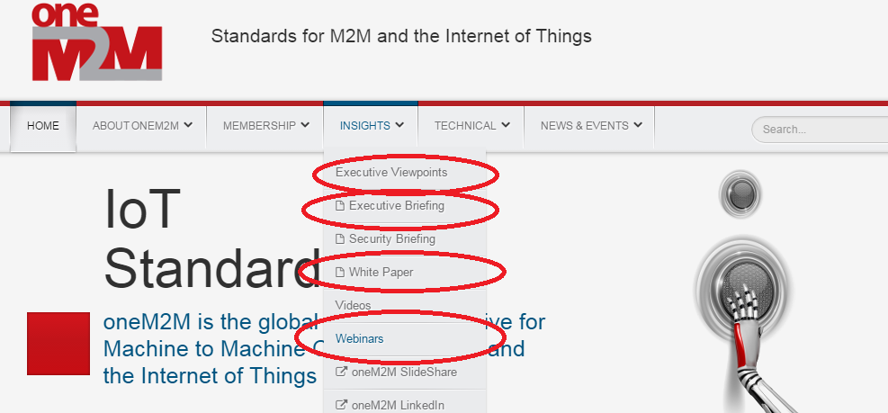
Time for questions
For further reading: www.oneM2M.org

