Slide 1
oneM2M Certification Updates
Keebum Kim, keebum.kim@tta.or.kr, TTA
TP #34, TP-2018-0091R01-oneM2M_Certification_Updates

Slide 2
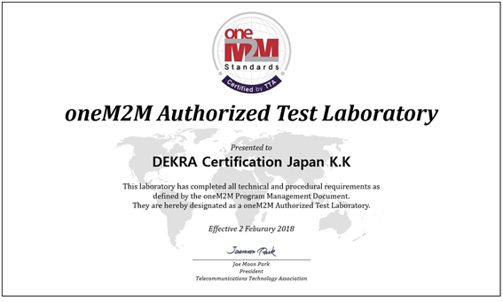
New Authorized Test Lab
DEKRA Certification Japan K.K, a global testing and certification organization, designated as the world’s second oneM2M Authorized Test Laboratory (ATL). (‘18.2.2)

Slide 3
Extension of oneM2M Certification program (1)
TTA oneM2M Certification program has been extended to include the scope of oneM2M Rel-1 conformance testing. (‘18.2.23)
Based on approved TS documents for conformance testing, certification program version has been updated. (TRSL v1.0 -> TRSL v1.1)
For the first step, validation of test cases and test system has been finished targeting IN profile.
Other profiles (ADN, MN) are expected to be finishing the validation and applying to the certification program until April.

Slide 4
Extension of oneM2M Certification program (2)
Based on oneM2M ATS (Commit ID : 6bf63abb81ad8e9fbb04cc177a4b9f98689d3425), there are 258 test cases for IN profile.
  These available test cases are presented on TRSL v1.1 document.
All these test cases has been validated using Chordant platform (InterDigital) as an golden sample and TTsuite-oneM2M (Spirent) as a test system.
※ Demonstration will be performed during the lunch break, 13:00 ~ 13:30 Thursday at the room Salons.

Slide 5
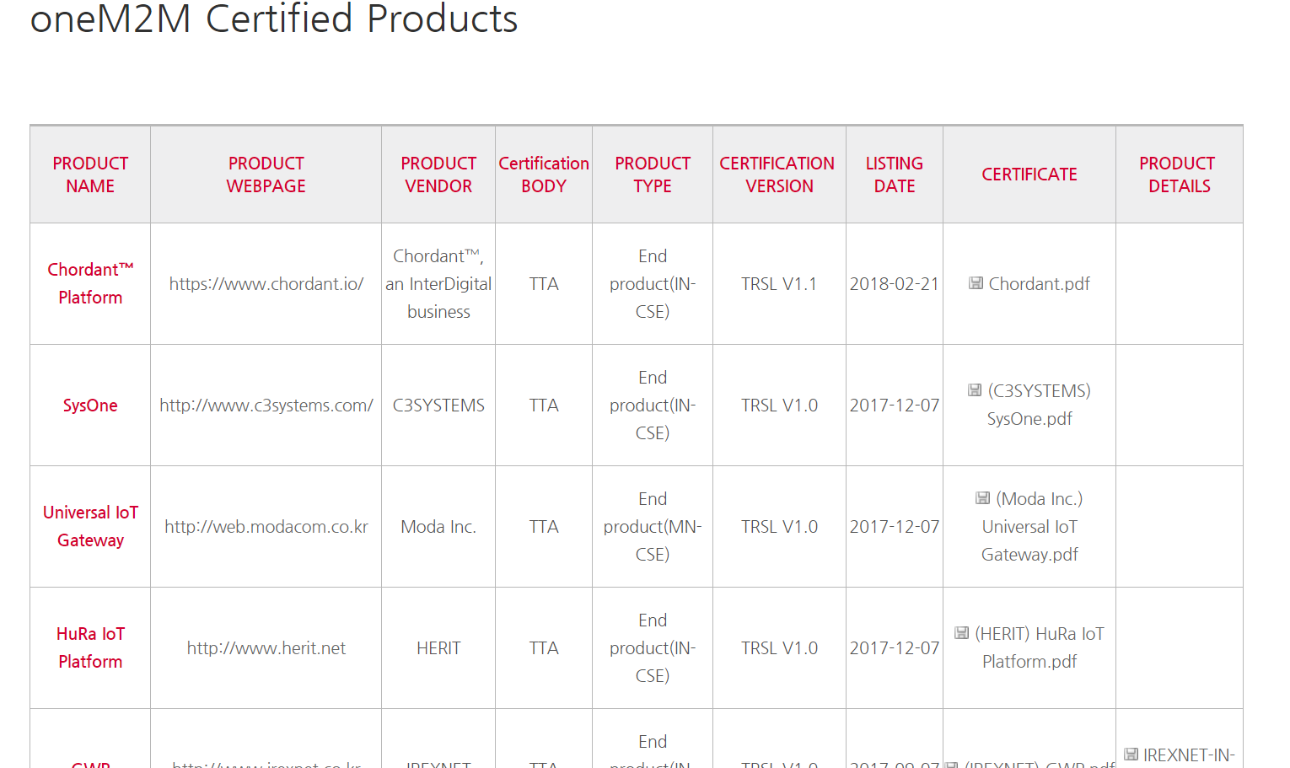
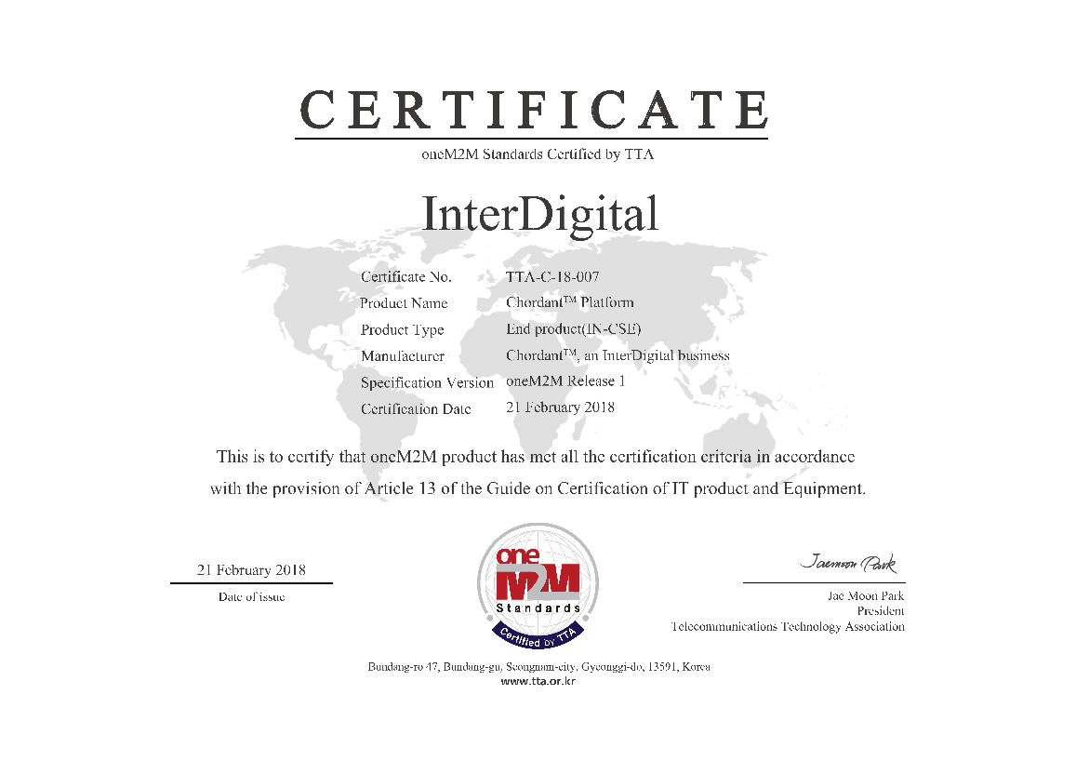
Status of certified products
Currently 15 products from 12 companies has been certified.
Chordant Platform, InterDigital, has been certified as the first product performing the conformance testing. (‘18.2.21)

Slide 6
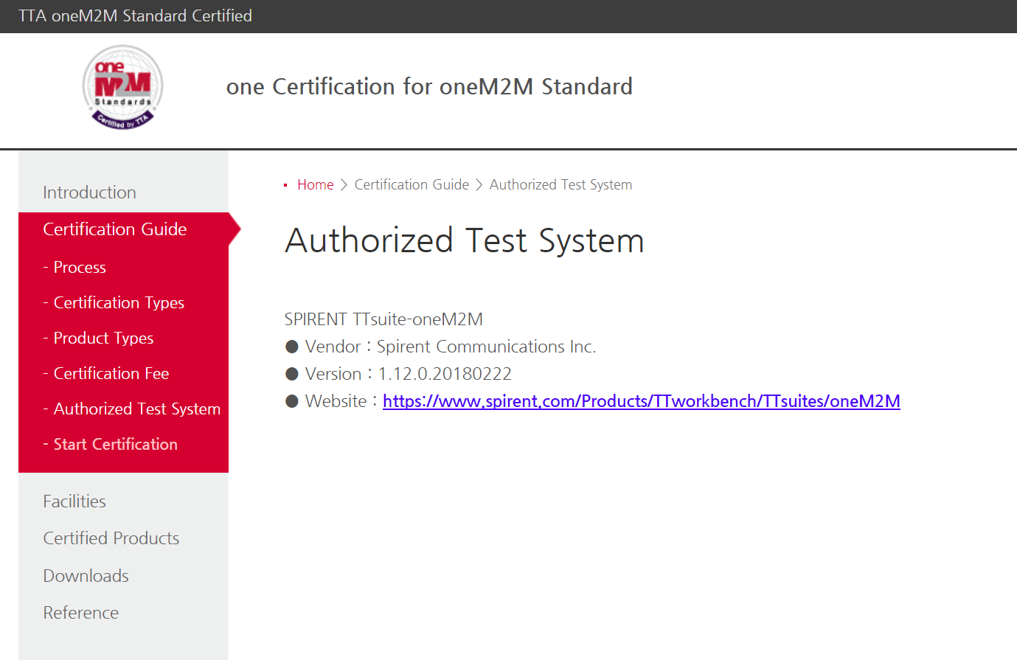
New Authorized Test System
Spirent, TTsuite-oneM2M is designated as the first Authorized Test System for oneM2M conformance testing.

Slide 7
Thank you!

