Slide 1
Report on oneM2M Hackathon Mar 9 - 10, in Dallas, TX
onem2m.org

Slide 2
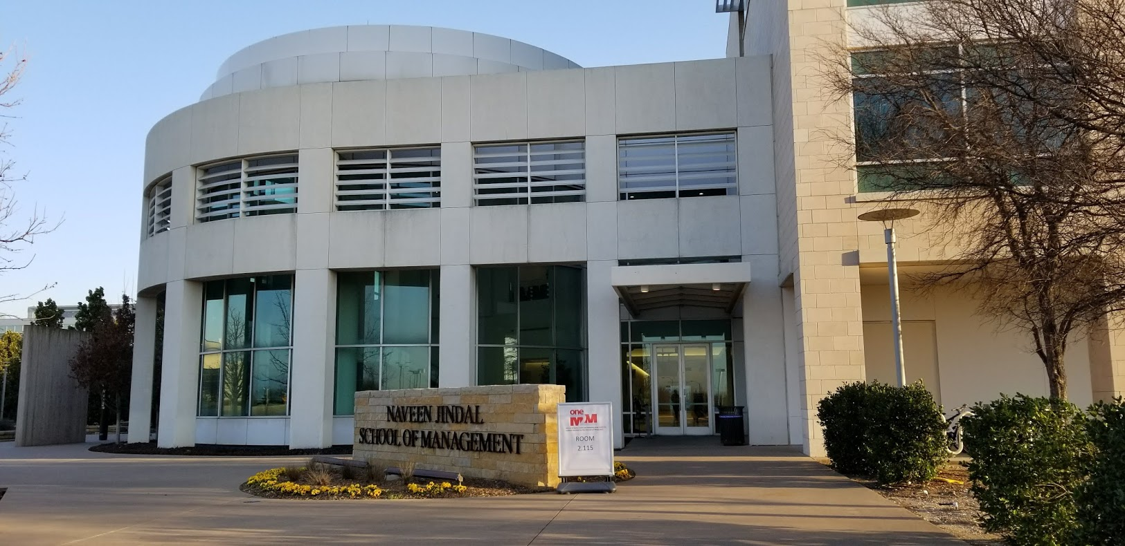
Event details
Dates: 9-10 March 2018
Location: University of Texas at Dallas (UTD)
Participation: 55 persons

Slide 3












The Organizations

Slide 4
Agenda
Day #1 (Friday, March 9th, 08:00 am - 07:00 pm )
Morning
  Tutorial on oneM2M: oneM2M Common Architecture for IoT
  Examples of projects using HW provided
Afternoon
  Hackathon rules and challenge overview
  Hands on exercise : Lighting control based on luminosity level using oneM2M platform.
  Form teams
  The teams develop their projects until Saturday 15:00.
Day #2 (Saturday, March 10th, 08:00 am - 06:00 pm)
Morning
  The teams develop and finalize their projects.
  Afternoon
  Presentation of each project
  Projects are reviewed by the judges
  Awards and certificates

Slide 5
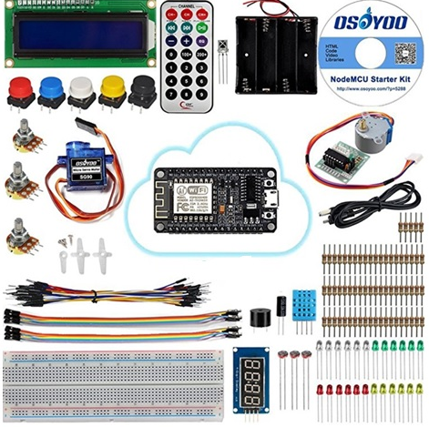
The device kit

Slide 6
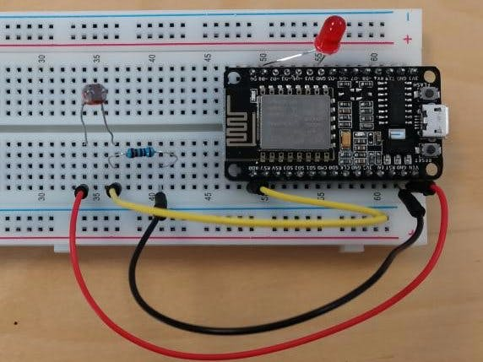
The Tutorial use case
Lighting control based on luminosity level
using oneM2M platform.
oneM2M demonstration using ESP8266
NodeMCU board and NodeJS application
https://www.hackster.io/onem2m/onem2m-demo-57022e

Slide 7
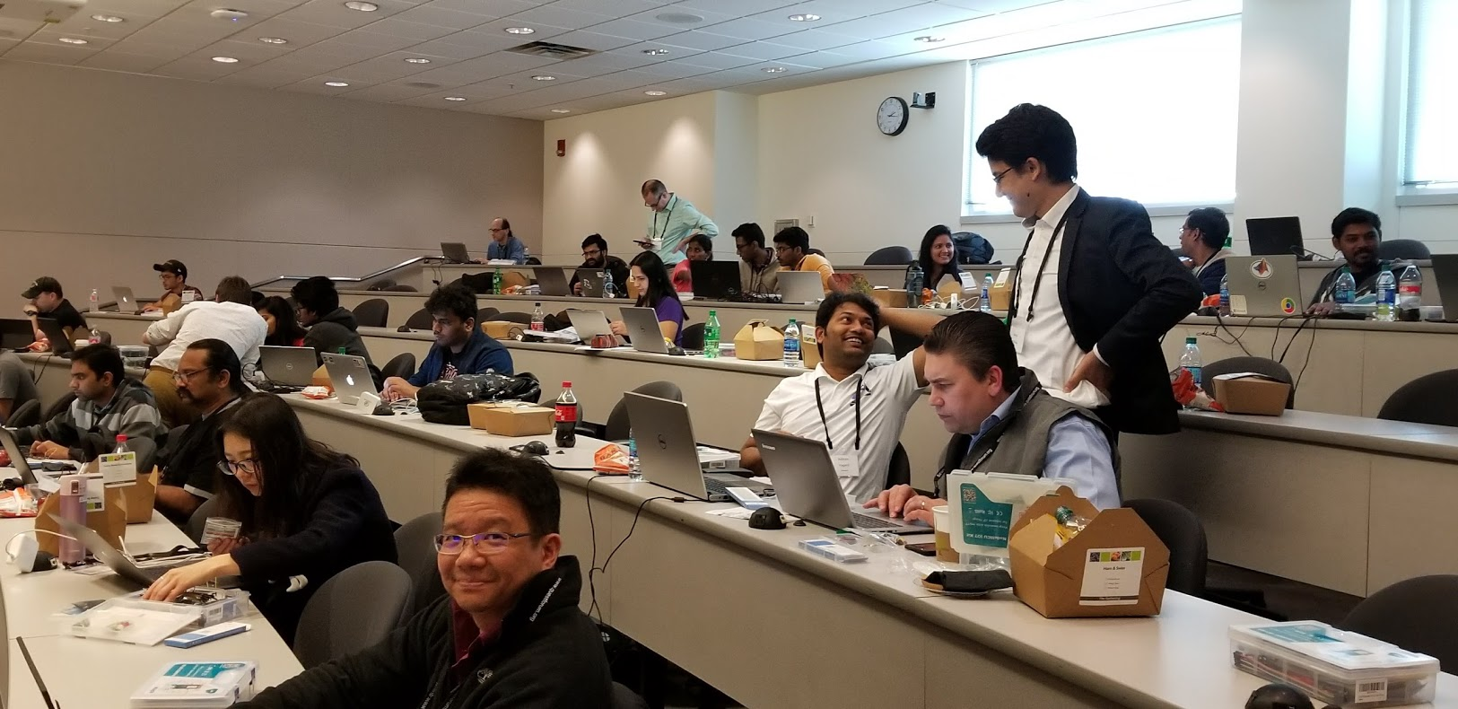
Hands on exercice

Slide 8
Award Rules
ALL PRIZES WILL BE GIVEN AS AMAZON GIFT CERTIFICATES
Total Prize Money:
Hackathon Prize from organizer budget $2500
Prizes will be awarded to the top 3 teams as follows:
1st Prize $1200
2nd Prize $800
3rd Prize $500
$50 Amazon GC - We will also send individual $50 Amazon GC to the first ten (10) individuals who post their completed project to the Hackster Web Site by March 31.
https://www.hackster.io/onem2m

Slide 9
The Teams
UTD Parking Locator - Johnathan Hottell, Scott Sawicki *
S3: Smarter Safer Schools - Praveen Javali, Nandish M, Suresh Kolguri, Ishaan *
SafeDrop - Make your package delivery Intelligent and secure -- Trusit Shah, Sabarish nadarajan, Vignesh, Shoaib Ur Rehman, Kavitha Rajendran.
Smart traffic system for safe and quick travel - Sourav Basak, Chris Martin, Adithya Yaganti, Rizwan Syed, Charu Pande: Abhilash Gudasi, Avinash Chandrashekaran *
Mask It: Intelligent Air Quality Detection - Mehak Beri, Lucia Botiquin *
The Jetsons: Park Smart -- Chandra Kiran Saladi, Shubham Kothari, Yaswanth Yadlapalli and Priyanka Joshi *
LazyMe - Resident behavior oriented smart homes - Vivek Shah, Ujjawal Mishra
Smart Chain - Karthik, Xiuli Gu *

Slide 10
Judging Criteria
Innovative scenario
Quality of the presentation
Quality of the demo
A creative oneM2M device application that supports sensors and actuators
oneM2M user application that supports
  Interaction with the sensor data from originating from the nodeMCU device and stored in the oneM2M Service Layer
  Interaction with the actuators connected to the nodeMCU device via the oneM2M Service Layer
  Analysis of the pre-installed data sets in the oneM2M Service Layer
  Graphical display of data analysis results
  The capability to trigger device actuators based on the analysis of the pre-installed data set

Slide 11
The winners
1st Prize: The Jetsons, Park Smart - optimized, distributed system for parking occupancy identification, reservation and analytics - $1200
2nd Prize: Mask It, Intelligent Air Quality Detection - machine learning approach for scoring pollution levels based on inexpensive sensors - $800
3rd Prize: Smart traffic system for safe and quick travel - collaborative traffic monitoring systems for traffic optimization - $500

Slide 12
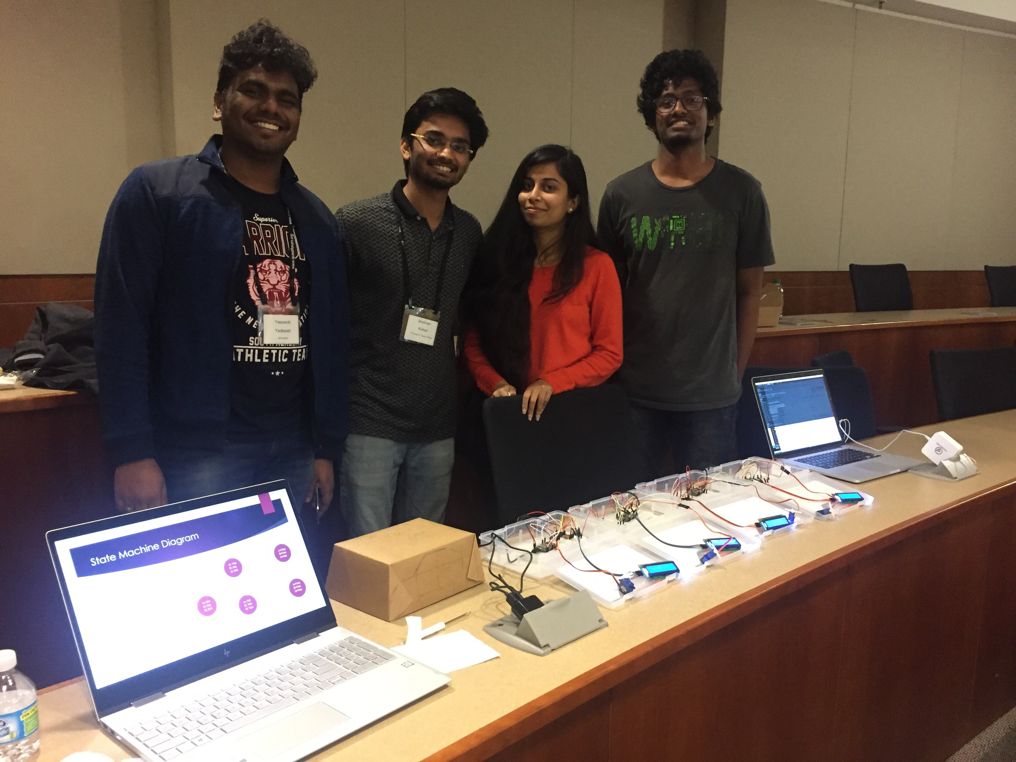
The winning team: The Jetsons
Project: “Park Smart“

Slide 13
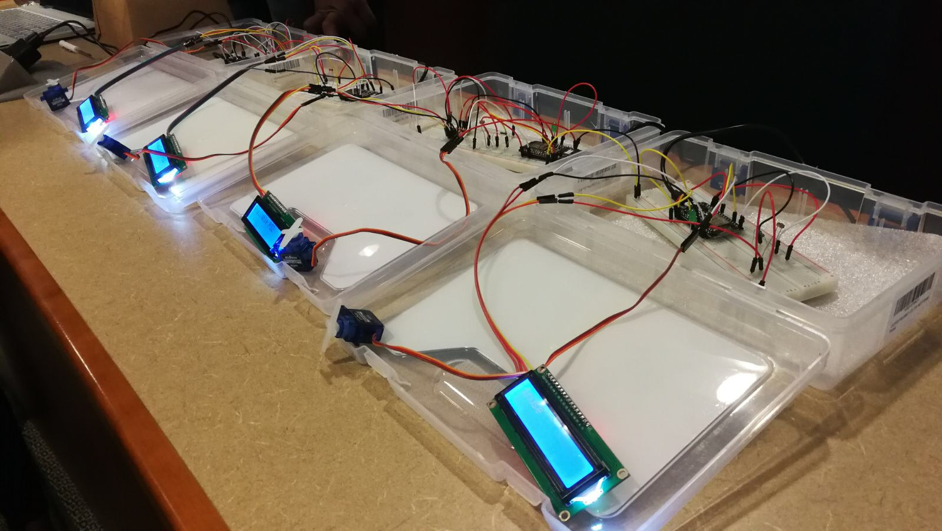
Some of the projects

Slide 14
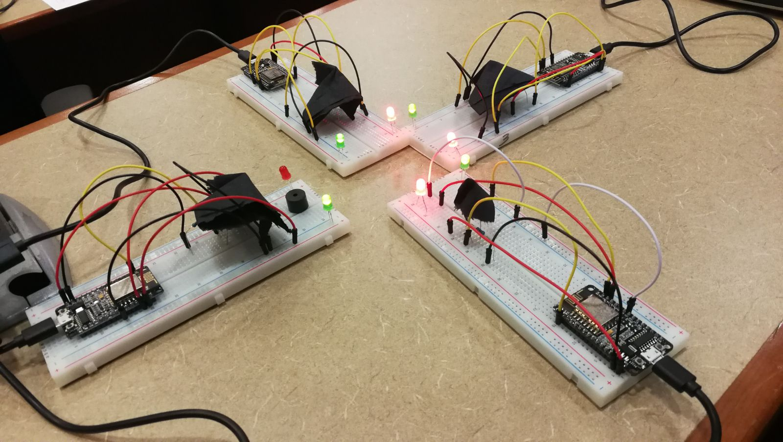
Some of the projects

Slide 15
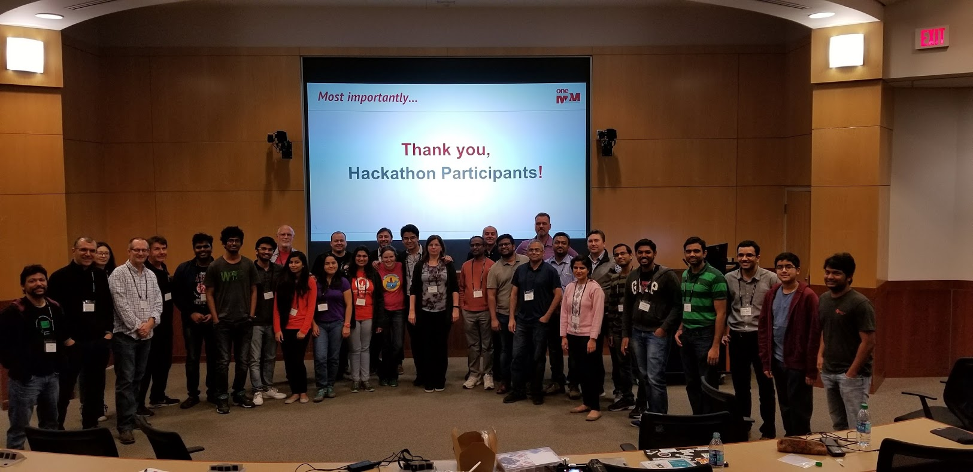
Thanks to all participants

