Slide 1
Report on oneM2M Developer Events Q1 2018
Laurent Velez, ETSI

Slide 2
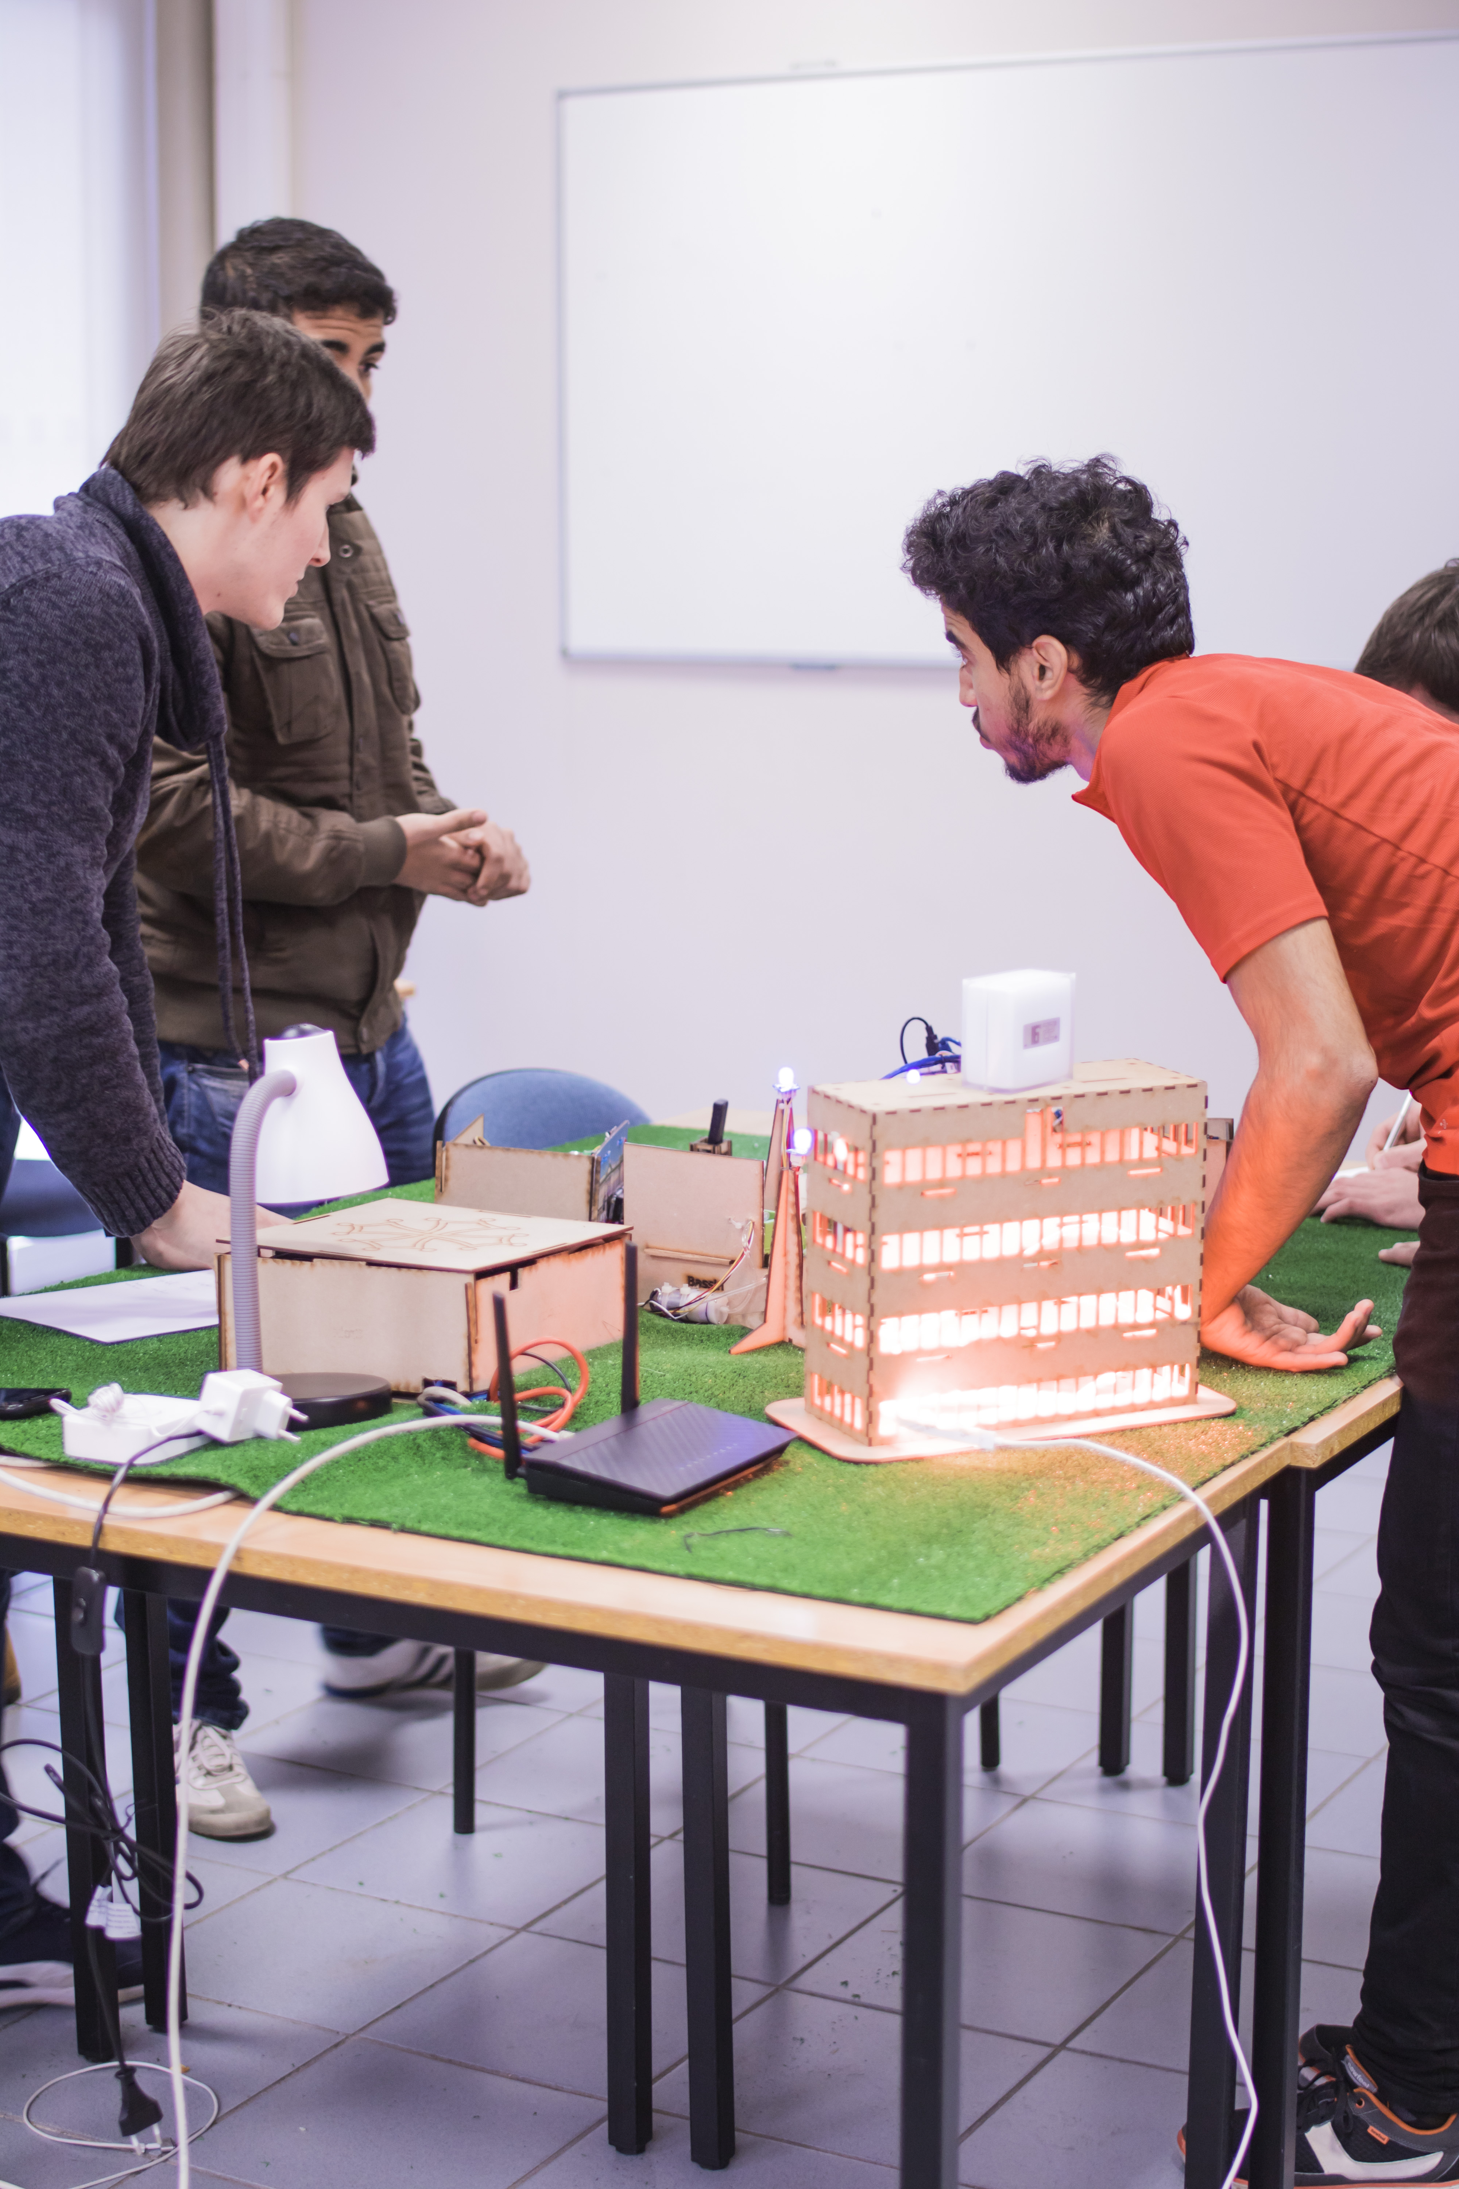
Toulouse (France)
Dates:
  24-26 January 2018
Location:
  INSA University, Toulouse
Organisation
  LAAS-CNRS and ETSI
Participation:
  Workshop IoT & Security 160 pers
  Hackathon 50 pers

Slide 3
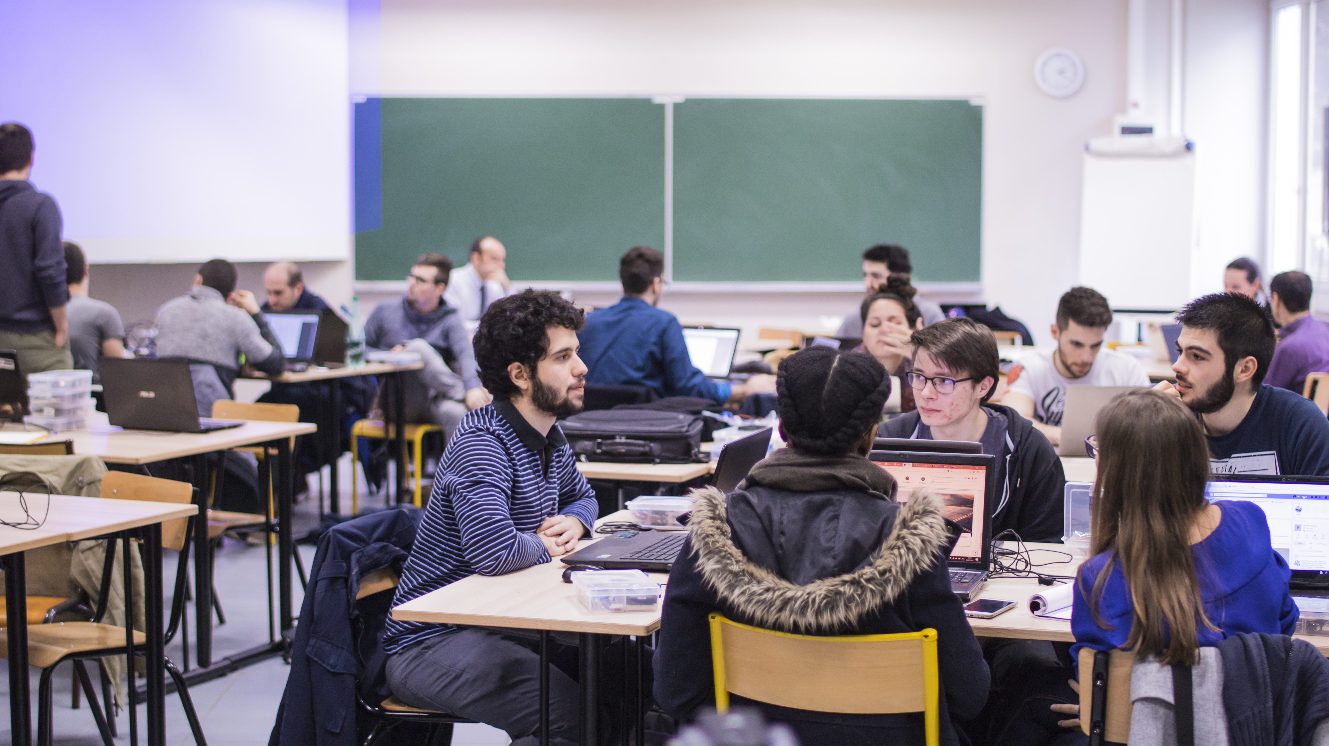

Slide 4
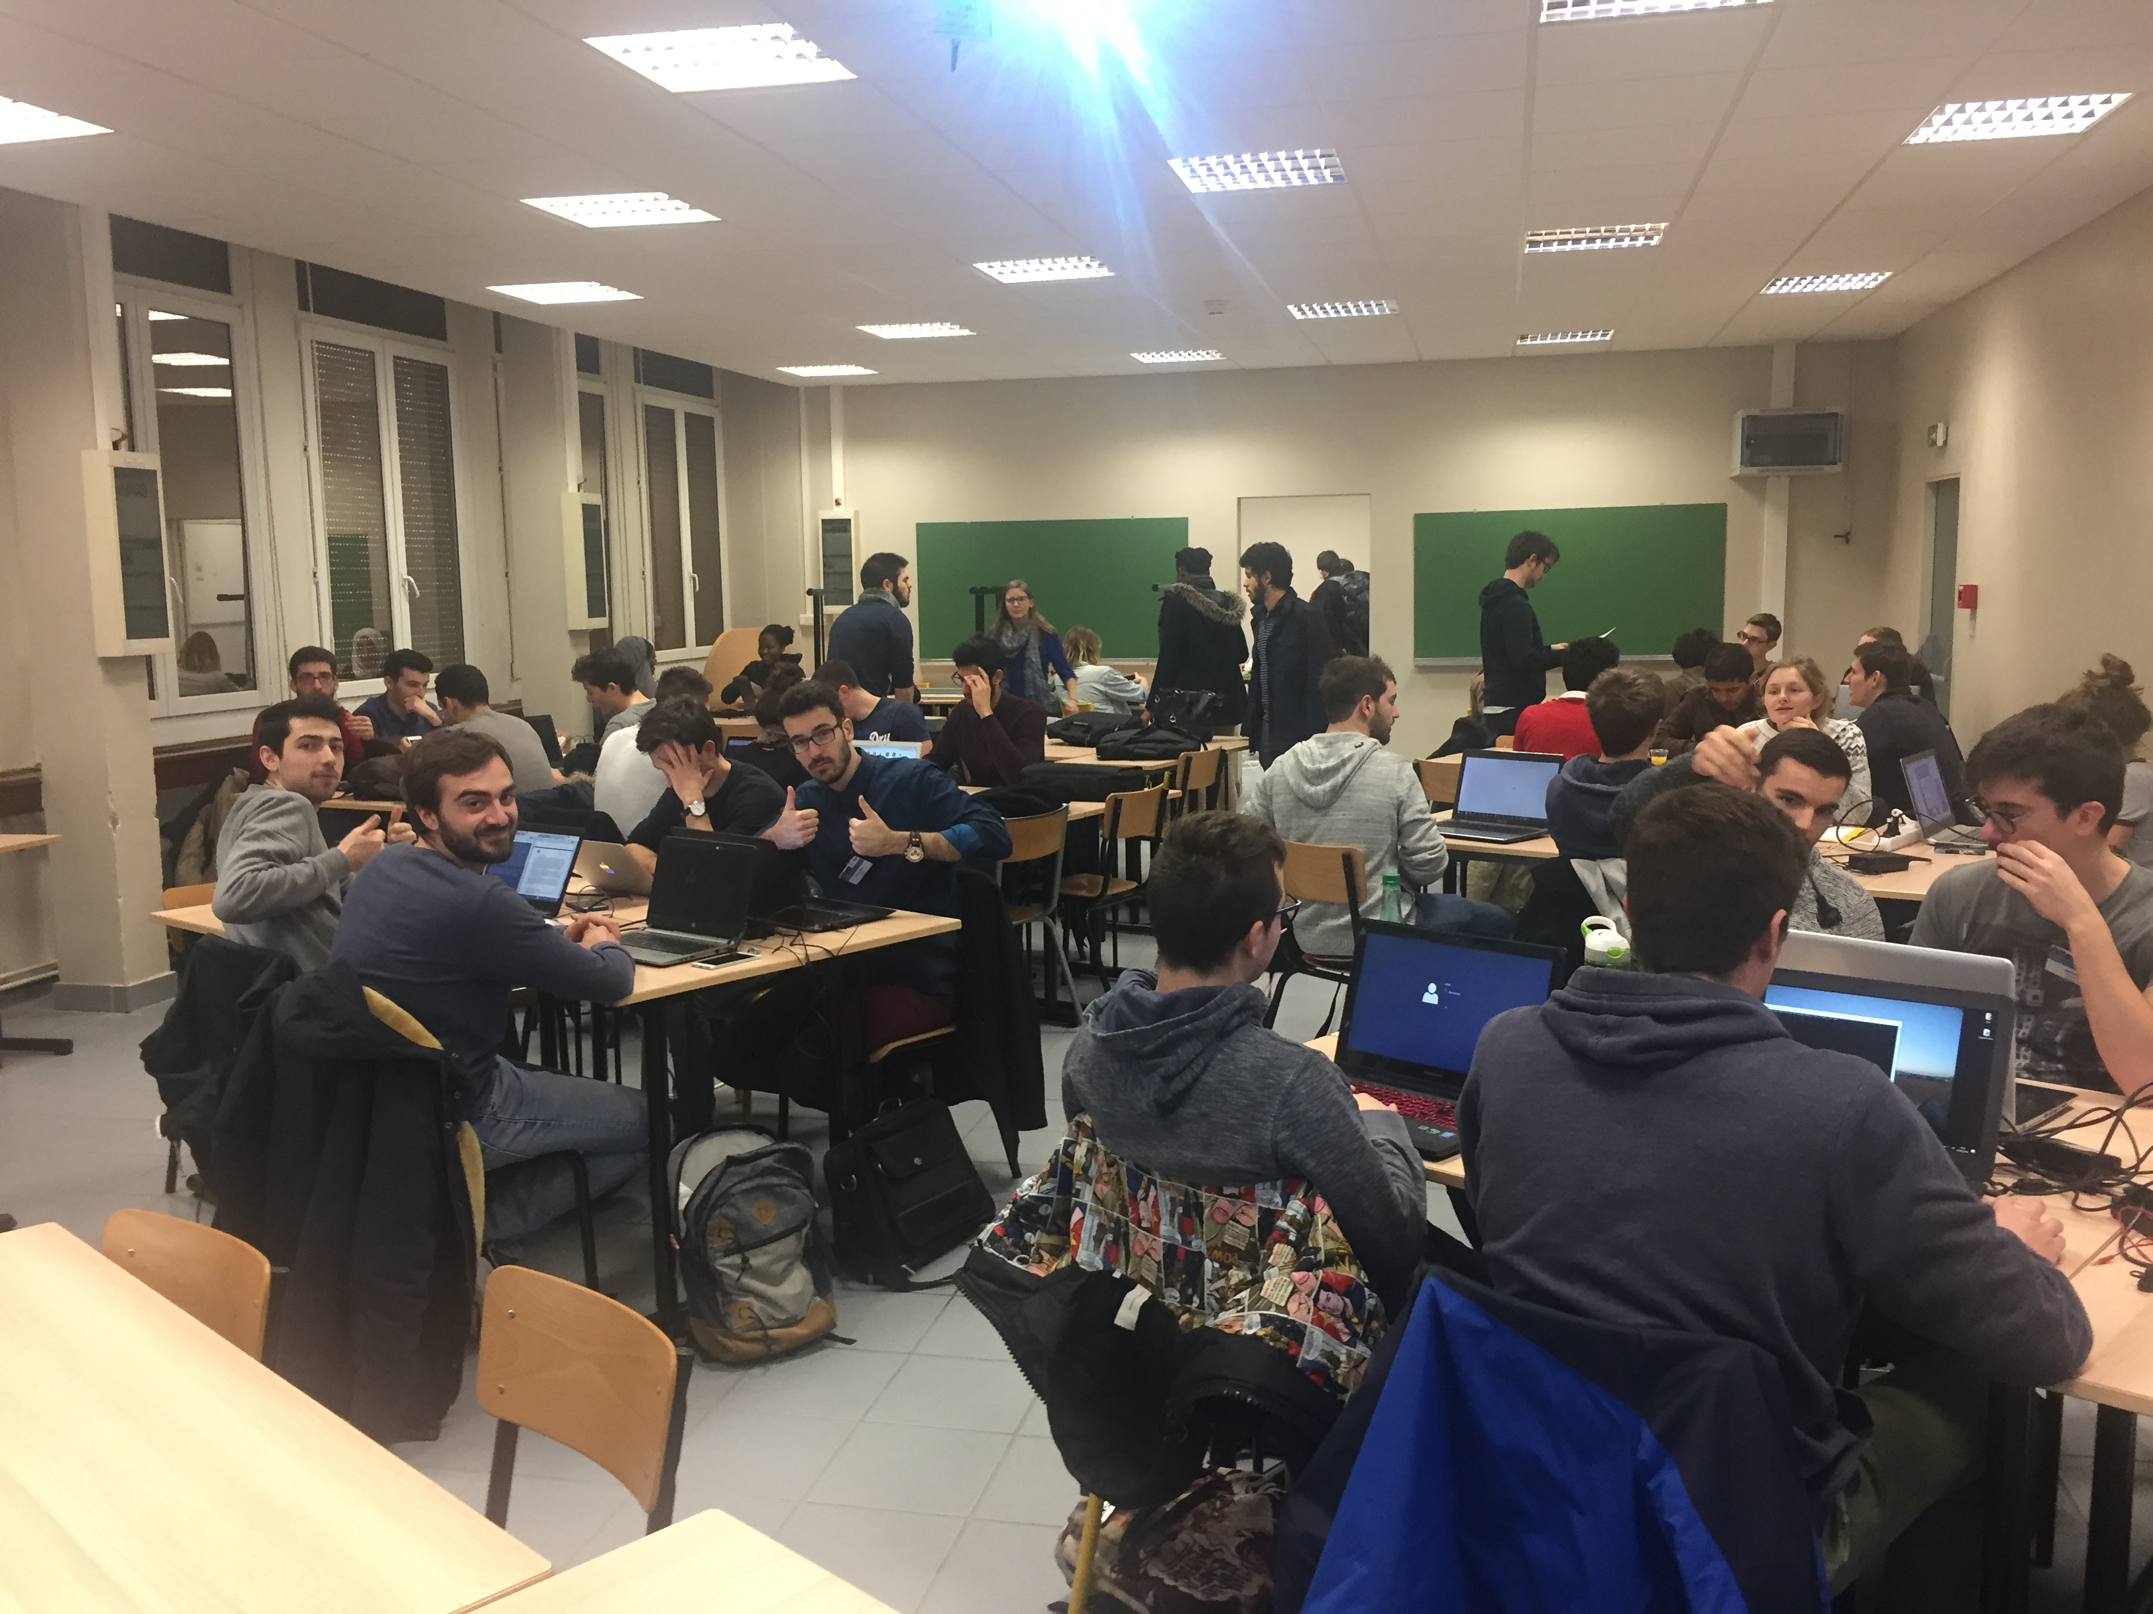

Slide 5
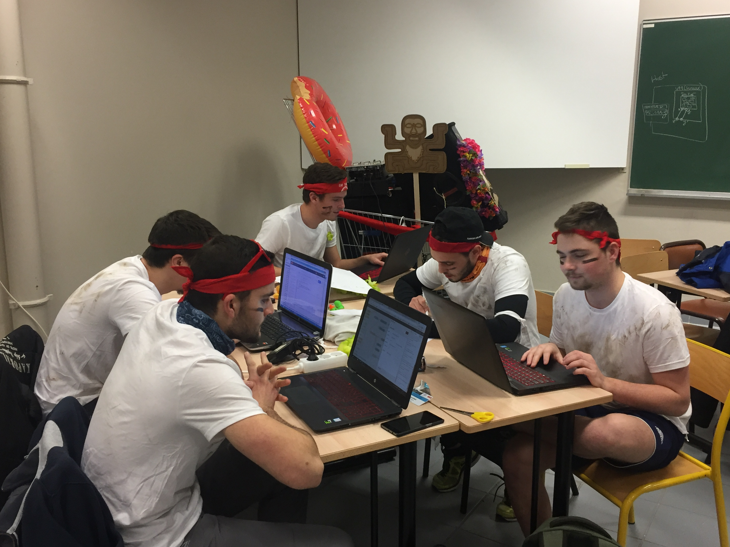

Slide 6
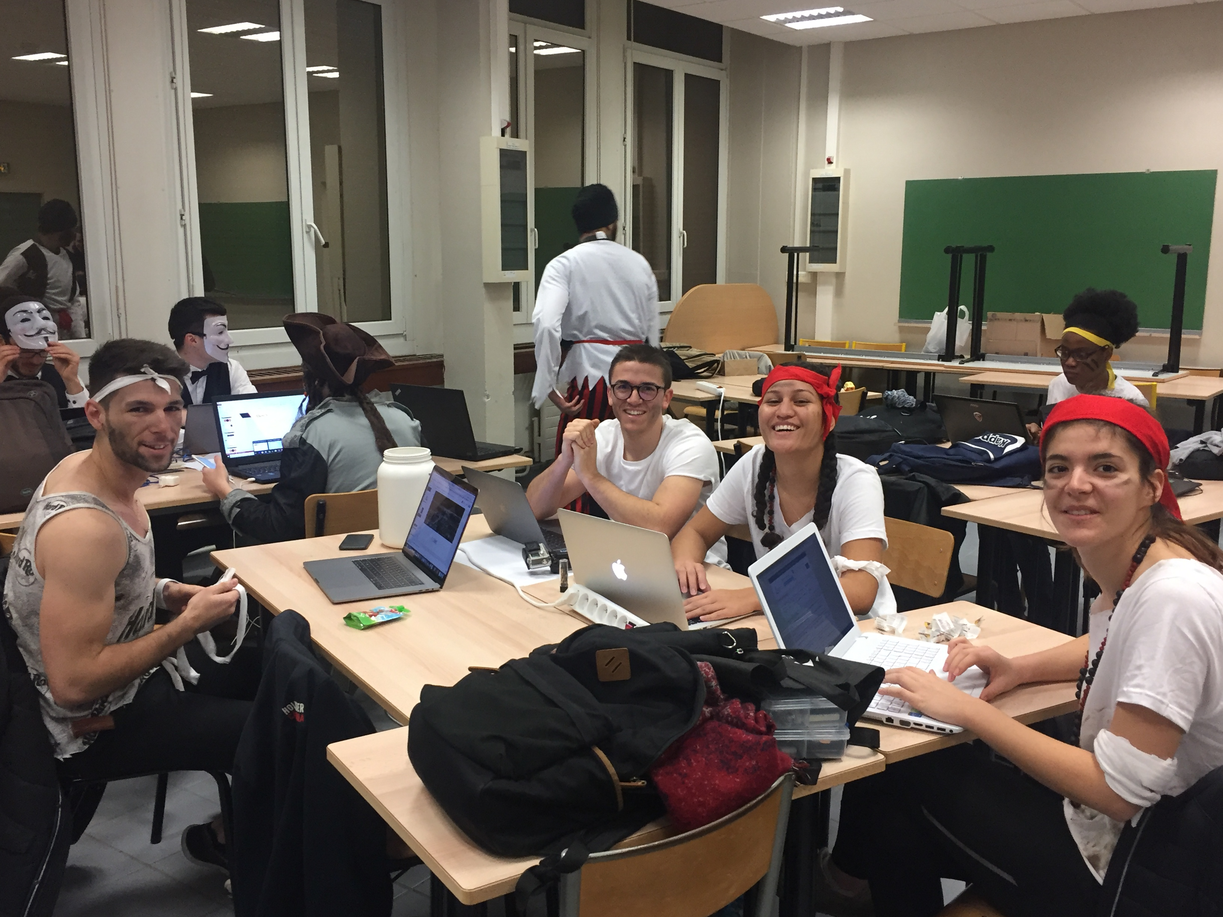

Slide 7
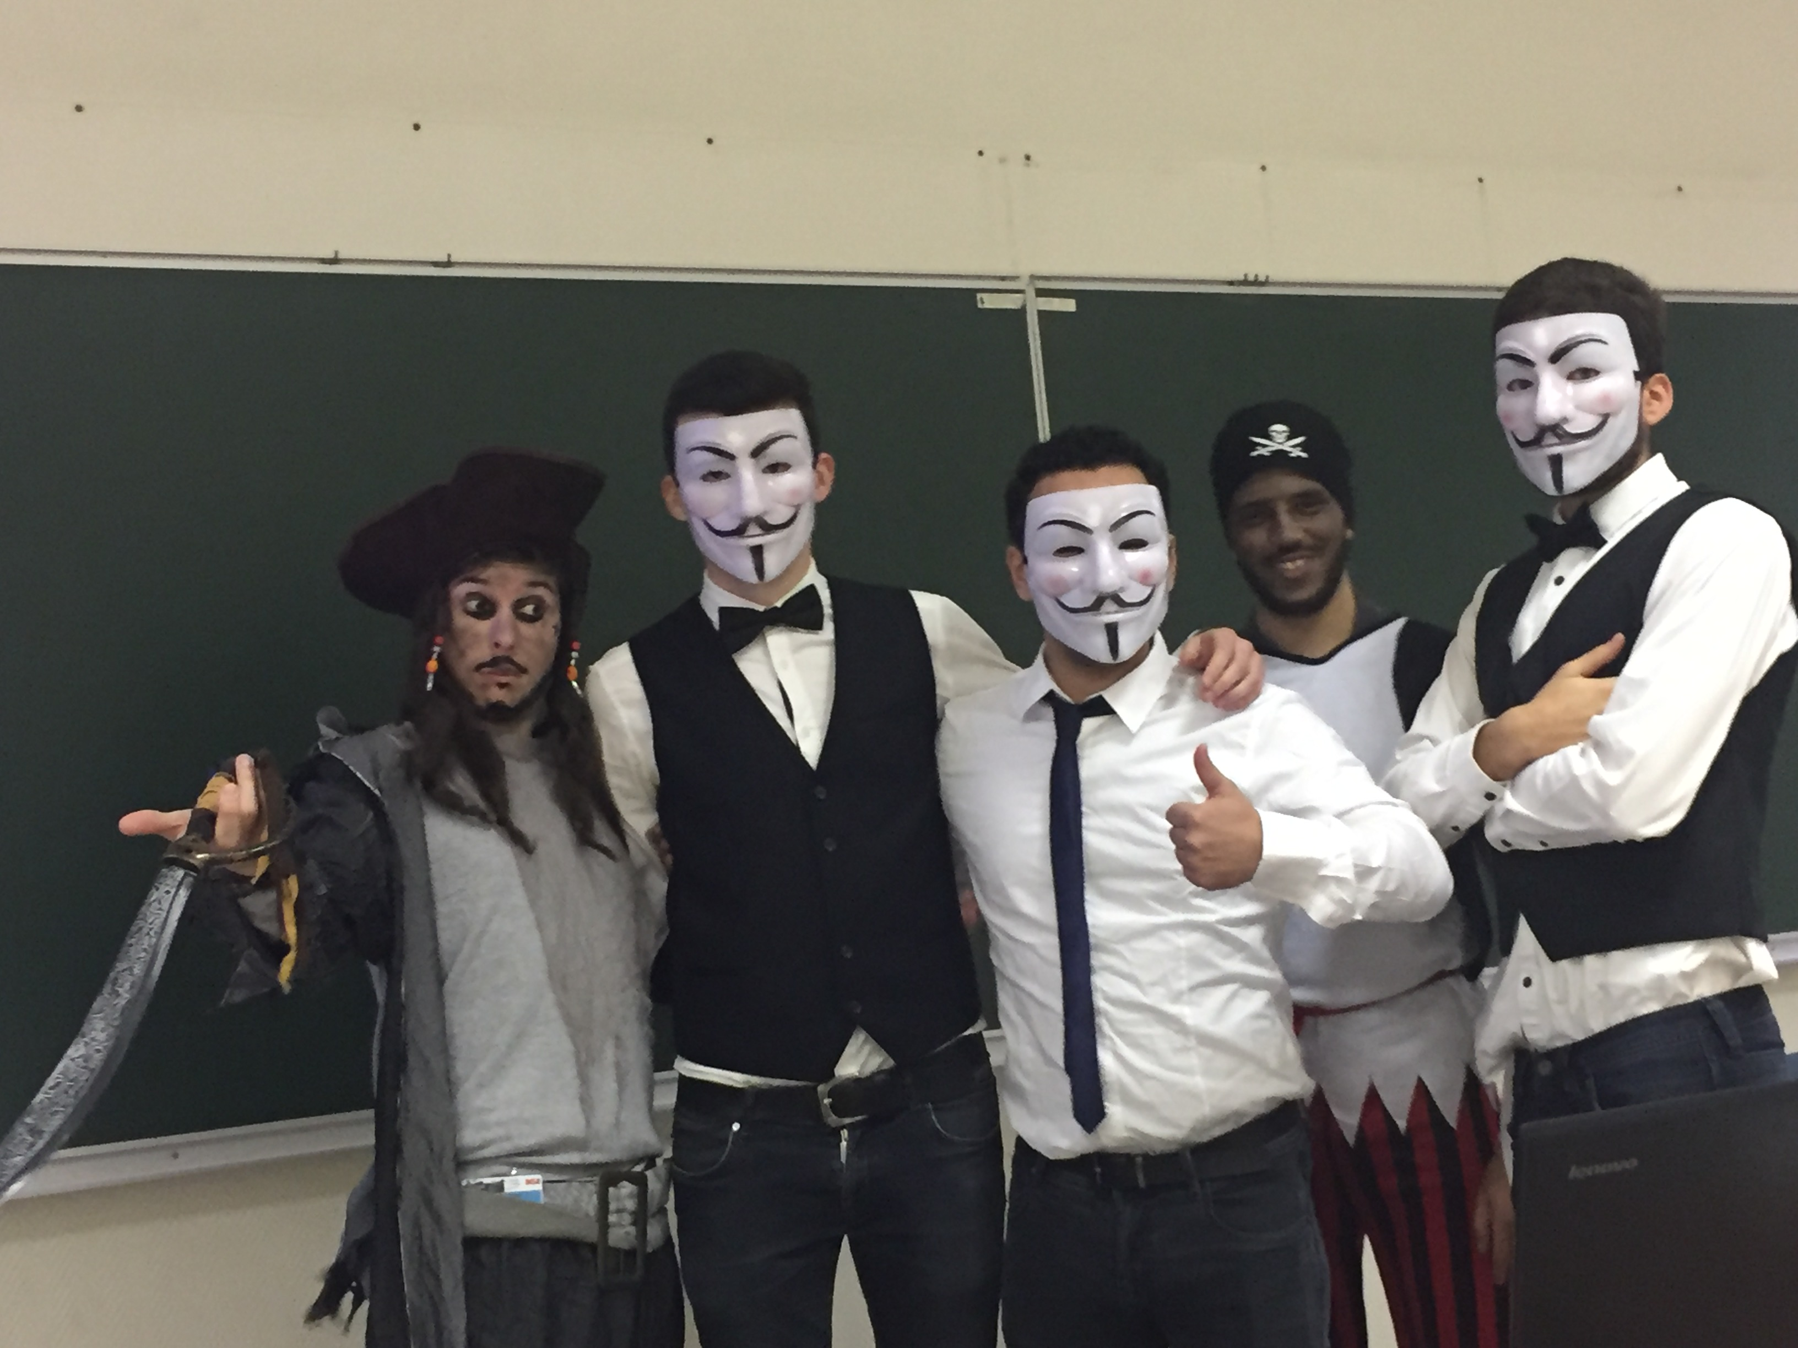

Slide 8
Video
https://youtu.be/t3-2vO7i2ek

Slide 9
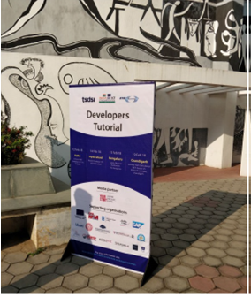
India Multi-city developer event details
Dates:
  12-19 February 2018
Location:
  Multi-city, India
Participation:
  more than 500 people in total
http://www.indiaeu-ictstandards.in/one-m2m-workshop-hackathon
The spirit of this initiative was to create
an interactive and stimulating exchange platform
for developers, allowing many opportunities for
hands on exercises.

Slide 10






The Organizations

Slide 11
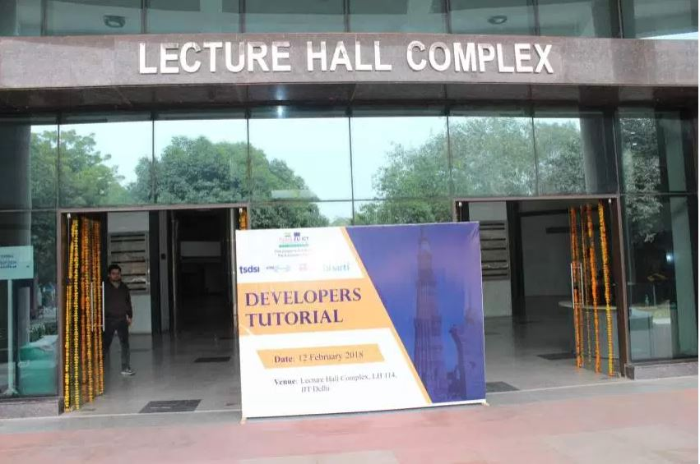
Agenda
  12 February: Tutorial in New Delhi
  14 February: Tutorial in Hyderabad
  15 February: Tutorial in Bangalore
  16 February: Hackathon in Bangalore
  19 February: Tutorial in Chandigarh

Slide 12
The Tutorials
Attended mainly by students from local universities
Topics covered included:
  Overview of oneM2M
  Introduction to Eclipse OM2M
  Comprehensive use case study followed by a demonstration
  Deep Dive into an implementation of the framework based on ADREAM smart Building of LAAS.
  A Massive Online Open Course (MOOC) material to go with the tutorial is available at:
    https://open.insa-toulouse.fr
    course title: Internet of Things with oneM2M standard

Slide 13
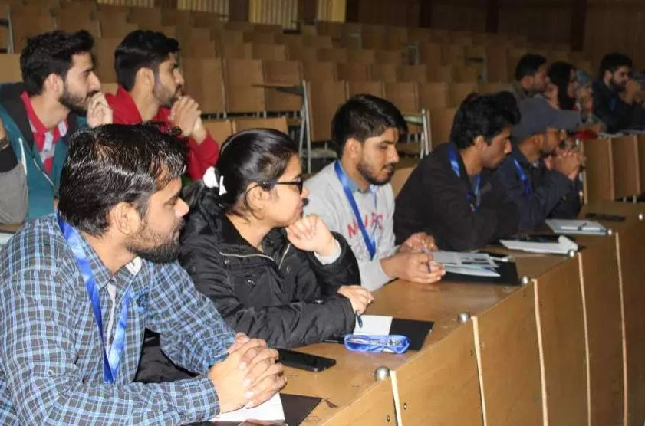
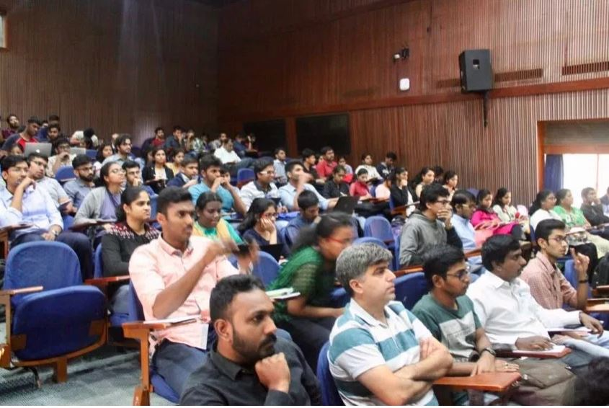
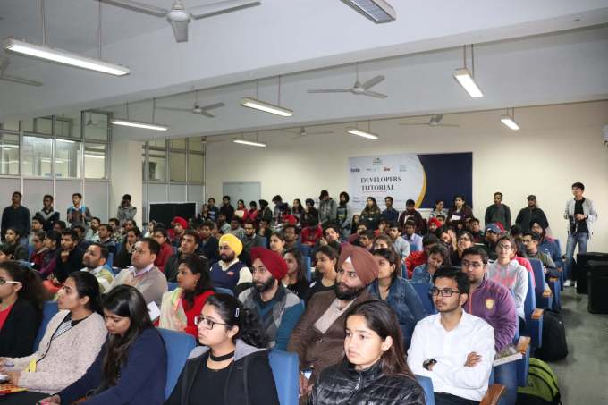
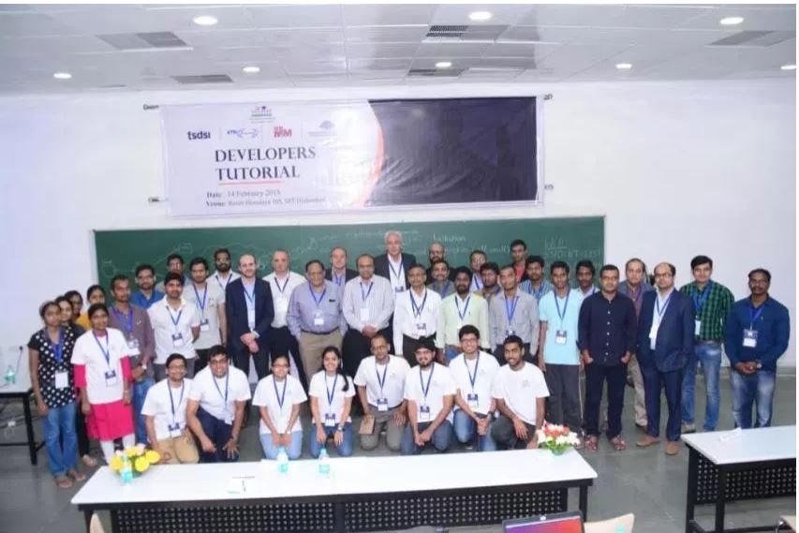
Tutorial Participants

Slide 14
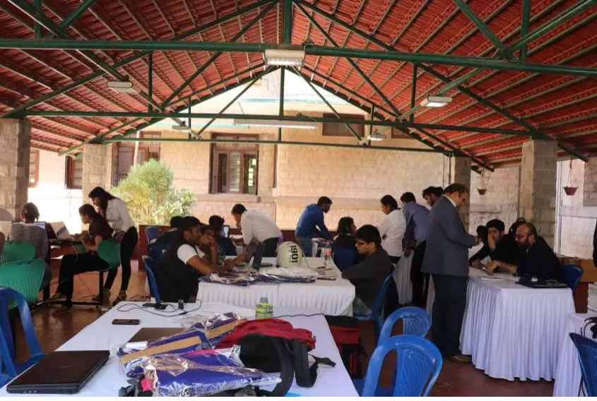
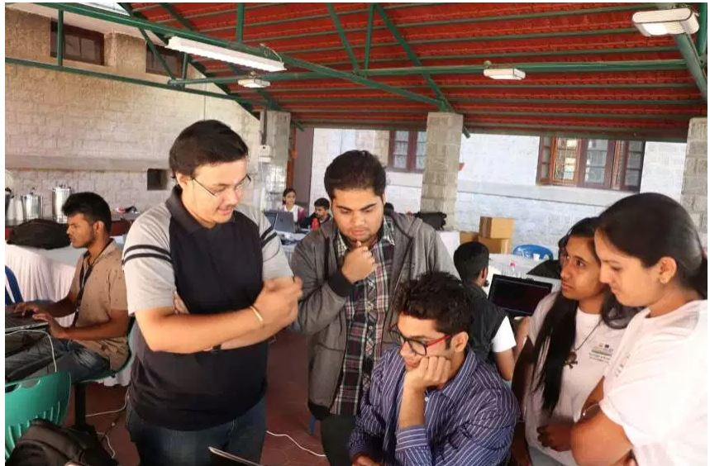
Hackathon in Bangalore
The Challenge
  to develop real applications
  in a smart city context
  based on an open source implementation of oneM2M

Slide 15
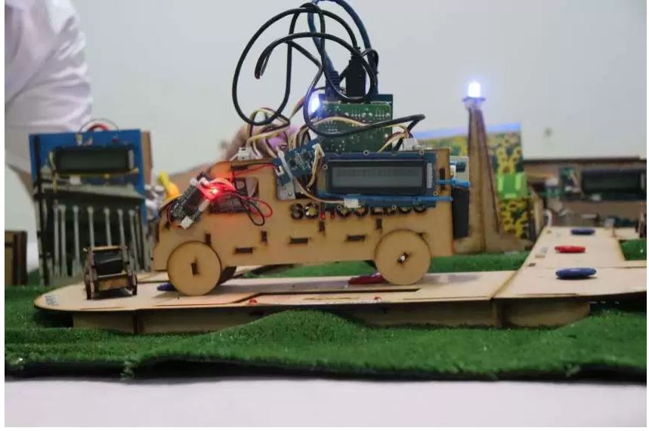
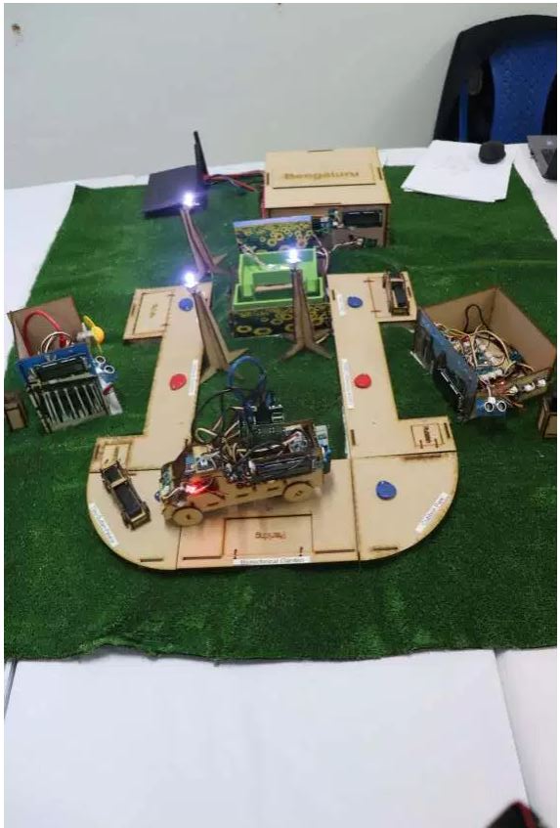
The Mockup

Slide 16
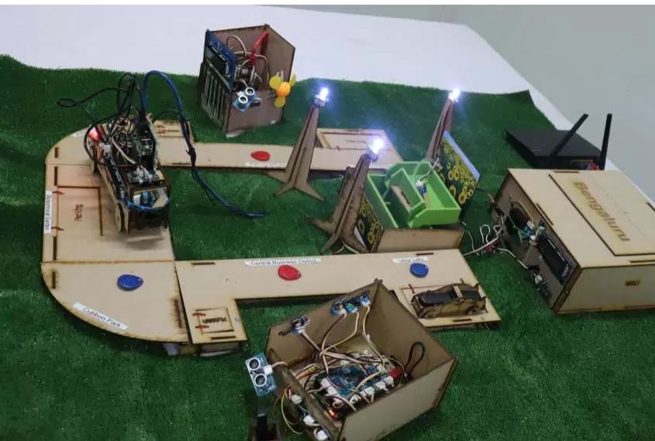
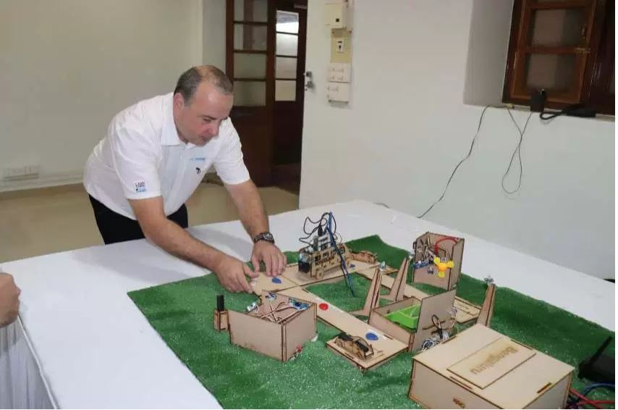
The Mockup

Slide 17
Teams & Prize
16 Teams were competing
The prize was:
  a trip to Estonia to attend the Estonian flagship startup & technology event Latitude59
In addition
  2nd Prize: selected participating teams were given direct access to the final jury for the SAP Startup Studio cohort of 2018-19, and an opportunity to receive several months of mentoring.
  3rd Prize: Selected participating team were given the possibility to make a 6 month paid internship in INSA university of Toulouse (France)
  .

Slide 18
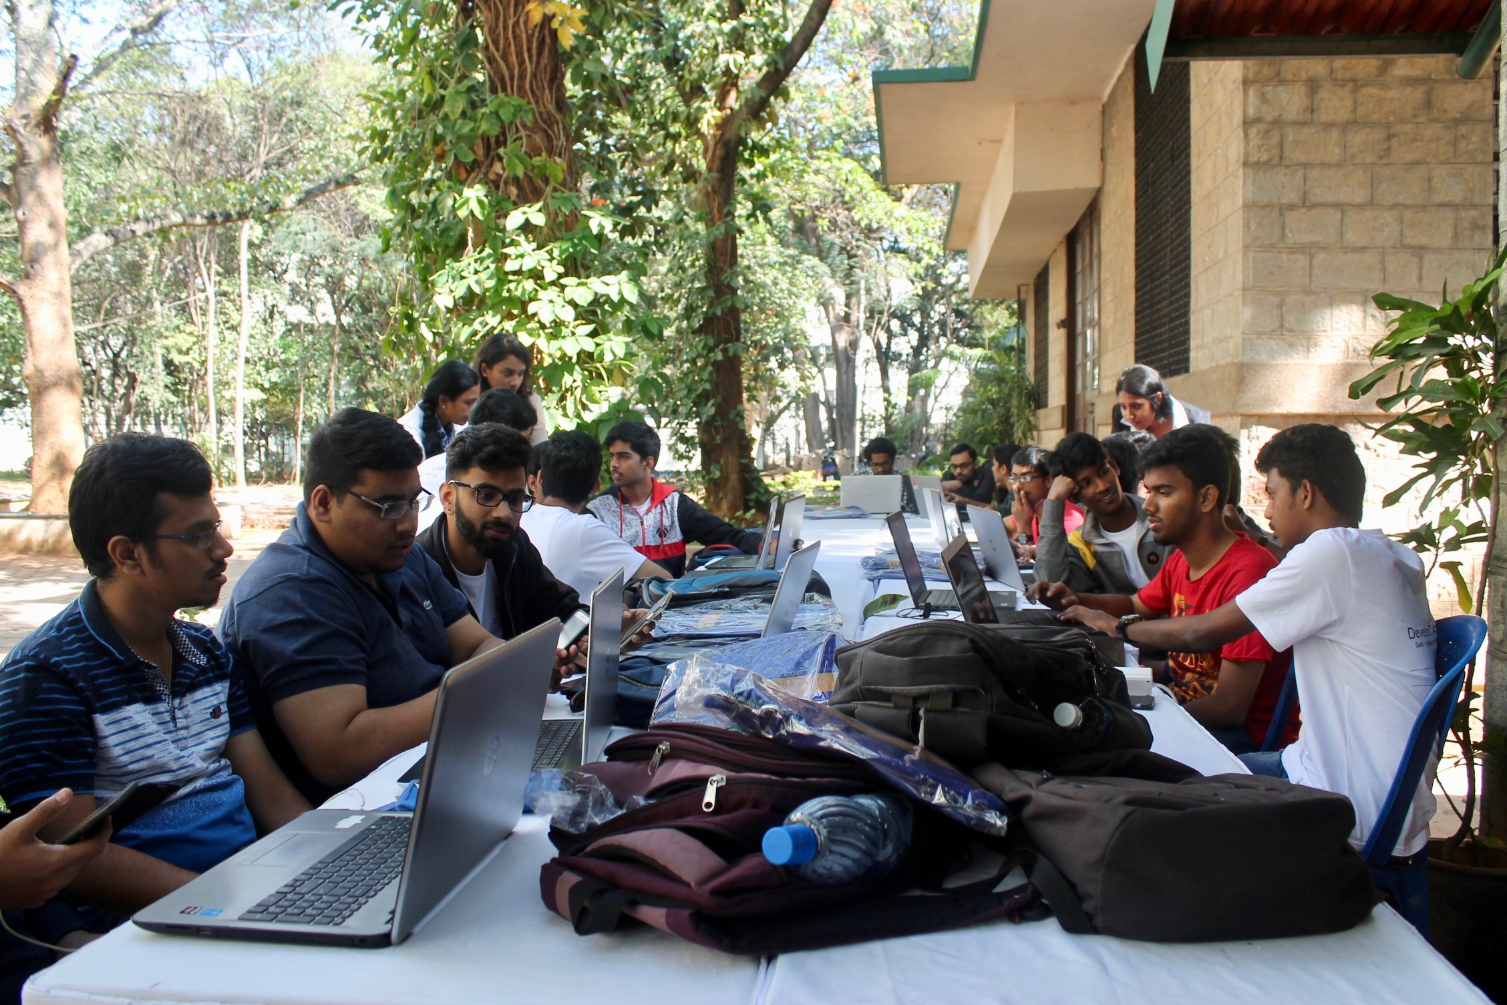

Slide 19
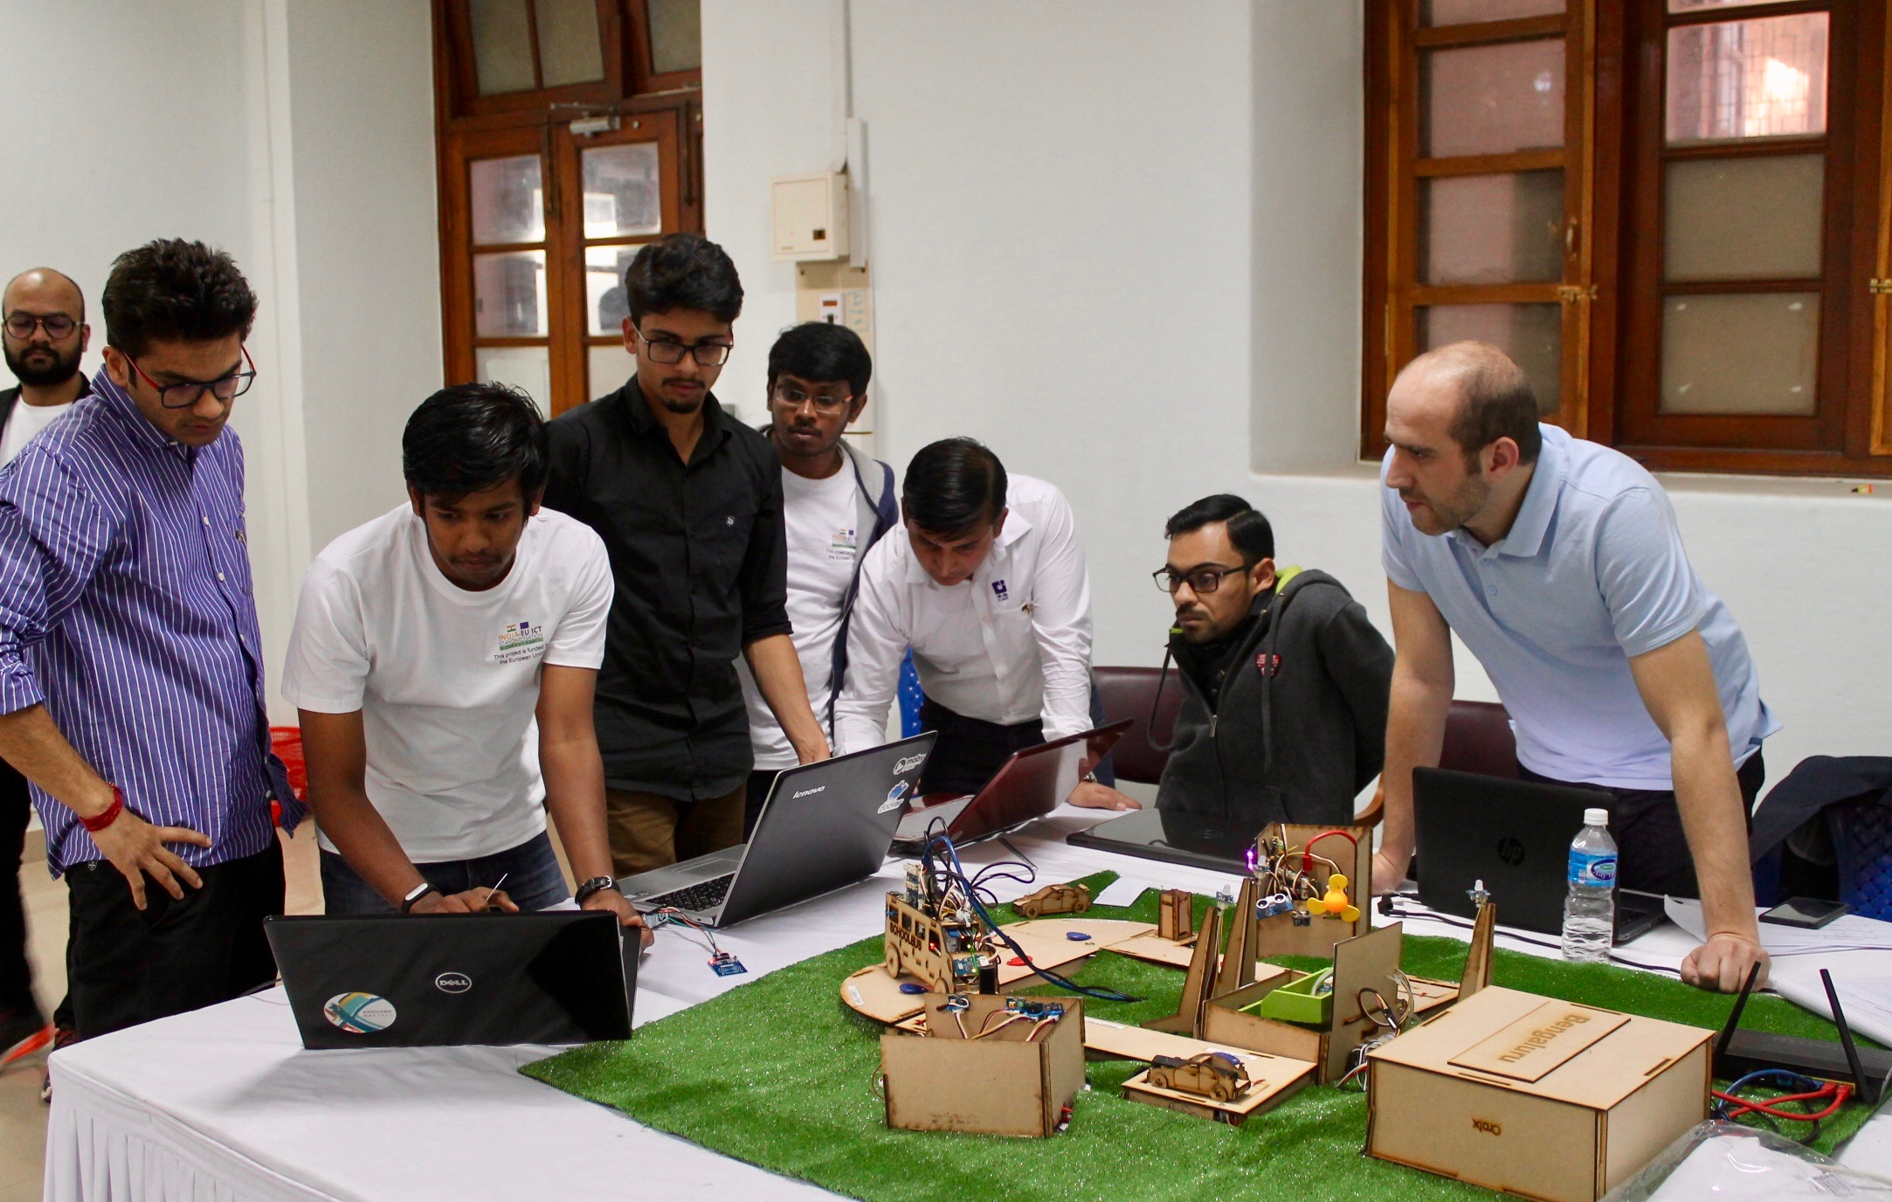

Slide 20
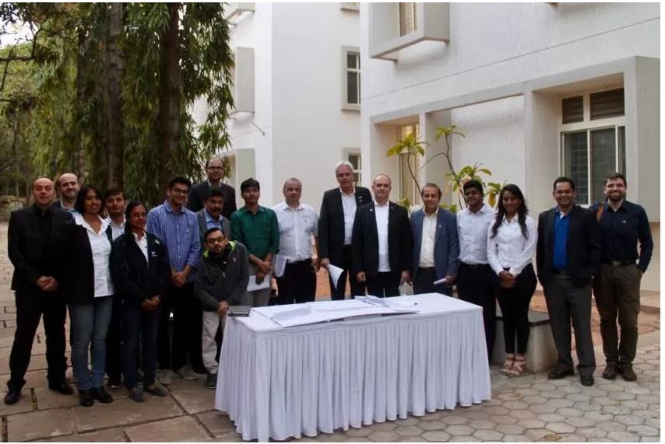
The Judges

Slide 21
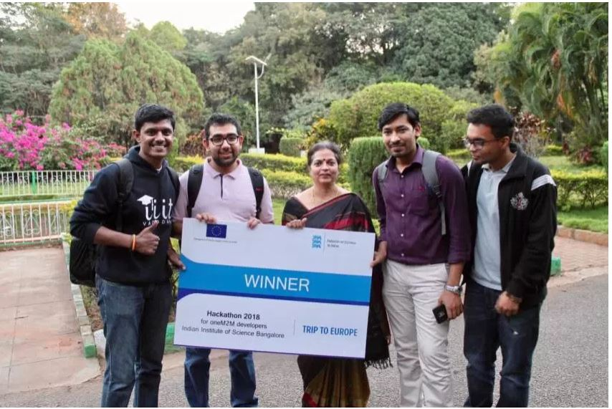
The winning team:

Slide 22
