Slide 1
TTA oneM2M Certification Program Status
GCF-oneM2M Workshop (oneM2M TP#35)
Keebum Kim, TTA, Keebum.kim@tta.or.kr

Slide 2





TTA’s oneM2M Activity
TTA has participated in oneM2M since 2012.
  TTA as SDO launched oneM2M Partnership project
  TTA has contributed to develop test specifications in TST WG
  TTA co-hosts Interop Event with ETSI two time annually
oneM2M Certification History
oneM2M Release 1 Published!
Commercial Availability of oneM2M based Service in Korean Market(2Q-2015)
.
oneM2M Testing WG Established
oneM2M Certification launch
(Feb. 2017)
- Agreed as 1st oneM2M CB(Sep. 2016)
2012
2013
2015~2016
2017
oneM2M™ Partnership Project launch
‘TTA Verified for oneM2M’ launch(Domestic Certification Program)

Slide 3
Certification Criteria and related documents
Certification Criteria
  Select features and resources that are necessary through reflecting vendor’s requirements.
  Define Product type & Certification type.
  Develop PMD(Program Management Document) that include certification policy, process and etc.
  Based on TS-0013(Interoperability Testing), TS-0017/18/19 (Conformance Testing) as test procedure.
Develop related documents
  PMD, TRSL, ICS&IXIT, Logo Usage Guideline and etc.

Slide 4

oneM2M Certification Logo
Shall only be used by products that have undergone and completed the oneM2M certification process conducted by the Certification Body.
Shall be applied and maintained in accordance with the policy of Logo Usage Guidelines
oneM2M Certification Logo

Slide 5
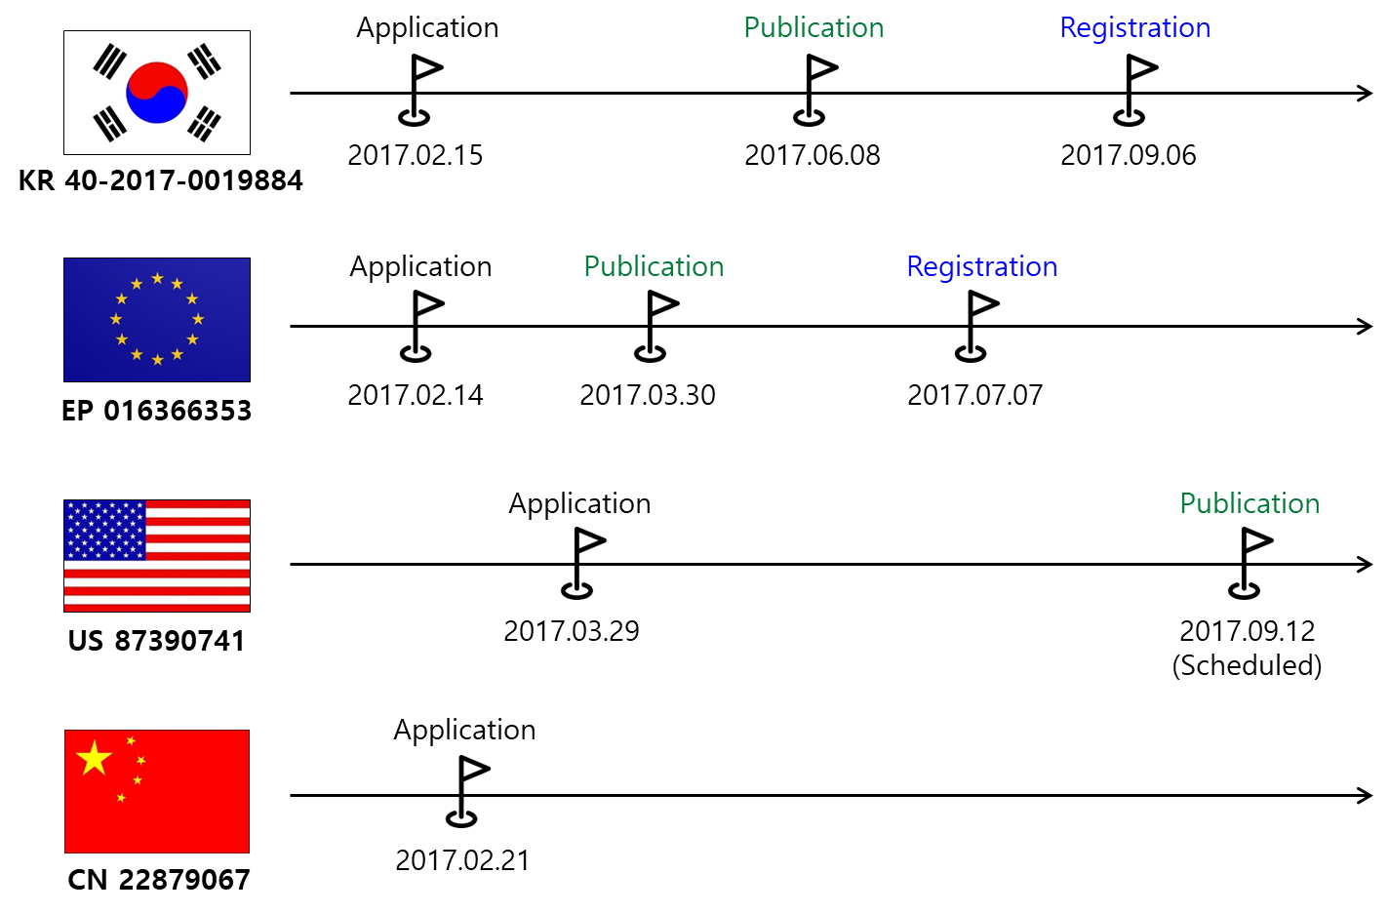
Certification Logo Status
oneM2M Certification Logo registration : Korea & Europe(completed), U.S.A & China(In progress)

Slide 6
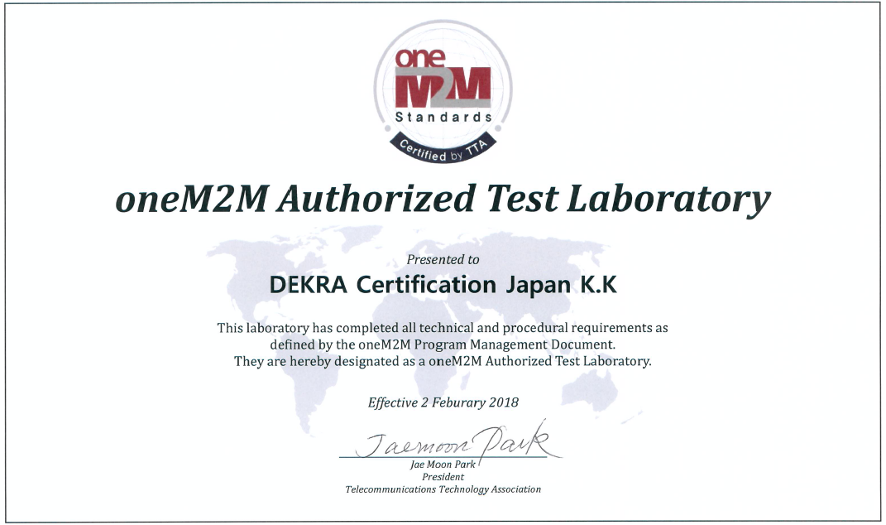
New ATL(Authorized Test Lab)- DEKRA Japan
TTA as oneM2M Certification Body designated DEKRA Certification Japan K.K as 2nd ATL at 2nd Feb. 2018

Slide 7
Test Scope updated
(Conformance Test is included)
oneM2M Test WG completed to develop the conformance test specification with ATS at Jan. 2018.
  oneM2M ATS (Commit ID : 6bf63abb81ad8e9fbb04cc177a4b9f98689d3425), there are 258 test cases for IN profile.
TRSL(Test Requirements Status List) updated from V1.0 to V1.1 including conformance test cases at Feb. 2018.
TTA designated TTsuite-oneM2M (@Spirent) as 1st Authorized Test System and Chordant Platform (@Convida) as a golden sample.

Slide 8
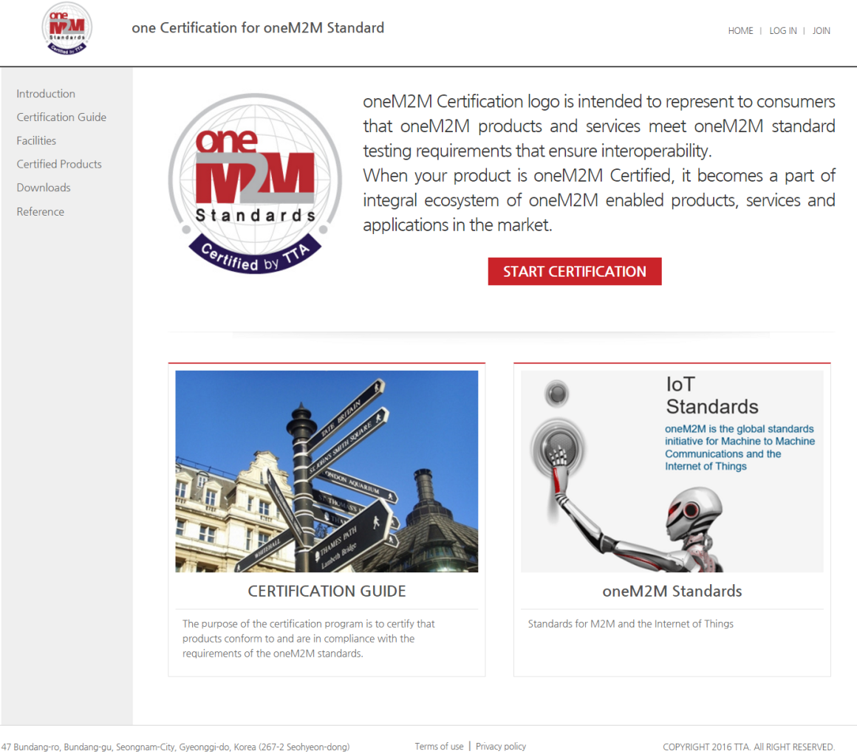
oneM2M Certification Website
www.onem2mcert.com
Information about oneM2M certification program.
All related documents are available.
Provides the list of certified products.

Slide 9
Certified Products
Certified Product: 15 products from 12 manufacturers
Product Vendor | Product Name | Product Website
SK Telecom | ThingPlug | http://Thingplug.sktiot.com
nTels | N-MAS | http://www.ntels.com
KT | IoTMakers Middleware | http://iotmakers.olleh.com
 | IoTMakers | http://iotmakers.olleh.com
KEPCO | e-IoT Energy Gateway | https://spin.kepco.co.kr
 | e-IoT Energy Platform | https://spin.kepco.co.kr
HANDYSOFT, Inc. | HANDYPIA IoT Platform | http://www.handypia.co.kr/homepage_eng/
HealthConnect Co., Ltd | IoT Healthcare Platform | http://110.93.135.108/
Samsung SDS | InsatorTM | https://iot.insator.io
IREXNET | AiSOP(iThings) | http://www.irexnet.co.kr
 | GWP(Global Water Platform) | http://www.irexnet.co.kr
HERIT | HuRa IoT Platform | https://www.chordant.io/
Moda Inc. | Universal IoT Gateway | http://www.c3systems.com/
C3SYSTEMS | SysOne | http://www.c3systems.com/
Chordant™, an InterDigital business | Chordant™ Platform | https://www.chordant.io/

Slide 10
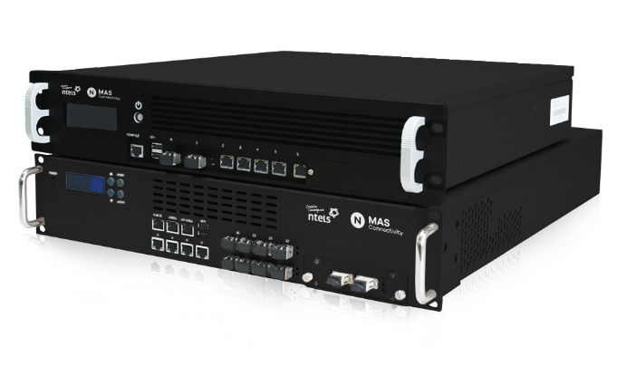
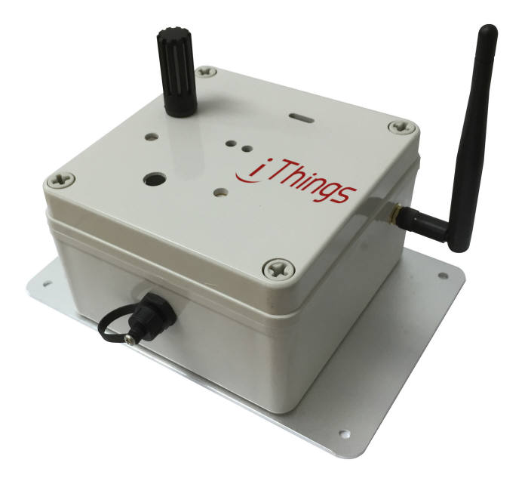
Certified Products
N-MAS from ntels
iThing(AiSOP) from iREXNET
Open IoT Platform
Service Use Case
  Smart City(Parking, Safety, Lighting)
  Power and Energy IoT
IoT Gateway supporting IoT connectivity
Service Use Case
  Power field IoT service
  Water Resource IoT service(e.g. Water Distance Internet Service)

Slide 11
Thank you!

