Slide 1
Key Items for Resolution
GCF-oneM2M Workshop (oneM2M TP#35)
oneM2M TST WG

Slide 2
Backgrounds
The migration of the oneM2M certification program to GCF is now in progress.
To proceed the migration smoothly, existing policies have to be deeply considered.
These slides address several key items for resolution.

Slide 3
Key item 1
Review & Discussion of TSRL V1.1 for Interoperability and Conformance Testing
  Test Certification Scope: Currently, TTA oneM2M certification program includes Interop and conformance testing.
  How to maintain Interop testing scope in GCF oneM2M certification program?
    GCF's plan for selecting and testing equipment (golden sample?) for the Interop test
  Review on TRSL (Test Requirement Status List) document.

Slide 4
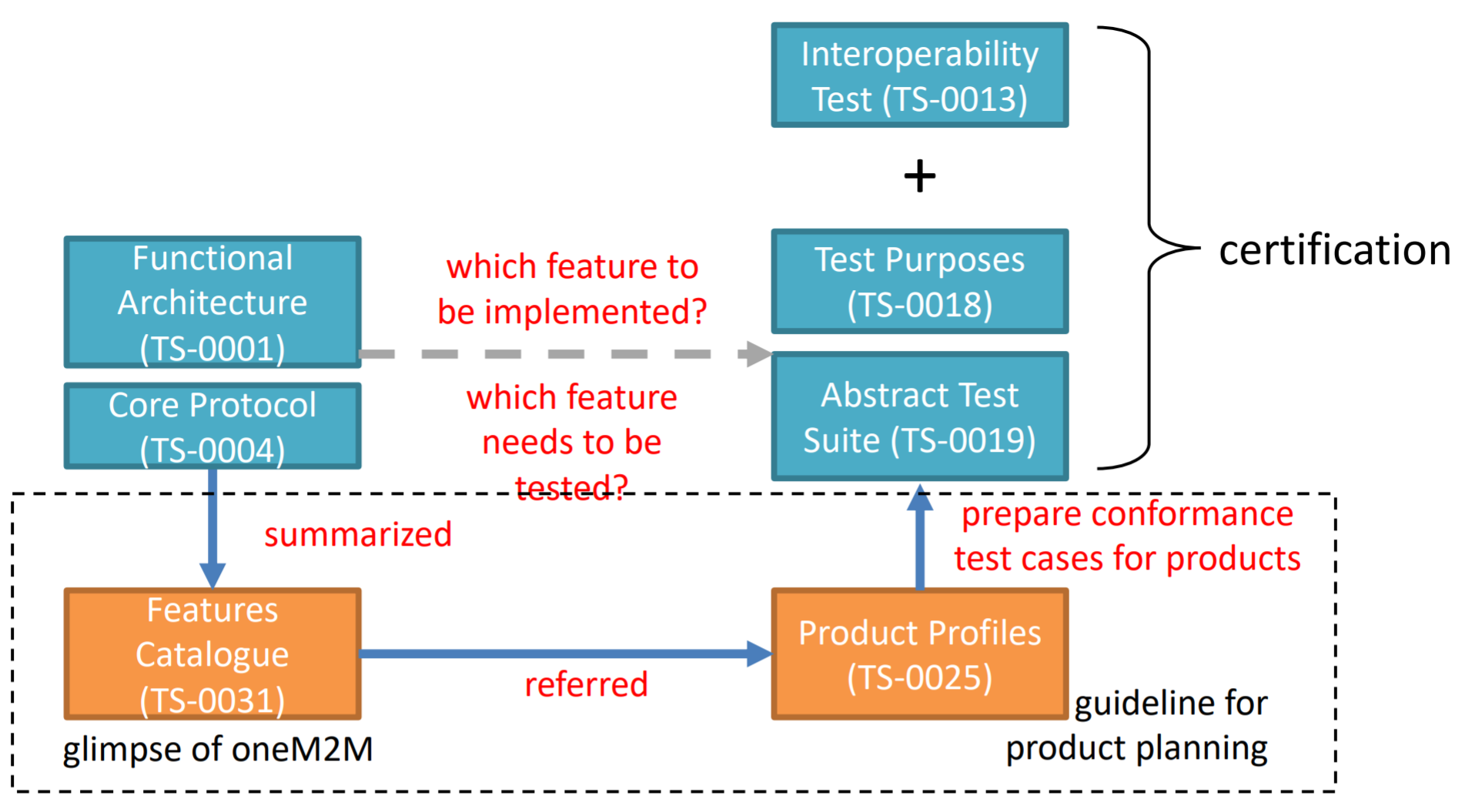
Key item 2
Discussion on how Product Profiles, Associated Test Cases, Validation Status, Bindings & Serializations can be incorporated into existing DCC Structure.

Slide 5
Key item 3
Finalization & Scope Lockdown of WID-291 and WID-292
  ??

Slide 6
Key item 4
Review and Discussion of Certification Process
  Accepted in the GCF oneM2M certification program for existing certified products.
  Acceptance of Certification Criteria defined in Certification Criteria (PMD).
    Product type, Certification type, etc.

Slide 7
Key item 5
Review and Discussion on Test Equipment Validation Process & Recognition of existing test equipment declarations
  1st authorized conformance test system has been designated. (oneM2M-TTsuite, Spirent)
  Acceptance is required from the GCF oneM2M certification program for the conformance test system which validation has been completed (No additional validation for existing test system.)

Slide 8
Key item 6
Review and Discussion on RTO process & incorporation of existing ATLs as GCF RTOs
  Recently, new ATL has been designated. (DEKRA Certification Japan K.K)
  Acceptance of existing authorized test lab, but DEKRA Japan only supports Interop test range.

Slide 9
Key item 7
Agreement on continued use of TTA Logo Program
  oneM2M Certification Logo registration is completed in Korea & Europe and progress in USA & China.
  Existing certified products are using the logo.
  To avoid the conflict, continuously using the existing logo is required.

Slide 10
Thank you!

