Slide 1
Status of Active Work Items
Summary & Level of Completeness
WPM convenor, Roland Hechwartner, roland.hechwartner@t-mobile.at
2018-07-24
TP-2018-0217-Work_Item_Status_%comp_TP36

Slide 2
48 active WIs*
Generic WIs
WI-0049 - Rel-1 & 2 Maintenance
WI-0050 - Rel-3 Small Technical Enhancements
WI-0079 - Rel-4 Small Technical Enhancements
REQ WG
WI-0015 - oneM2M Use Case Continuation
WI-0046 – Vehicular domain enablement
WI-0073 - App-ID Registry Function
ARC WG
WI-0031 – Optimized Group-based Operation
WI-0034 – Study of re-usable service layer contxt&Trnsct.
WI-0035 – Action Triggering
WI-0047 - DDS usage in oneM2M system
WI-0048 - OSGi Interworking
WI-0056 - Evolution of Proximal IoT Interworking
WI-0058 – Interworking with 3GPP networks
WI-0059 - OPC-UA Interworking
WI-0062 - Service Layer Forwarding
WI-0064 - Adaptation of oneM2M for Smart City
WI-0069 – Heterogen. identificat. service in oneM2M syst.
WI-0072 – Modbus interworking
WI-0076 - Lightweight oneM2M Services
WI-0080 - Edge and Fog Computing
WI-0082 - 3GPP V2X Interworking
WI-0083 - oneM2M Service Subscribers and Users
PRO WG
-
SEC WG
WI-0021 – Secure Environment Abstraction
WI-0057 - TEF Interface
WI-0061 - Distributed Authorization
WI-0065 - Trust Management in oneM2M
WI-0066 - Decentralized Authentication
WI-0068 - GlobalPlatform Interworking
WI-0077 - Attribute Based Access Control Policy
MAS WG
WI-0030 – M2M Appl. & Field Domain Comp. config.
WI-0052 - LWM2M DM & Interworking Enhancements
WI-0053 - Enhancements on Semantic Support (R3 => R4)
WI-0063 – R3 Enh. on Base Ontology & Generic IWK
WI-0070 - Disaster Alert Service Enabler
WI-0071 - oneM2M and W3C Web of Things Iwk
WI-0075 – Ind. Dom. Inf. Model Mapg. & Sem. Spt.
WI-0081 - Smart Device Template 4.0
WI-0084 - SDT_based_Information_Model_and_Mapping_for_Vertical_Industries
WI-0088 - M2M/IoT Application and Component Configuration
TST WG
WI-0032 - Conformance Test
WI-0051 - Security Functions Conformance Testing
WI-0054 - Developers guide series
WI-0055 - Product Profiles & Feature Catalog
WI-0060 - Interoperability testing Release 2
WI-0074 - Conformance Test Specifications Release 2
WI-0078 - oneM2M API guide
WI-0085 - Conformance Test Specifications Release 3
WI-0086 - Conformance Test Specifications Release 4
* status in ADM-0001-Work Program Management v36.0.0.

Slide 3
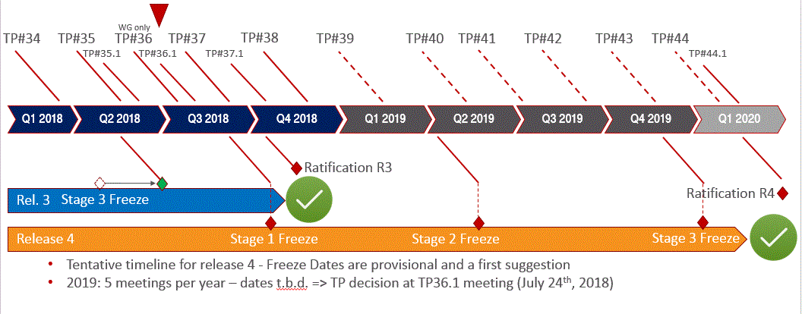
Timeline Release 3 and Release 4

Slide 4
Generic Work Items
WI-0049 – Maintenance of oneM2M Release 1 and 2 [WT 1a]
WI-0050 – Small Technical Enhancements of oneM2M Release 3 [WT 1a]
WI-0079 - Rel-4 Small Technical Enhancements

Slide 5
REQ WG – WI Level of Completeness TP36
WI-0015 – Use Cases Collection
75% WI-0046 – Vehicular domain enablement [2c]
100% WI-0073 - App-ID Registry Function [1d]

Slide 6
ARC WG – WI Level of Completeness TP36
95% WI-0031 – Optimized Group-based Operation [1d]
100% WI-0034 – Study of re-usable service layer context & Transaction enablement [1d]
95% WI-0035 – Action Triggering [1d]
50% WI-0047– DDS usage in oneM2M system [2a]
100% WI-0048 - OSGi Interworking [1b]
95% WI-0056 - Evolution of Proximal IoT Interworking [1b]
50% WI-0058 – Interworking with 3GPP Networks (WI scope enhanced at TP34)
30% WI-0064 - Adaptation of oneM2M for Smart City [2c]
90% WI-0069 - Heterogeneous identification service in oneM2M system [2b]
60% WI-0072 – Modbus interworking [2b]
10% WI-0076 - Lightweight oneM2M Services
20% WI-0080 - Edge and Fog Computing
10% WI-0082 - 3GPP V2X Interworking
10% WI-0083 - oneM2M Service Subscribers and Users

Slide 7
PRO WG – WI Level of Completeness TP36
none

Slide 8
SEC WG – WI Level of Completeness TP36
90% WI-0021 – Secure Environment Abstraction [1d]
20% WI-0065 - Trust Management in oneM2M [2c]
75% WI-0066 - Decentralized Authentication [2c]
0% WI-0068 - GlobalPlatform Interworking [3]
20% WI-0077 - Attribute Based Access Control Policy

Slide 9
MAS WG – WI Level of Completeness TP36
15% WI-0053 - Rel-4 Enh. on Semantic Support
100% WI-0063 – R3 Enh. on BaseOntology & Ontology based Interworking [1b]
10% WI-0070 - Disaster Alert Service Enabler [3]
25% WI-0071 - oneM2M and W3C Web of Things Iwk [3]
25% WI-0075 - Industrial Domain Information Model Mapping & Semantics Support
25% WI-0081 - Smart Device Template 4.0
25% WI-0084 – SDT based Information Model and Mapping for Vertical Industries
5% WI-0088 - M2M/IoT Application and Component Configuration

Slide 10
TST WG – WI Level of Completeness TP36
100% WI-0051 - Security Functions Conformance Testing
95% WI-0054 - Developers guide series [1b]
92% WI-0060 - Interoperability testing Release 2 [1c]
50% WI-0074 - Conformance Test Specifications Release 2 [1c]
90% WI-0078 - oneM2M API guide
0% WI-0085 - Conformance Test Specifications Release 3
0% WI-0086 - Conformance Test Specifications Release 4

Slide 11
WIs %completion & Work Tracks
  Work Track 1, “Market Adoption Track”
    Task on Essential Corrections & Small Technical Enhancements [1a]
    Task on development and/or enhancements of guidelines and/or TSs and best practices documents for easier implementation and take-up of oneM2M technology [1b]
    Task on testing [1c]
    Task on completion of well-progressed Release-2 Work Items [1d]
  Work Track 2, “Industrial IoT and smart cities”
    Task on reach out to IIoT & smart city experts & descriptions of deployments in IIoT/smart cities based on oneM2M [2a]
    Task on improvement and addition of requirements for the IIoT and smart Cities [2b]
    Task on studies on new features (targeting TRs for now) [2c]
  Work Track 3, “Forward Looking Areas” [3]

