Slide 1
TST #36 WG Status Report
TP-2018-0218-TST#36_report
Group Name: TP
Source: TST WG Chair, JaeSeung Song (KETI, jssong@sejong.ac.kr )
Meeting Date: 2018-07-24 to 2018-07-24

Slide 2
Summary
WG6 Objectives for TST 36
  Working on the development of new Test Purposes (TPs) for Rel-2 and Rel-3
  Interop 6
Status
  Developer guides:
    TR-0047, 3GPP Interworking DG → 80%
    TR-0051, Developers API → 90%
  Rel-2 Conformance testing WID ➔ 50%
  On track developing Rel-2 and Rel-3 TPs

Slide 3
Item for DECISION
TSes for approval
  None
CR packs for approval
  None

Slide 4
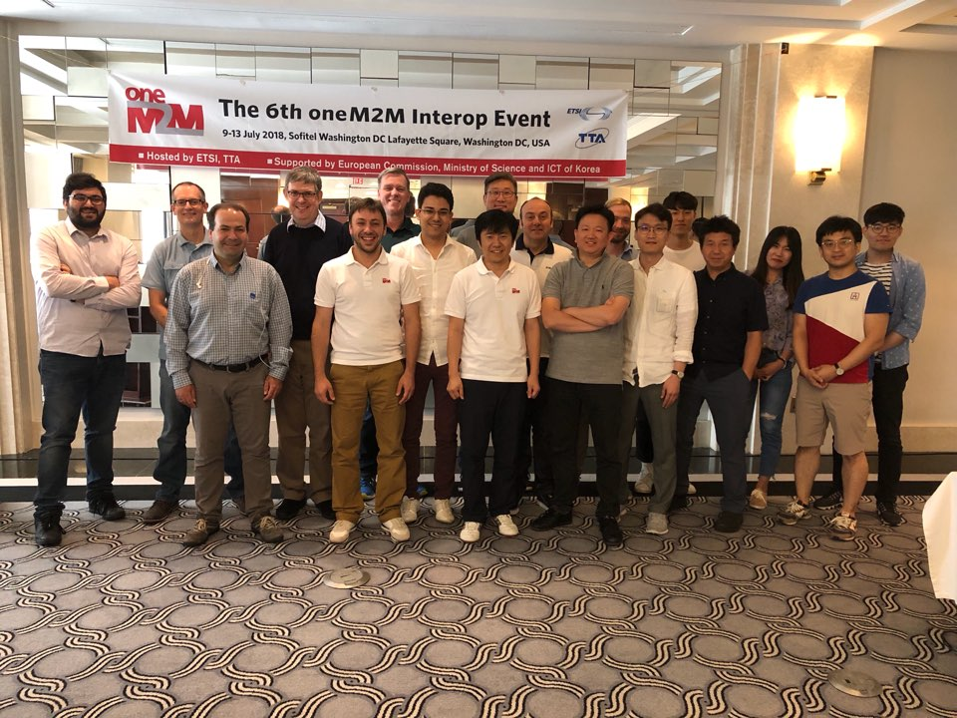
Items for Information
Interop 6
  Date: July (09. July ~ 13. July)
  Venue: Washington D. C., USA
  Host: ETSI & TTA
  Coverage: Interoperability and
  Conformance Testing
  9 issues were reported to TST and ARC
Interop 7 (TBD)
  There will be only one Interop in 2019
  Location and date will be decided based on a survey
  ETSI & TTA will suggest

Slide 5
Items for Information (GCF Certification)
Migration to GCF is on track!
oneM2M Certification WI has been approved at GCF SG #75
  Support from Miguel (ETSI) and Bob (Convida Wireless)
  Thanks to all TST members and oneM2M Certification Body (TTA)
GCF is currently finalising the oneM2M Certification Program, targeting a launch date in early Q1/2019
Joint communication (PR) with oneM2M, GCF and TTA (Q3/2018)
Rapporteurship of GCF oneM2M certification (Keebum Kim, TTA)

Slide 6
Items for Information
Release 2 Feature Catalog & Profiles
  New profiles with PolingChannel, Non-blocking
  New IN-CSE profile (extended one) with Group, Discovery, Result content, TLS1.3, flexContainer, Retargeting
Release 3 Feature Catalog & Profiles
  Announcement, 3GPP Interworking, Semantics, HAIM, Dynamic Authorization, Location and timeSeries (TBD)

Slide 7
Next Meetings / Calls
Conference Calls
  TST#36.1: 08. Aug. 2018, UTC 13:00-14:30
  TST#36.2: 03. Sep. 2018, UTC 13:00-14:30
Face-to-Face
  TST#37: September, 17-21, TTA, Bundang, Republic of Korea
  TST#38: December, 03-07, Kanazawa, Japan

Slide 8
Thank you!

