Slide 1
TST #36 WG Status Report
TP-2018-0218R01-TST#36_report
Group Name: TP
Source: TST WG Chair, JaeSeung Song (KETI, jssong@sejong.ac.kr )
Meeting Date: 2018-07-24 to 2018-07-24

Slide 2
Summary
WG6 Objectives for TST 36
  Working on the development of new Test Purposes (TPs) for Rel-2 and Rel-3
  Interop 6
Status
  Developer guides:
    TR-0047, 3GPP Interworking DG → 80%
    TR-0051, Developers API → 90%
  Rel-2 Conformance testing WID ➔ 50%
  On track developing Rel-2 and Rel-3 TPs

Slide 3
Item for DECISION
TSes for approval
  None
CR packs for approval
  None

Slide 4
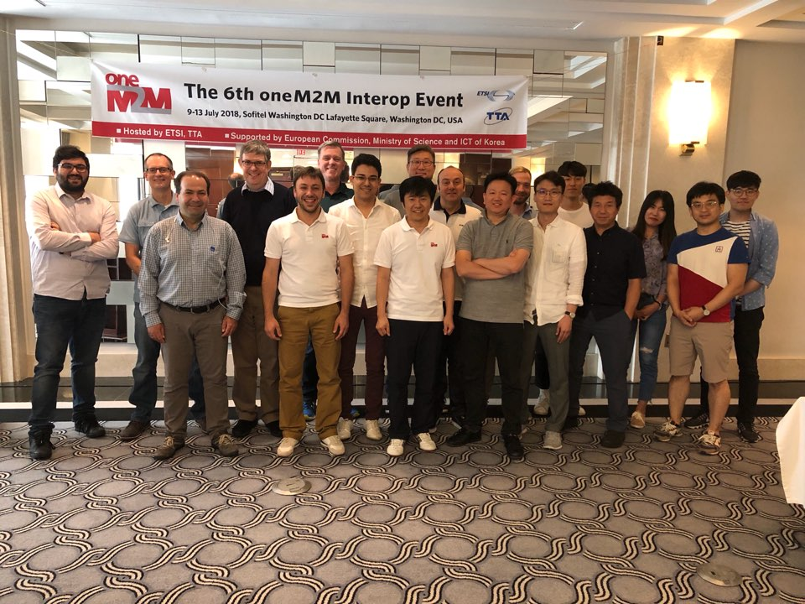
Items for Information
Interop 6
  Date: July (09. July ~ 13. July)
  Venue: Washington D. C., USA
  Host: ETSI & TTA
  Coverage: Interoperability and
  Conformance Testing
  9 issues were reported to TST and ARC
Interop 7 (TBD)
  There will be only one Interop in 2019
  Location and date will be decided based on a survey
  ETSI & TTA will suggest

Slide 5
Items for Information (GCF Certification)
Migration to GCF is on track!
oneM2M Certification WI has been approved at GCF SG #75
  Support from Miguel (ETSI) and Bob (Convida Wireless)
  Thanks to all TST members and oneM2M Certification Body (TTA)
GCF is currently finalising the oneM2M Certification Program, targeting a launch date in early Q1/2019
Joint communication (PR) with oneM2M, GCF and TTA (Q3/2018)
Rapporteurship of GCF oneM2M certification (Keebum Kim, TTA)

Slide 6
Items for Information
Release 2 Feature Catalog & Profiles
  New profiles with PolingChannel, Non-blocking
  New IN-CSE profile (extended one) with Group, Discovery, Result content, TLS1.3, flexContainer, Retargeting
Release 3 Feature Catalog & Profiles
  Announcement, 3GPP Interworking, Semantics, HAIM, Dynamic Authorization, Location and timeSeries (TBD)
Transfer the leadership of Feature Catalog to TST
  Agreed between TST and ARC to transfer the leadership of TS-0031
  Rapporteurship (from SeungMyeong Jeong to Bob Flynn)

Slide 7
Next Meetings / Calls
Conference Calls
  TST#36.1: 08. Aug. 2018, UTC 13:00-14:30
  TST#36.2: 03. Sep. 2018, UTC 13:00-14:30
Face-to-Face
  TST#37: September, 17-21, TTA, Bundang, Republic of Korea
  TST#38: December, 03-07, Kanazawa, Japan

Slide 8
Thank you!

