Slide 1
oneM2M – OCF Interworking
Dr. Josef J. Blanz
oneM2M Industry Day, September 14th 2018

Slide 2
Outline
Scope
  Technologies in IoT Stack
  Where OCF & oneM2M play
OCF & oneM2M characteristics
  Topology & simplified examples
  Commonalities & difference
OCF-oneM2M Interworking overview
  Examples Scenario
  Interworking functions and procedures
  Flow for example scenario
Vision of Interworking

Slide 3














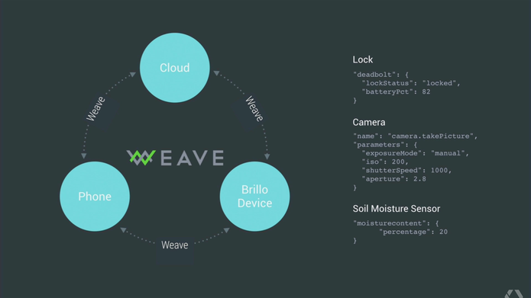


















Technologies in IoT Stack
Applications
Custom IoT Applications
Application
Service Layer
aka
Service Platform
Middleware
Enablement Platform
Industrial Non-IP
Presentation
Interworking
Session
Protocols
CoAP RTPS
HTTP
WebSocket
DTLS / UDP
TLS /
TCP
Transport
IP
Network
Access
IEEE 802.1TSN
Wired
Link
Physical

Slide 4
oneM2M Topology
AE: Application Entity
CSE: Common Services Entity
AE
AE
AE
Infrastructure Node
CSE
Middle Node
Middle Node
CSE
CSE
Middle Node
Application
Dedicated
Node
CSE
AE
AE
Application
Dedicated
Node
Application
Service
Node
AE
AE
Application
Dedicated
Node
CSE
AE
CSE

Slide 5

oneM2M RESTful Style & Access Control
Host Resources
= State Information
AE
AE
AE
Identifiers, credentials & access control privileges need to be provisioned
AEs discover resources
Infrastructure Node
CSE
Middle Node
Middle Node
CSE
CSE
Access Resources
= Consume Service
Middle Node
Application
Dedicated
Node
CSE
AE
AE
Application
Dedicated
Node
Application
Service
Node
Door Lock
AE
AE
Application
Dedicated
Node
CSE
AE
CSE
State: Locked

Slide 6



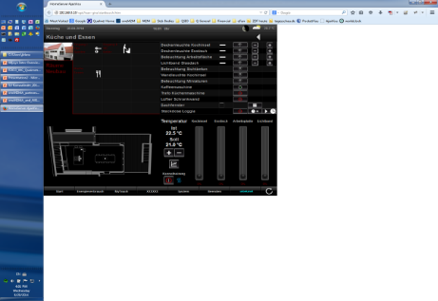

oneM2M Example
AE
AE
AE
UPDATE
Infrastructure Node
CSE
Update Lock Status
to “Open”
Middle Node
Middle Node
CSE
CSE
Middle Node
Application
Dedicated
Node
CSE
AE
AE
Unlock
Application
Dedicated
Node
Actuator
Sensors
Keypad
AE
AE
RESP.
OK!
Application
Dedicated
Node
Checking
Authorization
CSE
CSE
NOTIFY
AE
RESP.
Door Lock
State: Open
State: Locked

Slide 7
OCF Topology
C: OCF Client (might have limited server capabilities as well)
S: OCF Server
OCF Device
C
OCF Device
S
OCF Device
S
OCF Device
C
OCF Device
S
OCF Device
C
OCF Device
C
OCF Device
OCF Device
S
S
OCF Device
OCF Device
S
C
S

Slide 8
OCF RESTful Style & Access Control
Host Resources
= State
Information
Identifiers, credentials & access control privileges need to be provisioned via onboarding
Clients discover Servers
OCF Device
C
OCF Device
S
OCF Device
S
OCF Device
C
OCF Device
S
OCF Device
C
OCF Device
C
OCF Device
OCF Device
S
S
Access Resources
= Consume Service
OCF Device
OCF Device
S
C
S

Slide 9
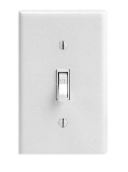

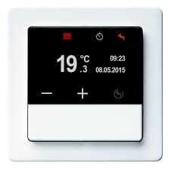
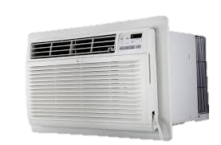

OCF Example
OCF Device
C
OCF Device
S
OCF Device
S
OCF Device
C
OCF Device
S
OCF Device
C
OCF Device
C
OCF Device
OCF Device
S
S
OCF Device
OCF Device
S
C
S

Slide 10
OCF Example
Update Lock Status
to “Open”
State: Locked
State: Open
OCF Device
C
OCF Device
Unlock
S
OCF Device
OK!
Checking
Authorization
S
RESP.
OCF Device
C
UPDATE
OCF Device
S
OCF Device
C
OCF Device
C
OCF Device
OCF Device
S
S
OCF Device
OCF Device
S
C
S

Slide 11
Commonalities & Differences
In Common
OCF
oneM2M
RESTful approach
Services exposed by CRUD access to resources
Discovery
Notifications
Support of access control
Aligned information models
Designed for local area networks = proximal IoT (e.g. smart home)
Entity hosting state also represents/controls “things” connected to it
Direct communication (P2P) between clients and servers
Relies on LAN (IP) where peers can reach each other
Discovery via local multicasts
Flat hierarchy
“User”-centric (onboarding)
Security & access control bi-lateral, provisioned with onboarding tool
Designed for wide area networks
= distal IoT (e.g. smart city)
State might be hosted on nodes different from those connected to and controlling “things”
Hierarchical overlay topology
Relies on app registration
Routing across hierarchy
Dealing with “store and forward”
Discovery via local lookup
Data hosting a service by itself (history, time-series)
Management-centric (provisioning)
Security & access control distributed, centralized and/or local provisioning

Slide 12
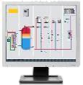








Example Scenario
Emergency Button:
All lights of building on!!
Also street light next to it
IN
AE
CSE
Facility Operator:
Monitor & control all lights
in building & outside
OXF Proximal IoT Network
e.g. one building
IPE / Bridge
MN
AE
ASN
S
C
AE
CSE
C
ASN
CSE
S
AE
C
CSE
Mobile
Network
S
LTE
S
LTE
ASN
AE
CSE
Street light right
next to building
LTE

Slide 13
Example Scenario
Mirrors resources
from OCF to oneM2M and vice versa
Converts CRUD requests in both
directions
IN
AE
CSE
IPE / Bridge
MN
AE
ASN
S
C
AE
CSE
C
ASN
CSE
S
AE
C
CSE
S
S
ASN
AE
CSE

Slide 14



Example for IPE / Bridge Stack
aligned
IPE
Bridge
OCF Server
Bridge
AE
& CSE
OCF Data Models
oneM2M Data Models
OCF Client
AE
& CSE
COAP
COAP
HTTP
HTTP
DTLS
DTLS
TLS
TLS
UDP
UDP
TCP
TCP
IP Routing
IP Routing
IP Routing
IP Routing
IPv4/IPv6
IPv4/IPv6
IPv4/IPv6
IPv4/IPv6
IEEE 802.11 MAC
IEEE 802.11 MAC
DSL Stack
Could also be WLAN/WWAN
DSL Stack
IEEE 802.11 PHY
IEEE 802.11 PHY
DSL PHY
DSL PHY
Might be BT-LE or other short range

Slide 15
Exposure of OCF Services to oneM2M
May or may not be hosted on same node as the IPE(s)
IPE:
Interworking
Proxy
Entity
Exposed OCF Services clubbed together. Depending on e.g. accounting, functions etc. Access control impact: IPE gets super-set of privileges, oneM2M consumers of services can get individual privileges.
oneM2M
resources
“mirror” &
provide access to
OCF state
Which OCF Servers are allowed to be exposed need to be determined e.g. during OCF onboarding process.

Slide 16
OCF to oneM2M: IPE Responsibilities
Determination of OCF Functions to be exposed to the oneM2M System
Creation / Deletion of corresponding oneM2M Resource(s) representing exposed OCF Functions
Mirroring state changes of exposed OCF Functions in oneM2M Resources
Detection of requests on oneM2M side to execute OCF Functions and invocation thereof

Slide 17
Exposure of oneM2M Services to OCF
Need to determine which oneM2M services to expose (e.g. pre-configuration).
Exposed oneM2M services clubbed together. Depending on e.g. accounting, functions, access privileges etc. IPE gets super-set of privileges, OCF consumers of services can get individual privileges.
OCF Servers
“mirror” &
provide access to
oneM2M state
Which OCF Client are allowed to be consume exposed oneM2M services needs to be configured.

Slide 18
oneM2M to OCF: IPE Responsibilities
Determination of oneM2M services to be exposed to the OCF Proximal IoT Network
Instantiation / removal of OCF Servers representing exposed oneM2M services
Mirroring state changes of oneM2M Resources representing exposed oneM2M services in OCF resources hosted on OCF Servers
Detection of requests on the OCF side to consume exposed oneM2M services and execution thereof

Slide 19
oneM2M-OCF Interworking Flow
IPE: Exposing all OCF lights and one oneM2M light
Operator AE: Subscribed to all light resources
OCF-IPE: Client observing all OCF light resources
Emergency Button pressed:
All lights of building & next street light on!
IN
AE
CSE
RESP
RESP
RESP
RESP
RESP
UPDATE
UPDATE
RESP
Facility Operator:
Switch the two illuminated
lights off!
OXF Proximal IoT Network
e.g. one building
S
C
AE
RESP
NOTIFY
UPDATE
NOTIFY
NOTIFY
UPDATE
NOTIFY
RESP
CSE
ASN
AE
RESP
NOTIFY
UPDATE
CSE
C
UPDATE
UPDATE
UPDATE
ASN
RESP
AE
RESP
S
RESP
Mobile
Network
NOTIFY
C
CSE
RESP
RESP
S
RESP
S
RESP
RESP
ASN
AE
CSE

Slide 20
Flows & procedures specified in TS-0024
Specified for
OCF-to-oneM2M
as well as for
oneM2M-to-OCF
exposure of services
(latter one still being
worked on)

Slide 21
Status
oneM2M TS-0033 specifies general interworking concept
oneM2M TS-0023 defined models for Home Automation & normative mapping to equivalent OCF Device Types
oneM2M TS-0024 specifies detailed interworking for OCF
  Exposure of oneM2M services to OCF still being worked on
  Completion expected next week during TP37
  Will be part of oneM2M Rel-3 (Q4 18)
Relevant OCF Specs: Core, Security, Bridging, Device Types
OCF completing oneM2M-derived OCF resource definition (Q4 18)
Links:
https://openconnectivity.org/specs
http://www.onem2m.org/technical/published-drafts

Slide 22




Implementation in OS-IoT
ATIS – a founding partner of oneM2M – started an
Open Source effort in 2017 for a oneM2M ASN/ADN
library targeting smaller devices
The project is called OS-IOT (www.os-iot.org)
OS-IoT recently started to implement
an OCF-oneM2M IPE
First direction is working (OCF-2-oneM2M)
See separate presentation later today
Participation is very welcome
OCF Device Lights
Interworking Proxy Entity (IPE)
oneM2M CSE
oneM2M HAIM Representation
of OCF Resources

Slide 23







Vision of Interworking
Open Standards
⬄ “Interworking Glue”
802.15.4
802.15.4

Slide 24

Thank You!
Dr. Josef J. Blanz jblanz@qti.qualcomm.com
Qualcomm Technologies Inc.
Principal Engineer
M2M & IoT Standards & Industry Fora
Chairman oneM2M Industry Liaison Committee
Vice-Chairman oneM2M Technical Plenary

Slide 25
Backup Material
Sub text

Slide 26







Vision: Interworking
Xyz
MNO
Private
Network
(e.g. Industrial)
Proximal
Network
(e.g. Home)
802.3
802.3
802.3
Proxy
802.15.4
802.15.4
802.15.4
Cat-M
Mobile
Network
Edge Routing
802.15.4
NB-IoT
Cat-M
802.15.4
802.15.4
Cat-M
802.15.4
LTE
Cat-M

