Slide 1
Socialization of
Railway Domain Enablement
TP-2018-0xxx-Socialize_WI_Railway_Domain_Enablement
Andrew Min-gyu Han, Hansung University
2018-09-19

Slide 2
Background
The railway service is one of the most important public transport system which provides massive, economical and environment-friendly service. The railway service is also an essential part of urban infrastructure as many forms of subway and high-speed train.
The current railway service is getting enhancement by adapting various sensors, devices and services to get more speed and more intelligence. Many SDOs are working on the railway domain such as 3GPP. In order to support this vertical field domain, oneM2M should consider services and devices of the railway field domain.

Slide 3
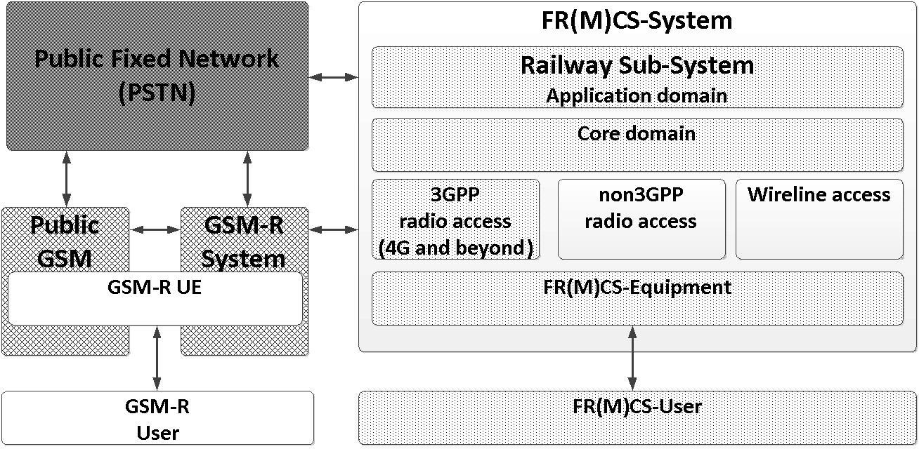
Railway Domain Activities of 3GPP
Two Wis:
  FRMCS(Future Railway Mobile Communication System)
  MONASTERY(Mobile Communication System for Railways)
Mainly focused in communication core and application
Interworking with legacy networks such as GSM and LMR

Slide 4
Scope
Railway vertical service
Discover railway use cases and its essential requirements
Refer 3GPP works but focusing service area such as managing devices and passenger services
Define information model of railway devices and sensors which could be useful to develop services of railway in vertical
FR(M)CS-System
Railway Device Information Model
Railway Sub-System
Application domain
oneM2M services
Core domain (3GPP communication)
3GPP
Radio access
(4G and beyond)
Non-3GPP
Radio access
Wireline access
FR(M)CS-Equipment
oneM2M devices/sensors
FR(M)CS-User
oneM2M devices

Slide 5
Outcomes
TR – Railway Domain Enablement
  Introduce other SDO’s activities (e.g. 3GPP, UIC and TTA) and field examples
  Collecting usecases with potential requirements
  Investigating the usecases and requirements to find gap between the railway domain and oneM2M system (minimize new requirements)
TS – Railway Device Information Model
  Discovering devices and services and considering their information model and mapping
  Define SDT-based device/sensor information model (like HAIM)

Slide 6
Impact
Railway industry could provide various railway services to its customer including passengers in efficient way in a short period
Managing Railway devices will be simpler, easier and more efficient
Railway industry could adopt and adapt many kinds of sensors and general devices easily
Booming up developing IoT services related to railway domain

