Slide 1
WPM status report TP#37
WPM convenor, Roland Hechwartner, roland.hechwartner@t-mobile.at
2018-09-21
TP-2018-0249R01-WPM_status_report_TP#37

Slide 2
WPM Status at TP#37 closing
Content
WI Snapshot
Activities since TP36
Items for TP decision
Release 3 candidate Technical Specifications and Technical Reports
Release 3 & Release 4 Timeline
Next Steps

Slide 3
TP 37 opening - WI Snapshot*
* See full work program status @ TP37 opening in ADM-0001-Work Program Management v37.0.0.
49 active work items of which
  12 work items @ 100% (to be closed)
  WI-0030 - M2M Appl. & Field Domain Comp. config.
  WI-0032 - Conformance Test
  WI-0034 – Study of re-usable service layer contxt&Trnsct.
  WI-0048 - OSGi Interworking
  WI-0052 - LWM2M DM & Interworking Enhancements
  WI-0055 – Product Profiles and oneM2M Features
  WI-0057 – TEF Interface
  WI-0059 – OPC-UA Interworking
  WI-0061 - Distributed Authorization
  WI-0062 - Service Layer Forwarding
  WI-0063 – R3 Enh. on Base Ontology & Generic IWK
  WI-0073 - App-ID Registry Function
4 new work items proposed at TP#37
  Getting started with oneM2M
  oneM2M and Zigbee interworking
  Railway Domain Enablement
  Services and platforms discovery
Release planning
  Release 3: Finalization of deliverables and preparation for ratification
  Release 4: Stage 1 Freeze milestone prop. to be postponed until TP#39
Work Items targeting Release 4
WI-0079 - Rel-4 Small Technical Enhancements
WI-0046 – Vehicular domain enablement
WI-0064 - Adaptation of oneM2M for Smart City
WI-0069 – Heterogen. identificat. service in oneM2M syst.
WI-0076 - Lightweight oneM2M Services
WI-0080 - Edge and Fog Computing
WI-0082 - 3GPP V2X Interworking
WI-0083 - oneM2M Service Subscribers and Users
WI-0065 - Trust Management in oneM2M
WI-0068 - GlobalPlatform Interworking
WI-0077 - Attribute Based Access Control Policy
WI-0053 - Enhancements on Semantic Support (R3 => R4)
WI-0070 - Disaster Alert Service Enabler
WI-0071 - oneM2M and W3C Web of Things Iwk
WI-0075 – Ind. Dom. Inf. Model Mapg. & Sem. Spt.
WI-0081 - Smart Device Template 4.0
WI-0084 – SDT based Information Model and Mapping for Vertical Industries
WI-0088 - M2M/IoT Application and Component Configuration
WI-0086 - Conformance Test Specifications Release 4

Slide 4
49 active WIs*
Release 4 candidates marked in blue
Generic WIs
WI-0049 - Rel-1 & 2 Maintenance
WI-0050 - Rel-3 Small Technical Enhancements
WI-0079 - Rel-4 Small Technical Enhancements
REQ WG
WI-0015 - oneM2M Use Case Continuation
WI-0046 – Vehicular domain enablement
WI-0073 - App-ID Registry Function
ARC WG
WI-0031 – Optimized Group-based Operation
WI-0034 – Study of re-usable service layer contxt&Trnsct.
WI-0035 – Action Triggering
WI-0047 - DDS usage in oneM2M system
WI-0048 - OSGi Interworking
WI-0056 - Evolution of Proximal IoT Interworking
WI-0058 – Interworking with 3GPP networks
WI-0059 - OPC-UA Interworking
WI-0062 - Service Layer Forwarding
WI-0064 - Adaptation of oneM2M for Smart City
WI-0069 – Heterogen. identificat. service in oneM2M syst.
WI-0072 – Modbus interworking
WI-0076 - Lightweight oneM2M Services
WI-0080 - Edge and Fog Computing
WI-0082 - 3GPP V2X Interworking
WI-0083 - oneM2M Service Subscribers and Users
WI-0087 Summary of differences between Release 2A & Release 3
PRO WG
-
SEC WG
WI-0021 – Secure Environment Abstraction
WI-0057 - TEF Interface
WI-0061 - Distributed Authorization
WI-0065 - Trust Management in oneM2M
WI-0066 - Decentralized Authentication
WI-0068 - GlobalPlatform Interworking
WI-0077 - Attribute Based Access Control Policy
MAS WG
WI-0030 – M2M Appl. & Field Domain Comp. config.
WI-0052 - LWM2M DM & Interworking Enhancements
WI-0053 - Enhancements on Semantic Support (R3 => R4)
WI-0063 – R3 Enh. on Base Ontology & Generic IWK
WI-0070 - Disaster Alert Service Enabler
WI-0071 - oneM2M and W3C Web of Things Iwk
WI-0075 – Ind. Dom. Inf. Model Mapg. & Sem. Spt.
WI-0081 - Smart Device Template 4.0
WI-0084 – SDT based Information Model and Mapping for Vertical Industries
WI-0088 - M2M/IoT Application and Component Configuration
TST WG
WI-0032 - Conformance Test
WI-0051 - Security Functions Conformance Testing
WI-0054 - Developers guide series
WI-0055 - Product Profiles & Feature Catalog
WI-0060 - Interoperability testing Release 2
WI-0074 - Conformance Test Specifications Release 2
WI-0078 - oneM2M API guide
WI-0085 - Conformance Test Specifications Release 3
WI-0086 - Conformance Test Specifications Release 4
* status in ADM-0001-Work Program Management v36.4.0.

Slide 5
Activities since TP#36
no f2f meeting at TP36 (WG only meeting)
two meetings WPM 36.1 CC and WPM 37 f2f meeting
Review of work program status
  ADM-0001-oneM2M Work Program V36.4.0 (latest version)
  Reminder that there is an urgent need to find rapporteurs for some of the TSs and TRs
Release 3
  Review to prepare for agreement of List of dliverables in ADM-0017 Release 3 Control Document
  Need to decide date for Release 3 ratification (i.e. dedicated Conference call TP37.1)
    Request to check with the ETSI editHelp team to see how long they need to process the deliverables
Release 4
  Assessment of provisional milestones shown on provisional timelines
  Stage 1 Freeze milestone at TP37 – discussion and proposal to move by two TP meetings. Adjust consecutive milestones accordingly. => Ratification of Release 4 EoY 2020

Slide 6
Items for TP Decision 1/2
TP is kindly requested to agree on:
the list of TSs and TRs to be ratified as oneM2M Release 3
  deliverables listed in the draft version of ADM-0017 Release 3 Control Document
    Current version ADM-0017 Release 3 Control Document V0.4.0 (see also slide 8 and 9)
    ADM-0017 will be approved at the time of ratification
a date for Ratification of Release 3 i.e. TP37.1 web-meeting
  Option 1: Agree to schedule TP37.1 in October or November
  Option 2: Agree Ratify Release 3 at TP38 f2f meeting
Release 4 milestones as follows:
  Freeze of stage 1 of release 4 at TP37 planned
  Agree to set new R4 Stage 1 Freeze date for TP39 (Feb 2019)

Slide 7
Items for TP Decision 2/2
TP is kindly requested to agree to close the following work items:
  WI-0030 - M2M Appl. & Field Domain Comp. config.
  WI-0032 - Conformance Test
  WI-0034 – Study of re-usable service layer contxt&Trnsct.
  WI-0048 - OSGi Interworking
  WI-0052 - LWM2M DM & Interworking Enhancements
  WI-0055 – Product Profiles and oneM2M Features
  WI-0057 – TEF Interface
  WI-0059 – OPC-UA Interworking
  WI-0061 - Distributed Authorization
  WI-0062 - Service Layer Forwarding
  WI-0063 – R3 Enh. on Base Ontology & Generic IWK
  WI-0073 - App-ID Registry Function

Slide 8
Release 3 Candidate Deliverables
See also ADM-0017 Release 3 Control Document V0.4.0
Candidate Technical Specifications
TS 0001 - Core Architecture v3.11.0
TS 0002 – Requirements v3.1.0
TS 0003 - Security Solutions v3.8.0
TS 0004 - Service Layer Core Protocol v3.7.0
TS 0005 - Management enablement (OMA) v3.4.0
TS 0006 - Management enablement (BBF) v3.6.0
TS 0007 - Service Components
TS 0008 - CoAP Protocol Binding v3.0.0
TS 0009 - HTTP Protocol Binding v3.0.0
TS 0010 - MQTT Protocol Binding
TS 0011 – Common Terminology v3.0.0
TS-0012 – Base Ontology v3.7.1
TS-0013 - Interoperability Testing
TS-0014 - LWM2M Interworking
TS-0015 - Testing Framework
TS-0016 – Secure Environment Abstraction v3.0.0
TS-0020 - WebSocket Protocol Binding
TS-0021 - oneM2M and AllJoyn Interworking
TS-0022 - Field Device Configuration
TS-0023 - Home Appliances Information Model and Mapping v3.7.0
TS-0024 - OCF Interworking v3.0.0
TS-0026 – 3GPP Interworking v0.9.0
TS-0030 – Ontology Based Interworking v3.0.1
TS-0031 - Feature Catalogue
TS-0032 – MAF and MEF Interface Specification
TS-0033 – Interworking Framework v0.1.1
TS-0034 – Semantics Support v3.0.0
TS-0035 – OSGi Interworking 0.2.0

Slide 9
Release 3 Candidate Deliverables
See also ADM-0017 Release 3 Control Document V0.4.0
Candidate Technical Reports
TR-0001 Use Cases Collection, V 3.1.0
TR-0007 Study on Abstraction and Semantics Enablement, V ?
TR-0008 Security, V ?
TR-0012 End-to-End-Security and Group Authentication, V ?
TR-0016 Authorization Architecture and Access Control Policy, V ?
TR-0017 Home Domain Abstract Information Model, V ?
TR-0018 Industrial Domain Enablement, V ?
TR-0020 Study of service transactions and re-usable service layer context, V 0.8.0
TR-0021 Action Triggering, V 0.5.0
TR-0022 Continuation and Integration of HGI Smart Home activities, V ?
TR-0024 3GPP_Rel13_IWK, V ?
TR-0025 Application developer guide, V ?
TR-0026 Vehicular Domain Enablement, V0.11.0
TR-0034 CoAP binding and long polling for temp. monit. , V ?
TR-0035 Device management use case, V ?
TR-0037 Smart farm example using MQTT binding, V ?
TR-0039 Developer guide-SDT-based implementation, V ?
TR-0045 Implementing semantics, V0.3.1

Slide 10
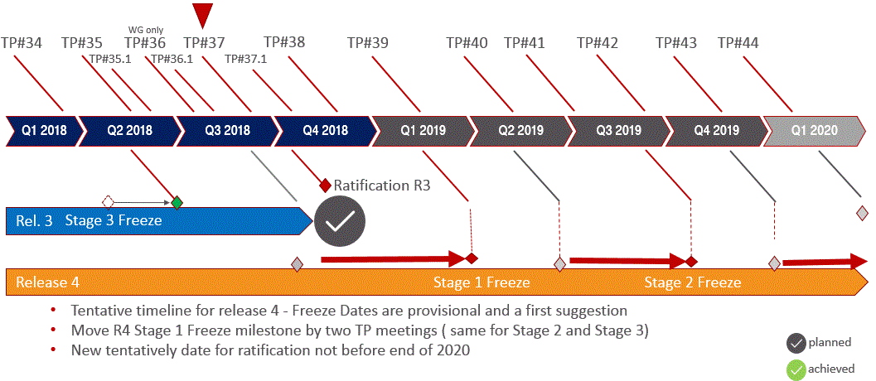
Timeline Release 3 and Release 4

Slide 11
Next Steps
Release 3 ratification
  dedicated CC TP37.1 / or during TP38 f2f
Release 4 planning
  Assess timing of R4
    Provisional milestones for stage 1, stage 2, stage 3 and ratification suggested (slide 10)
Update Work Program post TP#37
  document ADM-0001 oneM2M Work Program-V37.0.0
  WPM member portal

Slide 12
Next Meetings
WPM 37.1 Conference Call
  Tue, Nov 27th 12:00-13:30 GMT
WPM 38 Face to Face Meeting
  Tue, Dec 4th 12:30-13:30 (local time) t.b.c.

