Slide 1
WPM status report TP#38
WPM convenor, Roland Hechwartner, roland.hechwartner@t-mobile.at
2018-12-07
TP-2018-0297R01-WPM_status_report_TP#38

Slide 2
WPM Status at TP#38 closing
Content
WI Snapshot
Activities since TP37
Items for TP decision
Release 3 & Release 4 Timeline
Next Steps

Slide 3
TP 38 opening - WI Snapshot*
* See full work program status in ADM-0001-Work Program Management v38.0.0.
Work Items targeting Release 4
WI-0079 - Rel-4 Small Technical Enhancements
WI-0046 – Vehicular domain enablement
WI-0064 - Adaptation of oneM2M for Smart City
WI-0069 – Heterogen. identificat. service in oneM2M syst.
WI-0076 - Lightweight oneM2M Services
WI-0080 - Edge and Fog Computing
WI-0082 - 3GPP V2X Interworking
WI-0083 - oneM2M Service Subscribers and Users
WI-0065 - Trust Management in oneM2M
WI-0068 - GlobalPlatform Interworking
WI-0077 - Attribute Based Access Control Policy
WI-0053 - Enhancements on Semantic Support (R3 => R4)
WI-0070 - Disaster Alert Service Enabler
WI-0071 - oneM2M and W3C Web of Things Iwk
WI-0075 – Ind. Dom. Inf. Model Mapg. & Sem. Spt.
WI-0081 - Smart Device Template 4.0
WI-0084 – SDT based Information Model and Mapping for Vertical Industries
WI-0088 - M2M/IoT Application and Component Configuration
WI-0086 - Conformance Test Specifications Release 4
WI-0090 - oneM2M and Zigbee interworking
WI-0091 - oneM2M Services and Platforms Discovery
WI-0092 - Railway Domain Enablement
41 active work items of which
  3 work items @ 100% (to be closed)
  WI-0056 - Evolution of Proximal IoT Interworking
  WI-0031 – Optimized Group-based Operation
  WI-0035 – Action Triggering
1 new work items proposed at TP#38
  Action triggering enhancements
Release planning
  Release 3: ratification
    ADM-0017 Release 3 Control Document V3.0.0
  Release 4: Stage 1 Freeze milestone atTP#39

Slide 4
41 active WIs*
Release 4 candidates marked in blue
Generic WIs
WI-0049 - Rel-1 & 2 Maintenance
WI-0050 - Rel-3 Small Technical Enhancements
WI-0079 - Rel-4 Small Technical Enhancements
REQ WG
WI-0015 - oneM2M Use Case Continuation
WI-0046 – Vehicular domain enablement
WI-0092 - Railway Domain Enablement
ARC WG
WI-0031 – Optimized Group-based Operation
WI-0035 – Action Triggering
WI-0047 - DDS usage in oneM2M system
WI-0056 - Evolution of Proximal IoT Interworking
WI-0058 – Interworking with 3GPP networks
WI-0064 - Adaptation of oneM2M for Smart City
WI-0069 – Heterogen. identificat. service in oneM2M syst.
WI-0072 – Modbus interworking
WI-0076 - Lightweight oneM2M Services
WI-0080 - Edge and Fog Computing
WI-0082 - 3GPP V2X Interworking
WI-0083 - oneM2M Service Subscribers and Users
WI-0087 - Summary of differences between Release 2A & Release 3
WI-0089 - Getting started with oneM2M
WI-0090 - oneM2M and Zigbee interworking
WI-0091 - oneM2M Services and Platforms Discovery
PRO WG
-
SEC WG
WI-0021 – Secure Environment Abstraction
WI-0065 - Trust Management in oneM2M
WI-0066 - Decentralized Authentication
WI-0068 - GlobalPlatform Interworking
WI-0077 - Attribute Based Access Control Policy
MAS WG
WI-0053 - Enhancements on Semantic Support (R3 => R4)
WI-0070 - Disaster Alert Service Enabler
WI-0071 - oneM2M and W3C Web of Things Iwk
WI-0075 – Ind. Dom. Inf. Model Mapg. & Sem. Spt.
WI-0081 - Smart Device Template 4.0
WI-0084 – SDT based Information Model and Mapping for Vertical Industries
WI-0088 - M2M/IoT Application and Component Configuration
TST WG
WI-0051 - Security Functions Conformance Testing
WI-0054 - Developers guide series
WI-0060 - Interoperability testing Release 2
WI-0074 - Conformance Test Specifications Release 2
WI-0078 - oneM2M API guide
WI-0085 - Conformance Test Specifications Release 3
WI-0086 - Conformance Test Specifications Release 4
* status in ADM-0001-Work Program Management v38.0.0.

Slide 5
Activities since TP#37
f2f meeting at TP37
WPM 37.1 virtual meeting / no f2f meeting at TP38
Review of work program status
  ADM-0001-oneM2M Work Program V37.2.0
Release 3
  Review to prepare for agreement of List of dliverables in ADM-0017 Release 3 Control Document
  Ratification @ TP38 opening - see ADM-0017 Release 3 Control Document v0.9.0 => v3.0.0
Release 4
  Assessment of provisional milestones shown on timelines
  Stage 1 Freeze milestone at TP39 => Ratification of Release 4 EoY 2020

Slide 6
Items for TP Decision
TP is kindly requested to agree to close the following work items:
  WI-0031 – Optimized Group-based Operation
  WI-0035 – Action Triggering
  WI-0056 - Evolution of Proximal IoT Interworking

Slide 7
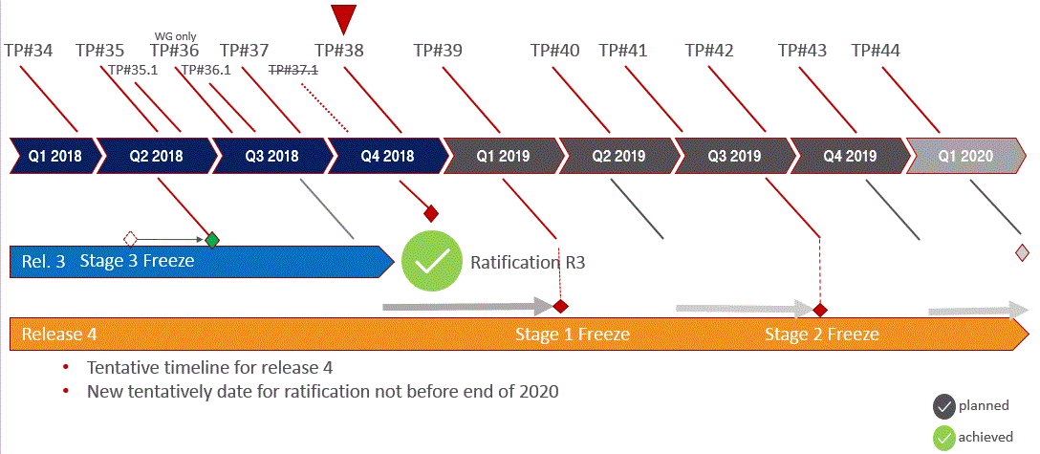
Timeline Release 3 and Release 4

Slide 8
Next Steps
Release 4 planning
  Assess timing of R4
    Provisional milestones for stage 1, stage 2, stage 3 and ratification suggested (slide 7)
Update Work Program post TP#38
  document ADM-0001 oneM2M Work Program-V38.0.0
  WPM member portal

Slide 9
Next Meetings
WPM 38.1 Conference Call
  t.b.d.
WPM 39 Face to Face Meeting
  Tue, Feb 19th 12:30-13:30 (local time) t.b.c.

