Slide 1
Overview of OCEAN’s OSIF
Group Name: TP
Source: InSong Lee, SeungMyeong Jeong (KETI)
Meeting Date: 2018-12-03 to 2018-12-07

Slide 2
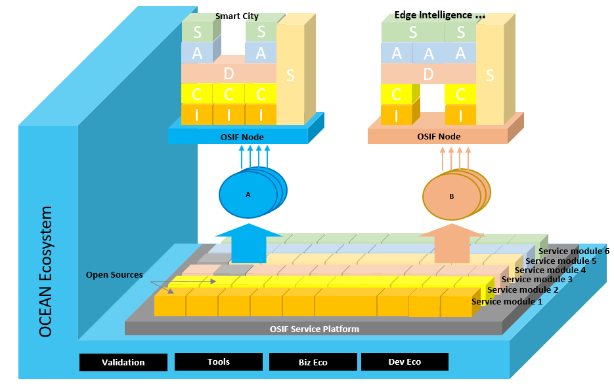
OSIF(Open Service Integration Framework)
Concept of OSIF
  OCEAN offers various open sources such as Mobius, nCube
  Has been developed for people who feel difficult to use service from OCEAN
  OSIF let people easy to use open source
    Run the program easily by using Web UI
    Make a system by choosing service block which is fit to Service

Slide 3
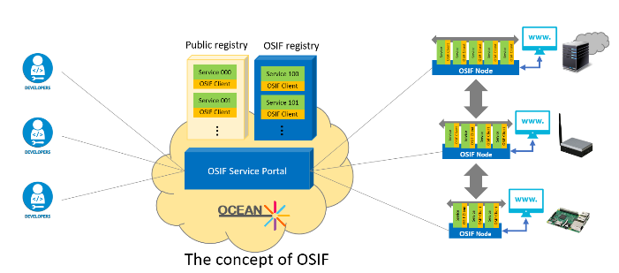
OSIF overview
Support the Microservices architecture
  Use several OCEAN’s program to solve the one problem
  Can be used any service such as smart city server, edge intelligence server
Provide OSIF data grid among services using Hazelcast’s IMDG (In-Memory Data Grid)
  Manage dispersed objects like a same object: once update Node 1 object, Node 3 object will be updated automatically
Manage the lifecycle of services: download, monitor, run, stop, and delete by Web UI

Slide 4
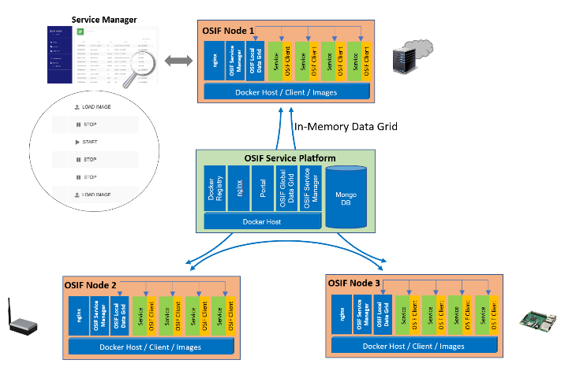
OSIF overview
OSIF Nodes are connected devices to OSIF Service Platform
  Blue color boxes are common module which is used in running micro services
  Green and yellow boxes are service modules on OSIF Node
As using IMDG, once data is updated in OSIF Service Platform, data is also updated on the gateway or device level

Slide 5
OSIF portal

Slide 6
OSIF portal

Slide 7

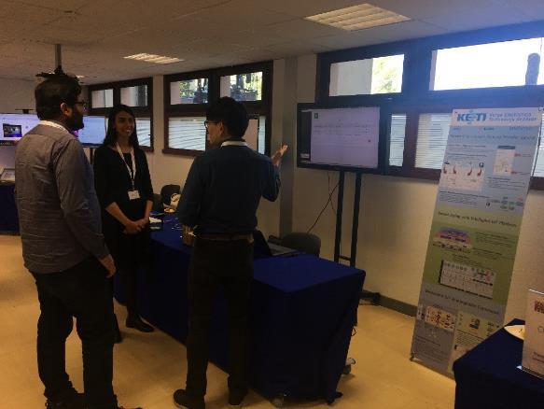
OSIF at ETSI IoT Week
OSIF was introduced in KETI booth at 2018 ETSI IoT Week

