Slide 1
oneM2M Technical Plenary #39
Intro
Xavier Piednoir
oneM2M Technical Plenary #39 (Malaga - Spain)
18.02.2019

Slide 2
Background
An action on International Digital Cooperation (InDiCo) with a view to create or strengthen links between Europe and a number of partners on the topic of ICT standardization. Running until end 2020.
To foster this international cooperation:
  Work to involve players on the EU side
  Build trust and understanding between partners (at policy/regulatory level as well as technical level)
  Support to the reduction of barriers to market access and the creation of a level playing field between the EU and partner countries
  Promote the work done with partners and support further technical cooperation

Slide 3
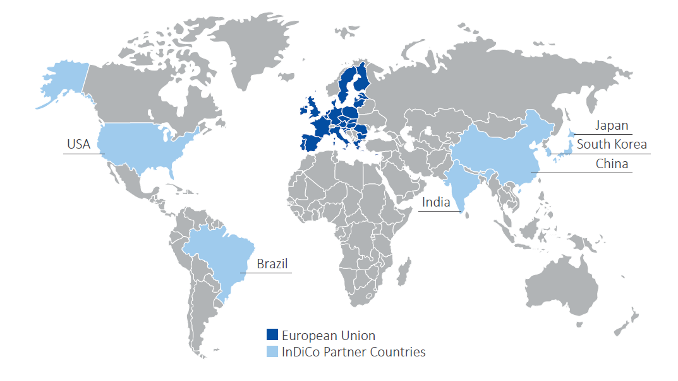
Scope: Geographical & Technical
GEOGRAPHICAL SCOPE
Cloud
Distributed Ledger Technologies
Intelligent Transport Systems
TECHNOLOGICAL PRIORITIES
IoT
Cybersecurity
Big Data

Slide 4
Focus on IoT
  A hot topic for everybody.
  Spans across verticals, each with their cultures, practices
  Brings a wealth of opportunities, and the challenges that come with them:
    Heterogenous devices/systems
    Potential large-scale fragmentation
    Security
  Consistency, Interoperability and Trust are key
InDiCo will work to support exchanges between EU and the partner countries with a view to create harmonised views and approaches towares these goals

Slide 5

Support to oneM2M
  Global partnership among SDOs and Industry Associations/Fora
  Successful collaboration between partners
Where the InDiCo project will provide support:
  Technical Activities in Europe (e.g. TP meetings)
  Promotion of oneM2M work and standards in the project's geographical scope
    In collaboration with oneM2M partners (India in the pipe, others to be discussed)
    Creation of oneM2M awareness in Brazil at various levels
    Example of India (currently with EU-India project, next with InDiCo):
      Tutorials, Developer Days and Hackathons for students and startups with TSDSI. Collaboration with C-DOT.
      Workshops connecting industry and policy makers, advocating standards-based approaches for Smart Cities
Action to be further shaped based on exchanges with partners + oneM2M leadership

Slide 6
Thank You!
Contact: indico@etsi.org

