Slide 1
Update Agoria Meeting
Group Name: TP#39
Source: Roland Hechwartner, TPC, Deutsche Telekom
Meeting Date: February 20, 2019

Slide 2
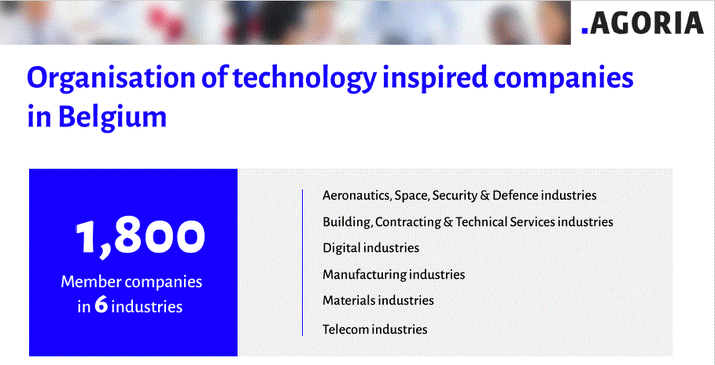
Agoria – Update
1st meeting of the ‘IoT expert group – Standardisation’ - Jan 31st 2019
  open to everyone interested
  Took place at
  After this first meeting only Agoria members, and official members of the ISO/IEC JTC1 SC41 mirror commission may join
introduced oneM2M organization & standard
  Well received, follow up expected
  E.g. hackathon, …
  Some companies know of resp. had implementations of oneM2M
Companies present: Agoria, AVR, BDO Crossroad, Akka, Altran, Cipal Schaubroeck, Barco NV, Vinçotte, UA, imec, Aloxy, Ugent, Atos
Companies informed: Microtron, Niko, Studiodott, Sirus, Tengu, Nokia, Bosch, Legrand Group, Atlas Copco, Agentschap wegen & verkeer, Sirris, Option, Ixor, KB Vlaanderen, Cegelec, Skylane, Novy NV

