Slide 1

SDS Status Report to TP39
Group Name: oneM2M SDS
Source: Dale Seed, Peter Niblett, SeungMyeong Jeong, Wei Zhou
Meeting Date: 2019-02-18 to 2019-02-22

Slide 2
Summary
WG3 Objectives for PRO 32.2 / PRO 33
  Review Actions
  Review TS/TR versions
  New TS/TR baselines
  Prioritize Rel-3 contributions for on Rel-3 ratification/publication
  Rel-4 contributions
Status details
  71 CRs agreed towards TSs (Mostly Rel-2 / Rel-3)
    18 TS-0001, 46 TS-0004, 2 TS-0026, 2 TS-0008, 2 TS-0009, 2 TS-0022 (Rel4), 1 TS-0034,
  23 CRs agreed towards TRs (Rel-4)
    TR-0024, TR-0026, TR-0033, TR-0044, TR-0050, TR-0052, TR-0054, TR-0055, TR-0056, TR-0057

Slide 3
CR Trends

Slide 4
Items for Discussion
How is the restructuring working out?
  Pros:
    Meetings have been more engaging and more participation!!!
  Cons:
    Throughput has slowed a bit (especially Rel-4 progress)
  → We have tried to schedule meetings to optimize things and selectively use ad-hoc sessions

Slide 5
Items for Decision
CR Packs:
TS-0001 R2 – TP-2019-0031 – 6 CRs
TS-0001 R3 – TP-2019-0032 – 12 CRs
TS-0004 R2 – TP-2019-0033 – 18 CRs
TS-0004 R3 – TP-2019-0034 – 28 CRs
TS-0008 R3 – TP-2019-0044 – 1 CR
TS-0008 R2 – TP-2019-0045 – 1 CR
TS-0009 R3 – TP-2019-0046 – 1 CR
TS-0009 R2 – TP-2019-0047 – 1 CR

Slide 6
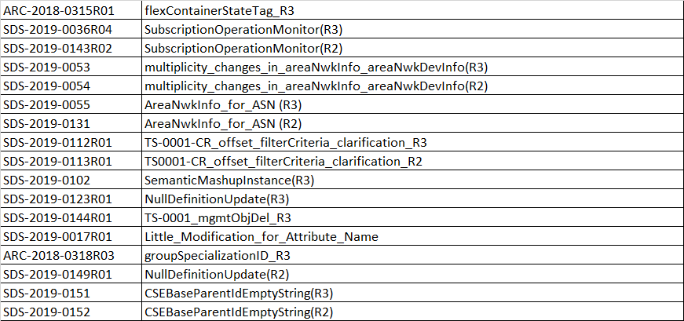
Agreed CRs TS-0001

Slide 7
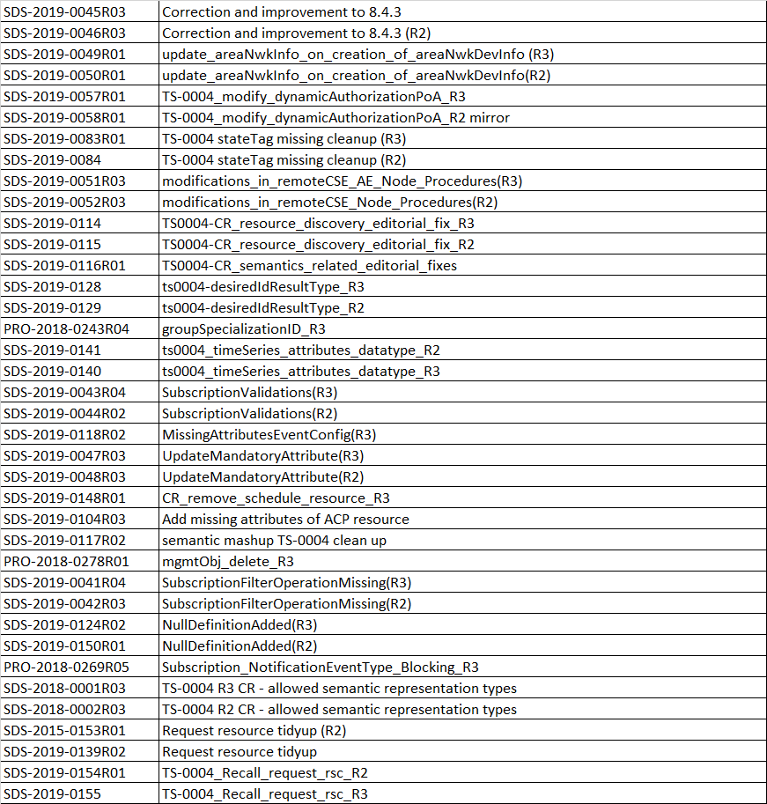
Agreed CRs TS-0004

Slide 8

Agreed CRs TS-0008 / TS-0009

Slide 9
Conference Calls
Meeting | Date | Time (UTC) | Priority / Focus
SDS 39.1 | Thurs 7-Mar-2019 | 12:30 – 14:00 | R2/R3
SDS 39.2 | Thurs 14-Mar-2019 | 12:30 – 14:00 | R4
SDS 39.3 | Thurs 21-Mar-2019 | 12:30 – 14:00 | R2/R3
SDS 39.4 | Thurs 28-Mar-2019 | 12:30 – 14:00 | R4
SDS 39.5 | Thurs 4-Apr-2019 | 12:30 – 14:00 | R2/R3
SDS 39.6 | Thurs 11-Apr-2019 | 12:30 – 14:00 | R4
SDS 39.7 | Thurs 18-Apr-2019 | 12:30 – 14:00 | R2/R3
SDS 39.8 | Thurs 25-Apr-2019 | 12:30 – 14:00 | R4

