Slide 1
WPM status report TP#41 opening
WPM convenor, Yongjing Zhang, zhangyongjing@huawei.com
2019-07-08

Slide 2
WPM Status at TP#41 opening
Content
WI Snapshot
WIs reaching Freeze or Approval milestone
Release 4 Timeline

Slide 3
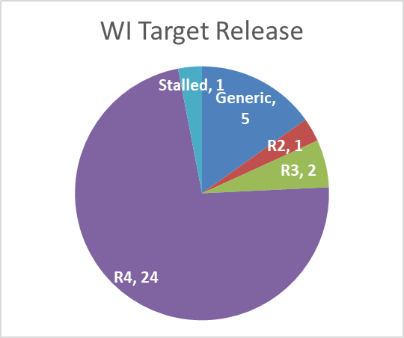
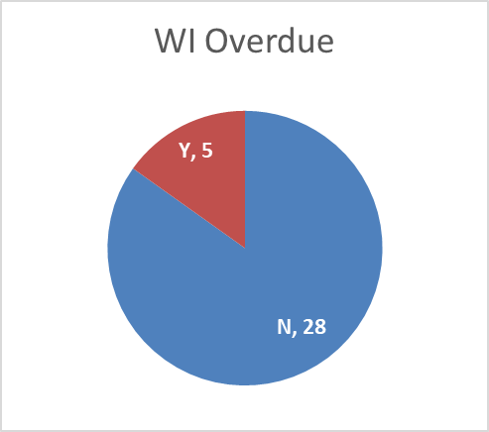
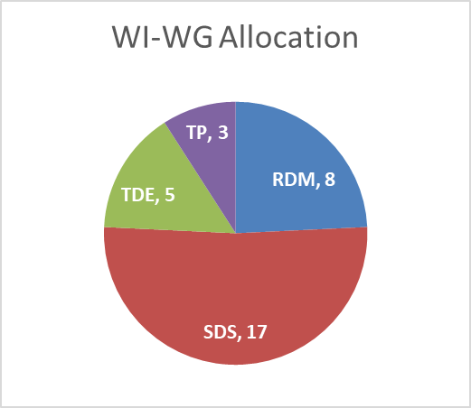
TP#41 opening - WI Snapshot
See full work program status @ TP41 opening in ADM-0001-Work Program Management v40.0.0.
33 active work items of which
Work Item Milestones targeted at TP#41
  1 WIs / their deliverables reach freeze date
  1 WIs / their deliverables reach approval date
  5 WIs / their deliverables missed approval/freeze dates
24 WIs target for Rel-4
Release 4 time line update
  Stage 1 Freeze TP40 – Q2 2019 : done!
  Stage 2 Freeze TP43 – Q4 2019
  Stage 3 Freeze TP45 – Q2 2020

Slide 4
33 active WIs*
Release 4 candidates marked in blue
Generic WIs
WI-0049 - Rel-1 & 2 Maintenance
WI-0050 - Rel-3 Small Technical Enhancements
WI-0079 - Rel-4 Small Technical Enhancements
RDM WG
WI-0015 - oneM2M Use Case Continuation
WI-0046 – Vehicular domain enablement
WI-0070 - Disaster Alert Service Enabler
WI-0075 – Ind. Dom. Inf. Model Mapg. & Sem. Spt.
WI-0081 - Smart Device Template 4.0
WI-0084 – SDT based Information Model and Mapping for Vert. Ind.
WI-0092 - Railway Domain Enablement
WI-0094- Ontologies for Smart City Services (OSCS)
SDS WG
WI-0053 - Enhancements on Semantic Support
WI-0058 – Interworking with 3GPP networks
WI-0064 - Adaptation of oneM2M for Smart City
WI-0066 - Decentralized Authentication
WI-0069 – Heterogen. identificat. service in oneM2M syst.
WI-0071 - oneM2M and W3C Web of Things Iwk
WI-0072 – Modbus interworking
WI-0076 - Lightweight oneM2M Services
WI-0077 - Attribute Based Access Control Policy
WI-0080 - Edge and Fog Computing
WI-0082 - 3GPP V2X Interworking
WI-0083 - oneM2M Service Subscribers and Users
WI-0088 - M2M/IoT Application and Component Configuration
WI-0089 - Getting started with oneM2M
WI-0090 - oneM2M and Zigbee interworking
WI-0091 - oneM2M Services and Platforms Discovery
WI-0093 - Action Triggering Enhancements
TST WG
WI-0054 - Developers guide series
WI-0060 - Interoperability testing Release 2
WI-0078 - oneM2M API guide
WI-0085 - Conformance Test Specifications Release 3
WI-0086 - Conformance Test Specifications Release 4
* status in ADM-0001-Work Program Management v38.2.0.

Slide 5
Freeze at TP#41
* FREEZE is per TS/TR.

Slide 6
Approval at TP#41
* APPROVAL is per TS/TR.

Slide 7
Overdue WIs
5 overdue WIs among 33 active ones
Proposal:
WI-0066: Close it @TP41. (TR-0041 already approved. No plan to work on TS).
WI-0054,0060,0078: approve the deliverables and close the WIs when ready.
WI-0088: consider to update the WID milestones.

Slide 8
Timeline Release 4
TP#38
TP#39
TP#40
TP#41
TP#42
TP#43
TP#44
TP#45
TP#46
TP#47
TP#48
TP#49
Q4 2018
Q1 2019
Q2 2019
Q3 2019
Q4 2019
Q1 2020
Q2 2020
Q3 2020
Q4 2020
Q1 2021
Q2 2021
Release 3
Ratification R3
Release 4
Stage 1 Freeze
Stage 2 Freeze
Stage 3 Freeze
R4 Appr./Rati.
R4 Stage 1 Frozen by TP#40 – done!
New tentatively date for R4 ratification at Q1 2021
planned
achieved

