Slide 1

Welcome to Shanghai oneM2M TP#41 Meeting
Organized By CCSA
Supported by Huawei

Slide 2
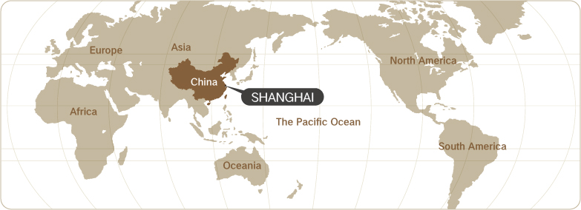
Location of Shanghai
2
1
3
4
Shanghai literally means the city by the sea. Right in the middle of China's east coastline, Shanghai is an excellent sea and river port, boasting easy access to the vast hinterland.
5
6

Slide 3
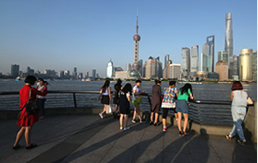
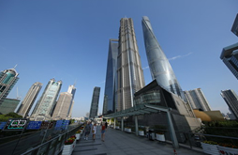
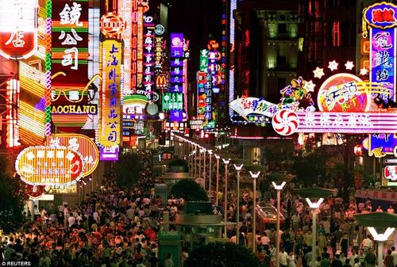
Shanghai’s Attractions
Throughout the past century, Shanghai has had numerous name tags attached to it; like "Paris of the Orient" and "Pearl of China". As the largest and most prosperous city in the nation, Shanghai is the economic, financial and cultural center of China.
The Bund, The Bund (Waitan) is one of the most noted architectural symbols of Shanghai. The Bund in Shanghai was first used when the first British company opened a office there in 1846.
Lujiazui, Lujiazui literally means "Lu's Mouth". It is located in the Pudong New Area on the eastern bank of Huangpu River just acrossing the Bund. Lujiazui is teemed with the futuristic, avant-garde buildings - Oriental Pearl Tower, Jin Mao Building, Bank of China Tower, Shanghai World Financial Center and Shanghai Tower
Nanjing Road Pedestrian Street, is the main shopping street of Shanghai. Today's Nanjing Road comprises two sections,Nanjing Road East and Nanjing Road West.The entirety of Nanjing Road has been a centre of commerce in Shanghai for more than a century.
2
1
3
4
5
6

Slide 4
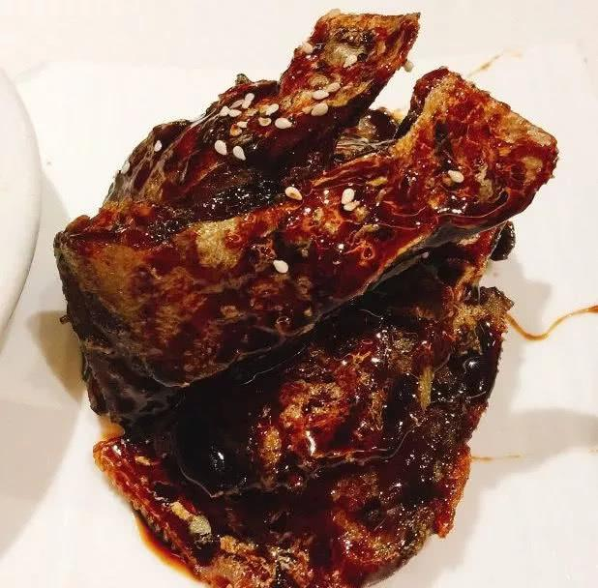

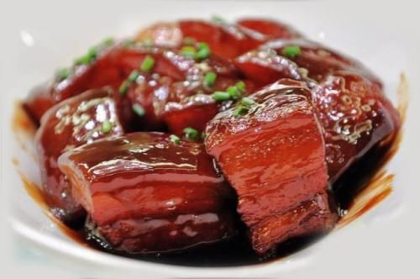
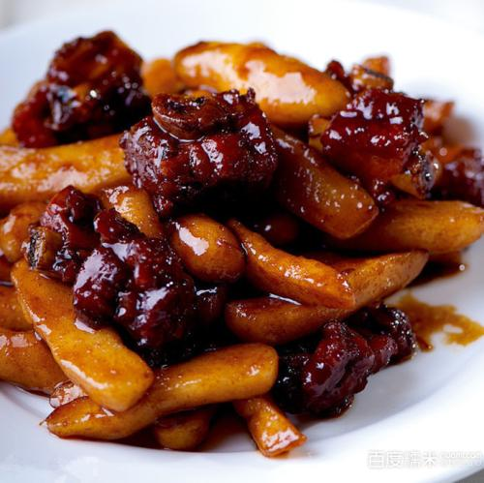
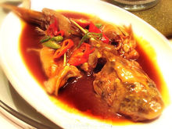
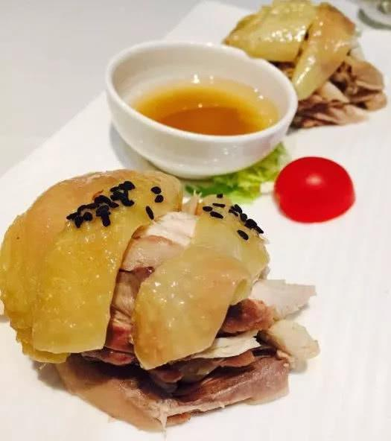
Shanghai Local Food
Shanghai Smoked Fish
上海熏鱼
Pan-Fried Pork Bun
生煎包
Braised pork in brown sauce
红烧肉
Spare Ribs with Rice Cake
排骨年糕
Braised catfish
红烧鮰鱼
Hand tore salty chicken
手撕咸鸡

Slide 5
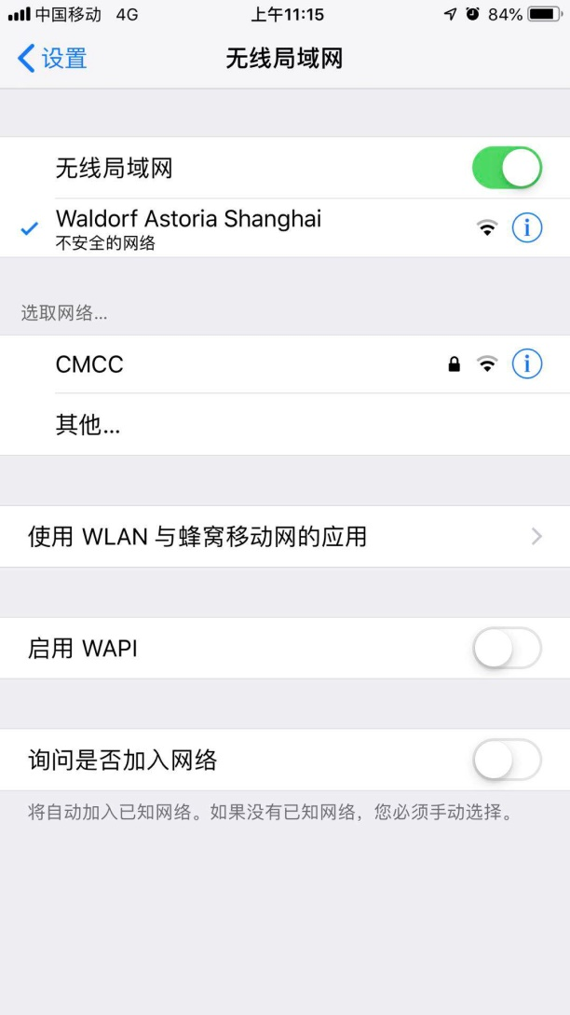
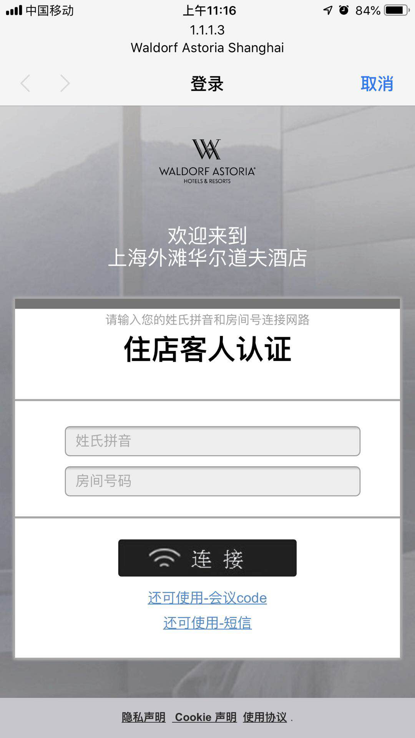
WLAN guideline
SSID：Waldorf Astoria Shanghai
Choose “会议code”and input “shawa1”

Slide 6
Lunch
LUNCH – Sponsored by Huawei
Huawei will provide buffet lunches for all the delegates.
Location: Grand Brasserie -- Waldorf Astoria Tower Ground Level（百味园——华尔道夫酒店下沉一层）
Time: 12:00-13:30 Monday - Friday

Slide 7
Cocktail Reception
COCKTAIL RECEPTION
Location: Long Bar -- Waldorf Astoria Club Lobby Level（廊吧——华尔道夫会所大堂楼层）
Time: July 10, Wednesday night (19:00-20:30)

Slide 8
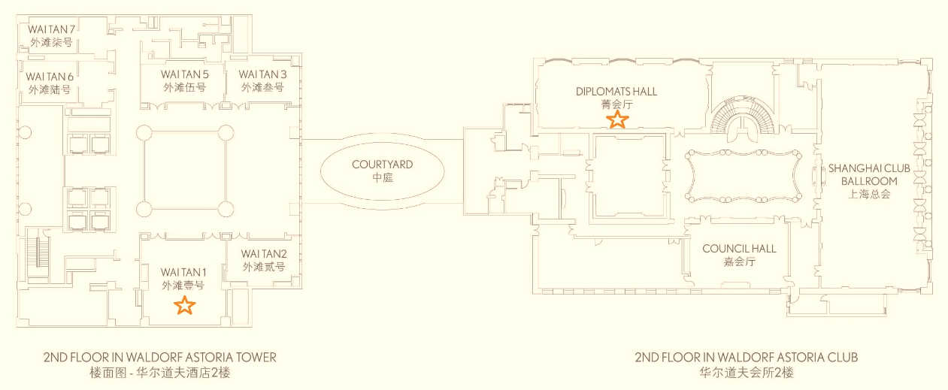
Floor Plan
Main Room: DIPLOMATS HALL; Break Room: WAITAN 1

Slide 9
Local Staff
If you need any help during your stay, you may find local staff from CCSA at the registration desk out side of the meeting room.
For any emergency please contact us at:
Mr. Shizhuo ZHAO (+86-13671348485)
Mr. Xu QI (+86-13466723696)

Slide 10
Have a successful meeting and enjoy your stay in Shanghai!

