Slide 1
TP42 meeting
Hyderabad, India
September 2019

Slide 2
Recent oneM2M coverage
Press releases
Topic | Online | Social Media | Print
Marcom appointments | 66 | 17
India workshop | 30 | 29
Technical Excellence Awards | 34 | 10
Industry Day | 25 | 18
Total | 155 | 74 | 0

Slide 3
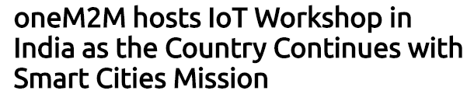





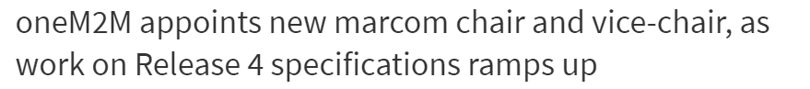








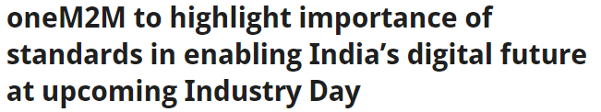

Press Release Coverage Highlights

Slide 4



Upcoming editorial coverage
  A feature on Smart Cities will appear in its November edition.
  A feature on IoT data models will be published in IEEE’s IoT September edition.
  A comment piece on securing smart cities in IT Pro Portal.

Slide 5






Features lined up

Slide 6

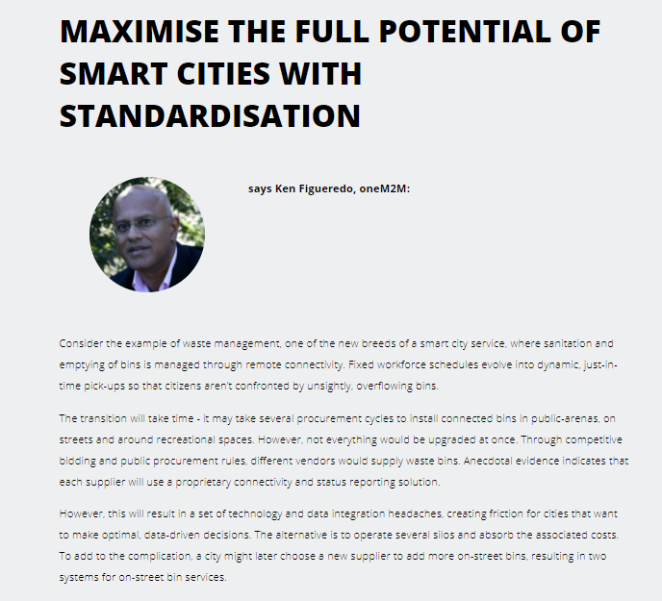
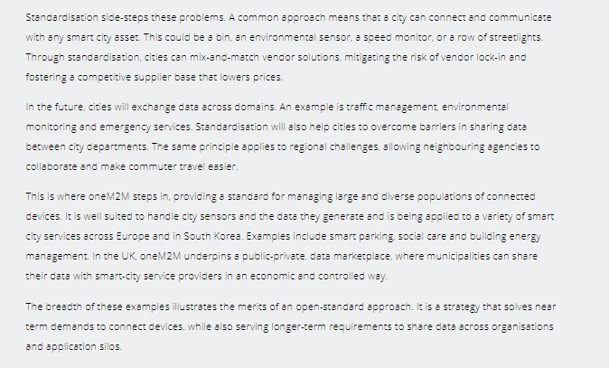
Contributed Content Highlights
    A piece by Ken Figueredo on the importance of standardisation in Smart Cities was published in Digitalisation World.

Slide 7

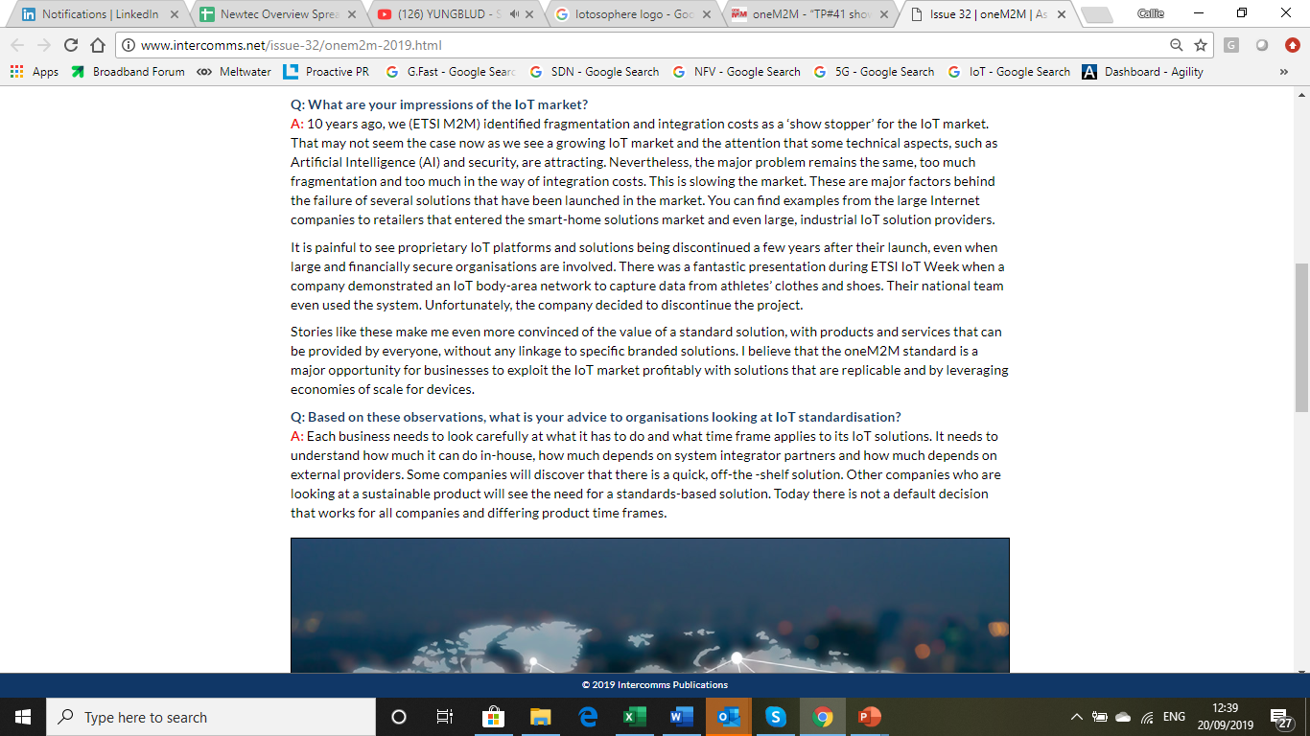
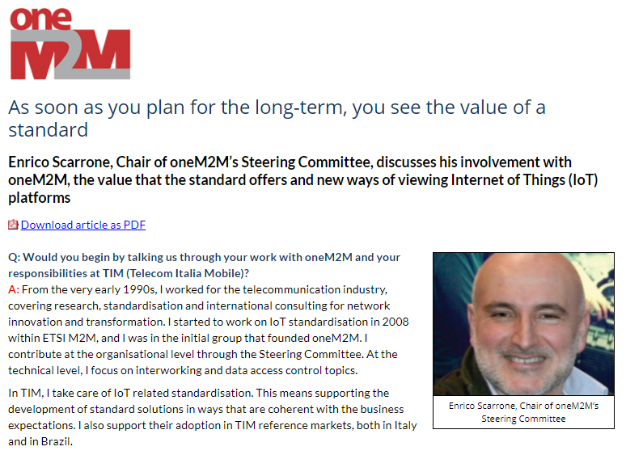
Contributed Content Highlights
    The executive interview with Enirco Scarrone has been published in Intercomms.

Slide 8
Upcoming Press Releases
Press releases in the pipeline
    A release announcing oneM2M and the IoT Connectivity Alliance’s partnership is currently being approved.
    A news release detailing the latest project work between ATIS, OFC and oneM2M is on the cards.
    A press release will be drafted on the Indian Government smart cities bid if successful.
    A release is also planned to announce the oneM2M demos at ETSI IoT Week.
    Once the information is available, a press release will be produced on oneM2M’s presence at IoT Week Korea.
    A news story sharing the details of Release 4 is also on the horizon.

Slide 9

Executive Interviews
  EE World has agreed to host an article on the Executive Interview with Aurindam Bhattacharya of C-DOT, on smart cities.
  An Executive Interview with Dale Seed, of Convida Wireless, was published on the activities at TP41.
  An Executive Interview three-part series on market adoption in South Korea is also currently being finalised. This will be published in the run up to IoT Week Korea.

Slide 10
Upcoming speaking slots
Event name | Date | Location | Topic | Audience | Reach | Level | Speaker?
IoT Security Summit | October 31-Nov 1 | Alanta, Georgia | IoT, security, securing data, Blockchain, edge-computing. | High-level executives across a range of industry sectors. | Global | 1 | Still requires speaker.
Smart Cities Summit | October 31- November 1, | Sheraton Atlanta, GA | Smart Cities, IoT, data | Event for government and technology decision-makers mapping America’s smart cities. | America | 1 | Syed Hossain, of ATIS will moderate a panel at the event.
Industrial IoT World | October 31- November 1, | Sheraton Atlanta, GA | IIoT, IoT, Industry 4.0, digital transformation, emerging tech. | IoT professionals from a range of industry verticals. | Global | 2 | Still requires speaker.
Smart Home Summit | November 18-20 | San Francisco, US | Smart home, smart lighting, consumer tech, AI. | Cross-departmental IoT decision-making teams, across: government/public infrastructure, manufacturing, energy, buildings, transportation, & electronics (OEM’s), as well as other BtoB IoT segments | Global | 1 | Still requires speaker.

Slide 11

oneM2M and GCF partnership
The GCF has invited oneM2M to co-exhibit at a number of industry events:
Mobile World Congress Los Angeles (opportunity still available)
Mobile World Congress India (opportunity still available)
IoT Solutions World Congress (Chordant will co-exhibit with the GCF and provide a oneM2M demo at the GCF’s booth. A press release will be drafted on the demo and co-exhibition.

Slide 12
How The TP Can Help
Take advantage of available speaking slots. Speaking slots give oneM2M a valuable platform to reach a much wider audience and it is important that these opportunities are not missed as and when they arise.
If you have taken part in a speaking opportunity on behalf of oneM2M, please share any feedback of the event with the Marcom team.
  Share any interesting activity or relevant updates which would make good content for press releases, features, white papers and social media. This is crucial in order for oneM2M to continue building its presence in the IoT sector and across the telecom industry. This also allows oneM2M to maintain a fresh and dynamic presence online.
  Please share any interesting projects, work area updates and events with us by completing our PR questionnaire.
Suggest future topics for webinars and help progress them.
Share relevant exposure of oneM2M-related content.
  Please keep us updated on any member companies that are speaking about oneM2M at events.
  Share progress and information regarding Release 4.
  Please share details of industry alliances that oneM2M has and how they are progressing.

