Slide 1
oneM2M Object License Update
A request by OMA
Group Name: TP#43
Source: Roland Hechwartner, TPC, Deutsche Telekom
Meeting Date: December 2, 2019

Slide 2
oneM2M Object License Update
oneM2M submitted objects into the OMA LightweightM2M (LwM2M) Object and Resource Registry under the ext-label Objects
  http://openmobilealliance.org/wp/OMNA/LwM2M/LwM2MRegistry.html (2048-2057)
OMA at the moment is collaborating with OneData Model (OneDM) to make the Objects more widely available with an agreed BSD-3-clause license.
Currently, the oneM2M Objects don’t have any license applied
  Please note, that the SDT 4.0 will be made available under the BSD-3-clause license
OMA approached oneM2M to update the oneM2M submitted objects with the BSD 3-clause license.
  If agreed by oneM2M, OMA (Sean McIlroy) will apply all the changes
Final decision has to be taken by the SC / LG based on support by membership
Decision required by TP (WGs):
Does TP agree to suggest to oneM2M SC/LG to apply BSD-3-clause license to oneM2M objects, which have been and will be submitted to the OMA LightweightM2M (LwM2M) Object and Resource Registry?

Slide 3
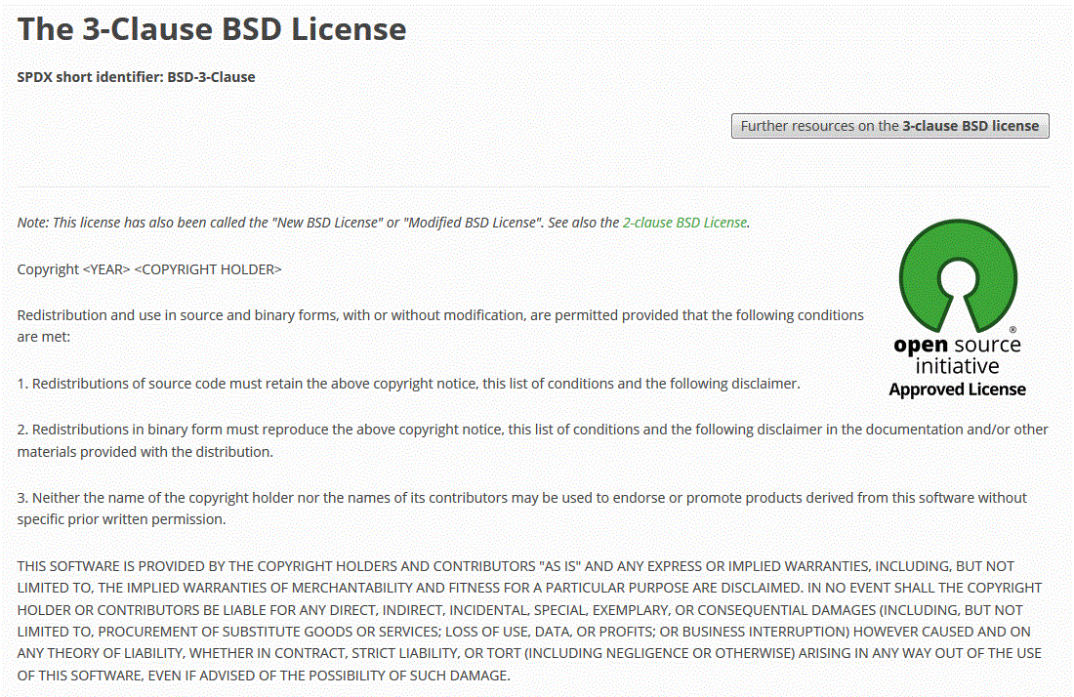
Annex
oneM2M submitted Objects
BSD-3-Clause license
http://openmobilealliance.org/wp/OMNA/LwM2M/LwM2MRegistry.html#extlabel
https://opensource.org/licenses/BSD-3-Clause
URN / Version | XML Name | LwM2M Editor | Object Name | Technical Specification | Owner
urn:oma:lwm2m:ext:2048 | 2048 | 2048 | CmdhPolicy |  | oneM2M
urn:oma:lwm2m:ext:2049 | 2049 | 2049 | ActiveCmdhPolicy |  | oneM2M
urn:oma:lwm2m:ext:2050 | 2050 | 2050 | CmdhDefaults |  | oneM2M
urn:oma:lwm2m:ext:2051 | 2051 | 2051 | CmdhDefEcValues |  | oneM2M
urn:oma:lwm2m:ext:2052 | 2052 | 2052 | CmdhEcDefParamValues |  | oneM2M
urn:oma:lwm2m:ext:2053 | 2053 | 2053 | CmdhLimits |  | oneM2M
urn:oma:lwm2m:ext:2054 | 2054 | 2054 | CmdhNetworkAccessRules |  | oneM2M
urn:oma:lwm2m:ext:2055 | 2055 | 2055 | CmdhNwAccessRule |  | oneM2M
urn:oma:lwm2m:ext:2056 | 2056 | 2056 | CmdhBuffer |  | oneM2M
urn:oma:lwm2m:ext:2057 | 2057 | 2057 | CmdhBackOffParametersSet |  | oneM2M

