Slide 1
oneM2M Short Name Finder
oneM2M TP#44
SeungMyeong Jeong (KETI)

Slide 2
Motivation
Short names are encryptic, so developers should check the short-long name pairs several times to momorize them
  This is the reason that SDS#44 has one proposal to use long names (optional feature)
Finding short names in TS-0004 is tough and even tedious
  open TS-04 (WORD version takes quiet time to open it), search for keyword and then navigate different clauses, tables to find a match
So, why don’t we have a tool with nice UX, easy accessibility and, of course, fast
  UX: search for short name, long name, occurs in, category (individually and as combination)
  accessibility and speed: single page HTML + Javascript application with no installation so it also works on local PCs

Slide 3
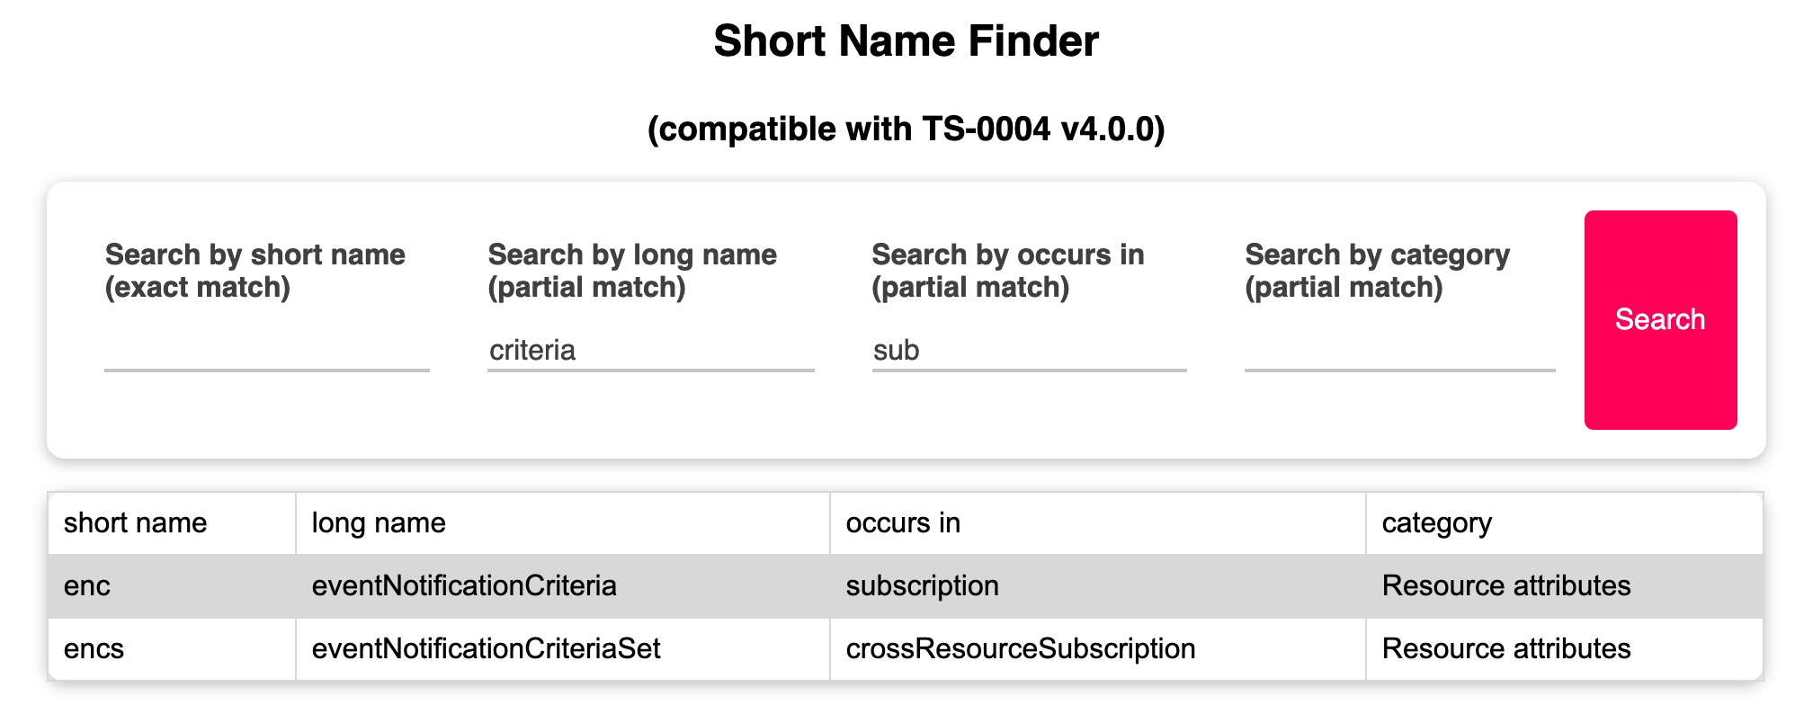
Search Features
A short name is searched with exact match, others apply partial string match
You can check if a short name that I want to define is used or not
You can also see existing definitions with search keyword combinations for those 4 criteria

Slide 4
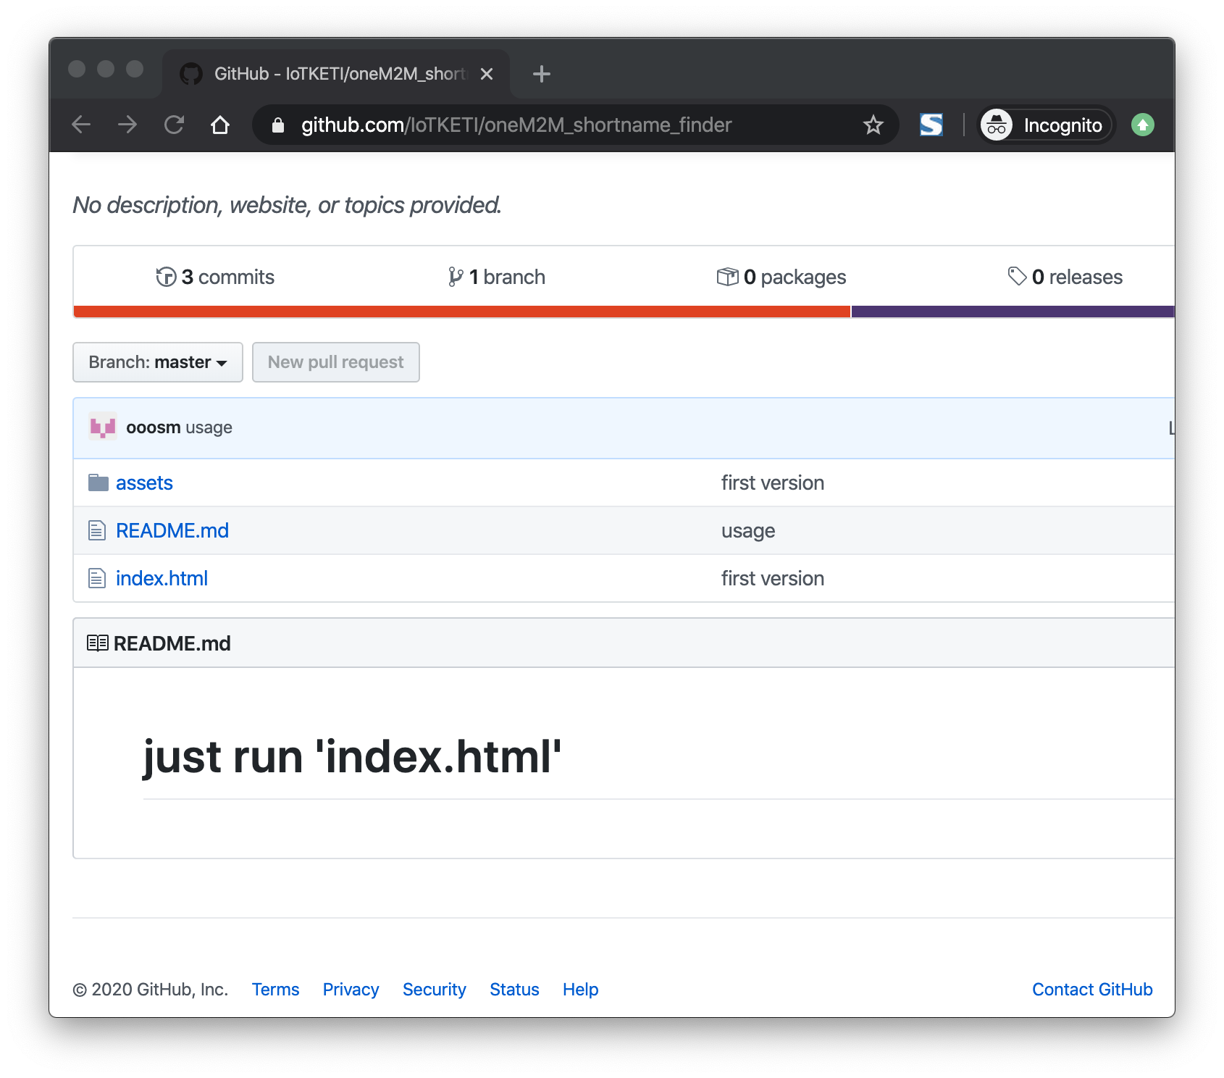
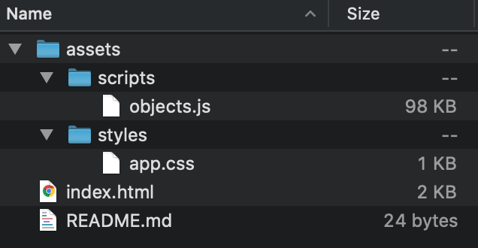
How it works
1 HTML with 1 Javascript and 1 CSS
If you want to use it locally, just download the latest one from github
  https://github.com/IoTKETI/oneM2M_shortname_finder

Slide 5
Proposals and way forwards
Proposes to put this on to the new developer’s portal on oneM2M public web site
  So anyone can use, would access our website more often
Updates will be made per TS-0004 baseline update
  short name definitions will be applied by KETI using the other tool to extract all the short name definitions in TS-0004 automatically, not manually

