Slide 1
Architecture mapping of
GSMA OPG
Kenichi Yamamoto, KDDI

Slide 2
Background
GSMA has launched a project, Operator Platform Group (OPG), to define the architecture and technical requirements for a federated platform.
It is the desire of the GSMA to instruct existing SDOs with the realization of the requirements.
GSMA OPG plan to collaborate with the SDOs (e.g. invitation of the SDOs Chairs, Liaison Statements) to align the activities and they are considering oneM2M for this collaboration.
GSMA TEC(Telco Edge Cloud) Chair gave a presentation of GSMA OPG activity on July 16.
oneM2M needs to reply the SDO survey of GSMA OPG.
This contribution is for architecture mapping based on the SDO survey.

Slide 3
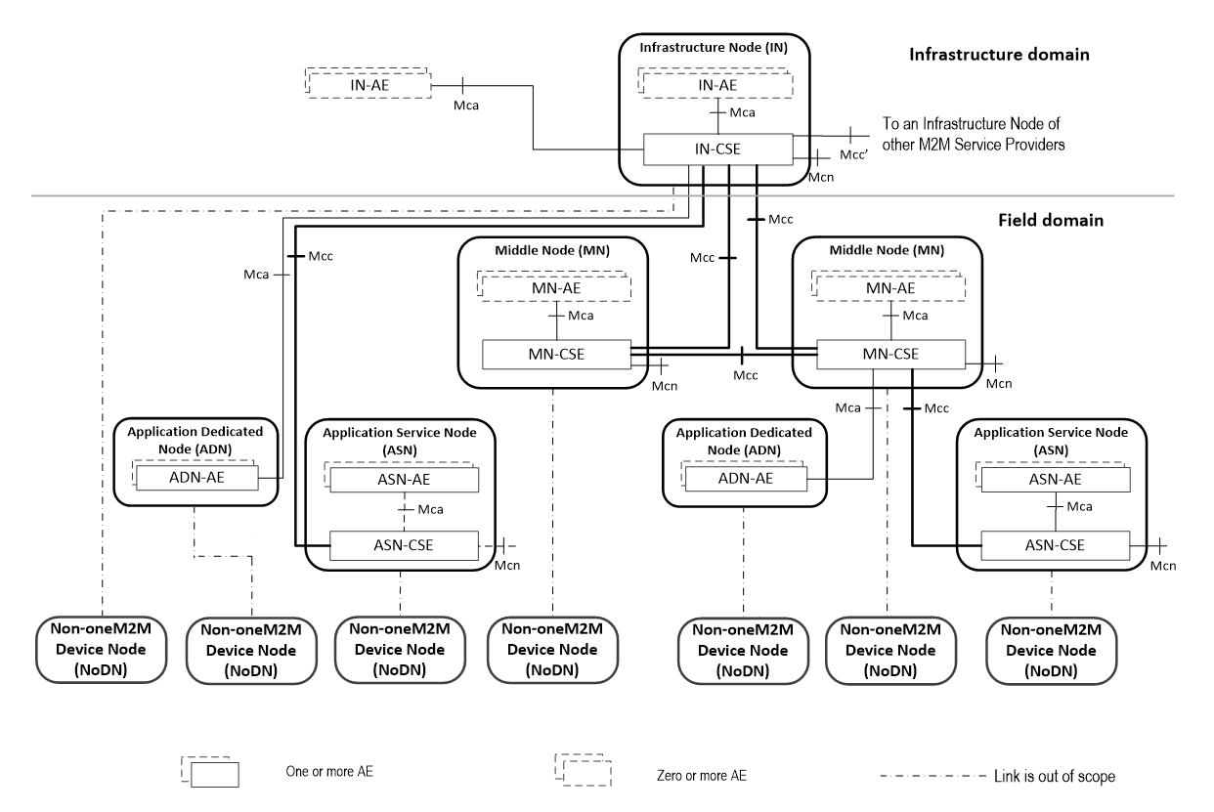
Architecture mapping between GSMA OPG and oneM2M
Application Provider
NBI (NorthBound Interface)
Operator
Platform 1
EWBI
(East-WestBound
Interface)
Operator
Platform 2
SBI-NR
UNI (User-Network Interface)
Network
Resources
User Client
APP APIs

Slide 4
Architecture mapping between GSMA OPG and oneM2M (cont.)
Northbound interface, in charge of service management and enabling fulfilment of enterprise and application provider use case requirements.
  This IF can be mapped between IN-CSE and IN-AE.
  oneM2M features may support some OPG requirements.
SBI-NR, allows access to network resources (e.g. 3GPP mobile data network)
  oneM2M supports 3GPP SCEF APIs and defines how to leverage those APIs.
  oneM2M features can support some OPG requirements (KDDI has already input SCEF/NEF requirements at GSMA OPG meeting on July) .
SBI CR, allows Access to cloud resources (e.g. operator VDC)
  oneM2M does not support the functionalities.
UNI, means for the User Client hosted in the user equipment
to communicate with the Operator PF.
  oneM2M may support the functionality.
  WI-0096 also studies to support GSMA TS.34.
EWBI, extends operator reach beyond own footprint,
this is the IF between instances of the Operator PF.
  oneM2M does not support the functionalities.
Application Provider
Application Provider
NBI (NorthBound Interface)
Operator
Platform 1
Operator
Platform 2
EWBI
(East-WestBound Interface)
SBI-NR
UNI (User-Network Interface)
Network
Resources
User Client
APP APIs

Slide 5
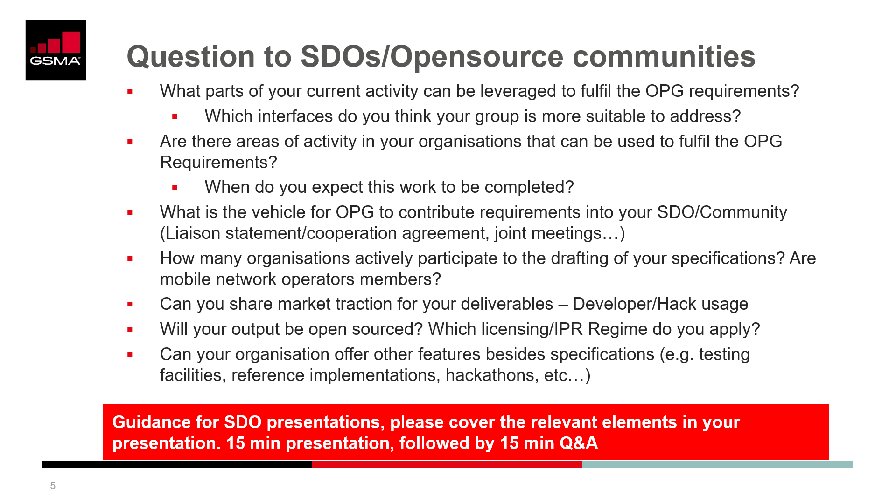
Next Steps
Based on the feedback / comments, we’ll prepare the SDO survey of GSMA OPG (TP-2020-0069R01).
NOTE: Regarding latest baseline document of GSMA OPG, please refer to the following meeting document.
https://www.gsma.com/aboutus/workinggroups/resources/opg-meeting-19-documents

