Slide 1
oneM2M Virtual 7th Interop Event
Summary
Laurent Velez, ETSI, laurent.velez@etsi.org
Keebum Kim, TTA, keebum.kim@tta.or.kr
Meeting Date: TP 48

Slide 2
Event Information
oneM2M 7th Virtual Interop Event
  Dates: From 16th (Mon) to 27th (Fri) Nov 2020
Organization
  The event is co-organized by ETSI and the TTA, and the European Project Indico, led by ETSI. (https://www.indico-ictstandards.eu/)
  Free of charge for participation.
  The company test results are confidential, participants need to sign the Non-Disclosure Agreement (NDA).
Purpose
  To validate the oneM2M standards in order to eliminate ambiguities and potential issues.
  To test interoperability between implementations from different companies.
  To provide conformance testing to verify the existing TTCN-3 test scripts as well as to debug participants’ implementations.

Slide 3



InDiCo project : Developing cooperation on ICT Policies, Regulations and
Standards between Europe and associated partners countries
Geographical scope:
Catalyst for
collaboration between EU and partner countries on
ICT standardization
Promote inclusive and industry-led cooperative processes for the development of global ICT standards
Help EU and partners understanding
each others'
regulatory frameworks and standardization models
Contribute to lower technical barriers to trade for players in
EU and partner countries
Technological priorities:
5G, IoT and Cybersecurity
implemented by
funded by the European Union
Notes:
Key message:
TO-DO:
Update the slide (INDICO team action point).
Script (Portuguese):
Além de projetos de pesquisa, como o 5G Range, o Brasil também trabalha como um país parceiro de atividades de padronização nos setores de ICT. Nós fazemos parte também de um projeto chamado InDiCo que tem como objetivo ser um catalizador de colaborações entre diferentes parceiras, empresas e governos, pra promoção de padrões internacionais.
As atividades do InDiCo involvem discussões de regulamentação das tecnologias e de diferentes padrões, como por exemplo o padrão 5G do 3GPP.
Um dos objetivos é diminuir as barreiras e os custos para a implantação das tecnologias no mundo.
Além do Brasil, países como estados Unidos, Índia, Japão, Coréia e China fazem parte do projeto, além da União Européia.
As tecnologias envolvidas nas discussão, além do 5G, incluem também IoT, big data, computação em núvel, blockchain, dentre outras.
Script (English):

Slide 4
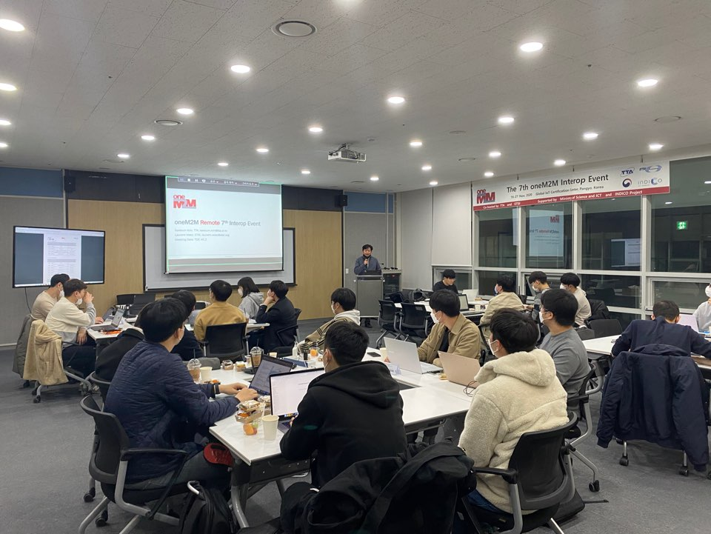
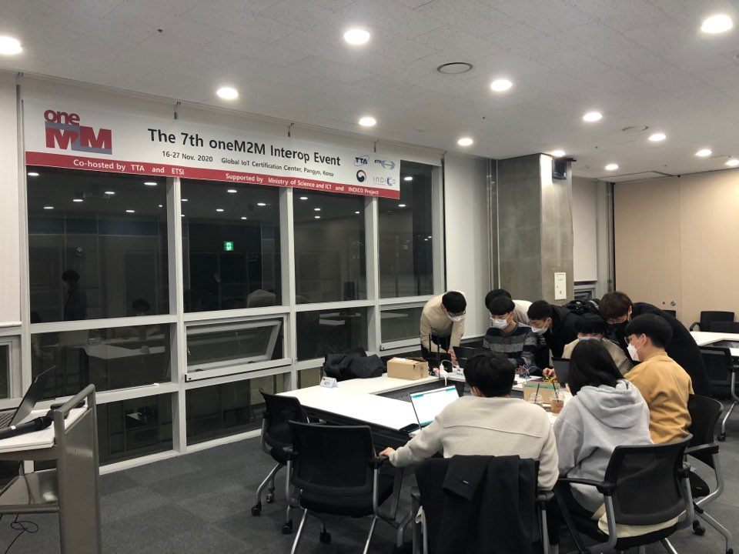
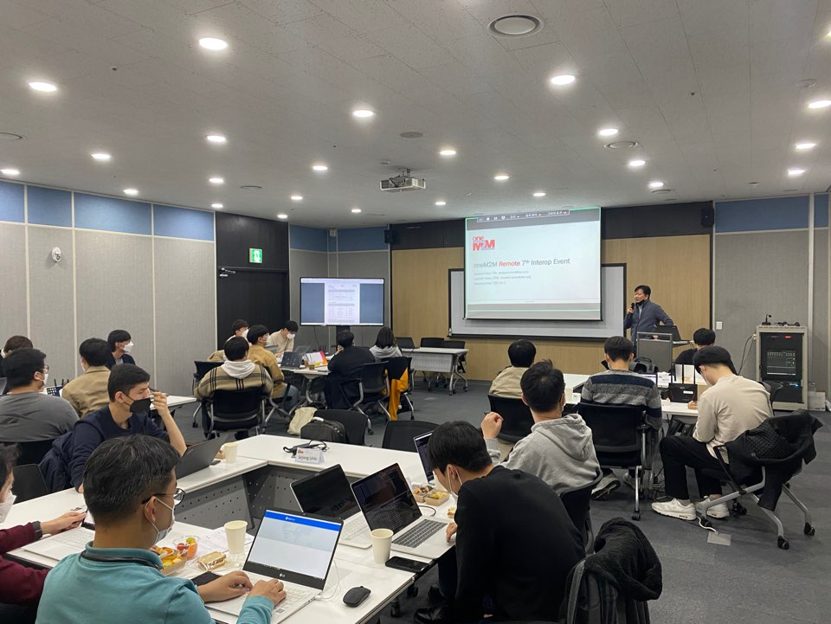
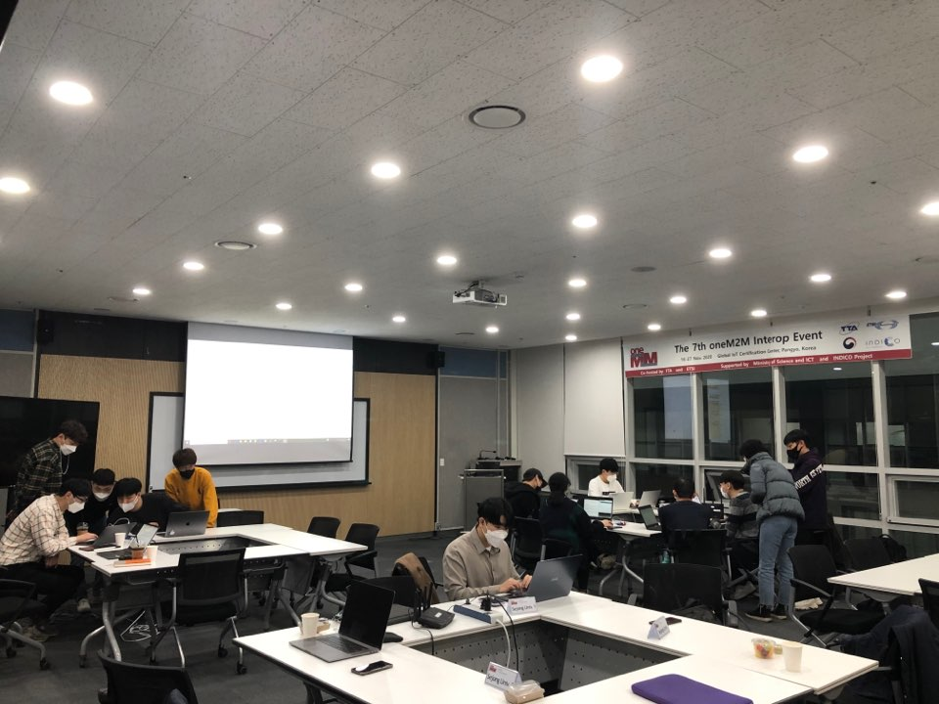
Fully virtual ?
On 16 and 17 Nov 2020, some F2F Interop test sessions took place in TTA premises at Global IoT Certification Center, Pangyo City, Korea

Slide 5
Testing Scope
Interoperability tests from TS-0013 (interoperability testing) V3.3.0.
  235 Tests in total ( ~ 130 more than at Interop 6)
  Conformance testing (TS-0018 and TS-0019) Release 2 and 3.
  Conformance sessions were operated in parallel of Interoperability testing sessions.
    Validate Test Purpose, TTCN-3 (oneM2M ATS).
    Run Conformance Test on participants’ implementations. (not for certification)

Slide 6
Tools
oneM2M Interop 7 Wiki
  All the details on of the event and user guide of the Test Automated Platform
oneM2M Interop 7 Slack
  Sharing information en technical or general topics
  Direct chat or private channel for participants during test sessions.
TRT Tool
  It allows to report Interoperability test results of each sessions
    Results are anonymous, covered by NDA
    Very important to get overall statistics
  Test report schedule of the event

Slide 7
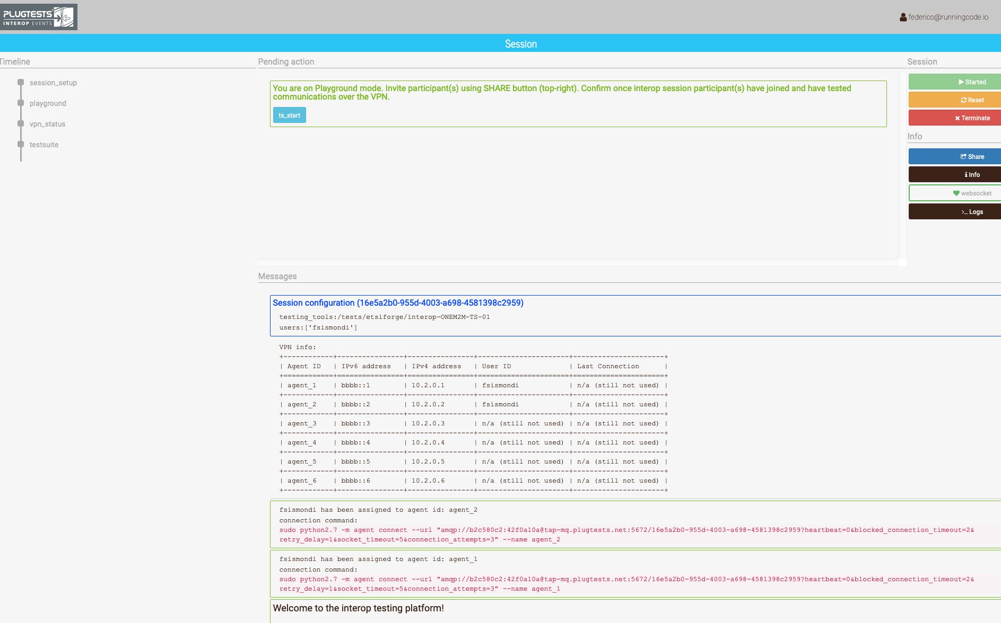
Test Automated Platform
  Hosted at ETSI, first time we will use it for a virtual interop event.
  Web portal , allow remote interop testing by establishing VPN between participants at each session.

Slide 8
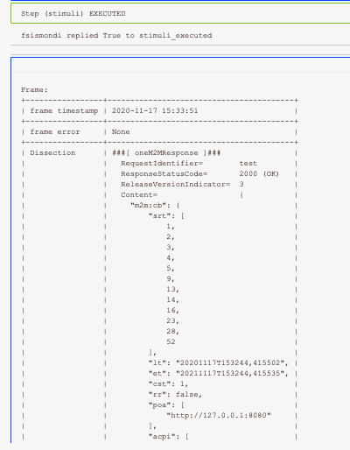
Test Automated Platform
  Not only VPN. It is a full test tool providing procedures and guidance for each test :
  Config descriptions
  test description
  step by step procedure to run the interop test
  oneM2M messages analysis to help debugging
  Test Report with capture .pcap

Slide 9
Participation
Total 56 participants registered
  Organizations with implementation AE and/or CSE
  Tools vendors
  Observers
  Scheduling sessions was pretty difficult as we took into account:
  The time zones from GMT-5 to GMT+9 !!!
  Fair working hours for each
  Availability of each participant for the 2 weeks.

Slide 10
Test Sessions
Interop
  Number of Sessions scheduled : 64
  Duration 1 , 2 or 4:30 hours depending of the config chosen ( AND-CSE, CSE-CSE, AND-CSE, CSE …)
  3 Binding addressed HTTP, CoAP and MQTT
  => The interoperability success rate is : 95.9 %
Conformance
  Number of Sessions scheduled : 23
  Session of 4:30 hours

Slide 11
Issues
Several technical topics would required to be discussed at SDS
A contribution gathering the issues/questions will be provided at SDS before the end of the TP.
Some Issues discovered into the interop and conformance test specifications will be raised at TDE.

Slide 12
Thank you!

