Slide 1


Webminar:
A primer on Advanced Semantic Discovery (ASD)
12 January 2021
INRIA & UPM &
KETI & J. Koss consulting & TIM & B. Flynn & L. Velez ...

Slide 2
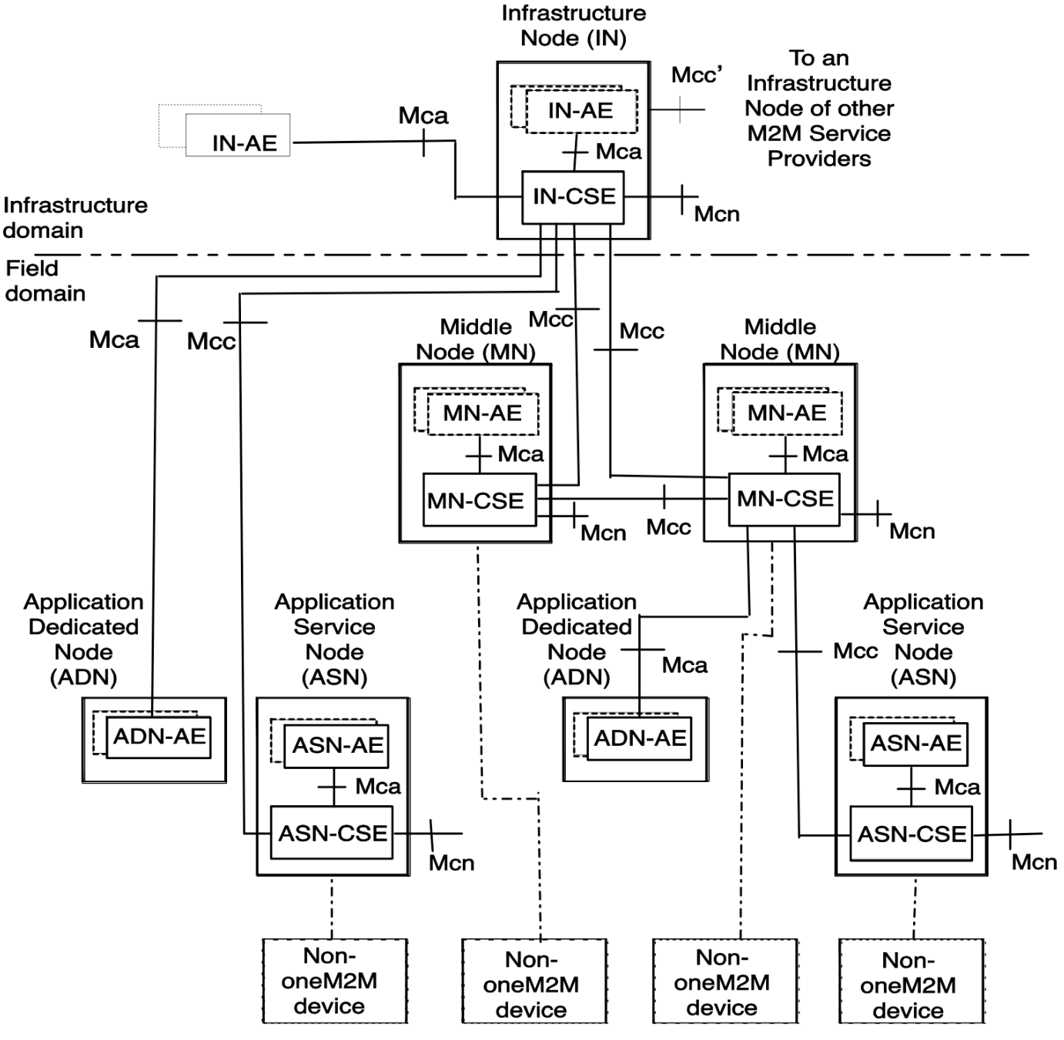
Semantic Discovery in oneM2M
Resources are typically
Application Entities (AE)
Discovering resources
according to Filter Criteria
Ontologies can be
used as Filter Criteria
Forwarding of the request is
very limited inside the
tree-network of the
Infrastructure node (IN-CSE)

Slide 3

Scaling up to a Network of Infrastructure Nodes
Infrastructure nodes (IN-CSE)
are interconnected via
Mcc’ nodes
Discovery Forwarding
now scale-up to
Discovery Routing
Routing of the request is
very limited inside the
tree-network of the
Infrastructure node (IN-CSE)

Slide 4
A simple use case that can be found in TR 103714
Challenge of
Advanced Semantic Discovery:
making all discoverable each others
AE_Smart_Energy
AE_Wearable
AE_eHealth
AE_Building_System
AE_Smart_Energy
AE_Wearable
AE_eHealth
AE_Building_System
Notes:
Formal Graph Topologies to capture most common scenarios involving networks of M2MSP;
Formal Semantic Discovery Routing Mechanism (SDRM) to route a Semantic Query between M2MSP with exhaustivity/non exhaustivity constraints and iterative vs. recursive routing modality;
Formal Semantic Discovery Query Language (SDQL) to express a large type of queries;
Formal Semantic Resolution Query Mechanism (SRQM) necessary to reduce locally a complex query into a number of simpler queries.

Slide 5
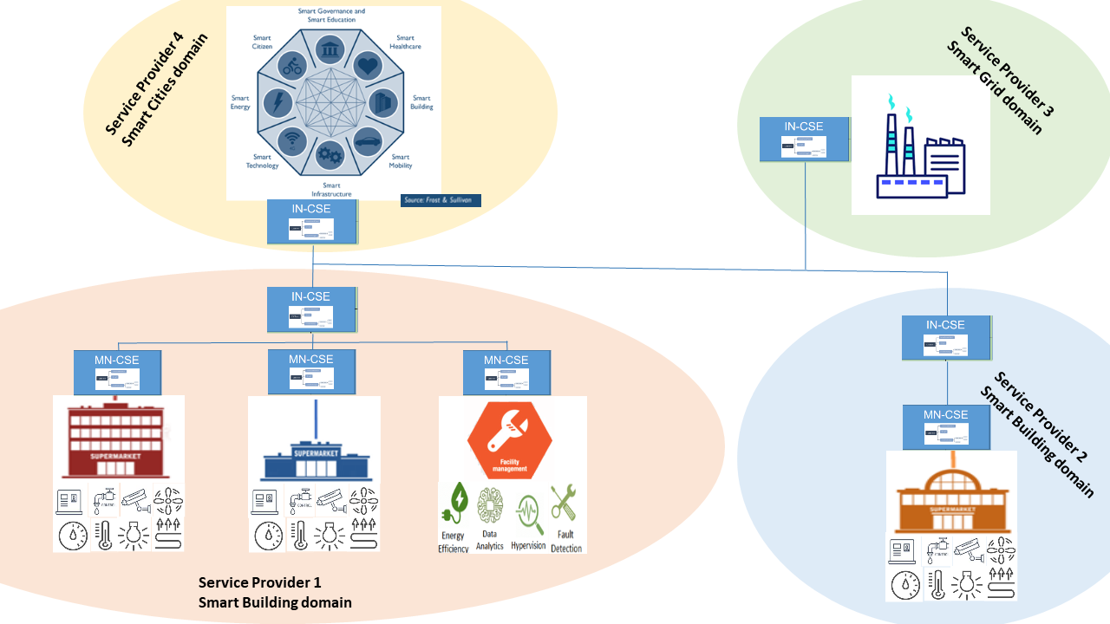
Notes:
Formal Graph Topologies to capture most common scenarios involving networks of M2MSP;
Formal Semantic Discovery Routing Mechanism (SDRM) to route a Semantic Query between M2MSP with exhaustivity/non exhaustivity constraints and iterative vs. recursive routing modality;
Formal Semantic Discovery Query Language (SDQL) to express a large type of queries;
Formal Semantic Resolution Query Mechanism (SRQM) necessary to reduce locally a complex query into a number of simpler queries.

Slide 6
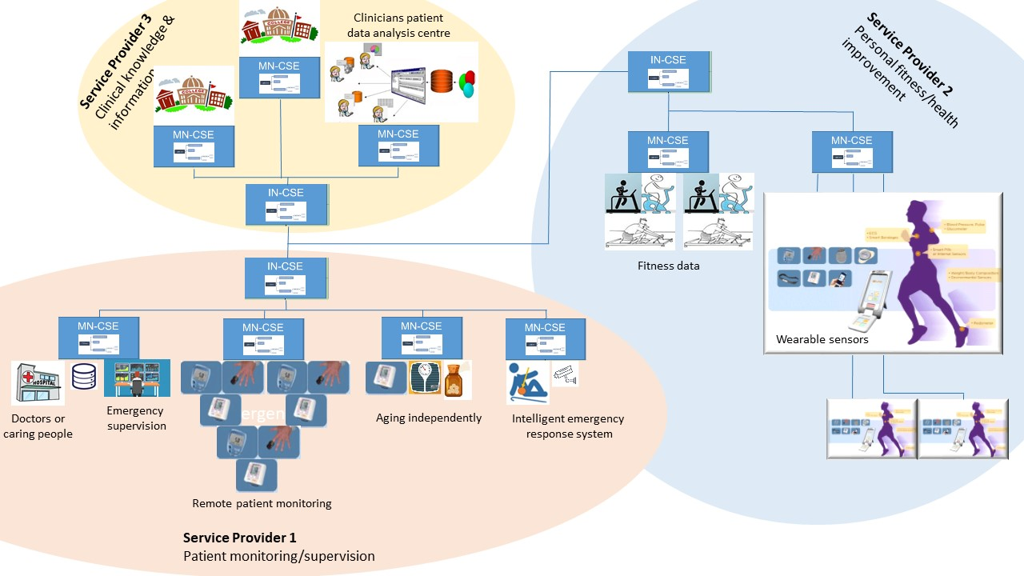
Notes:
Formal Graph Topologies to capture most common scenarios involving networks of M2MSP;
Formal Semantic Discovery Routing Mechanism (SDRM) to route a Semantic Query between M2MSP with exhaustivity/non exhaustivity constraints and iterative vs. recursive routing modality;
Formal Semantic Discovery Query Language (SDQL) to express a large type of queries;
Formal Semantic Resolution Query Mechanism (SRQM) necessary to reduce locally a complex query into a number of simpler queries.

Slide 7
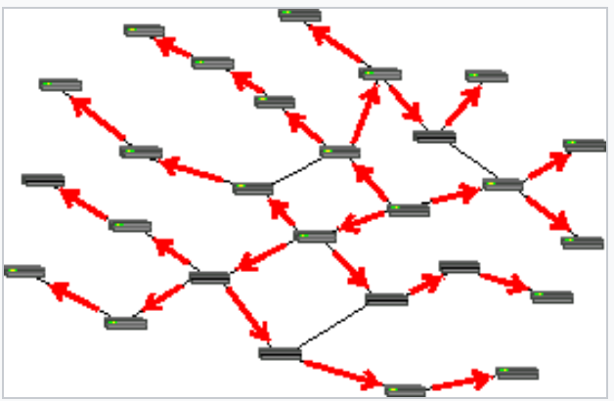
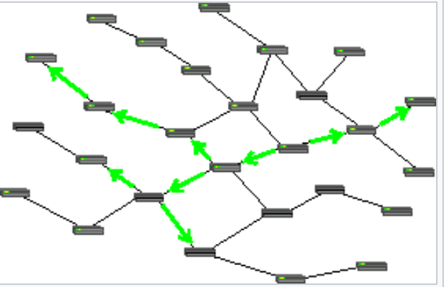
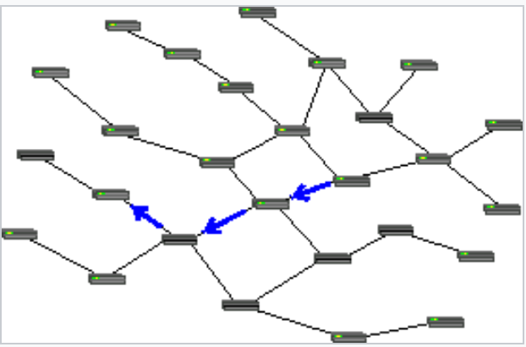
Routing: as simple as in Wikipedia
Routing is the process of selecting a path for traffic in a network or between or across multiple networks and exchange packets/messages
Many kind of routing: circuit switching (old telephone), message switching (ASD), packet switching (Internet)
Message = control information + user data (usually called payload).
Message routing is the relaying of packets from one network segment to another through nodes in a computer network
Many kind of routing: unicast, multicast (ASD), broadcast

Slide 8
Why ASD could be achieved via a multicast routing protocol
There is no global information to be exploited between CSEs
Each CSE acts as an ASD Network Router
Each CSE knows only the CSE directly connected via mcc/mcc’ pointers
Each CSE knows exactly (ie. URI) all the AEs directly registered in
Each CSE know partially the types and the numerosity (ie. the number of) the AE directly registered in
This information is dynamically stored in the, so called, Semantic Routing Table (SRT) stored in each CSE
Therefore the ASD routing tasks are
a) register AE in a local DB and SRT,
b) route ASD queries thought the CSE-network
c) keep SRT updated / fresh

Slide 9
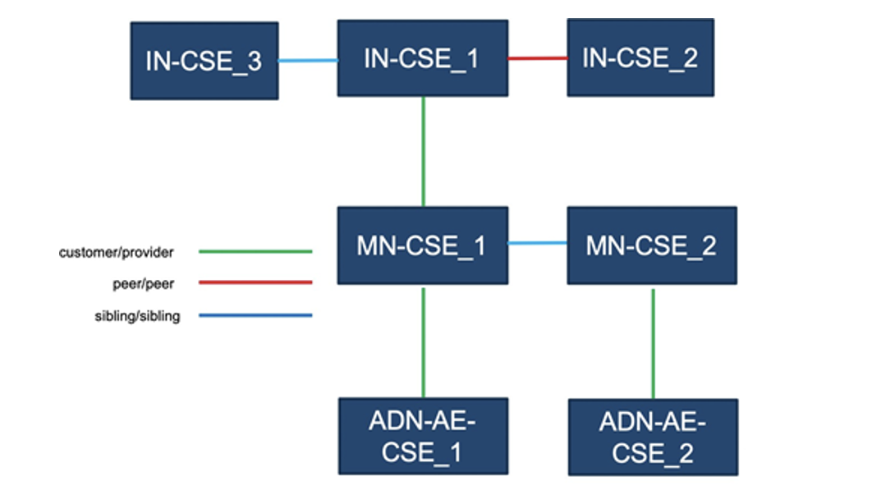
Semantic Discovery Agreements (SDA)

Slide 10
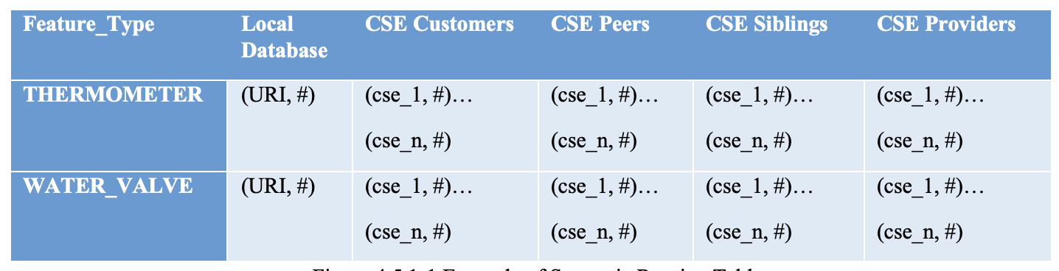
ASD Semantic Routing Table (one per CSE)
Semantic Routing Table (SRT) is a data structure, embedded in each CSE, that contains information to route an Advanced Semantic Query, received by a CSE and routed to another CSE. The structure should contains at least the following information:
Semantic Discovery Agreement, ie. listing the URI of all the CSE connected and the associated relationship (Customer2Provider, Peer2Peer and Sibling2Sibling);
Feature-table ie. listing the URI of all the AE, having the feature-type and directly registered (or announced) in the current CSE;
AE-Numerosity, ie. for each feature-type, the SRT should indicate the number of AEs of that feature-type grouped by the agreement relationships.

Slide 11
Keeping Routing Tables UP TO DATE
The notify message contains a condensed information saying the feature type and the number variation.
NOTIFY CSEcust with #+y Feature_type
NOTIFY CSEpeer with #+y Feature_type
NOTIFY CSEsibling with #+y Feature_type
NOTIFY CSEprovider with #+y Feature_type
NOTIFY CSEcust with #+y Thermometer

Slide 12
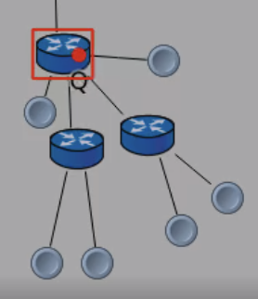
Experiment 1: successful downstream routing
CSE_1
This AE_A (read AE of type A) is
querying the CSE_1 where it is registered for another
AE_B (read AE of type B) registered on another CSE_2.
The query just mention the type B of the AE we are looking for
AE_A
CSE_2
AE_B

Slide 13
A bit about object numerosity
IN-CSE : approx hundred, fully connected graph
each IN-CSE can have thousands (10000-100000) of ADN-AE and hundreds of IN-AE
each IN-CSE can have approx several thousands of ASN-CSE (10000-100000)
50% of ASN-CSE have 1 to 5 of ASN-AE, the other 50% have hundreds of ASN-AE
each IN-CSE can have thousands (1000-5000) of MN-CSE; among those MN-CSE, 10% have another level of MN-CSE.
each MN-CSE have hundreds to few thousands (100-2000) of ADN and of ASN-CSE
each MN-CSE can have few MN-AE (10-20)
Comment: AEs and ADNs do not have CSE, but are connected via Mca to a CSE. That CSE internally contain the resources (typically AE and Containers) that represents the AEs and the containers associated to each of the AEs

Slide 14
If time: ASD Reccomendation System
The Semantic Recommendation System (SR): embedded in each CSE, has an access to the SRT and annotate can be seen as an observer of the query ad the associated response. On reception of an Advanced Semantic Query will look up the SDA-table and Semantic Routing table and will take the best possible decision to find the next hop for the query. The process can be descripted in points as follows.
read the SDA-Table and the SRT;
take the best decision to found the next hops for the Advanced Semantic Query;
annotate all the CSE belonging to the SDA-Table that participate pro-actively to successful routing

