Slide 1
Sustainability and IoT
Proposal to Establish a oneM2M Sub-Committee
Dale Seed, Convida Wireless
2/9/2021

Slide 2
What is Sustainability?
Sustainability is a complex concept
Some popular quoted definitions
  “sustainable development is development that meets the needs of the present without compromising the ability of future generations to meet their own needs.”
      Source: UN World Commission on Environment and Development
  “Sustainability is based on a simple principle: Everything that we need for our survival and well-being depends, either directly or indirectly, on our natural environment. To pursue sustainability is to create and maintain the conditions under which humans and nature can exist in productive harmony to support present and future generations.”
      Source: US Environmental Protection Agency

Slide 3

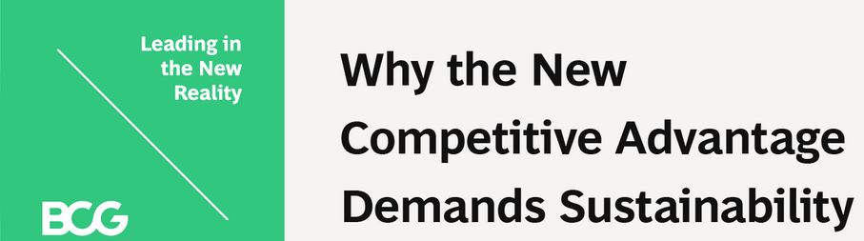




Sustainability is influencing government policy and business strategy
UN Sustainable Development Goals
Boston Consulting Group on Sustainability Strategy
National Sustainability Initiatives

Slide 4
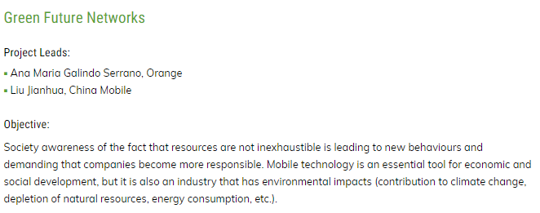


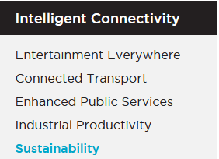

Sustainability is also present in the communications and IoT sectors

Slide 5
oneM2M plays an important role as a standard and for its enabling technology
oneM2M standards align with the core principles of sustainability
  Interoperability, scalability, modularity and re-use
oneM2M is integral in several sustainability usage scenarios
  Early deployments in street lighting, intelligent transport, smart city and waste management applications
Existing functionality in oneM2M enables sustainable IoT deployments
  Energy Efficiency: devices can disconnect and power down more often and for extended durations thus enabling them to conserve energy without impacting users / applications.
  Reuse and managed transition from legacy systems: oneM2M’s information model enables abstracting and interworking between diverse types of IoT solutions. This extends the life and reuse of brownfield deployments providing an operational pathway to more sustainable systems
Notes:
IoT as a technology, enables enhanced monitoring and detection of various types of impacts (e.g. environmental, social, economic, etc.) resulting from human and machine actions
Standardization encourages reuse, reduces waste and is fundamental to sustainability at scale
Standardization of the IoT middleware services layer by oneM2M has sustainability significance
The oneM2M standard enables large scale deployment, reuse and interoperability of IoT solutions targeting key sustainability centric use cases (e.g. smart cities, smart building, smart agriculture, supply chain management, etc.)
Several oneM2M service layer capabilities help improve efficiency and sustainability of IoT deployments
E.g. oneM2M distributed architecture enables gateways and servers in the network to function as digital twins for large numbers of connected devices. This enables devices to disconnect and power down more often and for extended durations thus enabling them to conserve more energy without impacting users / applications.
E.g. oneM2M’s information model enables abstracting and interworking diverse types of existing IoT solutions together with one another. This extends the life and promote the reuse of existing brownfield deployments.

Slide 6
Proposal to launch a oneM2M Sustainability sub-committee
Objectives
Create a market-responsive forum to promote the oneM2M standard externally
Advocate the role that IoT and the oneM2M standard have with respect to sustainability
Recruit new participants to oneM2M activities, going beyond standardization experts
Identify requirements that may feed into oneM2M working group activities
Demonstrate a strategic commitment to sustainability via a dedicated oneM2M sub-committee
Sub-committee will generate various content (webinars, articles, blogs, tweets, videos, etc.):
  the role of IoT in enabling sustainability, leveraging oneM2M deployment examples
  oneM2M capabilities that enable sustainability (network resource management, messaging scheduling for efficient communications etc.)
Approach
Organization
Sub-committee will report to SC and provide regular reports to TP and MARCOM
Sub-committee will recruit participants and provide a framework for members that may not seek to get involved in TP or WG discussions and commitments
Sub-committee will coordinate closely with MARCOM to publish generated content

Slide 7
Next Steps
Gather support from oneM2M members to form sub-committee
Get TP’s approval at TP49 closing plenary (Feb 9) to move ahead and propose formation of sub-committee to SC
Get SC approval at next quarterly SC meeting (Feb 17)
Commence recruitment and hold kick off meeting for oneM2M Sustainability Sub-committee at TP50 (or sooner)
  Leverage recent interest in oneM2M from over 50 TSDSI members from India

Slide 8
Sources
BCG - https://www.bcg.com/publications/2020/why-the-new-competitive-advantage-demands-sustainability
EU
  https://ec.europa.eu/environment/sustainable-development/SDGs/implementation/index_en.htm
  https://www.beuc.eu/press-media/news-events/european-parliament-calls-more-sustainable-and-durable-goods
USA - https://www.gsa.gov/governmentwide-initiatives/sustainability
China - https://www.weforum.org/agenda/2018/04/china-is-going-green-here-s-how
NGMN Project Portfolio | NGMN

