Slide 1
Status on Edge Computing
White paper
TP-2021-0043-Status_on_Edge_Computing_whitepaper
JaeSeung Song (KETI)

Slide 2
Motivation and Background
There was an interest between oneM2M and ETSI ISG MEC to support interworking
From oneM2M perspective, it would be good to place oneM2M platform instance to a place where MEC is running. The following two features allows this to happen:
  Software Campaign
  Enhanced resource announcement
Status of joint whitepaper work
  Started on Mid of 2019
  Targeted on End of 2019
  There was some delay and Covid-19
  Feb. 2021: A first draft was shared to interesting members both oneM2M and ETSI ISG MEC
  April. 2021: No one can provide feedback from ISG MEC

Slide 3
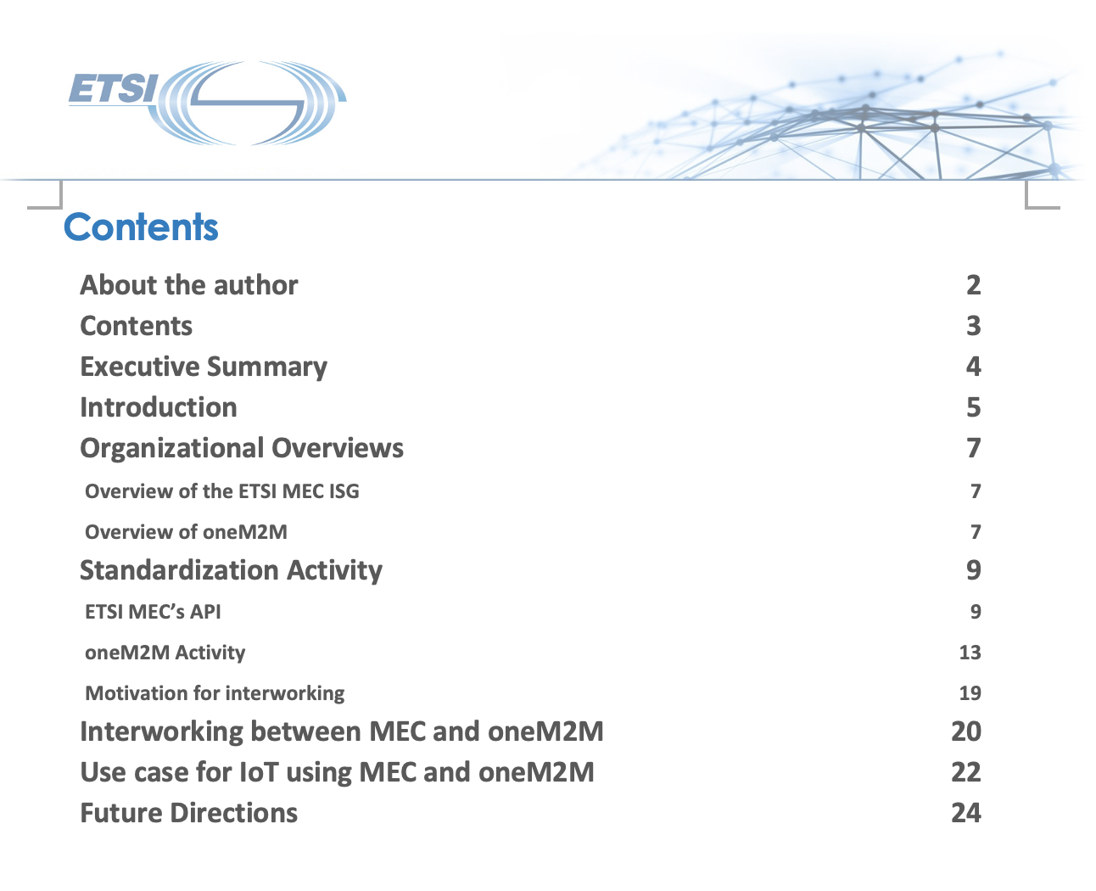
Progress & Plan
Feedback from the contact in MEC
  Not sure about ETSI MEC ISG position about the relationship with oneM2M
  Group’s interest has been changed
  Their leadership is also changing
Possible options
  Option 1: Publish the whitepaper without MEC
  Option 2: Start over again for the collaboration with MEC
  Option 3: Rewrite a whitepaper with 5G and oneM2M interworking via Edge Computing

Slide 4
Progress & Plan
Ongoing discussion with IETF/IRTF on Edge Computing
  IoT Edge Computing study going in on the IETF/IRTF
  The “IoT Edge Challenges and Functions” draft is now prepared and under review.
  Editors of the draft (in particular from InterDigital and Daejeon University) show interest in the collaboration with oneM2M
Potential collaboration with IETF/IRTF could be good to consider
  Set up a liasion relationship
  Share latest work on Edge Computing from both sides
  Identify areas and topics of mutual interest

Slide 5
Thank you

