Slide 1
Penn State University
CAPSTONE PROJECT
Source: Bob Flynn
Meeting Date: 2021-12-03

Slide 2
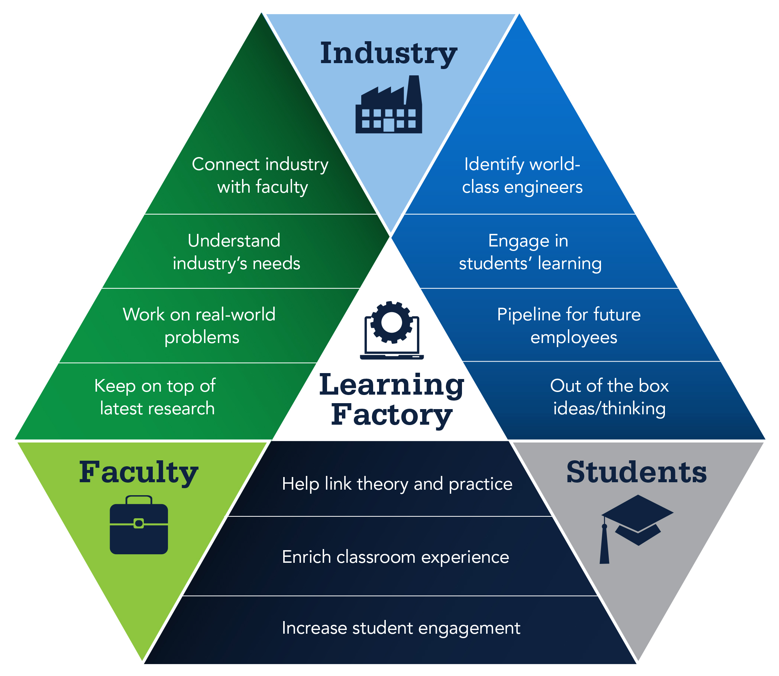

CAPSTONE PROJECT
https://www.lf.psu.edu/

Slide 3
CAPSTONE PROJECT sponsored by Exacta
An IOT device that operates far from power and communications infrastructure requires power efficient implementations, reduced complexity and sustainability. This can be achieved by using components that are already known and verified to work so that a developer can quickly bring a new product to market. Cellular devices are an example where the radio module components are formally certified to operate according to specific cellular radio standards. oneM2M is a global standard that serves to make developing IoT applications that can be formally certified as well. This project will build a oneM2M compliant sensor device and actuator device using the Thingy:91. The project team will be exposed to a global IoT standard and have the potential to contribute to an open source software project.
The team will learn oneM2M application development and embedded device programing using the Nordic Semiconductor Thingy:91 and Zephyr RTOS. The main deliverables will be:
Sample oneM2M compliant Sensor application hosted on a Nordic Semiconductor Thingy:91 using the Zephyr RTOS
Sample oneM2M compliant Actuator application hosted on a Nordic Semiconductor Thingy:91 using the Zephyr RTOS

Slide 4
CAPSTONE PROJECT
Student experience
  Intro to oneM2M (ACME)
  2nd Place Hackathon (KETI)
  Embedded device development
  Web Development
  Open Source SW
  Hackster article
oneM2M Community
  CIoT Device from Nordic Semiconductor
  Zephyr RTOS
Spring 2022
  Implement SDT devices
  Upper Tester for Thingy:91
  Application Profiles
  Conformance testing
Beyond …
  Demo at ETSI IoT Week Fall 2022

