Slide 1
oneM2M development and directions
TP-2022-0053-oneM2M_development_and_status
JaeSeung Song (Sejong University & KETI)

Slide 2
oneM2M Status
2012 ~ 2016:
  Teco industries develop and deploy oneM2M for their commercial services
  Various oneM2M activities
2016 ~ 2020:
  Various government funded projects used oneM2M (development of oneM2M testing system, oneM2M certification program, smart street, etc)
  Large scaled smart city projects were initiated and developed using oneM2M
2020 ~ 2022:
  Various projects use oneM2M as their infrastructure managing data ➔ Don’t’ know who use oneM2M as oneM2M is not their keyword and topic
  Enabling AI capabilities to oneM2M for AI/ML services → 2021~2023
  Metaverse system using oneM2M → 2021 ~ 2025

Slide 3









Enabling AI/ML to oneM2M
AI/ML
Intelligence
to make service smarter
High
quality training data
Smart city
Smart
Surveillance
IoT Platform
Smart home
Smart factory
Unmaned Vehicle
ML data augment
Smart energy
Common Functions for AI/ML
ML model mgt.
Training data mgt.
…

Slide 4
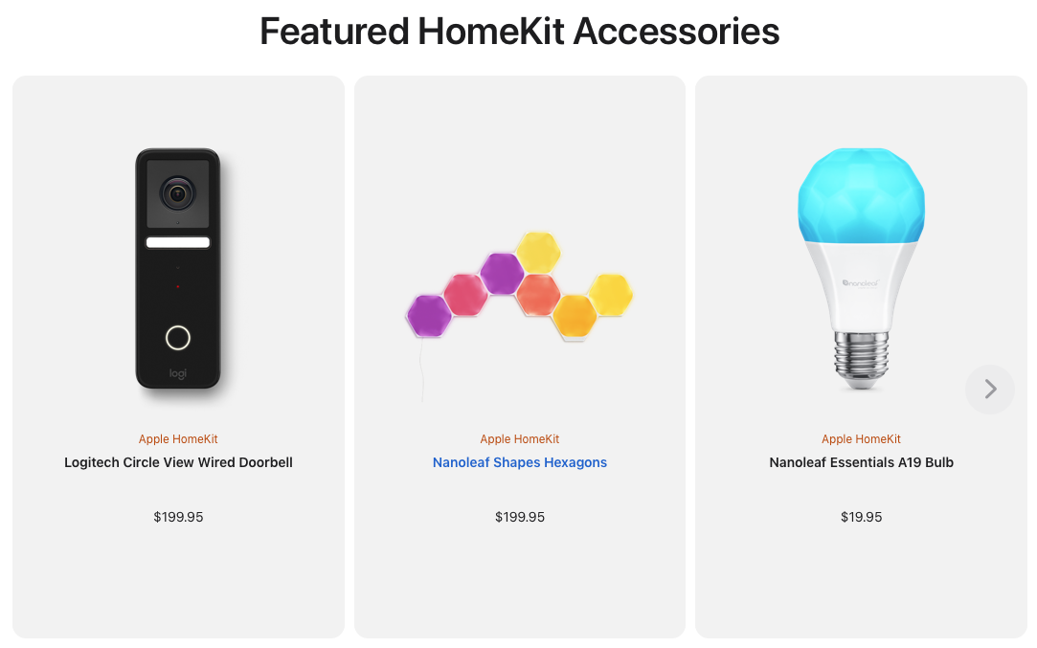
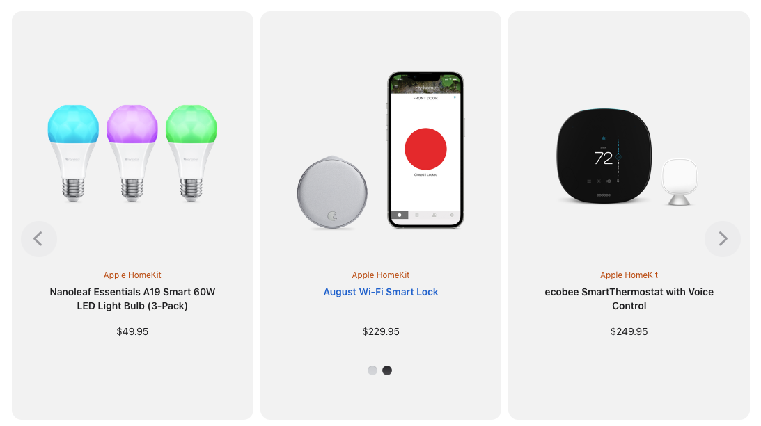
Others
Apple
  Introduces HomeKit Accessories
  Control their homekit devices using iPhone

Slide 5
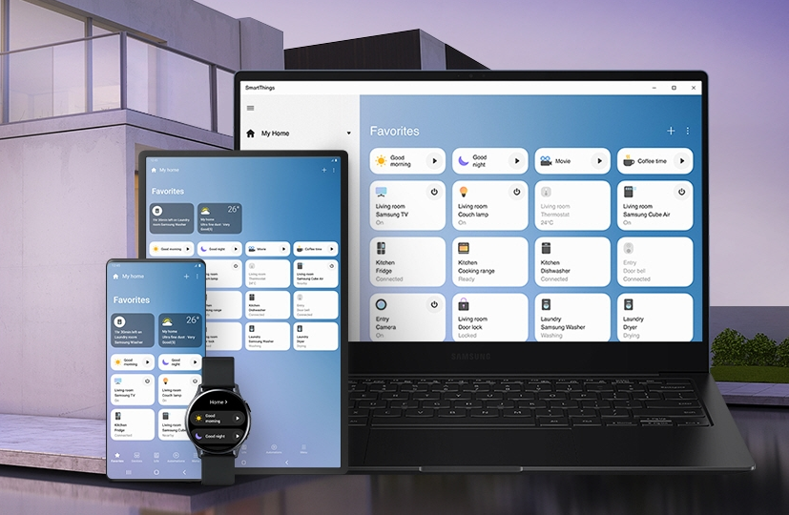
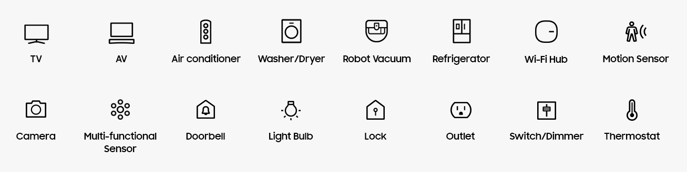
Others
Samsung
  SmartThings
  Connect home devices

Slide 6
Open source communities
OCEAN Mobius (active)
  Used in Smart City and many IoT domains (factory, energy, UAV, etc)
  Rel-2
  New features are not yet implemented
OM2M (active)
  Used in many IoT domains (smart city, building, energy, etc)
  Showed various interworking (e.g., interworked with IBM Watson, PoC for AI services)
  Maintenance issues (because of a strict policy from the Eclipse foundation)
ACME (active)
  Easy to install and extensible CSE with a WebUI
  Educational purposes
  Keep extending
TinyIoT (new)
  Focus on the development of tiny oneM2M server that can run even in an edge/fog node.
  Implemented in C
OASIS SI (inactivate)
OpenMTC (inactivate)
ATIS OS-IoT (inactivate)
IoTDM (inactivate)

Slide 7
Where to go?
Consider to support and interwork with new technologies (some key words)
  6G
  Metaverse
  Blockchain
  AI/ML
  Quantum computing
  Web 3.0
Still many features uncovered
Outreach to various industries (ITS, Smart City, Factory, etc)
Engage with other standards
  3GPP
  ETSI MEC, ETSI CIM, ETSI ITS, etc.

Slide 8
Thank you

