Slide 1
oneM2M development and directions
TP-2022-0053R01-oneM2M_development_and_status
JaeSeung Song (Sejong University & KETI)

Slide 2
oneM2M Status
2012 ~ 2016:
  Teco industries develop and deploy oneM2M for their commercial services
  Various oneM2M activities
2016 ~ 2020:
  Various government funded projects used oneM2M (development of oneM2M testing system, oneM2M certification program, smart street, etc)
  Large scaled smart city projects were initiated and developed using oneM2M
2020 ~ 2022:
  Various projects use oneM2M as their infrastructure managing data ➔ Don’t’ know who use oneM2M as oneM2M is not their keyword and topic
  Enabling AI capabilities to oneM2M for AI/ML services → 2021~2023
  Metaverse system using oneM2M → 2021 ~ 2025

Slide 3
Recent oneM2M activities
Items | Title | Status
WI-0100 | oneM2M and SensorThings API | Updated TP #52
WI-0101 | Advanced Semantic Discovery | New TP #45
WI-0102 | System enhancements to support Data License Management | New TP #45
WI-0103 | oneM2M API Guide Rel-3 | New TP #46
WI-0104 | SDT based Information Model and Mapping for Vertical Industries | New TP #49
WI-0105 | System enhancements to support AI capabilities | New TP #50
WI-0106 | Interoperability testing Release 4 | New TP #50
WI-0107 | Developers guide series | New TP #52
WI-0108 | Conformance Test Maintenance | New TP #52
WI-0109 | IPE-based Device Management with FlexContainers | New TP #52

Slide 4
Recent oneM2M activities
Items | Title | Status
WI-0100 | oneM2M and SensorThings API | Updated TP #52
WI-0101 | Advanced Semantic Discovery | New TP #45
WI-0102 | System enhancements to support Data License Management | New TP #45
WI-0103 | oneM2M API Guide Rel-3 | New TP #46
WI-0104 | SDT based Information Model and Mapping for Vertical Industries | New TP #49
WI-0105 | System enhancements to support AI capabilities | New TP #50
WI-0106 | Interoperability testing Release 4 | New TP #50
WI-0107 | Developers guide series | New TP #52
WI-0108 | Conformance Test Maintenance | New TP #52
WI-0109 | IPE-based Device Management with FlexContainers | New TP #52
Maintenance
AI/ML
Testing
Semantics
Device
Data

Slide 5
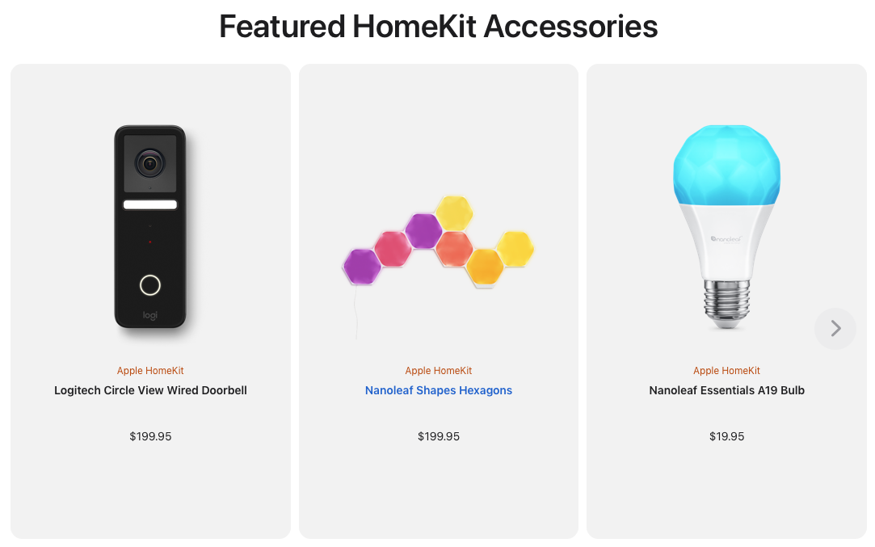
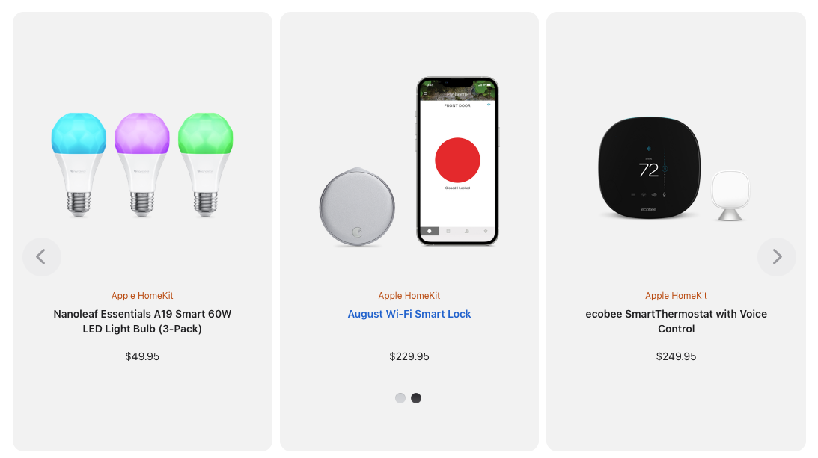
Others
Apple
  Introduces HomeKit Accessories
  Control their homekit devices using iPhone

Slide 6
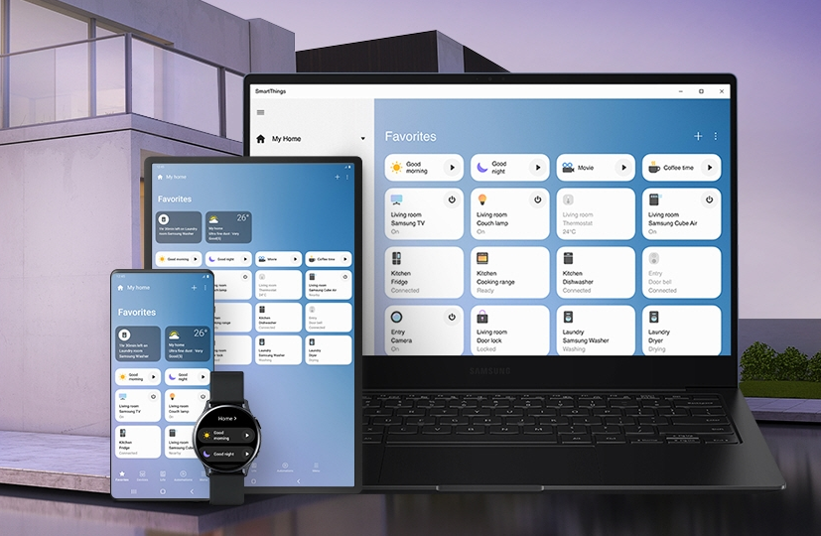
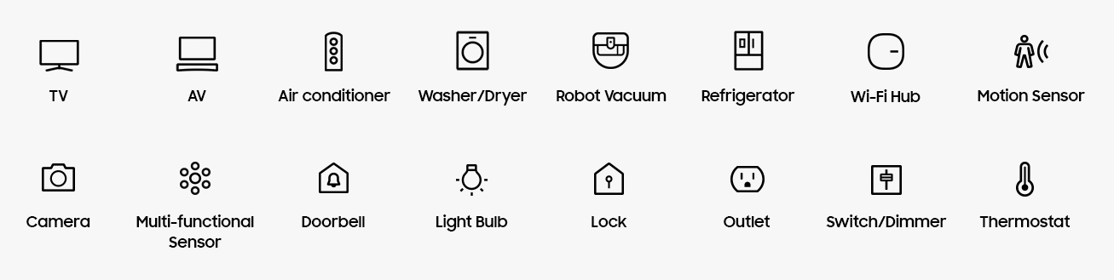
Others
Samsung
  SmartThings
  Connect home devices

Slide 7
Others
Samsung
  SmartThings
  Connect home devices
Still
Domains are fragmented
Proprietary solutions are used

Slide 8
Open source communities
OCEAN Mobius (active)
  Used in Smart City and many IoT domains (factory, energy, UAV, etc)
  Rel-2
  New features are not yet implemented
OM2M (active)
  Used in many IoT domains (smart city, building, energy, etc)
  Showed various interworking (e.g., interworked with IBM Watson, PoC for AI services)
  Maintenance issues (because of a strict policy from the Eclipse foundation)
ACME (active)
  Easy to install and extensible CSE with a WebUI
  Educational purposes
  Keep extending
TinyIoT (new)
  Focus on the development of tiny oneM2M server that can run even in an edge/fog node.
  Implemented in C
OASIS SI (inactivate)
OpenMTC (inactivate)
ATIS OS-IoT (inactivate)
IoTDM (inactivate)

Slide 9
Where to go?
Consider to support and interwork with new technologies (some key words)
  6G
  Metaverse
  Blockchain
  AI/ML
  Quantum computing
  Web 3.0
Still many features uncovered
Outreach to various industries (ITS, Smart City, Factory, etc)
Engage with other standards
  3GPP
  ETSI MEC, ETSI CIM, ETSI ITS, etc.

Slide 10
Thank you

