Slide 1
Marcom Report to TP# 55
Bindoo Srivastava
11 July 2022

Slide 2
Overview
MARCOM Initiatives CY’22 - Status
Updates:
  Articles
  Events & Speaking Opps
  Website
10th Anniversary Celebrations

Slide 3
Key Highlights
Focus Area | Status
Celebrate 10th Anniversary of oneM2M | Details in separate slide
Actively seeking speaking Opportunities in Global /Regional Events | Secured Speaking Slot for Dale Seed in IEEE IoT WF hybrid conference in Tokyo Oct-Nov 2022
Promote the oneM2M WiKi and Developer Resources | Presentation by Andreas Kraft on Developer Engagement Short tutorial videos for Developers under preparation by Andreas Kraft and Ken Figueredo
Short video tutorials on oneM2M
Strategic/oneM2M Level events | oneM2M Hybrid Conference planned on 1-2 Dec’22 collocated with TP57 in TTA premises, Seoul A oneM2M Webinar to mark our 10th anniversary in planning stage
Thought Leadership | oneM2M article on Smart Cities for IEEE Networks special edition Pipeline for Executive Insights
Introspection | 2nd Adhoc MARCOM-TP scheduled - JaeSeung’s contribution Investigation into attrition /waning engagement TBD
MARCOM Budget for CY23 | In Progress

Slide 4
Thought Leadership (Q2 CY’22)
  Global Journals
  Paper in IEEE Internet of Things Journal (CDAC India)
  Trade Journals
  oneM2M and sustainability - IoT Business News (Ken Figueredo)
  Open Standards article for Interoperability News EU (Ken Figueredo)
  Pipeline Magazine - Making IoT Intelligent by Ken Figueredo
  Regional (none)
  Partner Communiques
  ETSI Enjoy: Standards to Support AI/ML Services (JaeSeung)

Slide 5
Engagement – Interviews & Exec. Insights
  Executive Insights
  SMARTM2M study on IoT data for AI - Michelle W 25 May’22
  TP #54 (Roland) - 3 June 2022
  Interview with TCS (DigiFleet) - 23 June 2022
NEWS: Resources for developers working with oneM2M)
PRs – 4 YTD 1 Jul (0 new in Jun)
#Viewpoints published every month

Slide 6
Events & Speaking Opps. Q2 CY’22
VISIBILITY | oneM2M level | Partner driven | Regional
Events | - | 28 Apr: EU - Republic of Korea cooperation workshop on IoT and Smart Cities 6 Apr: ETSI- EU-Brasil cooperation workshop : on IoT Policy, Regulation & Standards 7 Apr: DoT-TSDSI Webinar #1 on M2M applied to verticals- transportation 28 Apr: ETSI-TTA Smart Cities in Korea 4 May: DoT-TSDSI Webinar #2 on M2M applied to Utilities | 7-8 Apr: New Delhi India - InTranSe conference 21 Apr: Webinar on CCSP and CoSMiC - indigenous software platforms for M2M/IoT Communication
Speaking Opportunities | 6 Jun: Bob Flynn spoke in Embedded Technology Convention, Las Vegas |  | 29 Jun: Aurindam and Rana Kamill spoke in the NTIPRIT event on IoT security
Significant Social Media posts: NIL
Activities Tracker link

Slide 7
Upcoming/Potential Opps
VISIBILITY | oneM2M | Partner driven | Regional
Events | oneM2M Webinar/s oneM2M Hybrid Conference 1-2 Dec’22 Interop being hosted by TTA in Dec’22 | multi-month hackathon (ETSI-TTA) 3-5 Oct: ETSI Security Conference 2022* 10-14 Oct: ETSI IoT Week 2022* 20-22 Oct: TTA - IoT Week Korea* 20 Oct: TTA seminar for oneM2M 10 years anniversary* 15-18 Nov: TSDSI- Tech Deep Dive* | 18-20 Oct: IMC 2022* 22-23 Nov: IET Future Tech Congress 2022 (Phygital event)
Speaking Opportunities | 20-21 Sep'22: "IoT Tech Expo : POWERING THE CONNECTED WORLD WITH IOT|| AMSTERDAM/Hybrid|| free to attend|| Rana Kamill speaking" 13-14 Oct’22: Rana (BT) speaking at IoT World Forum 2022 london (RESCHEDULED to 13-14 Oct ‘22) 26 Oct-11 Nov’22: IEEE IoT WF /Tokyo/Hybrid Other Potential speaking opportunities for CY’22 are listed in notes
Activities Tracker link
Notes:
Partner Driven:
Industry Event
12-15 Oct’22: The 2nd International Conference on AI-ML-Systems (AIMLSystems'22), Bangalore, India
Total Speaking Opportunities for CY’22
WORLD SMART CITY EXPO 2022 – Korea - 31 Aug-2 Sep’22
Embedded Technology Convention ASIA - 28-29 Sep’22
India Mobile Congress- 18-20 Oct’22
TSDSI Tech Deep Dive - 15-18 Nov’22
5th INTERNATIONAL CONFERENCE ON FUTURE SMART CITIES (FSC) - 18-20 Nov’22 (Malaysia)
IET Future Tech Congress 2022 (phygital event) - 22-23 Nov’22

Slide 8
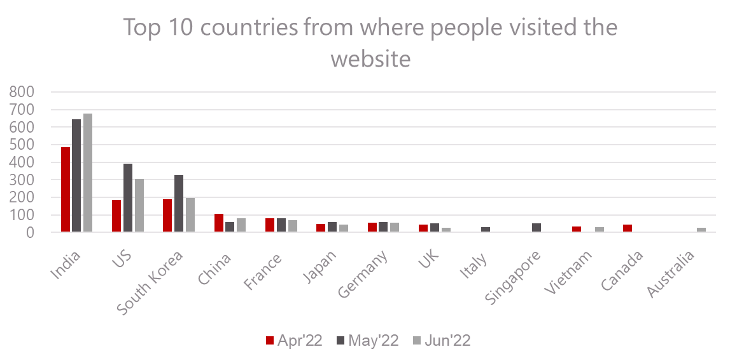
Website Visits
Visits from Australia to be noted
Spike in Social Media Channels Enegagment (71 visits in Jun as against 24 in May)

Slide 9
10th Anniversary Celebrations
Kick off on 24th July with messages from Partner HoDs (video messages)
PR on 10th Anniversary (with Partner written messages)
Release an Article on oneM2M @10
Special Sessions in SC 62 (26th July) and TP56 to mark the milestone
Social Celebration Event during TP56 being explored – subject to sponsorship
To be explored:
Executive Interviews of oneM2M Stalwarts
Explore obtaining a (video) anniversary greeting from ITU-T expert contact- Cristina Bueti

Slide 10
Reference Slides

Slide 11
Metrics
Thought Leadership:
Total 12 Articles Published YTD , 4 in Pipeline
Engagement:
7 Total Executive Insights published (visit link here), 4 in Pipeline, 2 planned
Visibility:
Events Total organized (NIL @oneM2M, 5@Partner, 8@ Regional level)
Total Speaking Opportunities – 8+3 availed in CY’22
Social Media:
1416 Twitter followers on 1 Jul (-4 in Jun), 187 posts CY’22 till 1 Jul
1247 LinkedIn followers on 1 Jul (+16 in Jun), 32 posts CY’22 YTD till 1 Jul
Communiques & PRs:
oneM2M in the News – 1200 followers
PRs issued – 0

Slide 12
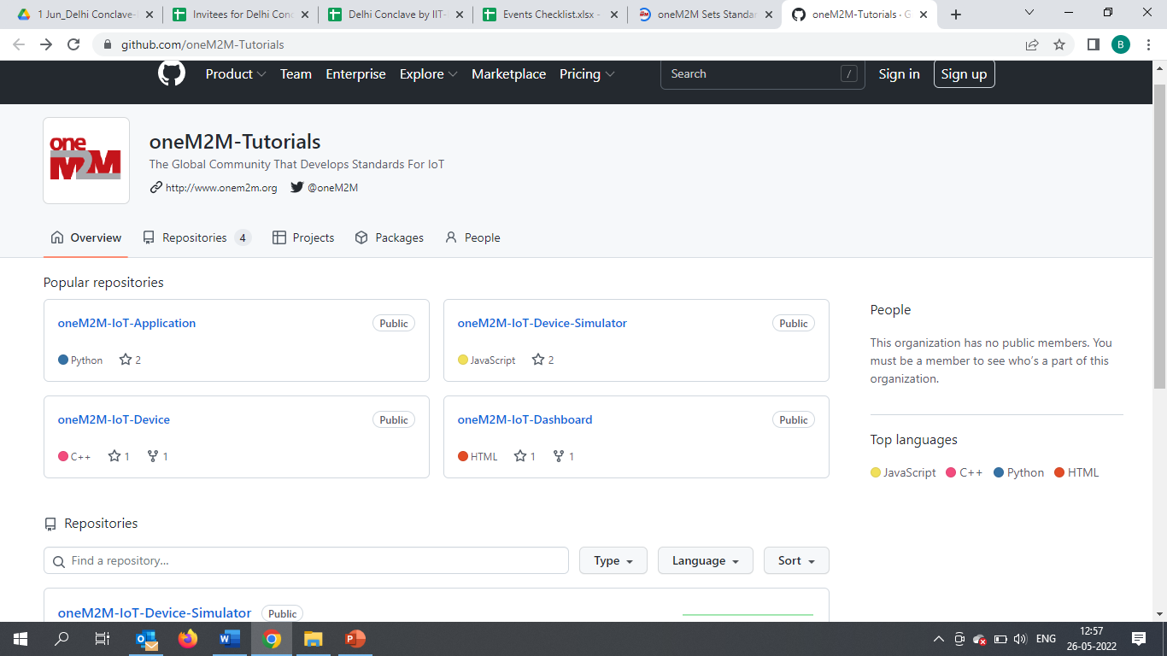
oneM2M WiKi
Teaching Material -
oneM2M Advanced Tutorial Full 2-day training to allow to build a complete IoT solution based on oneM2M
oneM2M Semantic Tutorial: An overview of semantics, applied to IoT and how using ontology can considerably enrich IoT applications and use cases.
oneM2M Hackster List of Hackster.io projects based on oneM2M. Some projects have been produced at the oneM2M International hackathon in Fall 2021.
IIIT Hyderabad MOOC:

Slide 13
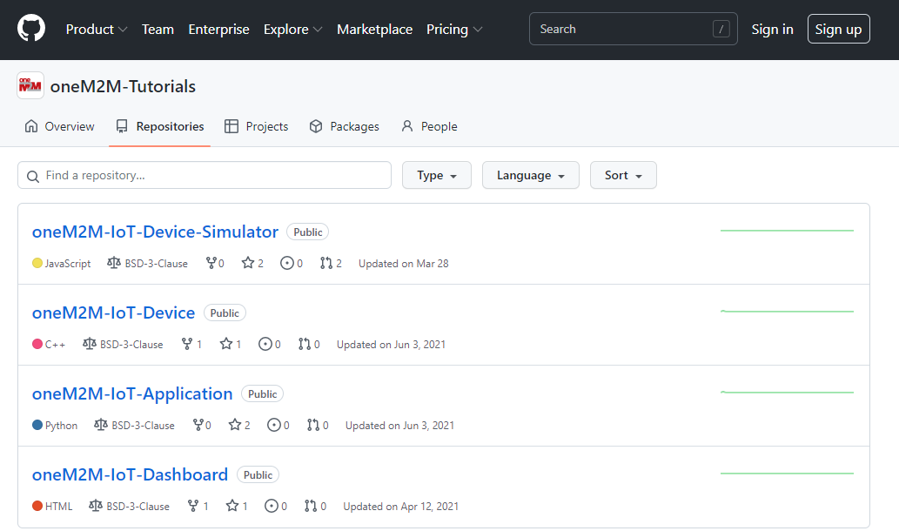
WiKi- Repositories

Slide 14
Website Engagement by Channels
This is the engagement by channel for last 2 months :
Default Channel Grouping | Visit May’22 | Visit Jun’22
Organic Search | 1158 | 1046
Direct | 927 | 773
Referral | 143 | 124
Social | 24 | 71
Organic: visitors that arrive from search engines by typing a keyword.
Direct: visitors arriving at website by typing the URL
into the address bar
Referral: someone referred to oneM2M website/page from another webpage where oneM2M related link is embedded
Social: someone clicks on oneM2M link embedded in a Tweet/LinkedIn post

Slide 15






Thank You

